Slide 1






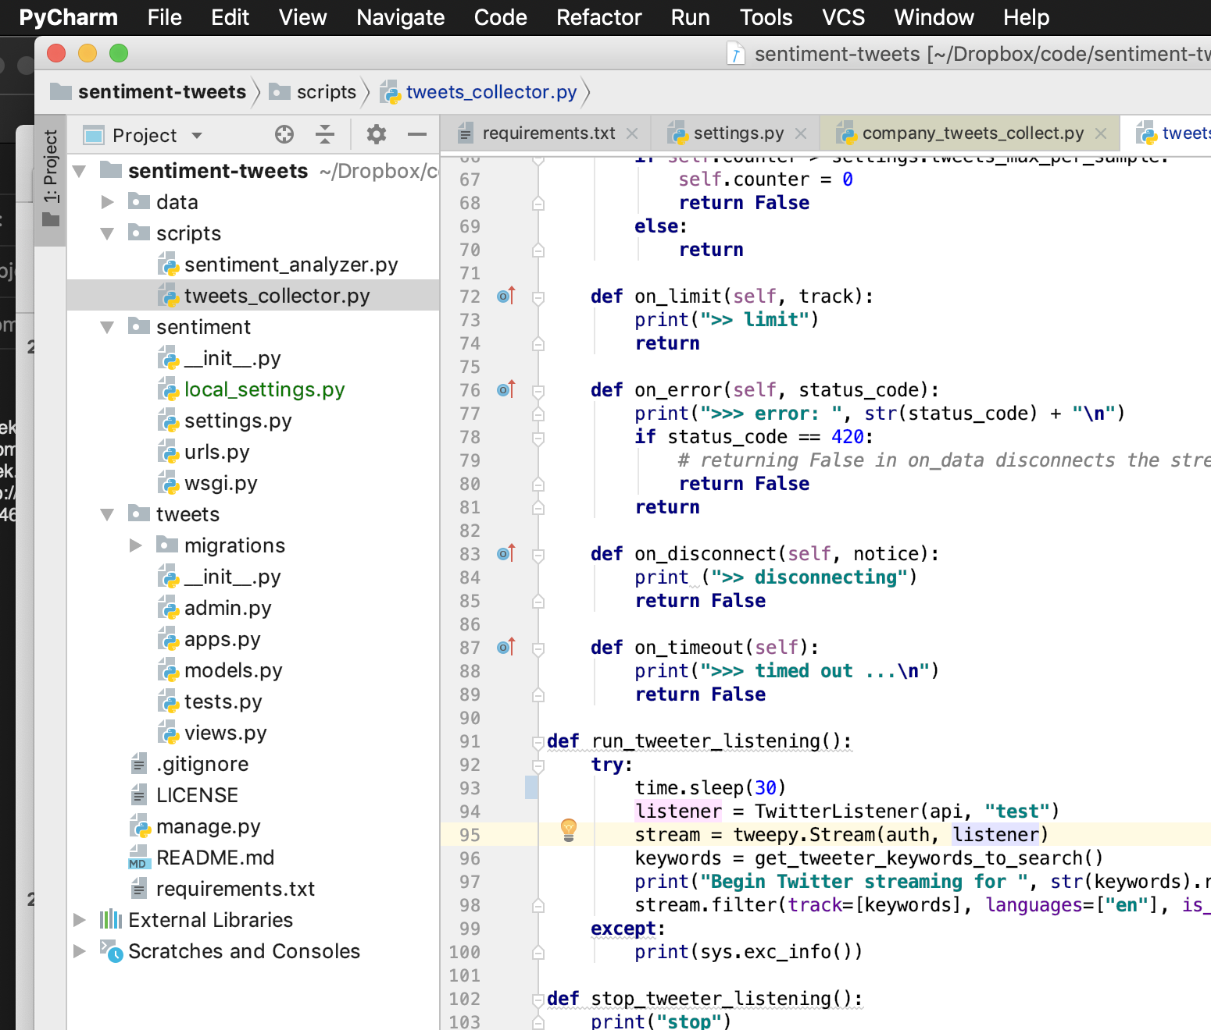
Built in few hours a Sentiment Analysis on Twitter using Django, Docker containers, Python & Google NLP
Sentiment Analysis using Google Cloud NLP AutoML
Django & Python to run and manage the code and data
Local Docker running PostGresql database
Twitter API using Tweepy
Python Library & Twitter Dev Account
Google Cloud Natural Language Processing SDK to run sentiment analysis
GITHUB Source Code:
https://github.com/hoteit/courses-sentiment-tweets

Slide 2
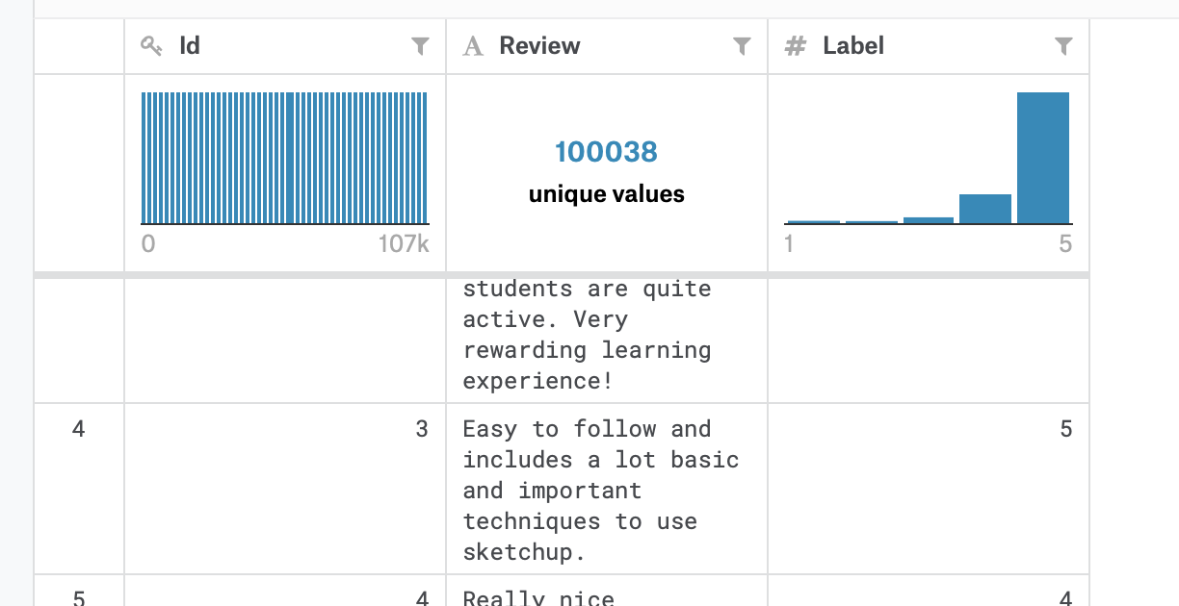

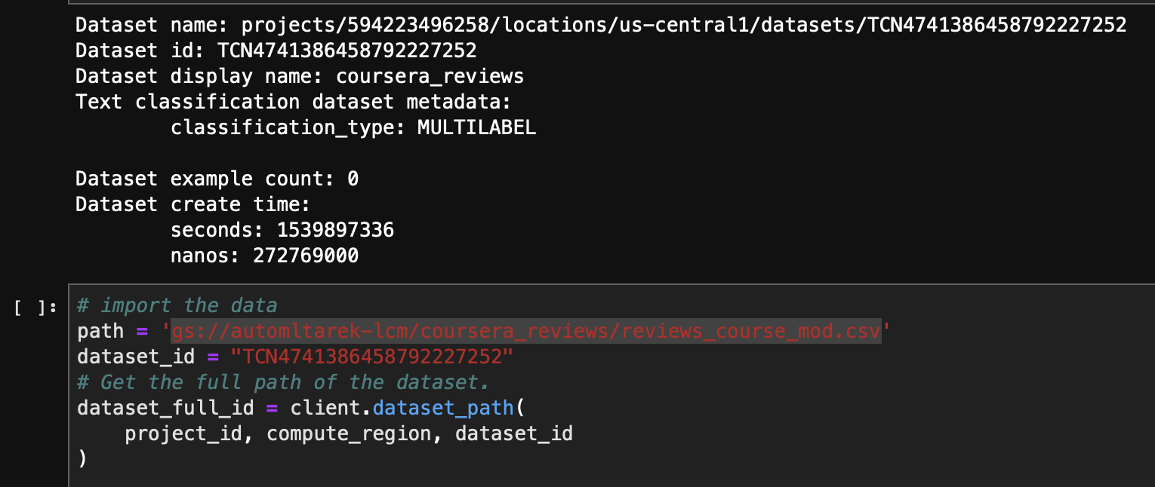

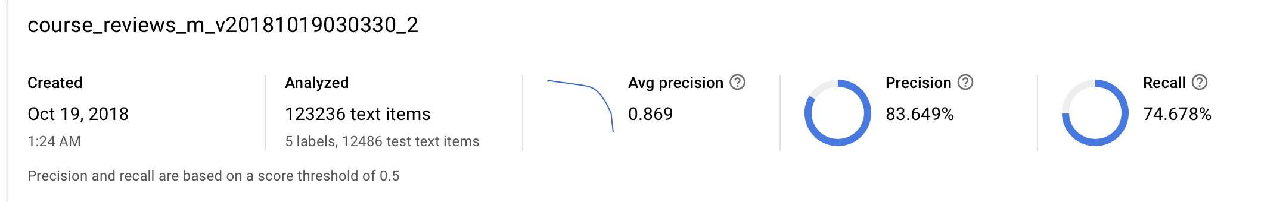
Training Google AutoML for 4 hours & $5 to categorize Coursera students reviews
The AutoML Setup
Analyzed the data,
cleaned when necessary
(pretraining step)
Searched for a dataset on
https://toolbox.google.com/datasetsearch
Dataset import
Created Google Cloud
AutoML project & activated
NLP APIs, uploaded data
Found “100K+ Scraped Course Reviews from the Coursera Website (As of May 2017)
Train/Evaluate/Predict model
No AI expertise needed!
GITHUB Source Code:
https://github.com/hoteit/courses-sentiment-tweets

