Slide 1
ROCK PAPER SCISSORS
IS IT AS SIMPLE AS WE THOUGHT?
YEAH, PROBABLY.
A PRESENTATION BY JAREN BROWNLEE

Slide 2
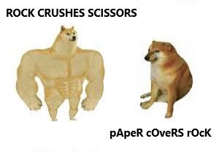
THE GAME
Rock Paper Scissors is a simple game in which a player can choose one of three options against another paper. The rules are as follows:
Rock crushes Scissors (Rock wins)
Paper covers Rock (Paper wins)
Scissors cut Paper (Scissors win)

Slide 3

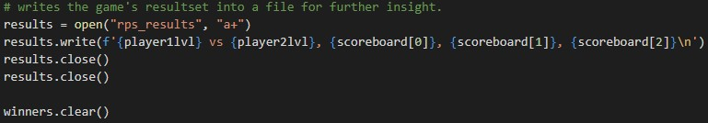
THE CODE

Slide 4
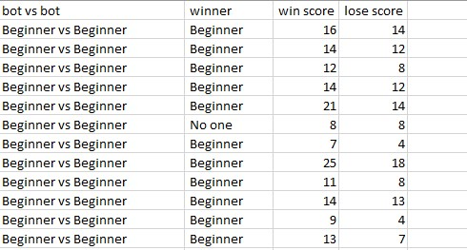
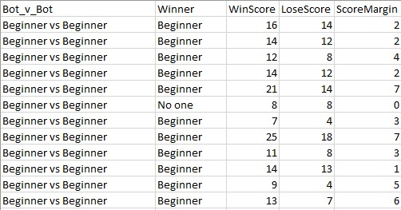
THE CODE

Slide 5
BEGINNER
Stays the same upon win/tie
Changes to random option upon loss

Slide 6

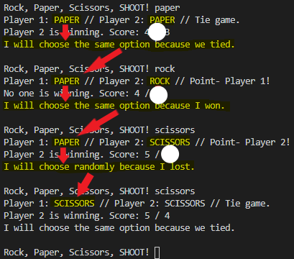

Slide 7
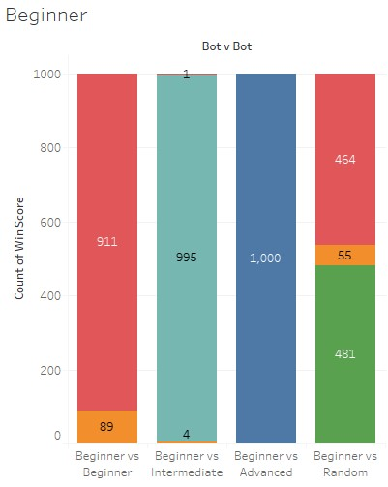
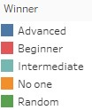
BEGINNER IMPLEMENTATION

Slide 8
INTERMEDIATE
Stays the same upon win/tie
Changes to beat winner upon loss

Slide 9

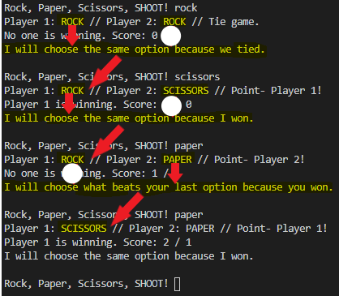

Slide 10
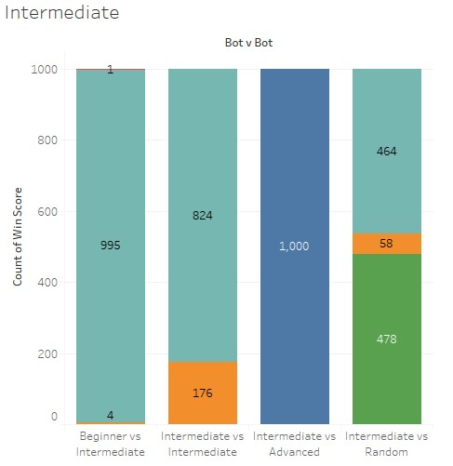
INTERMEDIATE IMPLEMENTATION

Slide 11
ADVANCED
Changes to break tie upon tie
Changes to beat winner upon loss
Beats opponent’s predicted next turn* upon win
*assumes that opponent will try to beat last round’s winning choice

Slide 12
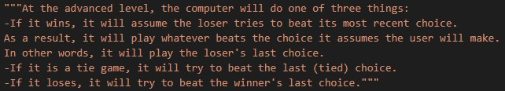
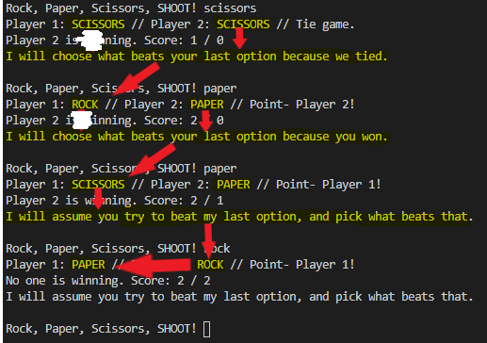

Slide 13
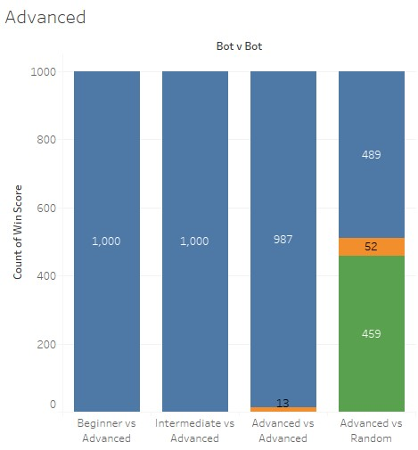
ADVANCED IMPLEMENTATION

Slide 14
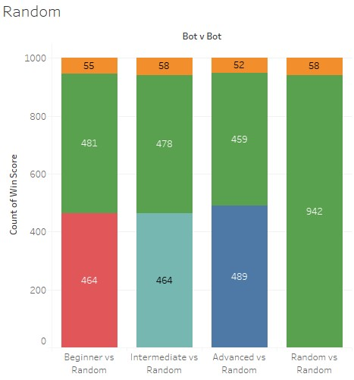
RANDOM
Chooses an option at Random

Slide 15

SCORE MARGINS
How does each Strategy line up?

Slide 16
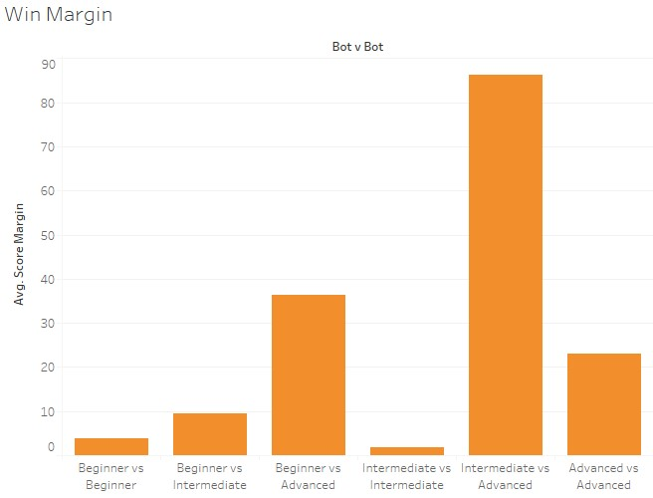

Slide 17
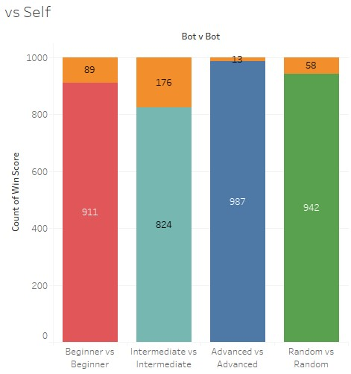

Slide 18
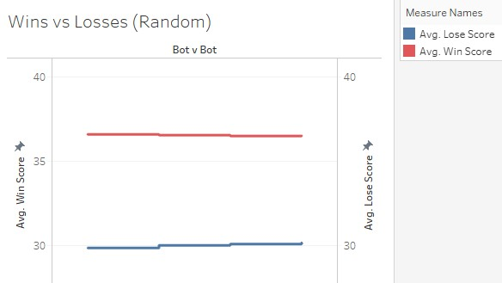

Slide 19

CONCLUSION
Should I play by a strategy? Or should I play randomly?

