Slide 1
Anti-Bullying
Jaeyoung Kim, Dung Ho, Jiwhan Kim

Slide 2
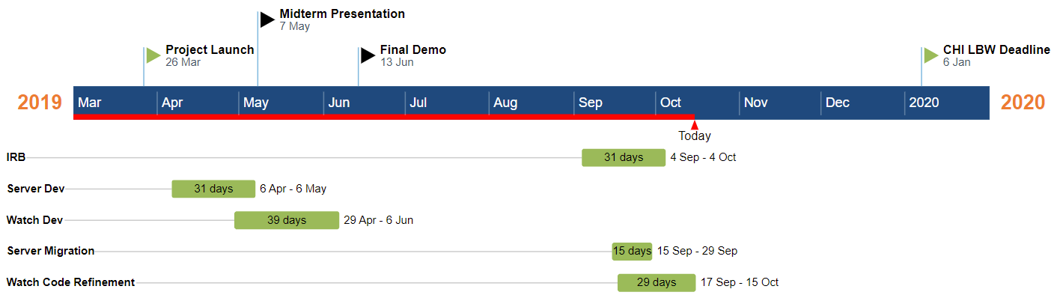
Anti-Bullying Project outline
Timeline
Refinement of the overall idea
Further literature research
Upgrade of server & Code cleaning at watch side
~ 52 days → more 1,5 month

Slide 3
Anti-Bullying Project outline
Refined project idea
Automatic detection bullying tendencies by utilizing physiological data
Verbal, physical, cyberbullying (focus emotional & activity tracking of students)
Detection at early stage
Possibility for better prevention and intervention
Target group: Students (Primary - high school; age: 7-18 years)
Unobtrusive, (privacy preserving to some extent), importance of
users‘ desires & expectations
Notes:
Widen the scope of covered cases

Slide 4
Anti-Bullying Project outline
Research questions
Q1. 감정의 변화가 bullying과 밀접한 연관성을 갖는가?
Q2. 센서를 사용하여 수집한 biometric marker를 사용하여 감정의 변화를 감지할 수 있는가?
Q3. 어떤 센서 & Biometric marker를 사용하여야 하는가?
Q4. 상용 웨어러블 디바이스를 사용할 수 있는가?
Notes:
Further refinement needed

Slide 5

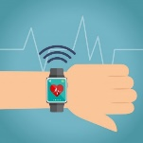






Anti-Bullying Project outline
Users
Anti-Bullying
System
Teachers
Students
Parents, mentors

Slide 6
Anti-Bullying Project outline
Interview with teachers
Teachers significant role → intervention & prevention of bullying situations → user of the system
View on class’s atmosphere, information about their methods to deal with bullying and views on introduced system → proper assistance provided
Impression (8 teachers):
Mobile device preferred to receive warning signal
Importance of emotional detection
New & skeptical approach, but raising curiosity

Slide 7
Anti-Bullying Project outline
Our proceeding
Present
To Do:
Conduct interviews with teachers
Evaluation and analysis of given answers
Extraction of design requirements for system
Structure findings
Record findings & building connections to system in paper
Submission of new IRB
Contacting & maintaing contacts with schools (11 schools)
Continuous update of interview questions
Running pre-interviews

