Slide 1
Anti-Bullying
Jaeyoung Kim, Dung Ho, Jiwhan Kim

Slide 2
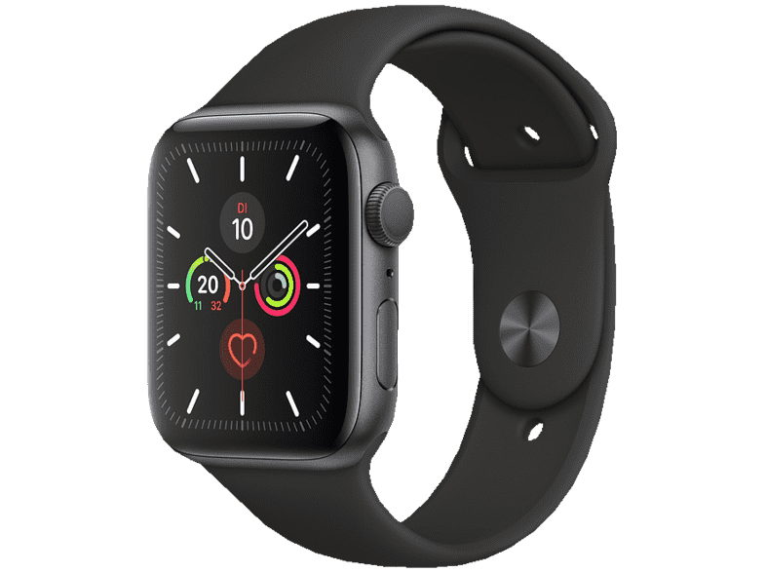
Anti-Bullying Project outline
Data sources
Heartrate
Location
Outdoor & Indoor
Audio (surrounding sound & voice)
Time stamp
Motion data
Features for emotion recognition (?)

Slide 3
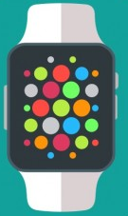


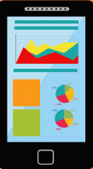

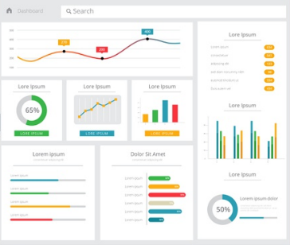
Anti-Bullying Project outline
System design
Receiving the warning notifications
Auto-report
Manual report
Warning
Manual report
Monitoring dashboard
Server

Slide 4
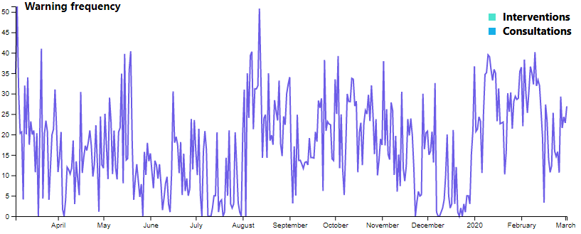
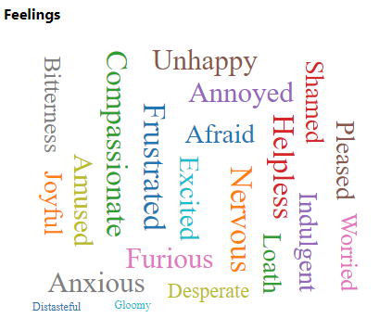
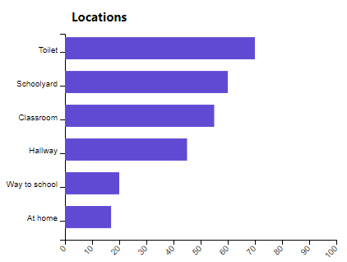
Anti-Bullying Project outline
Monitoring dashboard design: Overview
Class atmosphere
Class 7C
Overview
Seokwon Choi
Dorothea Schaan
Jeongjun Huh
Don Ho
Van Ho
Minhee Seo
Merle Hoenig
Jihwan Kim
Jan Heinsohn
Camilla Bas
Elisa Nord
Isabel Mueller
Thanh Tu Ho
Cody Conolly
Seoyeon Kim
Lukas Weiss
Anna Schmidt
Amelie Colberg
Dung Ho
Vero Arwaj
Thao Nguyen
0 %
100 %
Anger
Sadness
Fear
Disgust
Enjoyment
Self
Classmate
Auto
Add
Type
Place
Involved Students
Date, Time
Severity
Teacher

Slide 5
Anti-Bullying Project outline
Monitoring dashboard design: Individual view
Class 7C
Seokwon Choi
Dorothea Schaan
Jeongjun Huh
Don Ho
Van Ho
Minhee Seo
Merle Hoenig
Jihwan Kim
Jan Heinsohn
Camilla Bas
Elisa Nord
Isabel Mueller
Thanh Tu Ho
Cody Conolly
Seoyeon Kim
Lukas Weiss
Anna Schmidt
Amelie Colberg
Dung Ho
Vero Arwaj
Thao Nguyen
2019/04/13 – 2019/04/20
positive
negative
positive
Self
negative
Classmate
Auto
Add
Type
Place
Involved Students
Date, Time
Severity
Teacher
Seokwon’s depressive state lasts for 10 days
Intervention
Hallway
Seokwon, Jihwan
2019/04/15
High
Baek
Consultation
Classroom
Seokwon,
Vero
2019/06/04
Medium
Son

Slide 6

Anti-Bullying Project outline
Receiving warning notifications
Parent
Teacher
Warning via web notification
!
Bullying situation detected! Where: Hallway Older students involved, calling him names, violence may be involved
!
!
Bullying situation detected! Where: Hallway Older students involved,
calling him names, violence may be
involved
Bullying situation detected! Where: Hallway Older students involved,
calling him names, violence may be
involved

Slide 7
Anti-Bullying Project outline
Our proceeding
Done
To Do:
Contacted schools (still wait and see)
Implementing monitoring UI (web)
& notifications
Setting up & configuration of server
Conduct interviews with students
Evaluation and analysis of given answers
UbiComp (15th of May)
CHI 2021 (10th/17th of September)
Conduct of user experiment (???)
Generated new set of interview questions for students
pre-interview with 3 students (different opinions/tendencies could be seen)
Submission of IRB for student interview (high school and middle school students & primary school students)

