Slide 1

NORMA Lab. 1
Installing NORMA
Entering a simple ORM schema
Generating a Relational View
Generating DDL code
Generating other code
Note: Some of these slides have additional comments.
File: NORMA_Lab1.ppt. Author: T. Halpin. Last updated: 2011 March 26

Slide 2
Installing NORMA
Natural ORM Architect (NORMA)
supports ORM 2 (Object-Role Modeling, version 2).
Currently, NORMA requires prior installation of Microsoft
Visual Studio 2005, 2008 or 2010 (standard edition or higher).
Public builds of NORMA are freely available as a plug-in to Visual Studio.
Download the latest public build of the relevant (VS2005/VS2008/VS2010)
version of NORMA by downloading the relevant zip file at either
http://www.ormfoundation.org/files/folders/norma_the_software/default.aspx
or http://sourceforge.net/projects/orm.
Unzip the downloaded file
(e.g. right-click the file, and choose Extract All …).

Slide 3
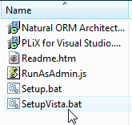
Install NORMA (including PLiX¹) as follows.
Open the unzipped folder.
If using Microsoft Vista or Windows 7,
double-click SetupVista.bat
and allow overrides of all the security blocks
(alternatively, right-click Setup.bat, and Run as Administrator).
If using Microsoft XP, double-click Setup.bat.
Follow all the defaults in the installation wizard.
Double-click the Readme.htm file in the extracted folder to view the
Readme file in your Web browser. This includes lots of useful tips.
Note: If you previously had an earlier version of NORMA installed,
this will be automatically uninstalled before the new installation.
All of your previous ORM models will be retained.
¹ PLiX (Programming Language in XML) is used internally to
facilitate code generation to multiple target languages.

Slide 4
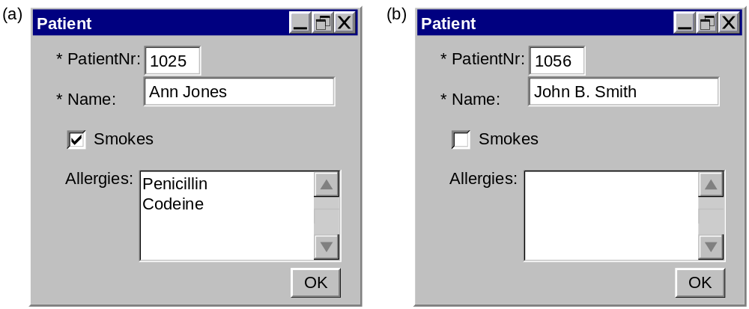
Entering a simple ORM schema
Reference schemes: Patient(.nr); PatientName(); Drug(.name)
Fact types: Patient has PatientName.
Patient smokes.
Patient is allergic to Drug [allergy].
Constraints:
Each Patient has exactly one PatientName.
It is possible that the same Patient is allergic to more than one Drug
and that more than one Patient is allergic to the same Drug.
Notes:
Consider the sample forms about medical patients. Conceptually, each form involves 3 elementary fact types, as shown. Each patient has exactly one (at least one and at most one) patient name. A check box is used to indicate whether a patient smokes. A person may have zero or more drug allergies, and vice versa – this many-to-many nature of the relationship may be verbalized as shown. The ORM conceptual schema is specified in textual form.

Slide 5
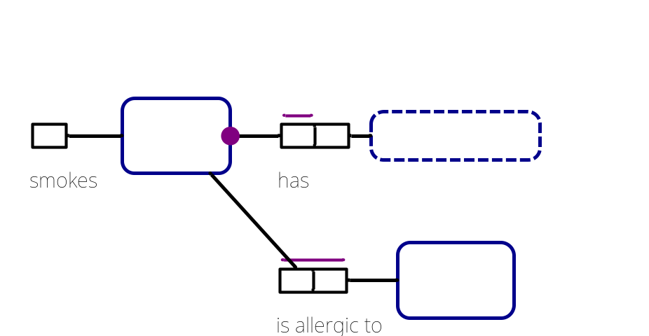
This is the basic ORM schema.
We will now enter it into NORMA
and then generate a database schema from it.
We will begin by creating the ORM file,
and later adding it a project (needed to generate DDL code).
Alternatively, you may create a project to begin with.

Slide 6
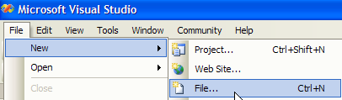
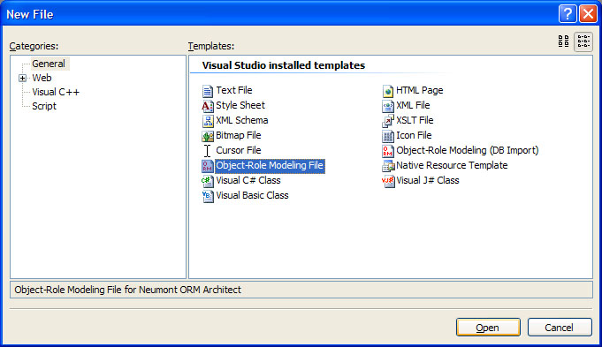
Launch Visual Studio.
File > New > File
Select General category,
Object-Role Modeling File template,
then click Open.

Slide 7
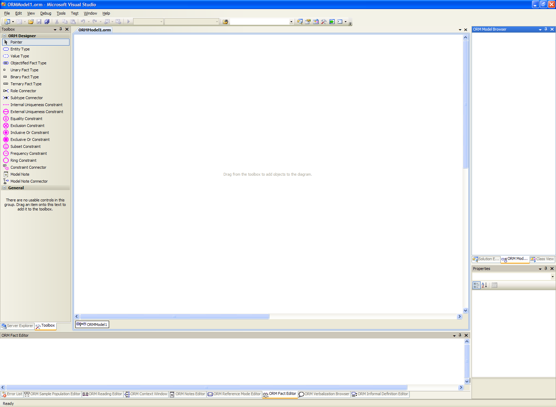
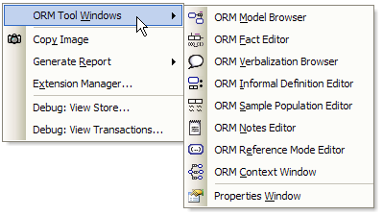
This is the Document Window
for displaying the ORM diagram.
To see all
available windows,
right-click the
empty space in the
document window.
This context menu
appears. If the
Model Browser and
Properties Window
don’t appear, select them here to display them.

Slide 8
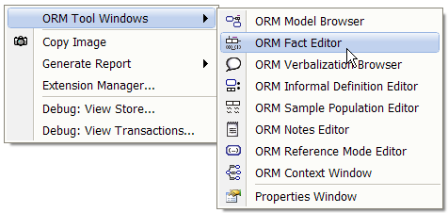
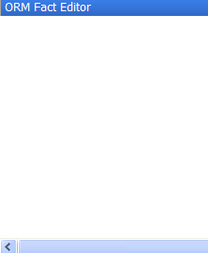
To open the Fact Editor window,
move the cursor to this option
then left-click the mouse.
The fact editor window should now be displayed.

Slide 9
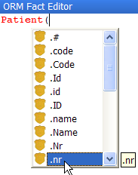


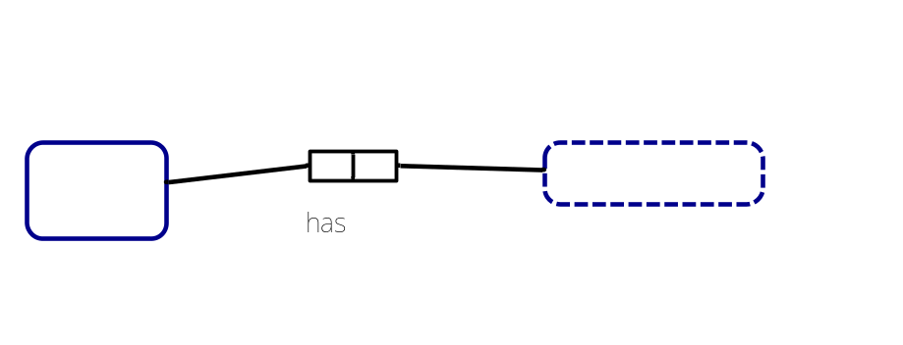
Enter the fact type
Patient(.nr) has PatientName()
into the Fact Editor as follows:
Type “Patient(”
Click .nr from the drop-down list
Type the closing parenthesis “)”
Type “ has PatientName()”
Press Ctrl-Enter
The fact type should now be
displayed in the document window.

Slide 10
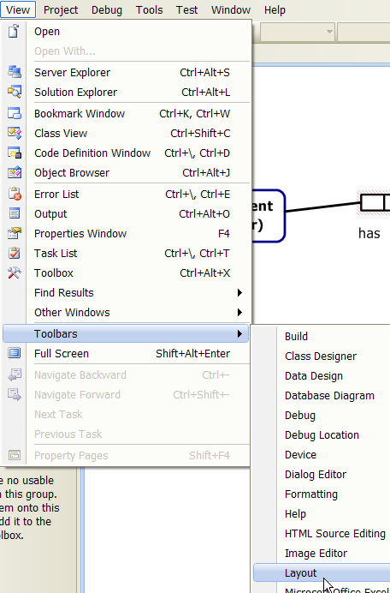
Display the Layout Toolbar
by selecting the menu option
View > Toolbars > Layout

Slide 11
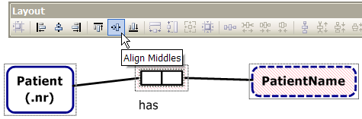
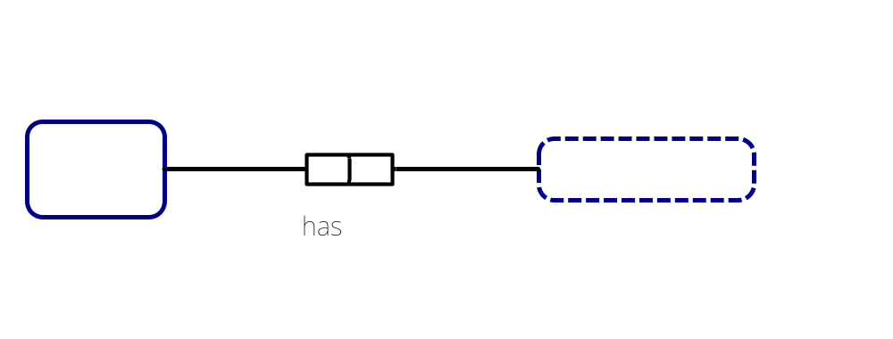
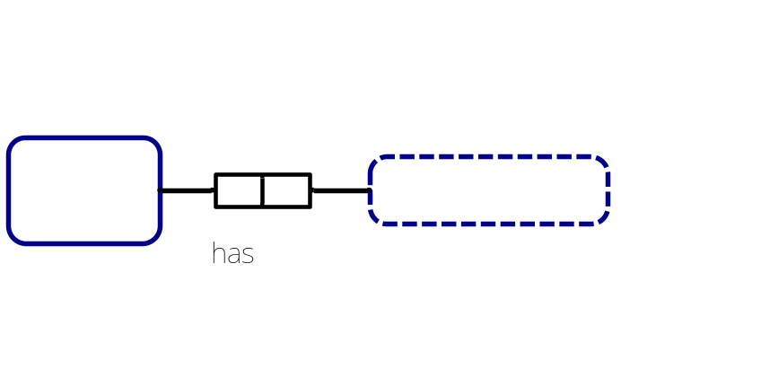
Drag the mouse to select
the predicate and object types,
then
align these shapes horizontally
by choosing Align Middles
from the Layout toolbar¹.
The alignment is based on
the last shape selected.
Nudge Patient closer to the predicate
by selecting Patient and
pressing the right-arrow key.
Similarly, nudge PatientName closer
using the left-arrow key.
¹ As an alternative to using the Layout toolbar,
you may select the menu options Format > Align > Middles
Notes:
Alignment is activated if multiple top-level items are selected AND one of the top level items is the primary selection (indicated by a dotted line inside and outside the shape border). If a non-top level shape is the primary selection then alignment is not activated. You can shift-click on a selected element to make it primary, or Control-Click twice to turn selection off and back on for the element. Note that selecting the fact type (as opposed to one of its roles or internal uniqueness constraints) is tricky. Make sure the move cursor (4 arrow tips) is showing when you click the fact type to select it.

Slide 12
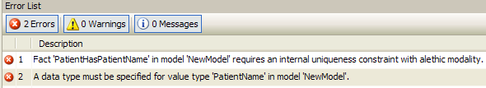
The predicate and object type are displayed with
a red line fill or outline, indicating an error state.
Here, the error on the predicate is that it has no uniqueness constraint.
To view errors on an element, right-click the element’s Context-menu
and select Validation Errors,
e.g. for the object type we get
Alternatively,
to see all errors
look in the
Error List window.
We will add the required constraint and data type later,
and at that point the red error fill will disappear.
Notes:
You can also double-click any shape (see notes in previous slide on where to click a fact) to activate the first error that supports activation. Error activation puts the editor in the state required to fix the error. In this case a double-click on the fact type (or selecting the error) will add an internal uniqueness constraint with no selected roles and activate it for editing. A second double click on the first role will add that role to the constraint and commit the change.
To be less invasive, the error fill color is actually pink rather than red, but think of it as red to associate it with the color commonly used for warning signs.

Slide 13
The document window has two scroll bars.
Use the bottom scroll bar to scroll horizontally.
Use the side scroll bar to scroll vertically.
To reposition any part of the diagram, select it,
then either drag it
or use the arrow keys to nudge it.
To select all of the diagram, press Ctrl+A.
To zoom in (magnify), press Ctrl+WheelUp -- wheel mouse
or press Ctrl+Shift+LeftClick.
To zoom out, press press Ctrl+WheelDown --wheel mouse
or press Ctrl+Shift+RightClick.
Notes:
You can see two parts of one diagram at the same time with the Window > New Window command. You can also add additional diagrams to the document.

Slide 14

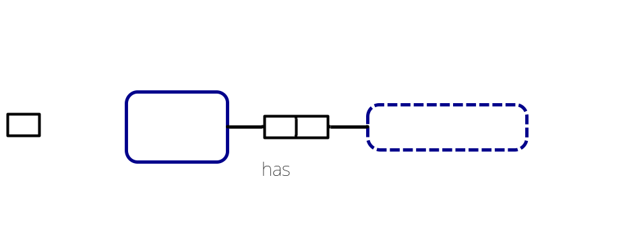
You could enter all 3 fact types in the Fact Editor.
Pressing Ctrl-Enter at the end of a line displays the fact type on that line.
This is typically the fastest way to enter fact types.
But instead, let’s enter the other fact types graphically.
To add a unary predicate shape to the left of the Patient shape
either
Click the Unary Fact Type shape in the Toolbox
then click where you want the shape to display
or
Drag a Unary Fact Type shape from the toolbox to where you want it

Slide 15




Select the unary fact type
(click just above its right top corner).
The Move Cursor appears to show the predicate is selected
(not the role).
Now right-click to see the validation error for the predicate.
Now select the role
(click inside it).
Now right-click to see the validation error for the role.

Slide 16





To connect the role to the Patient shape
select the role,
then drag the mouse pointer
(which now displays as a role connector pointer)
onto the Patient shape
then release the mouse.
Alternatively,
click the Role Connector shape in the Toolbox
then click the role and the Patient shape.
For practice, use Undo (select from the menu, or type Ctrl+Z)
to remove the connection,
then use the alternative method to restore the connection.
Notes:
You can also select the role and use the Properties Window to set the RolePlayer property.

Slide 17



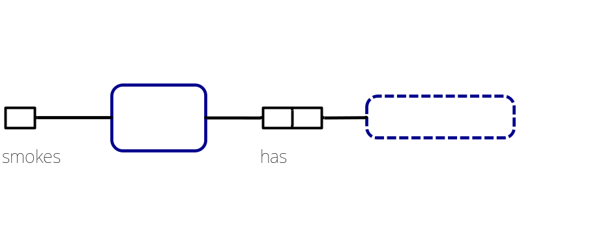
To add a predicate reading,
select the unary predicate shape
and double-click it to open
the ORM Reading Editor.
Type “smokes” after Patient
and press the Enter key.
The predicate reading should
now appear next to the role.
To reposition a predicate reading in the document window
select it then drag it to where you want.
Use Align Middles to align the shapes horizontally.
To change a predicate reading, select the reading on the predicate shape,
then select the reading in the Reading Editor, then edit as needed.
Notes:
Activating the error will make the correct selection in the ORM Reading Editor and activate the control for editing.

Slide 18
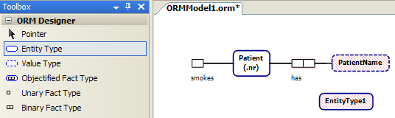

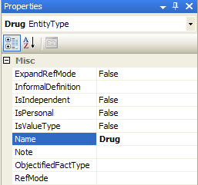
To add the Drug entity type,
drag the Entity Type shape from the Toolbox to the document window.
It initially displays with a default name, e.g. “EntityType1”.
Change the name to “Drug”, either by editing it in place
or by editing the Name entry in the Properties window.
Notes:
F2 can be used to activate any in-place editing.

Slide 19
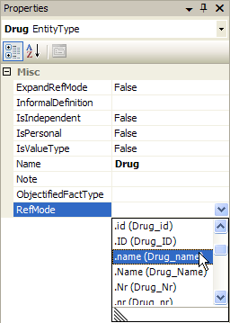

Add the reference mode “name”
in the RefMode property
either by typing it and hitting Enter
or
by selecting it from the drop-down list
of pre-defined reference modes.
The reference mode is now displayed
on the diagram.
Notes:
Double-click the Drug entity type to automatically open the RefMode dropdown.

Slide 20

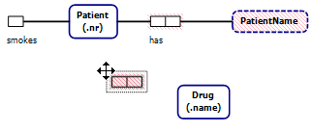
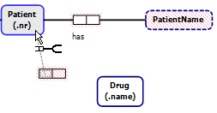
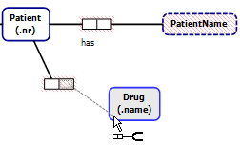
Click the Binary Fact Type shape in the Toolbox
then click where you want to position it
(alternatively,
drag the shape from the Toolbox)
To connect the left role, select it
(click the mouse pointer inside it),
then drag the mouse pointer
to the Patient shape.
Similarly,
select the right role
and drag the pointer to connect it.

Slide 21



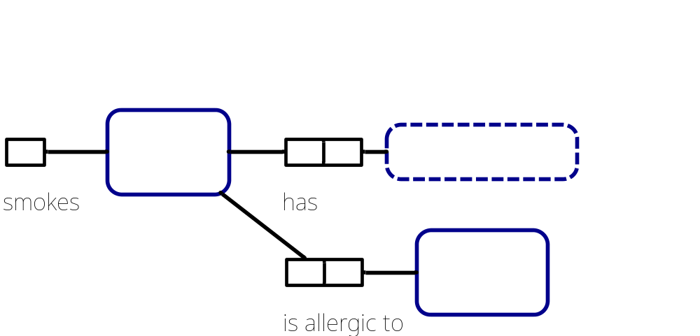
To add a reading for the new predicate,
first select it (click its border so that
the mouse pointer displays as )
Double-click the predicate,
to invoke the ORM Reading Editor
then enter forward predicate reading
“is allergic to” between
“Patient” and “Drug”.
The reading now displays
on the diagram.
Notes:
The ORM Reading Editor is available with any selection that is associated with a fact type (role, reading, constraint, rolename, fact type, etc).

Slide 22

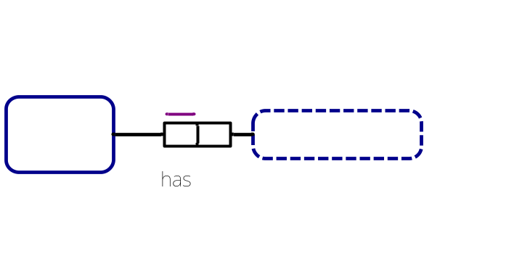



Select the left role
of the patient name fact type,
right-click to open its context menu
and click Add Uniqueness Constraint.
The constraint is now displayed.
Select the constraint, and click the
ORM Verbalization Browser
to see the positive verbalization.
Click the button to see the negative verbalization.

Slide 23

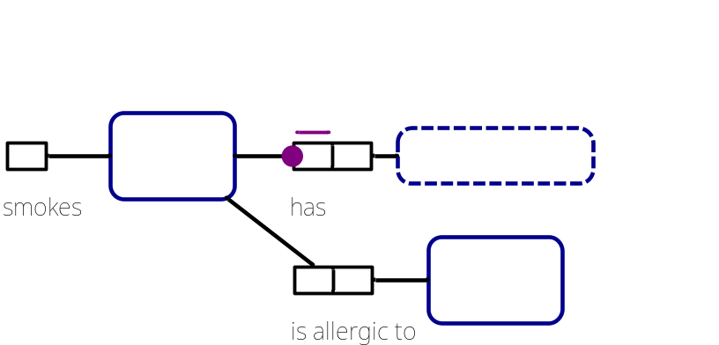



Select the left role
of the name fact type,
right-click to open its context menu
and click Is Mandatory.
The mandatory role constraint
is now displayed
and its verbalization is added.
Click for the
positive verbalization.
Click for the
negative verbalization.
Notes:
The IsMandatory property is also available in the Properties Window. In addition, for binary facts, the Multiplicity property on a role can be used to add uniqueness and mandatory constraints.

Slide 24
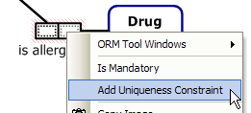
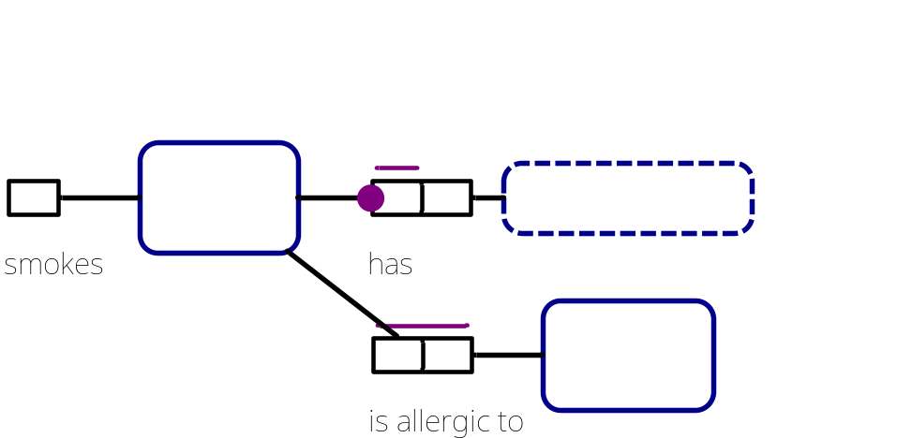

Select one role of the drug fact type then hold the Shift key down and select the second role, right-click to open its context menu
and click Add Uniqueness Constraint.
The constraint is now displayed.
In the Verbalization Browser, view
the positive and negative verbalizations.
Notes:
The toolbox gesture for this is:
Select Internal Uniqueness Constraint
Click the fact to add it to. The constraint will be added activated with no constraints.
Click the first role
Double click the second role to add it and commit the constraint
To extend a single role constraint:
Double-click the constraint to activate it for editing
Double-click the role to add
To make a double-role constraint a single
Double-click the constraint to activate it for editing
Control-Double-Click the role to remove

Slide 25
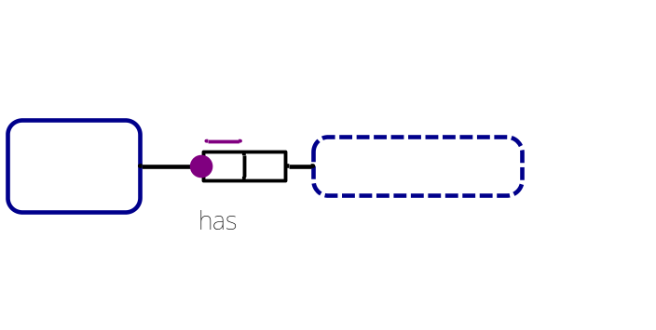
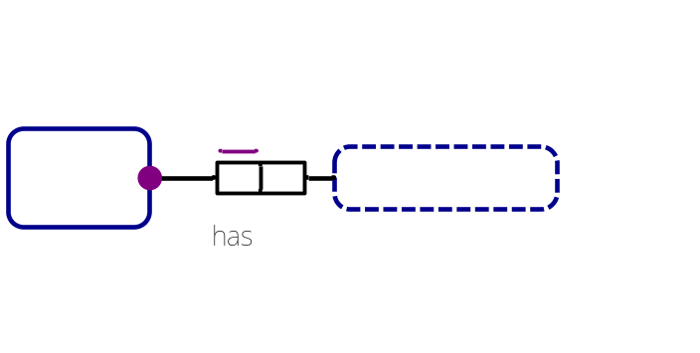
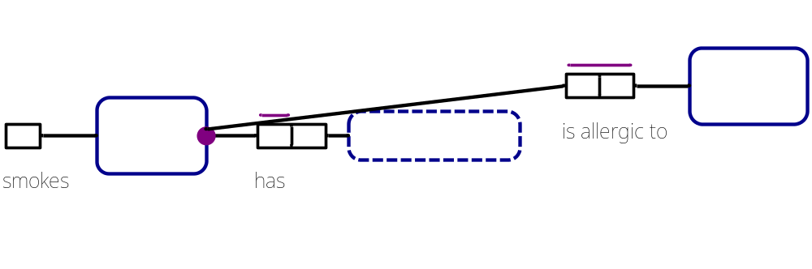
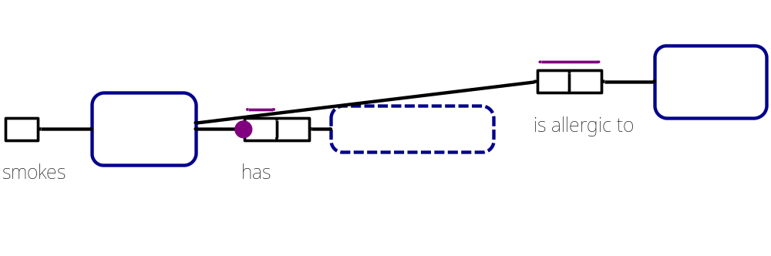
By default, NORMA places the mandatory role dot
at the role end
instead of at the object type.
This helps to disambiguate the constraint
when role attachments are very close together
e.g.
this diagram is ambiguous
but this is unambiguous

Slide 26
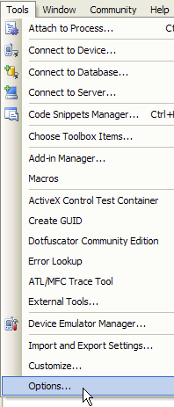
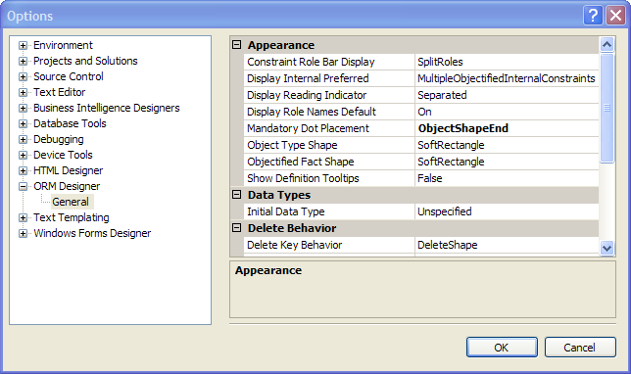
To change this default (as well as many other options)
open the Options Window (main menu: Tools > Options…)
then select ORM Designer

Slide 27


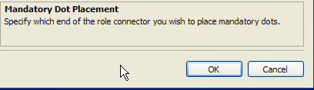
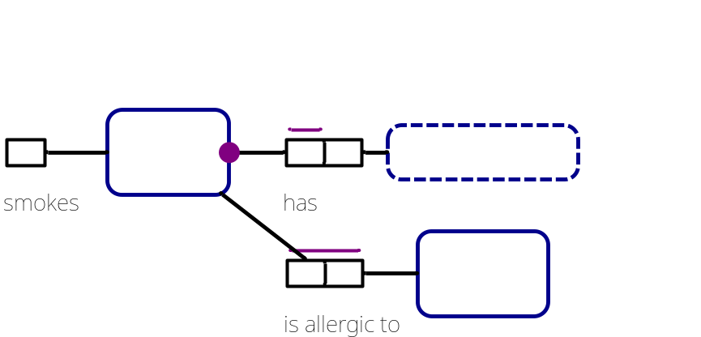
Double-click the field entry for
Mandatory Dot Placement
to toggle its value
(from RoleBoxEnd to ObjectShapeEnd).
Alternatively, choose the desired
option from the drop-down list.
To activate this choice, press OK
(this remains your default
preference until you change it).
The mandatory role dot is now
displayed at the object type end.
Notes:
Note that these are machine-specific settings. All diagrams display according to the users settings.

Slide 28
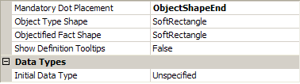
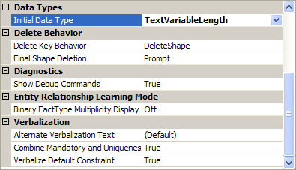

By default, NORMA sets data types to Unspecified
until you assign a specific data type.
If you wish to set a default data type,
use the Options dialog to
set the Initial (default) Data Type,
e.g. to TextVariableLength
then press OK.

Slide 29
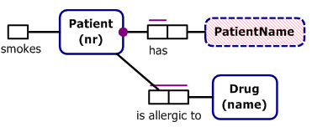
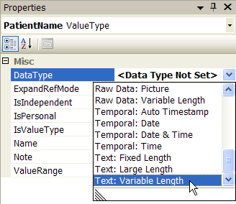
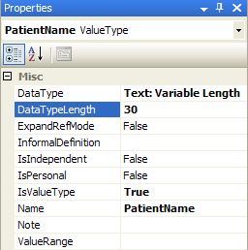
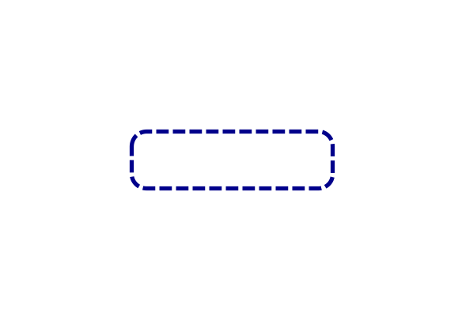
Setting the default data type
has no impact on the three object types,
since you created them earlier.
To set the data type for PatientName,
select the PatientName shape,
then in its Properties grid
select the DataType property
and choose Text: Variable Length
from the drop-down list.
Then enter 30 in the DataTypeLength property.
This sets the data type to varchar(30).
The red error fill
disappears, since
the data type is set.

Slide 30


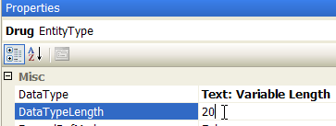
If you earlier selected the “.nr” RefMode
for Patient from the drop-down list,
its data type is set to signed integer.
Change its data type to
Numeric: Unsigned Integer.
If you earlier selected the “.name” RefMode
for Drug from the drop-down list,
its data type is already set
to variable length text.
If not, change its data type to that now.
Regardless,
you still need to set the data type length
(e.g. to 20).
Currently, NORMA uses almost the same portable data types as Visio. A later version will
provide an improved set of data types that may be used with a wider range of targets.

Slide 31

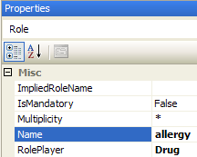
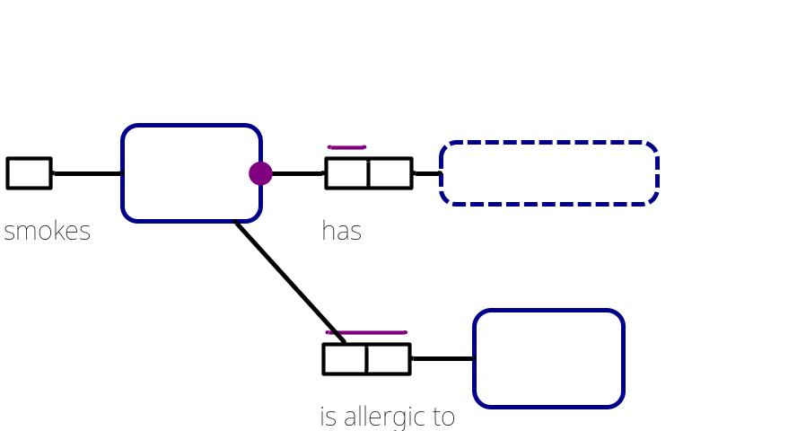
Let’s add the role name “allergy”
to the role played here by Drug.
To add a role name, select the role
and then add the role name
in the Name property
in the Properties window.
The role name is displayed
in square brackets
on the diagram.
Select then drag the role name
to your preferred position
near the role box.

Slide 32
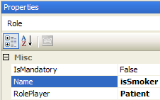

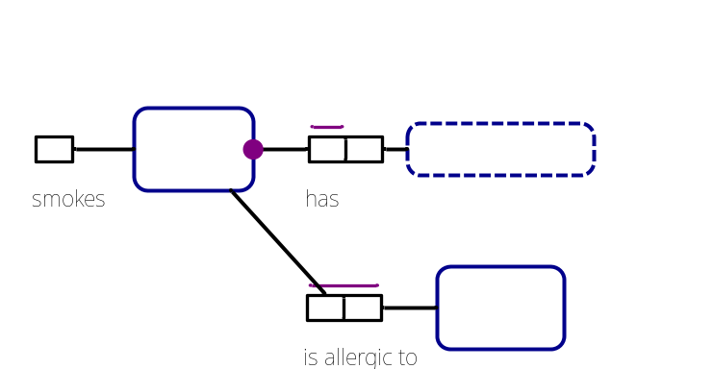


If desired, select the smokes role,
and add the role name isSmoker.
This is purely to predetermine
the precise attribute name
for code generation.
You may toggle
display of role names on/off
using the Options dialog.
Notes:
Each fact type shape also has a DisplayRoleNames property that can be used to control role name display on individual fact types.

Slide 33
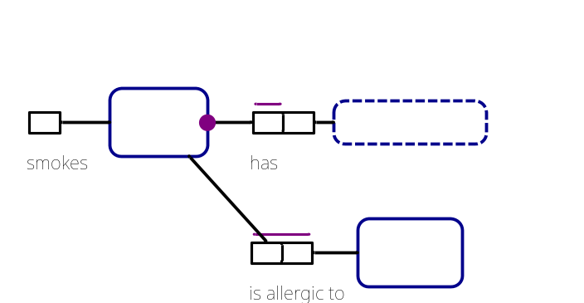
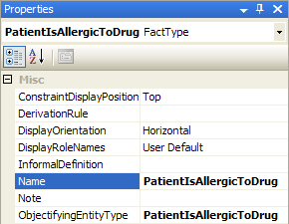

The allergy fact type is m:n,
so will map to a table by itself
when we generate a relational schema.
The table name will be the name of
the fact type, which by default
is the fact type’s primary reading
“PatientIsAllergicToDrug”.
Select the fact type, and look at its
name in the Properties window.
Edit the Name
to “DrugAllergy”.
This will now be used as the
generated table name.

Slide 34



Make any fine adjustments
you like to the figure
and then save the file
either
by pressing the Save icon
on the main menu
or by choosing the relevant Save option
from the File menu.
Choose SaveAs to save another copy of the model
(entering your desired filename and folder destination).
Choose Save All to save all the open files.

Slide 35


For practice, Exit Visual Studio by clicking the Close icon.
Now open Visual Studio again,
and reopen your saved file
by choosing File > Recent Files
and selecting the file
you wish to work with.

Slide 36

NORMA supports mappings to/from various implementation artifacts

Slide 37
Generating a Relational View

Slide 38


To generate a relational view
right-click in the document window
and choose Extension Manager …
In the Extension manager
dialog, select the
“Map to Relational Model”
check box as shown
(this will automatically turn
on the “Map to Abstraction
Model” check box)
and press OK.

Slide 39

This adds a Relational Schema
node to the model browser.
Expand the tree by toggling the
“+” expand buttons to see the
relational schema, as shown.
Mandatory columns are displayed in bold.
The relational schema is implemented
as a view of the ORM schema, so changes
in the ORM schema are reflected in the
relational schema.
Changing names and mandatory role
settings in the ORM schema are reflected immediately.
Other changes currently cause the tree to contract,
so to see the relational changes you need to re-expand the tree.
Now save your work.

Slide 40



In addition to the model
browser relational view,
a relational diagram view
is available by checking the
Relational View option in the
Extension Manger.
This adds another page
for the relational view
and
produces the diagram
shown opposite.

Slide 41
Generating DDL code

Slide 42


To generate code from an ORM schema,
first create a new project using C# or Visual Basic¹.
Launch Visual Studio.
File > New > Project
Select Visual C# or VB,
and a template
(e.g. Windows Forms App,
Console App, or
Class Library).
Add project name.
Uncheck the Create
directory option.
Press OK.
  ¹ The type of project you create determines the type of generated 3GL code
  (assuming you are going to generate C# or VB code).

Slide 43


Right-click the Project name in the Solution Explorer,
then choose
Add > Existing Item….
In the Add Existing Item dialog,
click to change to the Projects folder,
set “Files of type:” to
All Files to include .orm files,
then select your ORM file
(ORM_Lab1.orm)
and press Add to add
a copy of your ORM file
to the project
If you later want to make
changes to the ORM file
inside the project,
do it to that copy.

Slide 44


As seen before, the ORM schema maps to
a 2 table relational schema
To generate the DDL code to create the relational schema,
proceed as follows.

Slide 45




To generate code from the ORM model,
first select the model file in Solution Explorer.
In the Properties window,
check that “ORMCustomTool”
is the value for the CustomTool property.
(This should be there by default)
The ORMGeneratorSettings property
should be visible in the dialog
(if not, click a different item in
Solution Explorer and reselect your ORM file).
Now click the button at the right.

Slide 46

The ORM Generator
Selection dialog
now appears.
Now select
the target(s)
for code generation.
For this example,
let’s choose
SQL Server.
Press Save Changes.
After clicking Save Changes, the generation takes a little while.
When generation is complete, the dialog closes.

Slide 47


In Solution Explorer
press the expand button
for the ORM file
to view the files below it
(the button changes to ).
Now select the relevant code file
(e.g. ORM_Lab1.SQLServer.sql)
and double-click it to open it
and view the code generated
(or right-click and choose Open
from its context menu).

Slide 48

The code currently generated for SQL Server is shown below.
NORMA includes further options for controlling column name generation
(see later Lab).

Slide 49


To ensure that code is word-wrapped, set this option in Visual Studio.
Choose Tools > Options,
select Text Editor > All Languages – General, check the Word wrap
option, and press OK.

Slide 50
Generating other code

Slide 51

To see code
generation for
other targets,
repeat the procedure
for ORM Generator
Settings
(press button),
select desired options,
press Save Changes
and open the
relevant files to
see the code
generated.
*** Generation options may change between versions.***
Note: Check PlixSupport at most once per project.
For the options shown here, choose PLiX_Implementation
to generate C# code.
Notes:
As noted in the SourceForge install instructions, you’ll need the http://www.sourceforge.net/projects/PLiX files installed to see the CSharp and VisualBasic code generation.

Slide 52


To see the C# generated
select the ORM file in Solution Explorer
expand the abstract PLiX xml entry
and double-click the .cs file under it.
A fragment of the code is shown below.

Slide 53
C# was generated because
we initially set up our project as a C# project.
If we had instead created a Visual Basic project,
then VB code would have been generated
(with code file suffix .vb).
In a VB project, ‘Show All Files’
needs to be selected in the Solution Explorer toolbar.
DO NOT delete generated files from Solution Explorer.
To remove generated files, open the ORM Generator Settings dialog from the properties window of the ORM file. Deselect the generator types that you do not want, and then click Save Changes. The unwanted generated files will then be removed.

Slide 54

That concludes laboratory session 1. Lab 2 introduces ternary associations, external constraints, value constraints, and derived fact types.

