Slide 1

NORMA Lab. 2
Revision: Unary and Binary Fact Types
Ternary Fact Types
Inclusive-Or Constraints
External Uniqueness Constraints
Value Constraints
Derived Fact Types
Renaming Pages
In this lab,
we will enter the first page of the following 2 page ORM schema.
File: NORMA_Lab2.ppt. Author: T. Halpin. Last updated: 2009 June 9

Slide 2
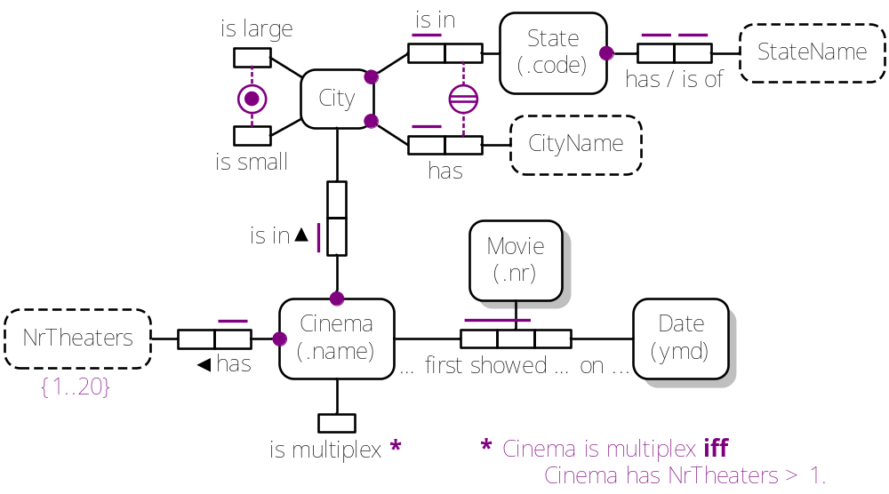
Page 1: Cinema

Slide 3
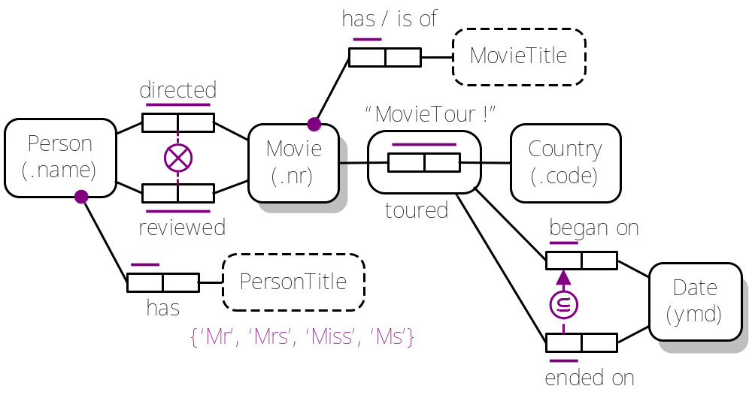
Page 2: Movie

Slide 4
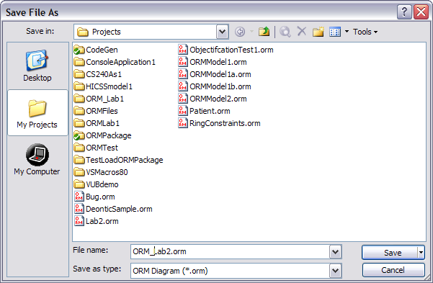
1. In Visual Studio, open a new ORM file.
File > New > File
Select General > Object-Role Modeling File.
Press Open.
2. Press the Save icon
name the file ORM_Lab2.orm
and press Save.

Slide 5

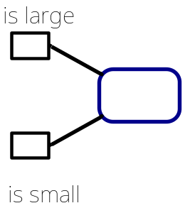

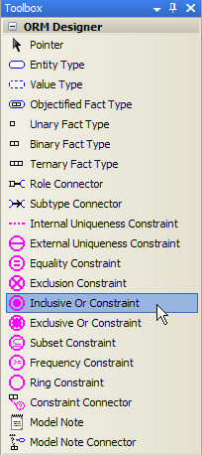
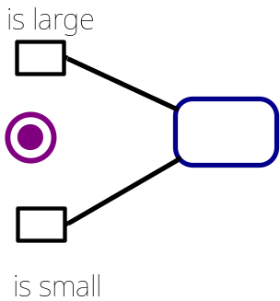
Type the fact type “City is large” into the Fact Editor.
Press Ctrl-Enter to add it to the diagram.
Do the same for “City is small”.
(“City” should be there already).
Move the City object type to the right,
and place the predicate text as shown.
Select the Inclusive Or Constraint shape.
Position then click the mouse
to place the constraint shape
(alternatively, drag the constraint shape
from the Toolbox to the desired position).

Slide 6
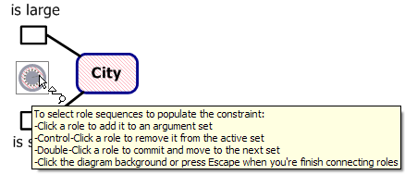
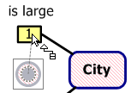
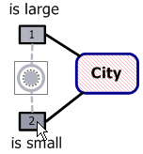
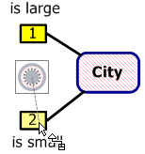

If needed,
double-click the constraint shape
to activate editing mode
(the mouse pointer changes,
and displays the instructions).
Move the constraint pointer to
the first role and click it
(a “1” appears in the role).
Move the constraint pointer to
the second role and click it
(a “2” appears in the role).
Double-click to commit
the constraint.
The pointer returns to normal.
If you click the ORM Verbalizer window
you will see the constraint verbalized.

Slide 7
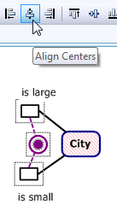
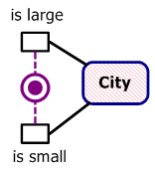
If the Layout Toolbar is not already displayed, display it by selecting
the menu option View > Toolbars > Layout.
To align the constraint shape
vertically with the roles,
drag the mouse to select these 3 shapes,
then select the Align Centers option
from the layout toolbar¹.
The shapes are now aligned.
¹ Alternatively, select Format > Align > Centers from the menu.

Slide 8
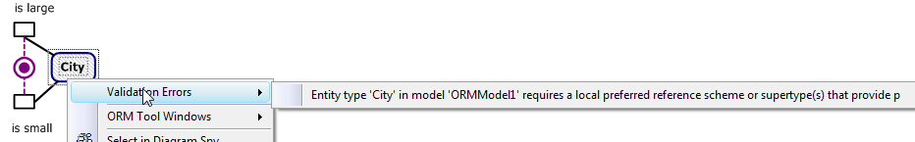
The City shape has red hash fill
indicating an error state.
Right-click the City shape to see the error.
The error may also be viewed in full from the ORM Verbalizer window.
We need to add a preferred reference scheme.

Slide 9


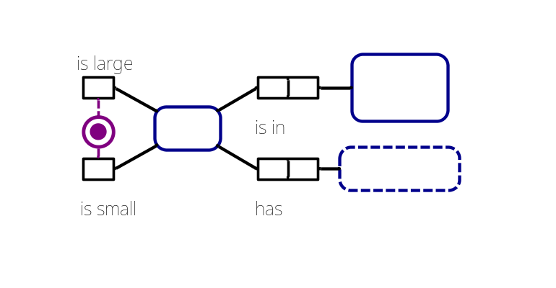


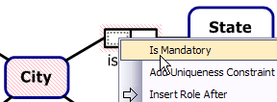
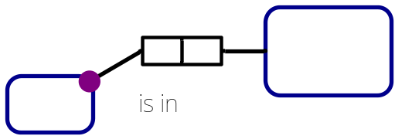
Enter the following fact types in the Fact Editor.
Press Ctrl-Enter after each to add it to the diagram.
Drag the shapes roughly to the positions shown.
Select the predicates, then use
Align Centers
to align the predicates vertically.
For each binary predicate,
select the predicate and its right hand object type,
then use Align Middles from the layout toolbar
(or Format > Align > Middles from the menu)
to align them horizontally.
Select City’s role in the location predicate,
right-click, then select IsMandatory
from its context menu
to add the mandatory role constraint.

Slide 10
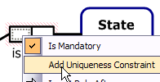
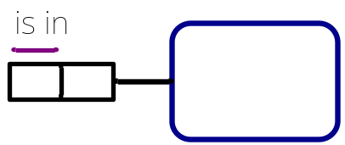
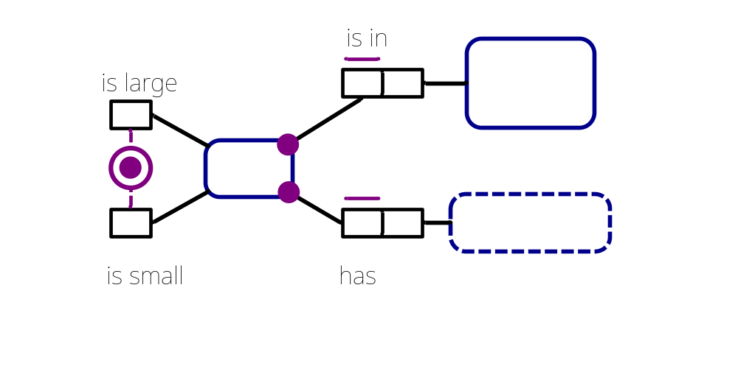
Select City’s role in the location predicate,
right-click, then select Add Uniqueness Constraint
from its context menu
to add the uniqueness constraint.
Now drag the predicate text
to position it over the role as shown.
Similarly, add a mandatory role constraint
and a uniqueness constraint to City’s role
in the CityName predicate,
and position the predicate text as shown.

Slide 11
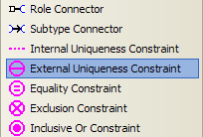
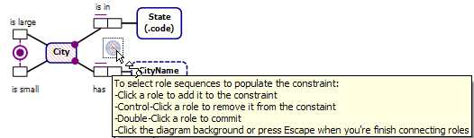
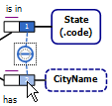
Now select the External Uniqueness constraint shape from the tool box
and click to position it between the roles played by State and CityName.
Double click the External Uniqueness constraint to activate the constraint connector tool.
Move the constraint pointer to the first role and click it
(a “1” appears in the role).
Move the constraint pointer to the second role and click it
(a “2” appears in the role).
Double-click the last role to commit the constraint.
The pointer returns to normal, and the constraint is verbalized.

Slide 12
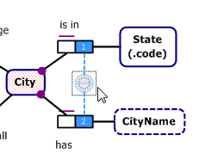
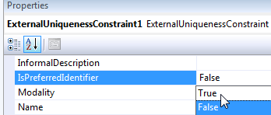
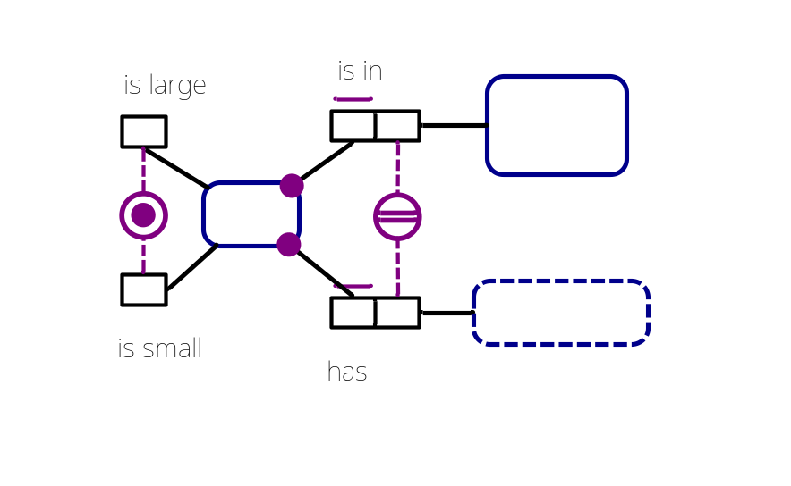
With the constraint selected,
set its IsPreferredIdentifier
property to True,
either by double-clicking
the field where it says False
(which toggles the value to True)
or by selecting True from the
drop-down list (as shown).
The constraint now displays
as a preferred identifier
(double uniqueness bar)
and
City is no longer in an error state.

Slide 13
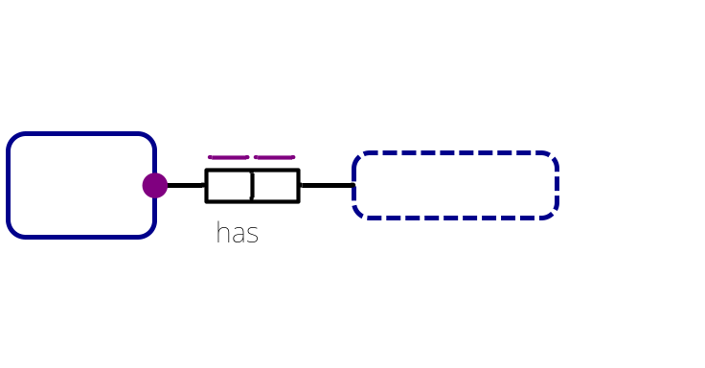


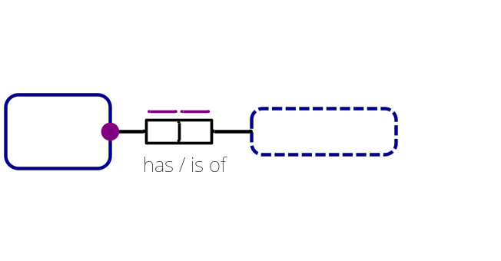
In the Fact Editor, type the fact type
“State has StateName()” and press Ctrl-Enter
to add it to the diagram.
Then add the constraints shown.
To add an inverse predicate reading for “has”,
select the fact type, open the Fact Editor,
edit the fact type reading by inserting “/is of”
after the “has”¹,
and then Ctrl-Enter to commit the change.
Both forward and inverse readings
now display on the diagram.
Note: To delete an inverse reading in the Fact Editor,
select the inverse reading after the slash “/”
(do NOT remove the slash),
press the Delete key, and then Ctrl-Enter to commit the change.
¹NORMA displays a space on either side of “/” when displaying it in the document window,
whether or not you include these spaces in the Fact Editor.

Slide 14
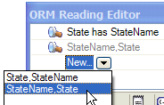

An alternative way to edit fact type readings
that works also for more complex cases
such as adding multiple readings for n-aries
is to use the Reading Editor.
For example, as another way to add an
inverse predicate reading for “has”,
double-click the predicate reading to open the
Reading Editor with that fact type displayed.
Press “New” then the down-arrow
and double-click the second row with the
reading order StateName, State.
A view of the new fact type reading now appears.
Edit this by inserting “is of” between the terms as shown.
Press Enter to commit the new reading,
and it now displays on the diagram.

Slide 15
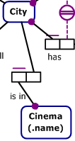
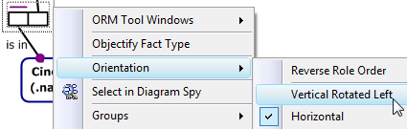
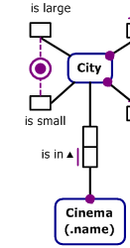
Now add the fact type
“Cinema(.name) is in City”
and add mandatory and uniqueness constraints
to the first role, and position the shapes roughly as shown.
All predicates in NORMA are
displayed horizontally by default.
Move the Cinema shape
directly below the City shape.
Right-click the “is in” predicate,
and from its context menu choose
Orientation > Vertical Rotated Left.
NORMA adds an upwards arrow-tip to the predicate
reading to indicate the direction in which to read it.
Select the fact type and align the shapes vertically
as shown using the layout toolbar option Align Centers
(or the menu option Format > Align > Centers).

Slide 16

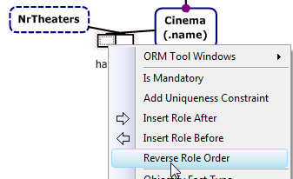

Now add the fact type “Cinema has NrTheaters()”, and move the new shapes to the left of Cinema,
as shown. The predicate is displayed in left-to-right reading order.
To reverse the predicate reading order display,
select a role, right-click and
select Reverse Role Order.
The predicate is now displayed
in right-to-left reading order.
NORMA adds a left-pointing arrow-tip
to indicate the direction in which
to read the predicate.

Slide 17
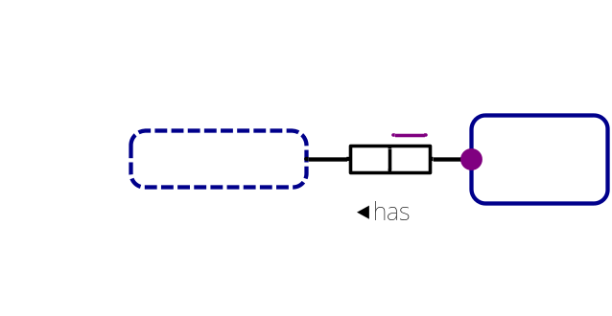
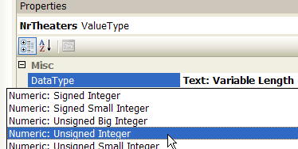
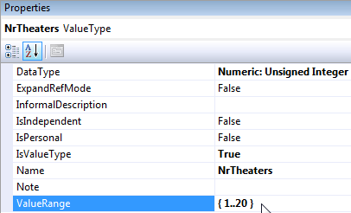

Add mandatory and uniqueness
constraints to the right-hand role
then use Align Middles to align
as shown.
Then select NrTheaters,
and change its DataType property
to numeric (e.g. Unsigned Integer).
Now select NrTheaters and
enter the value constraint 1..20
in its ValueRange property
(don’t add braces,
as NORMA does that for you).
Pressing Enter displays the constraint
in braces on the diagram.
Position it as shown.

Slide 18

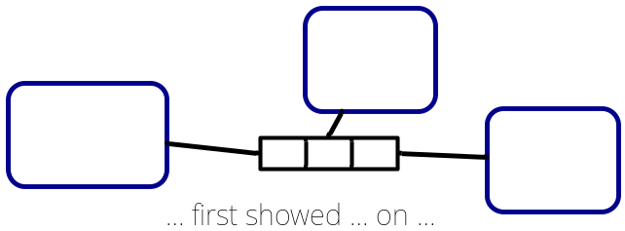

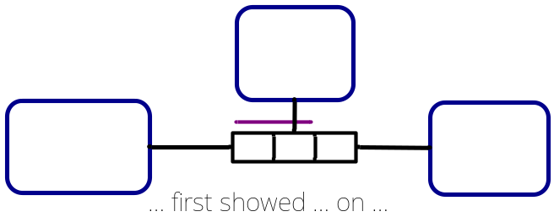
Now add this ternary fact type:
Position it as shown.
Add a uniqueness constraint
spanning the first two roles
by holding the Shift key down
as you select the two roles
then right-click and choose
Add Uniqueness Constraint.
Align the shapes
and reposition the predicate text
as shown.

Slide 19
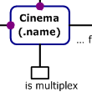

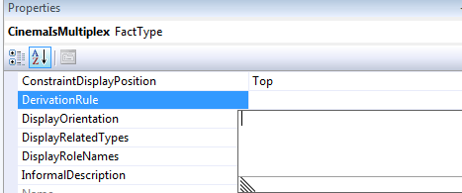
Add the fact type “Cinema is multiplex”
in the Fact Editor, Cntrl-Enter to commit,
then position it as shown.
Now select the unary fact type
(not just the role) by clicking
just outside the top-right corner
of the role.
The cursor should display as
a 4-headed arrow.
In the DerivationRule property,
click the drop-down arrow to
open the DerivationRule window.

Slide 20

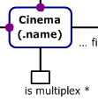
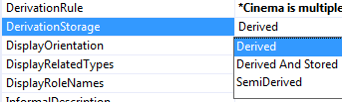
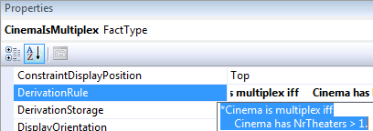
Now type the derivation rule shown.
Press Ctrl-Enter after “iff”
to move to the next line,
then indent a few spaces before typing the rest.
Press Enter to commit the rule.
The tool now displays an asterisk
after the predicate reading on the diagram
and enters “Derived” in the
DerivationStorage property,
indicating the fact type is fully derived
and not stored.
For later use in a model note,
select the derivation rule
and press Ctrl-C
to copy the rule to the clipboard.

Slide 21

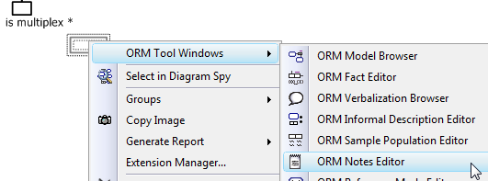
To explicitly show your derivation rule on the model,
you must add a Model Note.
Click “Model Note” in the toolbox,
drag it near the unary predicate,
then
right-click the Note shape
and open the Notes Editor
ORM Tools Windows > ORM Notes Editor.

Slide 22



Paste the derivation rule previously copied to the clipboard
into the Notes Editor by pressing Ctrl-V.
Alternatively, you can enter the rule
directly (press Ctrl-Enter to add a new line;
press Enter to commit the change).
Click anywhere on the document window to display the note.
If you wish to connect the
model note to the unary predicate,
click the “Model Note Connector”,
in the toolbox,
then click inside the note,
then click again inside the role box to connect.
A dotted line should now appear
connecting the note to its model element.

Slide 23
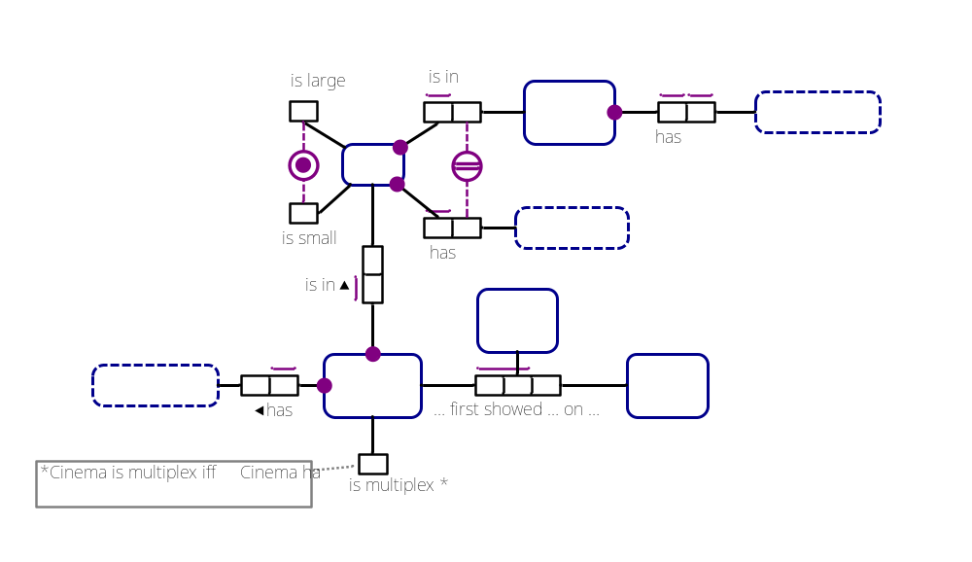
That completes page 1 of our schema,
which should now look something like this:

Slide 24

To name this page “Cinema”
right-click the page tab
(by default named “ORM NewModel”),
select Rename Page
and enter “Cinema”.
The new page name now displays.
Save your file and exit.
We will complete page 2 of the schema in the next lab.

