Slide 1
Jargonizer
Software for Jargon Identification in Congressional Documents

Slide 2
Summary
Challenges in document interpretation
Project goals
Project structure/steps
Analysis of Congress.gov and
Project site interface
What’s next?

Slide 3
Challenges in document interpretation:
Complex sentence structure:
High average sentence length
Passive voice
Ambiguity: unclear word/phrase definition used + jargon
Inconsistency: variation in word/phrase definitions used throughout the document
Lack of examples and context:
Why is this document important
Which companies/individuals are impacted by the document
Related documents
Other:
Contradiction with other/previous laws
Intentional manipulation (lie detection)
Cultural and contextual differences

Slide 4
Project goals.
Clarity: selection of the most correct definition for word/phrase/jargon
Simple sentence structure:
Breaking lengthy sentences/paragraphs into smaller pieces
Active voice
Overall context: give background on why the bill was introduced
Citation: link sections mentioned in the document
Examples: provide persons/companies affected
Focus on the U.S. legal system (Congress.gov)

Slide 5
Project structure
Site information: display bill overview and summary
Context: history on why was the bill introduced
Parsing: collect words/sentences/paragraphs/document structure
Identification: find jargon/cited documents
Definition: provide most correct interpretation of individual words/identified elements based on document context
Citation: link sections mentioned in the document
Readability:
Releasing a readability score
breaking lengthy sentences/paragraphs into several sentences or bullet points
Active voice
Examples: provide persons/companies affected
Extra: producing visual aids for percentages/geography through jupyter (maybe)

Slide 6
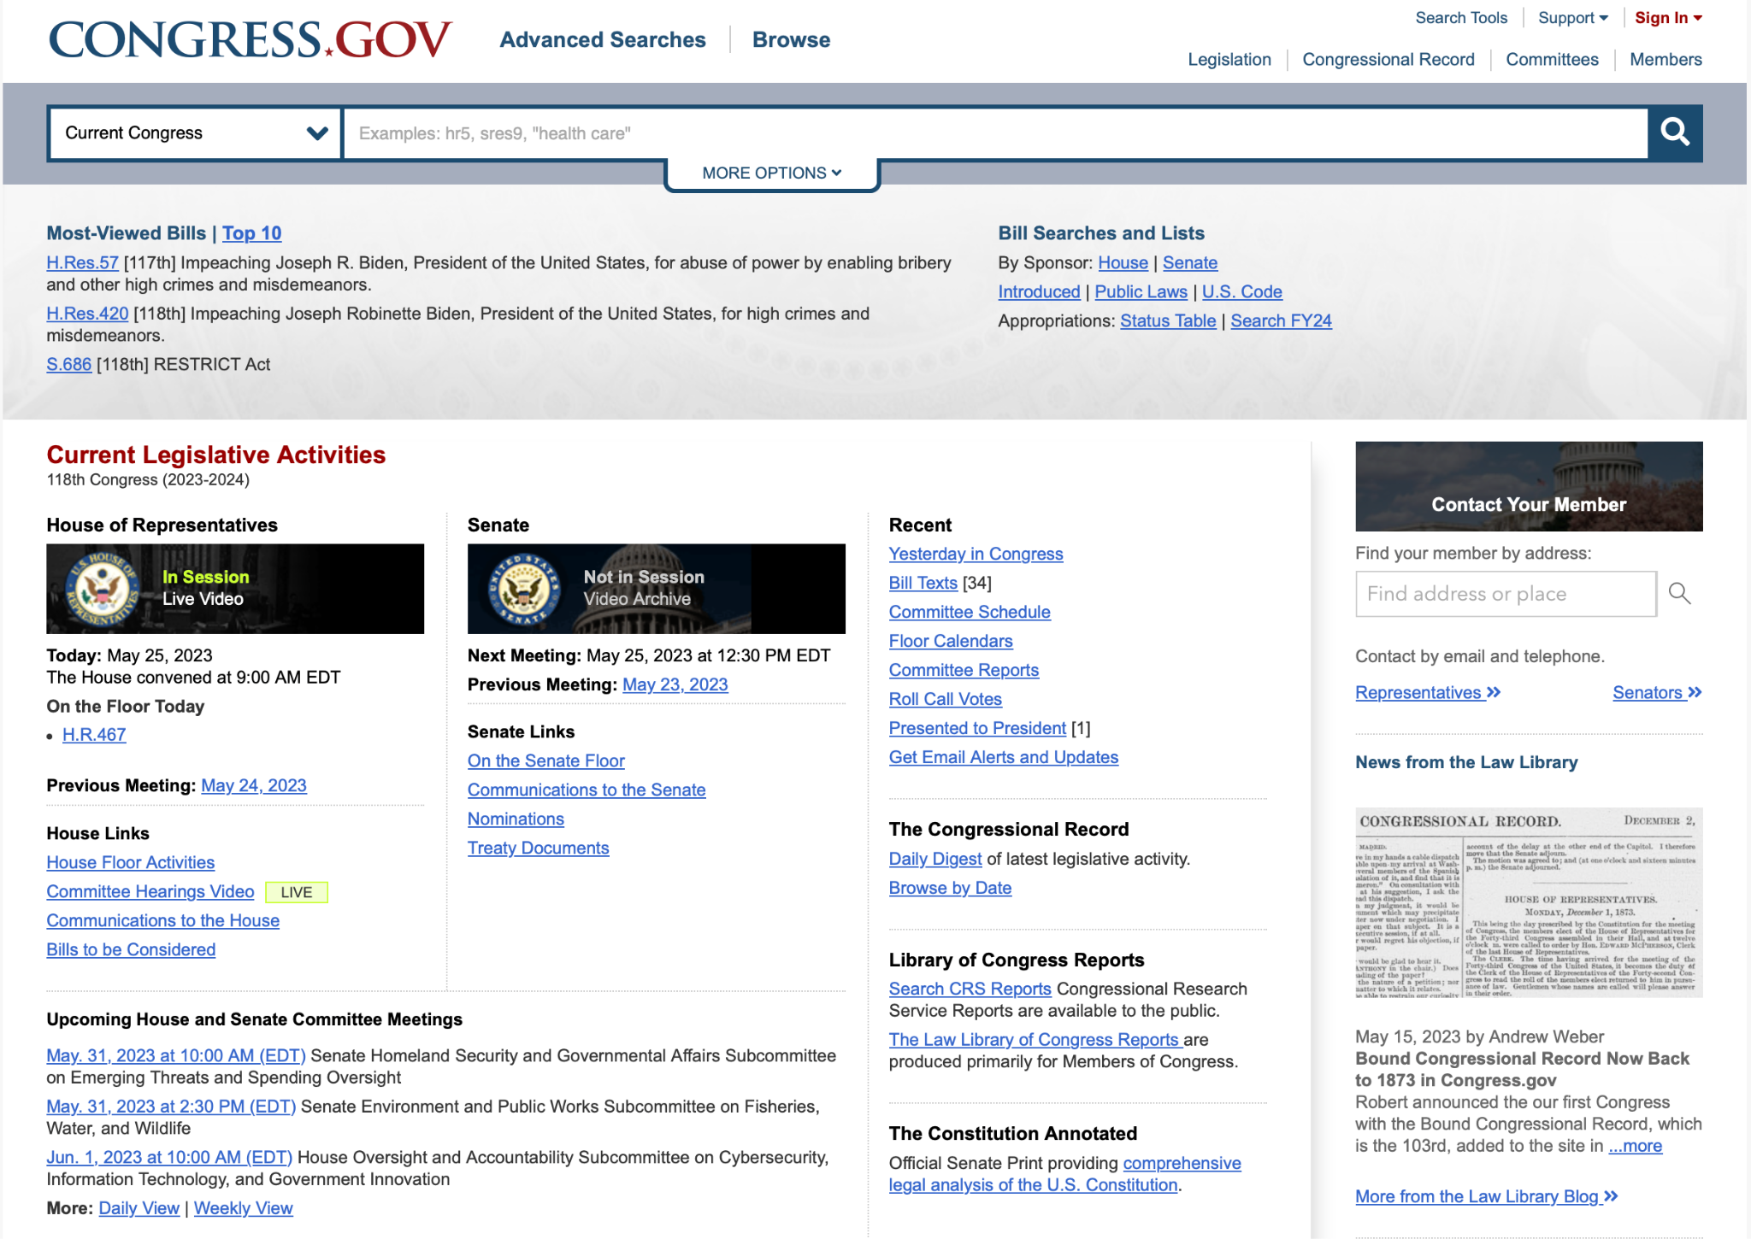
Analysis of Congress.gov: Front Page
Search bar: type in keyword

Slide 7
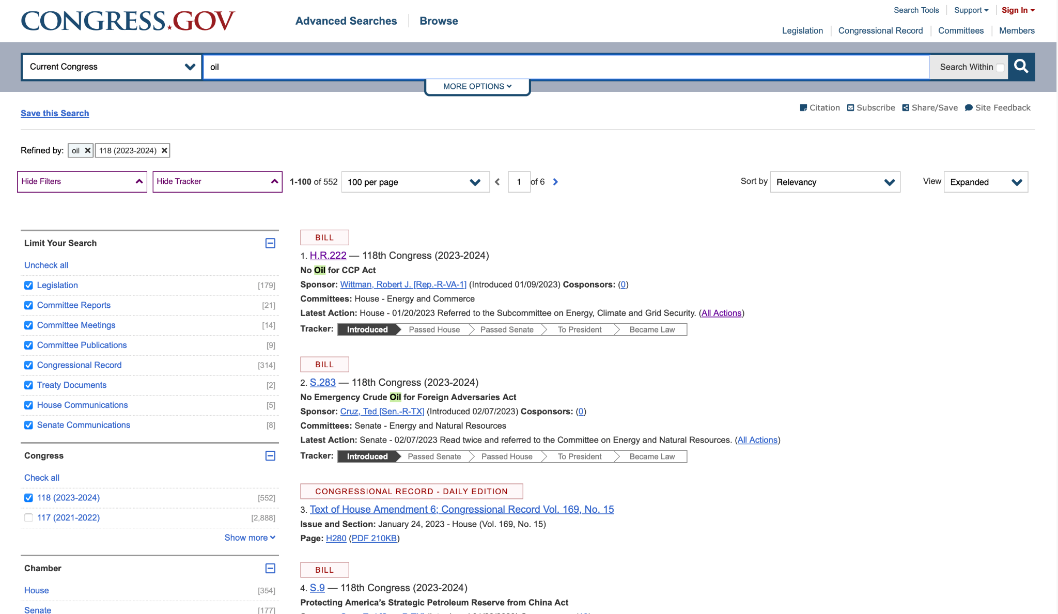
Analysis of Congress.gov: Bill page of a keyword
Bill options
URL to bill

Slide 8
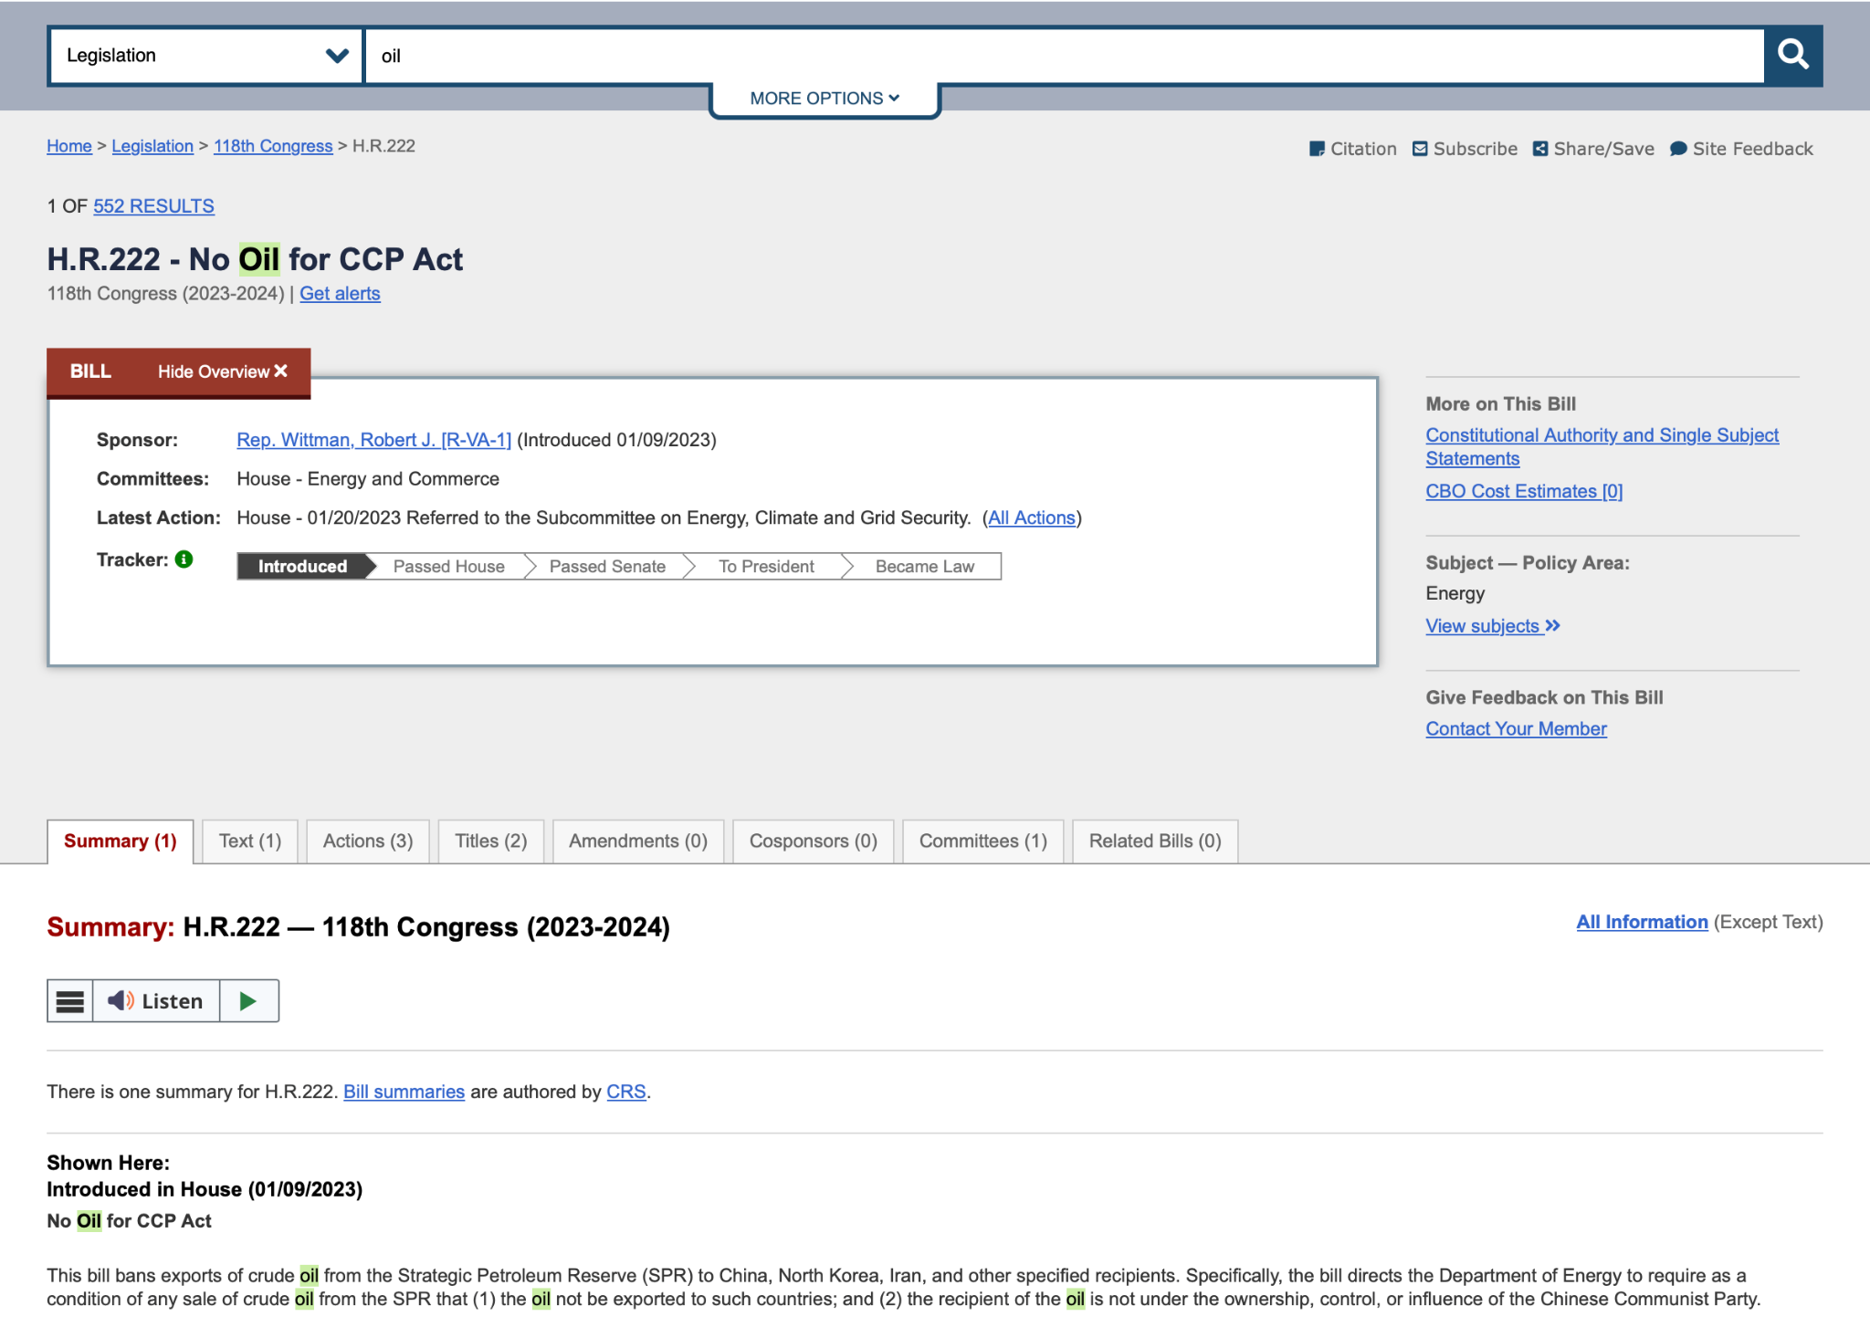
Analysis of Congress.gov: Bill front page
Bill overview
Summary: add context for the bill

Slide 9
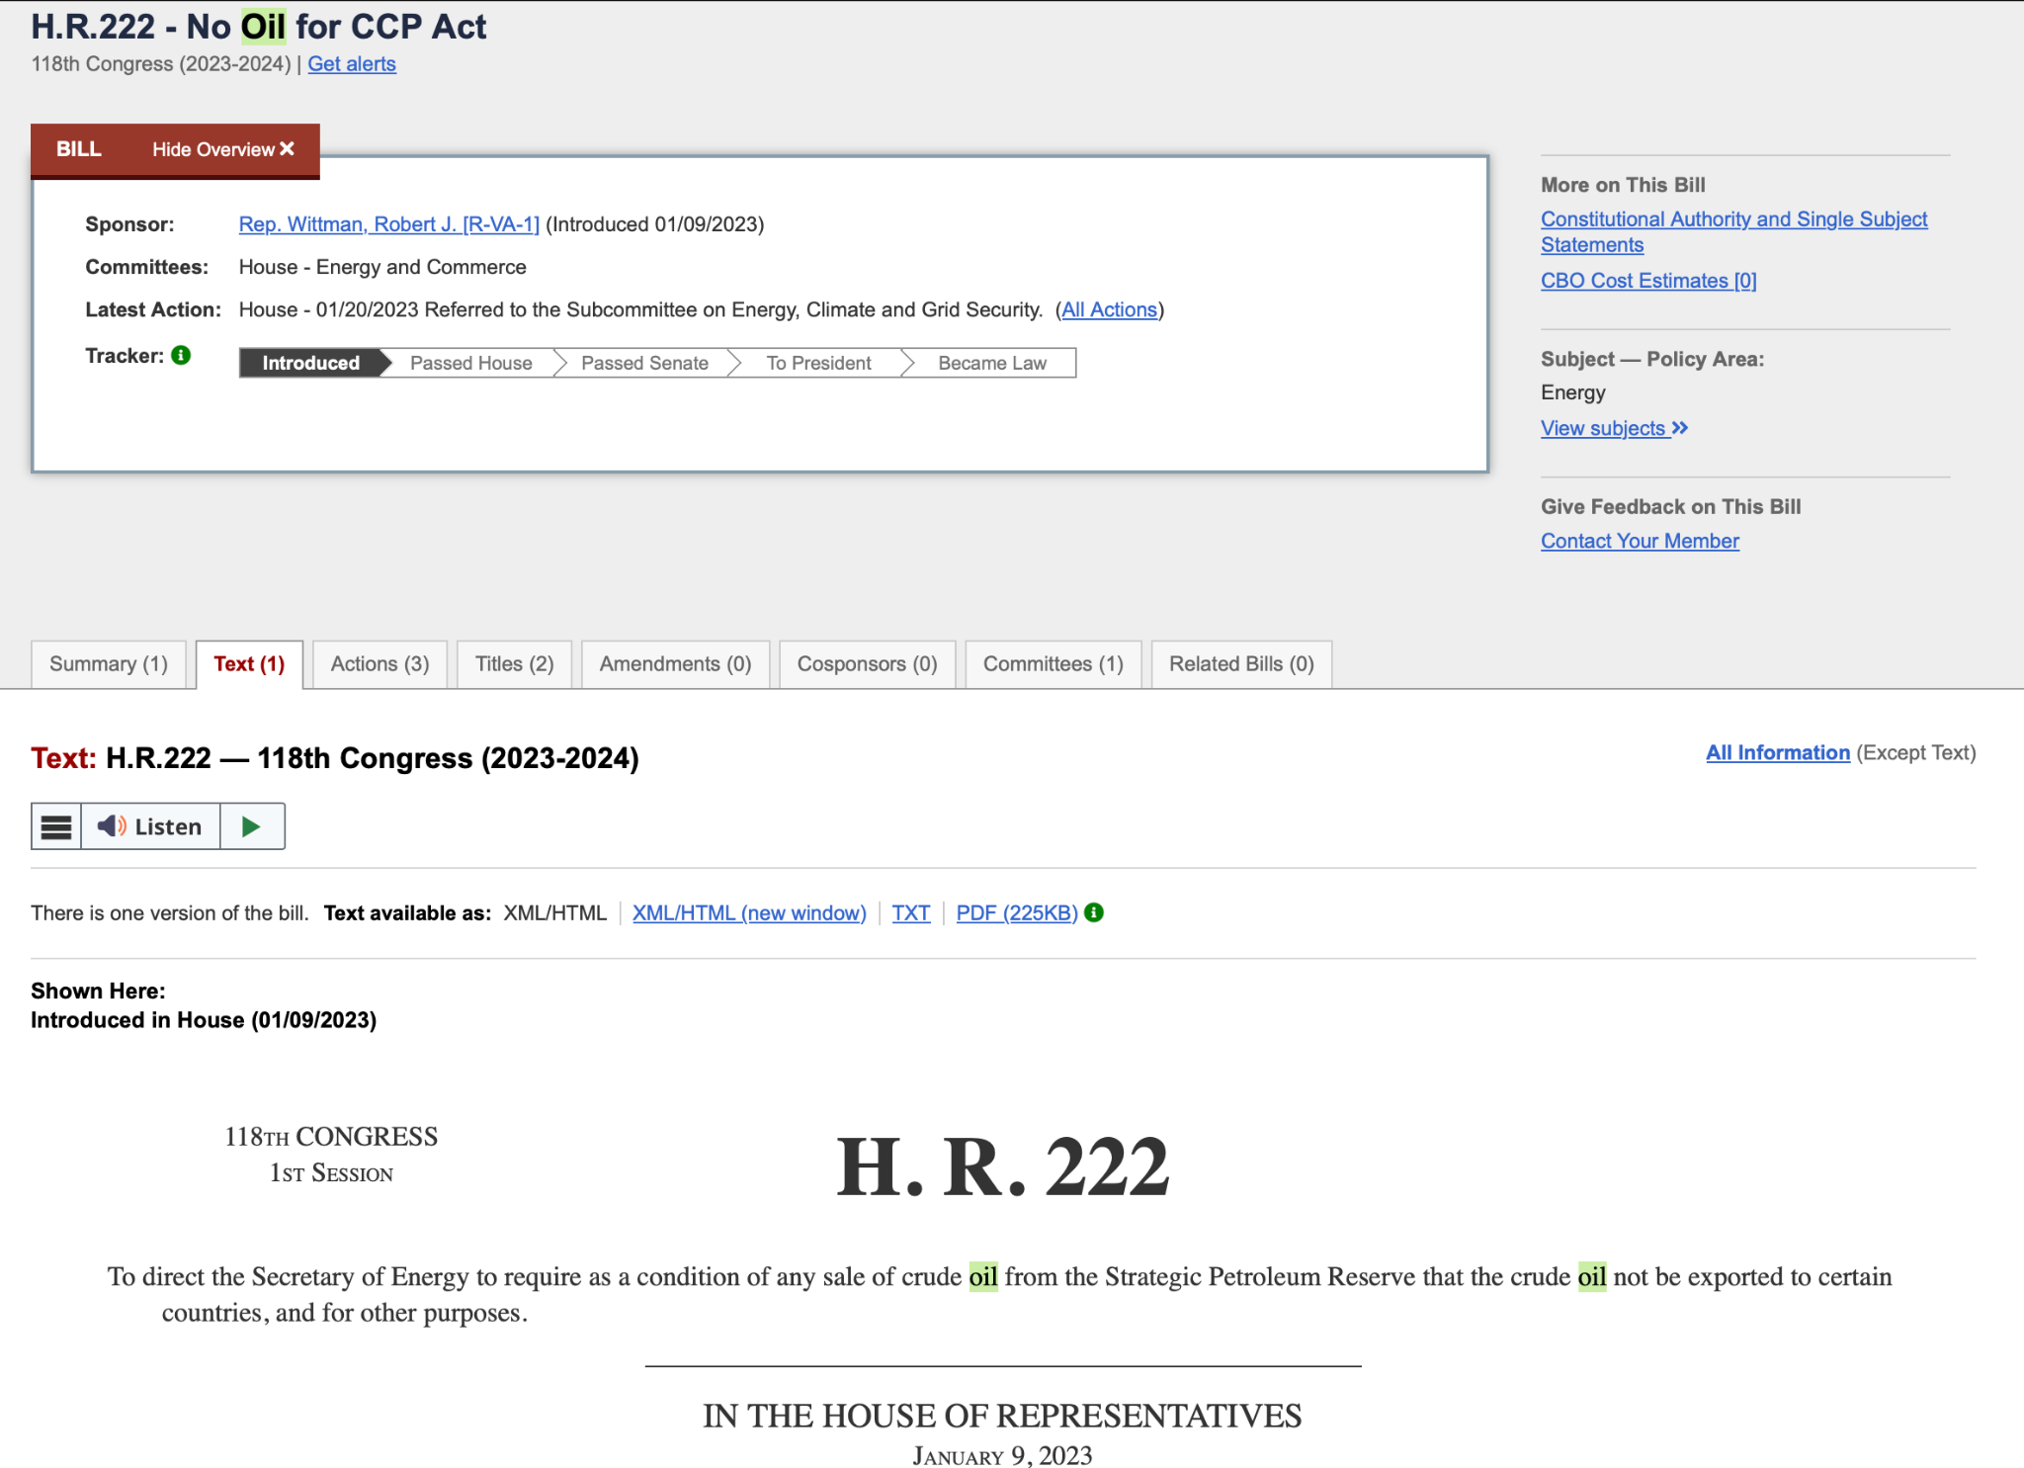
Analysis of Congress.gov: Bill text page
Select text
Convert bill to txt for parsing

Slide 10
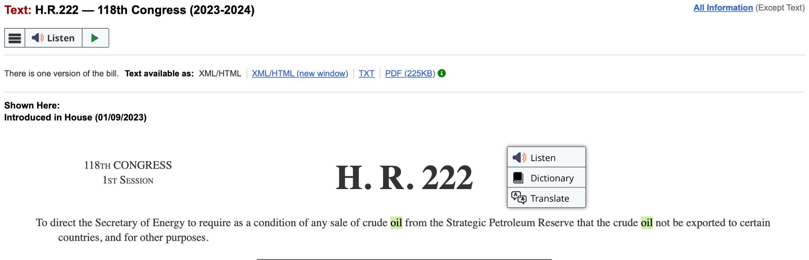
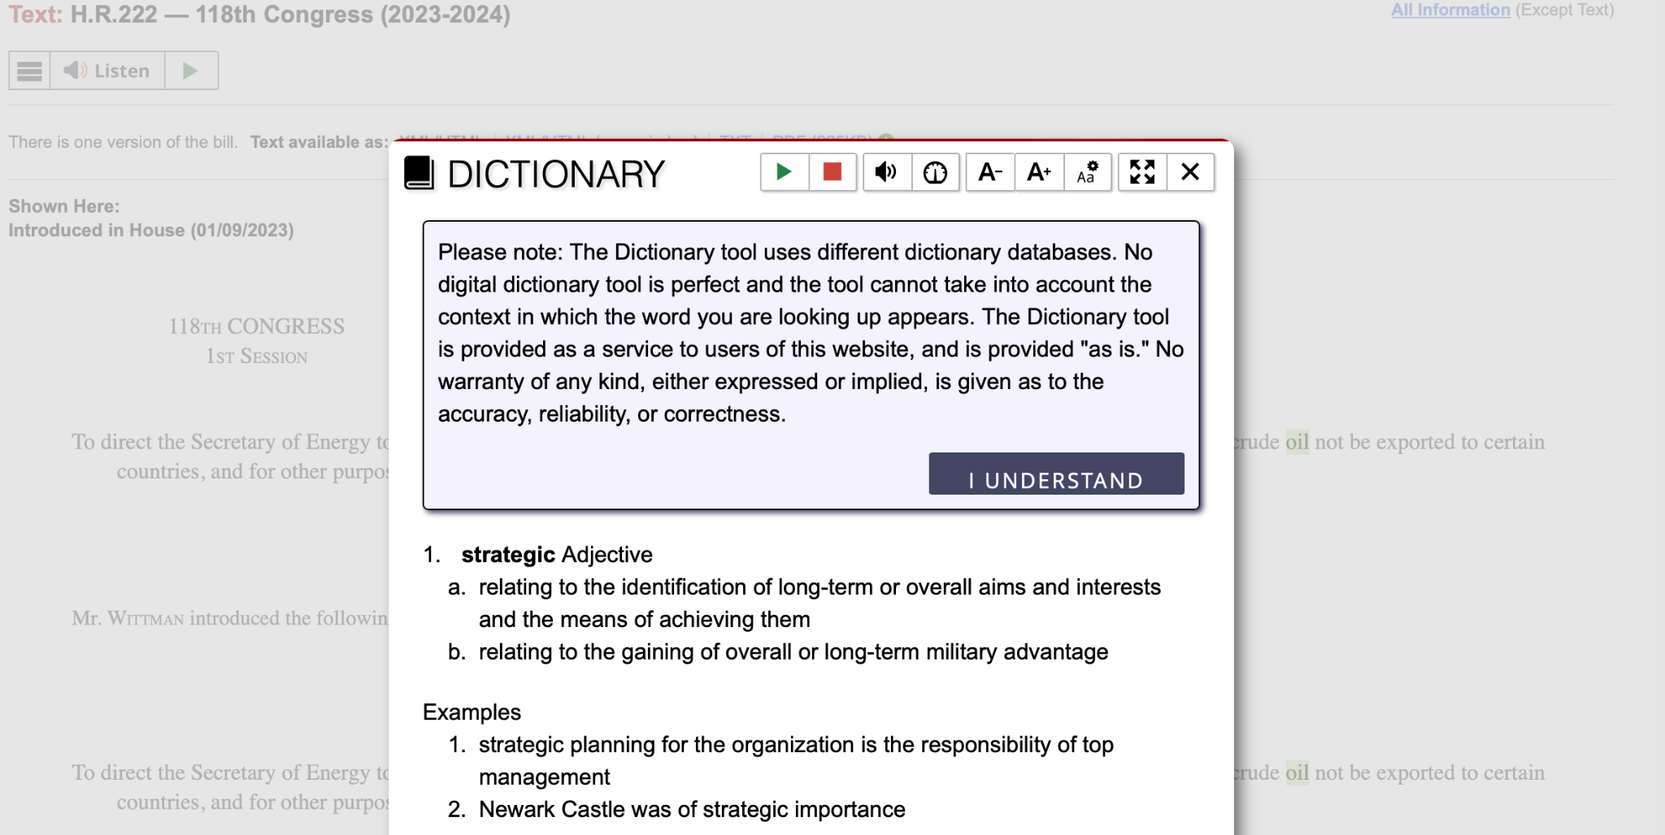
Analysis of Congress.gov: problem with text definitions
Strategic Petroleum Reserve: select dictionary
Gives definition of only the first word, not the term

Slide 11
Site Structure/Steps
Search bar on Jargonizer. Collect keyword
Connect to congress.gov
Paste keyword into congress.gov’s search bar
Output available bills on Jargonizer
The user selects desired bill
Scrape congress.gov for overview, summary, text to display on Jargonizer
On Jargonizer, output bill context (why in was introduced and who/what is impacted), and readability level
The user can select an section (highlight in pink) for most correct definition. Upon selection the user can select a complexity level of to-be displayed definition.
Highlight jargon in green.
Highlight referenced sections in blue and link them to a Jargonizer page about the bill (open a new window) (if there is time)
Highlight in yellow sections that lack context/ are ambiguous (if there is time)
The user can highlight a sentence or a paragraph, select complexity level for restructuring the sentence structure, creating bullet points.

Slide 12
Jargonizer
Paste bill keyword here: oil
Submit

Slide 13
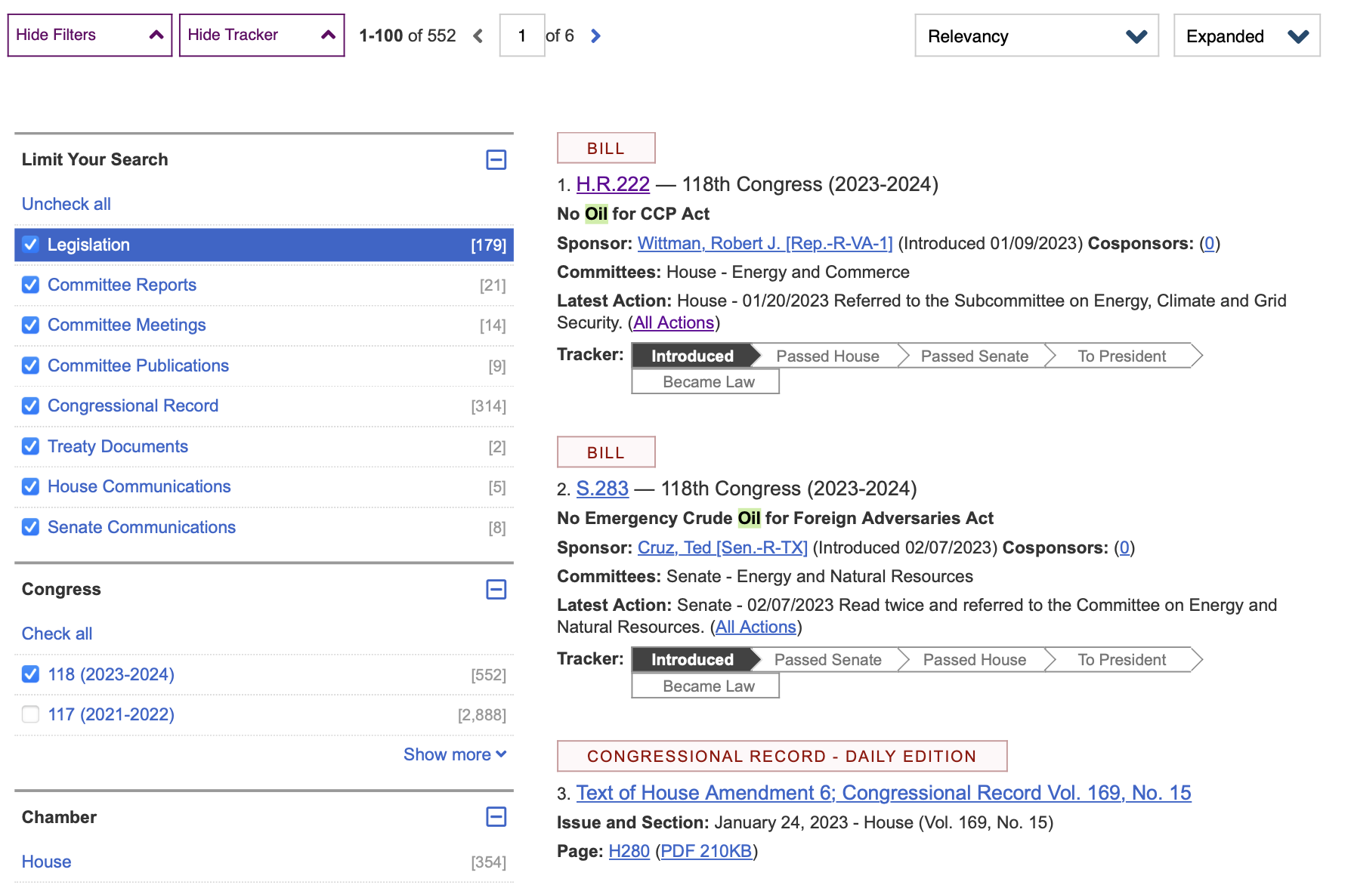
Jargonizer
Paste bill keyword here: oil
Submit

Slide 14
Jargonizer
Readability score: FKGL ≈ -11.44
Bill’s goal:
The goal of H.R. 222, as stated in the provided text, is to direct the Secretary of Energy to impose a condition on the sale of crude oil from the Strategic Petroleum Reserve. Specifically, the condition is that the crude oil should not be exported to certain countries. The bill also includes a provision that the recipient of the crude oil should not be under the ownership, control, or influence of the Chinese Communist Party.
The overall goal of the bill appears to be twofold:
1. Restricting the export of crude oil from the Strategic Petroleum Reserve: The bill aims to ensure that the crude oil resources held in the reserve are not exported to specific countries, namely the People's Republic of China, the Democratic People's Republic of Korea, and the Islamic Republic of Iran. This goal could be driven by various reasons, such as national security concerns, geopolitical considerations, or economic factors.
2. Preventing ownership, control, or influence by the Chinese Communist Party: The bill seeks to ensure that the recipient of the crude oil is not under the ownership, control, or influence of the Chinese Communist Party. This objective might be motivated by concerns related to the potential implications of supplying crude oil to entities associated with a particular political party or ideology.
Please note that the precise goals and motivations behind the bill might be further elucidated in the full text of H.R. 222 or through additional legislative discussions and context.
H.R.222 - No Oil for CCP Act
[Congressional Bills 118th Congress]
[From the U.S. Government Publishing Office]
[H.R. 222 Introduced in House (IH)]
<DOC>
118th CONGRESS
1st Session
H. R. 222
To direct the Secretary of Energy to require as a condition of any sale
of crude oil from the Strategic Petroleum Reserve that the crude oil
not be exported to certain countries, and for other purposes.
_______________________________________________________________________
IN THE HOUSE OF REPRESENTATIVES
January 9, 2023
Mr. Wittman introduced the following bill; which was referred to the
Committee on Energy and Commerce
_______________________________________________________________________
A BILL
To direct the Secretary of Energy to require as a condition of any sale
of crude oil from the Strategic Petroleum Reserve that the crude oil
not be exported to certain countries, and for other purposes.
Be it enacted by the Senate and House of Representatives of the
United States of America in Congress assembled,
SECTION 1. SHORT TITLE.
This Act may be cited as the ``No Oil for CCP Act''.
SEC. 2. SPR CRUDE OIL EXPORT BAN.
Notwithstanding any other provision of law, including section 161
of the Energy Policy and Conservation Act (42 U.S.C. 6241), with
respect to the draw down and sale at auction of any crude oil from the
Strategic Petroleum Reserve after the date of enactment of this Act,
the Secretary of Energy, in consultation with the Secretary of Commerce
and the Director of National Intelligence, shall require, as a
condition of any such sale, that--
(1) the crude oil not be exported to--
(A) the People's Republic of China;
(B) the Democratic People's Republic of Korea; or
(C) the Islamic Republic of Iran; and
(2) the recipient is not under the ownership, control, or
influence of the Chinese Communist Party.
<all>

Slide 15
Jargonizer
Readability score: FKGL ≈ -11.44
Bill’s goal:
The goal of H.R. 222, as stated in the provided text, is to direct the Secretary of Energy to impose a condition on the sale of crude oil from the Strategic Petroleum Reserve. Specifically, the condition is that the crude oil should not be exported to certain countries. The bill also includes a provision that the recipient of the crude oil should not be under the ownership, control, or influence of the Chinese Communist Party.
The overall goal of the bill appears to be twofold:
1. Restricting the export of crude oil from the Strategic Petroleum Reserve: The bill aims to ensure that the crude oil resources held in the reserve are not exported to specific countries, namely the People's Republic of China, the Democratic People's Republic of Korea, and the Islamic Republic of Iran. This goal could be driven by various reasons, such as national security concerns, geopolitical considerations, or economic factors.
2. Preventing ownership, control, or influence by the Chinese Communist Party: The bill seeks to ensure that the recipient of the crude oil is not under the ownership, control, or influence of the Chinese Communist Party. This objective might be motivated by concerns related to the potential implications of supplying crude oil to entities associated with a particular political party or ideology.
Please note that the precise goals and motivations behind the bill might be further elucidated in the full text of H.R. 222 or through additional legislative discussions and context.
H.R.222 - No Oil for CCP Act
[Congressional Bills 118th Congress]
[From the U.S. Government Publishing Office]
[H.R. 222 Introduced in House (IH)]
<DOC>
118th CONGRESS
1st Session
H. R. 222
To direct the Secretary of Energy to require as a condition of any sale
of crude oil from the Strategic Petroleum Reserve that the crude oil
not be exported to certain countries, and for other purposes.
_______________________________________________________________________
IN THE HOUSE OF REPRESENTATIVES
January 9, 2023
Mr. Wittman introduced the following bill; which was referred to the
Committee on Energy and Commerce
_______________________________________________________________________
A BILL
To direct the Secretary of Energy to require as a condition of any sale
of crude oil from the Strategic Petroleum Reserve that the crude oil
not be exported to certain countries, and for other purposes.
Be it enacted by the Senate and House of Representatives of the
United States of America in Congress assembled,
SECTION 1. SHORT TITLE.
This Act may be cited as the ``No Oil for CCP Act''.
SEC. 2. SPR CRUDE OIL EXPORT BAN.
Notwithstanding any other provision of law, including section 161
of the Energy Policy and Conservation Act (42 U.S.C. 6241), with
respect to the draw down and sale at auction of any crude oil from the
Strategic Petroleum Reserve after the date of enactment of this Act,
the Secretary of Energy, in consultation with the Secretary of Commerce
and the Director of National Intelligence, shall require, as a
condition of any such sale, that--
(1) the crude oil not be exported to--
(A) the People's Republic of China;
(B) the Democratic People's Republic of Korea; or
(C) the Islamic Republic of Iran; and
(2) the recipient is not under the ownership, control, or
influence of the Chinese Communist Party.
<all>

Slide 16
Jargonizer
Readability score: FKGL ≈ -11.44
Bill’s goal:
The goal of H.R. 222, as stated in the provided text, is to direct the Secretary of Energy to impose a condition on the sale of crude oil from the Strategic Petroleum Reserve. Specifically, the condition is that the crude oil should not be exported to certain countries. The bill also includes a provision that the recipient of the crude oil should not be under the ownership, control, or influence of the Chinese Communist Party.
The overall goal of the bill appears to be twofold:
1. Restricting the export of crude oil from the Strategic Petroleum Reserve: The bill aims to ensure that the crude oil resources held in the reserve are not exported to specific countries, namely the People's Republic of China, the Democratic People's Republic of Korea, and the Islamic Republic of Iran. This goal could be driven by various reasons, such as national security concerns, geopolitical considerations, or economic factors.
2. Preventing ownership, control, or influence by the Chinese Communist Party: The bill seeks to ensure that the recipient of the crude oil is not under the ownership, control, or influence of the Chinese Communist Party. This objective might be motivated by concerns related to the potential implications of supplying crude oil to entities associated with a particular political party or ideology.
Please note that the precise goals and motivations behind the bill might be further elucidated in the full text of H.R. 222 or through additional legislative discussions and context.
H.R.222 - No Oil for CCP Act
[Congressional Bills 118th Congress]
[From the U.S. Government Publishing Office]
[H.R. 222 Introduced in House (IH)]
<DOC>
118th CONGRESS
1st Session
H. R. 222
To direct the Secretary of Energy to require as a condition of any sale
of crude oil from the Strategic Petroleum Reserve that the crude oil
not be exported to certain countries, and for other purposes.
_______________________________________________________________________
IN THE HOUSE OF REPRESENTATIVES
January 9, 2023
Mr. Wittman introduced the following bill; which was referred to the
Committee on Energy and Commerce
_______________________________________________________________________
A BILL
To direct the Secretary of Energy to require as a condition of any sale
of crude oil from the Strategic Petroleum Reserve that the crude oil
not be exported to certain countries, and for other purposes.
Be it enacted by the Senate and House of Representatives of the
United States of America in Congress assembled,
SECTION 1. SHORT TITLE.
This Act may be cited as the ``No Oil for CCP Act''.
SEC. 2. SPR CRUDE OIL EXPORT BAN.
Notwithstanding any other provision of law, including section 161
of the Energy Policy and Conservation Act (42 U.S.C. 6241), with
respect to the draw down and sale at auction of any crude oil from the
Strategic Petroleum Reserve after the date of enactment of this Act,
the Secretary of Energy, in consultation with the Secretary of Commerce
and the Director of National Intelligence, shall require, as a
condition of any such sale, that--
(1) the crude oil not be exported to--
(A) the People's Republic of China;
(B) the Democratic People's Republic of Korea; or
(C) the Islamic Republic of Iran; and
(2) the recipient is not under the ownership, control, or
influence of the Chinese Communist Party.
<all>
Select term complexity level:
Simple
Intermediate
complex

Slide 17
Jargonizer
Readability score: FKGL ≈ -11.44
Bill’s goal:
The goal of H.R. 222, as stated in the provided text, is to direct the Secretary of Energy to impose a condition on the sale of crude oil from the Strategic Petroleum Reserve. Specifically, the condition is that the crude oil should not be exported to certain countries. The bill also includes a provision that the recipient of the crude oil should not be under the ownership, control, or influence of the Chinese Communist Party.
The overall goal of the bill appears to be twofold:
1. Restricting the export of crude oil from the Strategic Petroleum Reserve: The bill aims to ensure that the crude oil resources held in the reserve are not exported to specific countries, namely the People's Republic of China, the Democratic People's Republic of Korea, and the Islamic Republic of Iran. This goal could be driven by various reasons, such as national security concerns, geopolitical considerations, or economic factors.
2. Preventing ownership, control, or influence by the Chinese Communist Party: The bill seeks to ensure that the recipient of the crude oil is not under the ownership, control, or influence of the Chinese Communist Party. This objective might be motivated by concerns related to the potential implications of supplying crude oil to entities associated with a particular political party or ideology.
Please note that the precise goals and motivations behind the bill might be further elucidated in the full text of H.R. 222 or through additional legislative discussions and context.
H.R.222 - No Oil for CCP Act
[Congressional Bills 118th Congress]
[From the U.S. Government Publishing Office]
[H.R. 222 Introduced in House (IH)]
<DOC>
118th CONGRESS
1st Session
H. R. 222
To direct the Secretary of Energy to require as a condition of any sale
of crude oil from the Strategic Petroleum Reserve that the crude oil
not be exported to certain countries, and for other purposes.
_______________________________________________________________________
IN THE HOUSE OF REPRESENTATIVES
January 9, 2023
Mr. Wittman introduced the following bill; which was referred to the
Committee on Energy and Commerce
_______________________________________________________________________
A BILL
To direct the Secretary of Energy to require as a condition of any sale
of crude oil from the Strategic Petroleum Reserve that the crude oil
not be exported to certain countries, and for other purposes.
Be it enacted by the Senate and House of Representatives of the
United States of America in Congress assembled,
SECTION 1. SHORT TITLE.
This Act may be cited as the ``No Oil for CCP Act''.
SEC. 2. SPR CRUDE OIL EXPORT BAN.
Notwithstanding any other provision of law, including section 161
of the Energy Policy and Conservation Act (42 U.S.C. 6241), with
respect to the draw down and sale at auction of any crude oil from the
Strategic Petroleum Reserve after the date of enactment of this Act,
the Secretary of Energy, in consultation with the Secretary of Commerce
and the Director of National Intelligence, shall require, as a
condition of any such sale, that--
(1) the crude oil not be exported to--
(A) the People's Republic of China;
(B) the Democratic People's Republic of Korea; or
(C) the Islamic Republic of Iran; and
(2) the recipient is not under the ownership, control, or
influence of the Chinese Communist Party.
<all>
Crude Oil (simple definition):
Crude oil is a naturally occurring, unrefined petroleum resource that is extracted from underground reservoirs. It is a dark, thick liquid composed of various hydrocarbon compounds. Crude oil serves as a vital energy source and is the primary raw material used in the production of fuels, such as gasoline, diesel, and jet fuel. It also serves as a feedstock for the manufacturing of numerous other products, including plastics, lubricants, and chemicals. Crude oil is typically refined through various processes to separate its different components and obtain usable products.

Slide 18
Jargonizer
Readability score: FKGL ≈ -11.44
Bill’s goal:
The goal of H.R. 222, as stated in the provided text, is to direct the Secretary of Energy to impose a condition on the sale of crude oil from the Strategic Petroleum Reserve. Specifically, the condition is that the crude oil should not be exported to certain countries. The bill also includes a provision that the recipient of the crude oil should not be under the ownership, control, or influence of the Chinese Communist Party.
The overall goal of the bill appears to be twofold:
1. Restricting the export of crude oil from the Strategic Petroleum Reserve: The bill aims to ensure that the crude oil resources held in the reserve are not exported to specific countries, namely the People's Republic of China, the Democratic People's Republic of Korea, and the Islamic Republic of Iran. This goal could be driven by various reasons, such as national security concerns, geopolitical considerations, or economic factors.
2. Preventing ownership, control, or influence by the Chinese Communist Party: The bill seeks to ensure that the recipient of the crude oil is not under the ownership, control, or influence of the Chinese Communist Party. This objective might be motivated by concerns related to the potential implications of supplying crude oil to entities associated with a particular political party or ideology.
Please note that the precise goals and motivations behind the bill might be further elucidated in the full text of H.R. 222 or through additional legislative discussions and context.
H.R.222 - No Oil for CCP Act
[Congressional Bills 118th Congress]
[From the U.S. Government Publishing Office]
[H.R. 222 Introduced in House (IH)]
<DOC>
118th CONGRESS
1st Session
H. R. 222
To direct the Secretary of Energy to require as a condition of any sale
of crude oil from the Strategic Petroleum Reserve that the crude oil
not be exported to certain countries, and for other purposes.
_______________________________________________________________________
IN THE HOUSE OF REPRESENTATIVES
January 9, 2023
Mr. Wittman introduced the following bill; which was referred to the
Committee on Energy and Commerce
_______________________________________________________________________
A BILL
To direct the Secretary of Energy to require as a condition of any sale
of crude oil from the Strategic Petroleum Reserve that the crude oil
not be exported to certain countries, and for other purposes.
Be it enacted by the Senate and House of Representatives of the
United States of America in Congress assembled,
SECTION 1. SHORT TITLE.
This Act may be cited as the ``No Oil for CCP Act''.
SEC. 2. SPR CRUDE OIL EXPORT BAN.
Notwithstanding any other provision of law, including section 161
of the Energy Policy and Conservation Act (42 U.S.C. 6241), with
respect to the draw down and sale at auction of any crude oil from the
Strategic Petroleum Reserve after the date of enactment of this Act,
the Secretary of Energy, in consultation with the Secretary of Commerce
and the Director of National Intelligence, shall require, as a
condition of any such sale, that--
(1) the crude oil not be exported to--
(A) the People's Republic of China;
(B) the Democratic People's Republic of Korea; or
(C) the Islamic Republic of Iran; and
(2) the recipient is not under the ownership, control, or
influence of the Chinese Communist Party.
<all>

Slide 19
Jargonizer
Readability score: FKGL ≈ -11.44
Bill’s goal:
The goal of H.R. 222, as stated in the provided text, is to direct the Secretary of Energy to impose a condition on the sale of crude oil from the Strategic Petroleum Reserve. Specifically, the condition is that the crude oil should not be exported to certain countries. The bill also includes a provision that the recipient of the crude oil should not be under the ownership, control, or influence of the Chinese Communist Party.
The overall goal of the bill appears to be twofold:
1. Restricting the export of crude oil from the Strategic Petroleum Reserve: The bill aims to ensure that the crude oil resources held in the reserve are not exported to specific countries, namely the People's Republic of China, the Democratic People's Republic of Korea, and the Islamic Republic of Iran. This goal could be driven by various reasons, such as national security concerns, geopolitical considerations, or economic factors.
2. Preventing ownership, control, or influence by the Chinese Communist Party: The bill seeks to ensure that the recipient of the crude oil is not under the ownership, control, or influence of the Chinese Communist Party. This objective might be motivated by concerns related to the potential implications of supplying crude oil to entities associated with a particular political party or ideology.
Please note that the precise goals and motivations behind the bill might be further elucidated in the full text of H.R. 222 or through additional legislative discussions and context.
H.R.222 - No Oil for CCP Act
[Congressional Bills 118th Congress]
[From the U.S. Government Publishing Office]
[H.R. 222 Introduced in House (IH)]
<DOC>
118th CONGRESS
1st Session
H. R. 222
To direct the Secretary of Energy to require as a condition of any sale
of crude oil from the Strategic Petroleum Reserve that the crude oil
not be exported to certain countries, and for other purposes.
_______________________________________________________________________
IN THE HOUSE OF REPRESENTATIVES
January 9, 2023
Mr. Wittman introduced the following bill; which was referred to the
Committee on Energy and Commerce
_______________________________________________________________________
A BILL
To direct the Secretary of Energy to require as a condition of any sale
of crude oil from the Strategic Petroleum Reserve that the crude oil
not be exported to certain countries, and for other purposes.
Be it enacted by the Senate and House of Representatives of the
United States of America in Congress assembled,
SECTION 1. SHORT TITLE.
This Act may be cited as the ``No Oil for CCP Act''.
SEC. 2. SPR CRUDE OIL EXPORT BAN.
Notwithstanding any other provision of law, including section 161
of the Energy Policy and Conservation Act (42 U.S.C. 6241), with
respect to the draw down and sale at auction of any crude oil from the
Strategic Petroleum Reserve after the date of enactment of this Act,
the Secretary of Energy, in consultation with the Secretary of Commerce
and the Director of National Intelligence, shall require, as a
condition of any such sale, that--
(1) the crude oil not be exported to--
(A) the People's Republic of China;
(B) the Democratic People's Republic of Korea; or
(C) the Islamic Republic of Iran; and
(2) the recipient is not under the ownership, control, or
influence of the Chinese Communist Party.
<all>
Select rephrasing complexity level:
Simple
Intermediate
complex

Slide 20
Jargonizer
Readability score: FKGL ≈ -11.44
Bill’s goal:
The goal of H.R. 222, as stated in the provided text, is to direct the Secretary of Energy to impose a condition on the sale of crude oil from the Strategic Petroleum Reserve. Specifically, the condition is that the crude oil should not be exported to certain countries. The bill also includes a provision that the recipient of the crude oil should not be under the ownership, control, or influence of the Chinese Communist Party.
The overall goal of the bill appears to be twofold:
1. Restricting the export of crude oil from the Strategic Petroleum Reserve: The bill aims to ensure that the crude oil resources held in the reserve are not exported to specific countries, namely the People's Republic of China, the Democratic People's Republic of Korea, and the Islamic Republic of Iran. This goal could be driven by various reasons, such as national security concerns, geopolitical considerations, or economic factors.
2. Preventing ownership, control, or influence by the Chinese Communist Party: The bill seeks to ensure that the recipient of the crude oil is not under the ownership, control, or influence of the Chinese Communist Party. This objective might be motivated by concerns related to the potential implications of supplying crude oil to entities associated with a particular political party or ideology.
Please note that the precise goals and motivations behind the bill might be further elucidated in the full text of H.R. 222 or through additional legislative discussions and context.
H.R.222 - No Oil for CCP Act
[Congressional Bills 118th Congress]
[From the U.S. Government Publishing Office]
[H.R. 222 Introduced in House (IH)]
<DOC>
118th CONGRESS
1st Session
H. R. 222
To direct the Secretary of Energy to require as a condition of any sale
of crude oil from the Strategic Petroleum Reserve that the crude oil
not be exported to certain countries, and for other purposes.
_______________________________________________________________________
IN THE HOUSE OF REPRESENTATIVES
January 9, 2023
Mr. Wittman introduced the following bill; which was referred to the
Committee on Energy and Commerce
_______________________________________________________________________
A BILL
To direct the Secretary of Energy to require as a condition of any sale
of crude oil from the Strategic Petroleum Reserve that the crude oil
not be exported to certain countries, and for other purposes.
Be it enacted by the Senate and House of Representatives of the
United States of America in Congress assembled,
SECTION 1. SHORT TITLE.
This Act may be cited as the ``No Oil for CCP Act''.
SEC. 2. SPR CRUDE OIL EXPORT BAN.
Notwithstanding any other provision of law, including section 161
of the Energy Policy and Conservation Act (42 U.S.C. 6241), with
respect to the draw down and sale at auction of any crude oil from the
Strategic Petroleum Reserve after the date of enactment of this Act,
the Secretary of Energy, in consultation with the Secretary of Commerce
and the Director of National Intelligence, shall require, as a
condition of any such sale, that--
(1) the crude oil not be exported to--
(A) the People's Republic of China;
(B) the Democratic People's Republic of Korea; or
(C) the Islamic Republic of Iran; and
(2) the recipient is not under the ownership, control, or
influence of the Chinese Communist Party.
<all>
This paragraph establishes a specific provision within the legislation that overrides any conflicting laws or regulations, including Section 161 of the Energy Policy and Conservation Act. The provision applies to the withdrawal and subsequent sale of any crude oil from the Strategic Petroleum Reserve after the enactment of the Act.
Under this provision, the Secretary of Energy, in collaboration with the Secretary of Commerce and the Director of National Intelligence, is mandated to impose a condition on any sale of crude oil from the reserve. The condition consists of two requirements:
1. The crude oil being sold should not be exported to three specific countries: the People's Republic of China, the Democratic People's Republic of Korea, or the Islamic Republic of Iran. This restriction is likely based on geopolitical considerations or national security concerns related to these countries.
2. The recipient of the crude oil must not be under the ownership, control, or influence of the Chinese Communist Party. This condition aims to prevent the transfer of oil to entities associated with the Chinese Communist Party, possibly due to concerns about potential adverse effects or implications.
The paragraph sets forth these requirements as essential conditions for any future sales of crude oil from the Strategic Petroleum Reserve, ensuring that these limitations are observed.

Slide 21
Jargonizer
Readability score: FKGL ≈ -11.44
Bill’s goal:
The goal of H.R. 222, as stated in the provided text, is to direct the Secretary of Energy to impose a condition on the sale of crude oil from the Strategic Petroleum Reserve. Specifically, the condition is that the crude oil should not be exported to certain countries. The bill also includes a provision that the recipient of the crude oil should not be under the ownership, control, or influence of the Chinese Communist Party.
The overall goal of the bill appears to be twofold:
1. Restricting the export of crude oil from the Strategic Petroleum Reserve: The bill aims to ensure that the crude oil resources held in the reserve are not exported to specific countries, namely the People's Republic of China, the Democratic People's Republic of Korea, and the Islamic Republic of Iran. This goal could be driven by various reasons, such as national security concerns, geopolitical considerations, or economic factors.
2. Preventing ownership, control, or influence by the Chinese Communist Party: The bill seeks to ensure that the recipient of the crude oil is not under the ownership, control, or influence of the Chinese Communist Party. This objective might be motivated by concerns related to the potential implications of supplying crude oil to entities associated with a particular political party or ideology.
Please note that the precise goals and motivations behind the bill might be further elucidated in the full text of H.R. 222 or through additional legislative discussions and context.
H.R.222 - No Oil for CCP Act
[Congressional Bills 118th Congress]
[From the U.S. Government Publishing Office]
[H.R. 222 Introduced in House (IH)]
<DOC>
118th CONGRESS
1st Session
H. R. 222
To direct the Secretary of Energy to require as a condition of any sale
of crude oil from the Strategic Petroleum Reserve that the crude oil
not be exported to certain countries, and for other purposes.
_______________________________________________________________________
IN THE HOUSE OF REPRESENTATIVES
January 9, 2023
Mr. Wittman introduced the following bill; which was referred to the
Committee on Energy and Commerce
_______________________________________________________________________
A BILL
To direct the Secretary of Energy to require as a condition of any sale
of crude oil from the Strategic Petroleum Reserve that the crude oil
not be exported to certain countries, and for other purposes.
Be it enacted by the Senate and House of Representatives of the
United States of America in Congress assembled,
SECTION 1. SHORT TITLE.
This Act may be cited as the ``No Oil for CCP Act''.
SEC. 2. SPR CRUDE OIL EXPORT BAN.
Notwithstanding any other provision of law, including section 161
of the Energy Policy and Conservation Act (42 U.S.C. 6241), with
respect to the draw down and sale at auction of any crude oil from the
Strategic Petroleum Reserve after the date of enactment of this Act,
the Secretary of Energy, in consultation with the Secretary of Commerce
and the Director of National Intelligence, shall require, as a
condition of any such sale, that--
(1) the crude oil not be exported to--
(A) the People's Republic of China;
(B) the Democratic People's Republic of Korea; or
(C) the Islamic Republic of Iran; and
(2) the recipient is not under the ownership, control, or
influence of the Chinese Communist Party.
<all>
Select rephrasing complexity level:
Simple
Intermediate
complex

Slide 22
Jargonizer
Readability score: FKGL ≈ -11.44
Bill’s goal:
The goal of H.R. 222, as stated in the provided text, is to direct the Secretary of Energy to impose a condition on the sale of crude oil from the Strategic Petroleum Reserve. Specifically, the condition is that the crude oil should not be exported to certain countries. The bill also includes a provision that the recipient of the crude oil should not be under the ownership, control, or influence of the Chinese Communist Party.
The overall goal of the bill appears to be twofold:
1. Restricting the export of crude oil from the Strategic Petroleum Reserve: The bill aims to ensure that the crude oil resources held in the reserve are not exported to specific countries, namely the People's Republic of China, the Democratic People's Republic of Korea, and the Islamic Republic of Iran. This goal could be driven by various reasons, such as national security concerns, geopolitical considerations, or economic factors.
2. Preventing ownership, control, or influence by the Chinese Communist Party: The bill seeks to ensure that the recipient of the crude oil is not under the ownership, control, or influence of the Chinese Communist Party. This objective might be motivated by concerns related to the potential implications of supplying crude oil to entities associated with a particular political party or ideology.
Please note that the precise goals and motivations behind the bill might be further elucidated in the full text of H.R. 222 or through additional legislative discussions and context.
H.R.222 - No Oil for CCP Act
[Congressional Bills 118th Congress]
[From the U.S. Government Publishing Office]
[H.R. 222 Introduced in House (IH)]
<DOC>
118th CONGRESS
1st Session
H. R. 222
To direct the Secretary of Energy to require as a condition of any sale
of crude oil from the Strategic Petroleum Reserve that the crude oil
not be exported to certain countries, and for other purposes.
_______________________________________________________________________
IN THE HOUSE OF REPRESENTATIVES
January 9, 2023
Mr. Wittman introduced the following bill; which was referred to the
Committee on Energy and Commerce
_______________________________________________________________________
A BILL
To direct the Secretary of Energy to require as a condition of any sale
of crude oil from the Strategic Petroleum Reserve that the crude oil
not be exported to certain countries, and for other purposes.
Be it enacted by the Senate and House of Representatives of the
United States of America in Congress assembled,
SECTION 1. SHORT TITLE.
This Act may be cited as the ``No Oil for CCP Act''.
SEC. 2. SPR CRUDE OIL EXPORT BAN.
Notwithstanding any other provision of law, including section 161
of the Energy Policy and Conservation Act (42 U.S.C. 6241), with
respect to the draw down and sale at auction of any crude oil from the
Strategic Petroleum Reserve after the date of enactment of this Act,
the Secretary of Energy, in consultation with the Secretary of Commerce
and the Director of National Intelligence, shall require, as a
condition of any such sale, that--
(1) the crude oil not be exported to--
(A) the People's Republic of China;
(B) the Democratic People's Republic of Korea; or
(C) the Islamic Republic of Iran; and
(2) the recipient is not under the ownership, control, or
influence of the Chinese Communist Party.
<all>
This paragraph states that regardless of any other laws or rules, a specific condition will apply to the withdrawal and sale of crude oil from the Strategic Petroleum Reserve after the new law is enacted. The Secretary of Energy, in consultation with the Secretary of Commerce and the Director of National Intelligence, will require two things for any such sale:
1. The crude oil cannot be exported to certain countries, namely the People's Republic of China, the Democratic People's Republic of Korea, or the Islamic Republic of Iran.
2. The recipient of the crude oil should not be connected to or influenced by the Chinese Communist Party.
These conditions are put in place to control where the oil goes and who receives it, likely for reasons related to national security and foreign relations.

Slide 23
What’s next?
Jargonizer for other websites
Other formats (pdf, html, etc)

