Slide 1
VERSION CONTROL

Slide 2
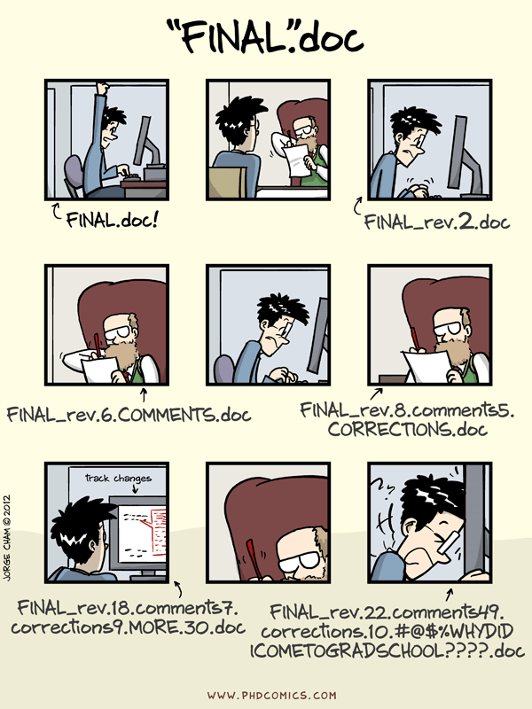

Slide 3
What is version control?
A way to keep a backup of changing files
History of the changes made to files
Enables people to easily collaborate on the same files

Slide 4
sorting_by_country.sh

Slide 5
sorting_by_country_20130606.sh
sorting_by_country.sh

Slide 6
sorting_by_country_20130606.sh
sorting_by_country.sh
sorting_by_country_20130606_A1.sh

Slide 7
sorting_by_country_20130606.sh
sorting_by_country.sh
sorting_by_country_20130606_A1-2.sh
sorting_by_country_20130606_A1.sh

Slide 8

Huh?
(Stan Behal Photo, Toronto Sun/QMI Agency)

Slide 9

Meanwhile , in version control
http://www.usageorge.com/

Slide 10
sorting_by_country.sh

Slide 11
sorting_by_country.sh
sorting_by_country.sh

Slide 12
sorting_by_country.sh
sorting_by_country.sh
sorting_by_country.sh

Slide 13
sorting_by_country.sh
sorting_by_country.sh
sorting_by_country.sh

Slide 14
sorting_by_country.sh
sorting_by_country.sh
sorting_by_country.sh

Slide 15
sorting_by_country.sh
sorting_by_country.sh
sorting_by_country.sh

Slide 16
sorting_by_country.sh
sorting_by_country.sh

Slide 17
other reasons version control is good:
no overwrites
blame is evident
nothing is ever lost
freedom to experiment

Slide 18
Ok it’s not perfect….
Version control good at finding and tracking text files
…..but not as much for images, sound, word documents(pdfs, docs, tiffs, etc.).
it can still tell they are different and track the changes, but cannot display the differences

Slide 19

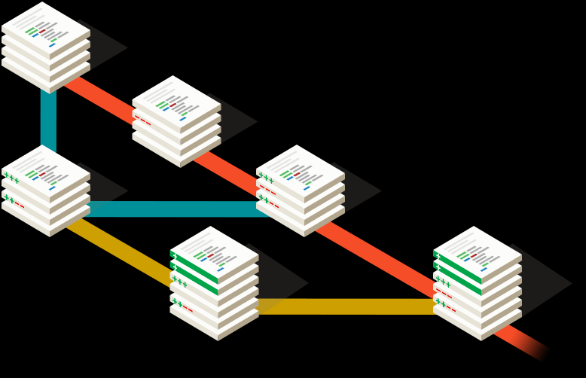
Today we’ll be using git.
One type of version control (there are many others: subversion, mercurial, bazaar, etc.).

Slide 20
What are we going to do with Version Control over the next 2 days?
using git locally (at the command line):
setting up a repository
making commits
differences between files
online repositories (yours and other people’s)
collaborating
github
pulling
pushing
conflicts

Slide 21
What are we going to do with Version Control over the next 2 days?
using git locally (at the command line):
setting up a repository
making commits
differences between files
using git with a remote:
online repositories (yours and other people’s)
collaborating
github
pulling
pushing
conflicts

Slide 23
Branching
Master branch
sorting_by_country.sh
sorting_by_country.sh

Slide 24
Branching
Master branch
sorting_by_country.sh
sorting_by_country.sh
*Create new branch!
new branch
sorting_by_country.sh
sorting_by_country.sh

Slide 25
Branching
Master branch
sorting_by_country.sh
sorting_by_country.sh
sorting_by_country.sh
new branch
sorting_by_country.sh
sorting_by_country.sh

Slide 26
If you branch, eventually you should merge..
Master branch
sorting_by_country.sh
sorting_by_country.sh
sorting_by_country.sh
merge new branch into master branch
new branch
sorting_by_country.sh
sorting_by_country.sh

Slide 27
After the merge
Master branch
sorting_by_country.sh
sorting_by_country.sh
sorting_by_country.sh
new branch
sorting_by_country.sh

