Slide 1
Software Carpentry Workshop
July 17-18
Portland, OR

Slide 2
KBase-Plants Demo
Introduction to IRIS
File upload/download
Central Store
Networks
Expression
Introduction to Narrative
Expression

Slide 3
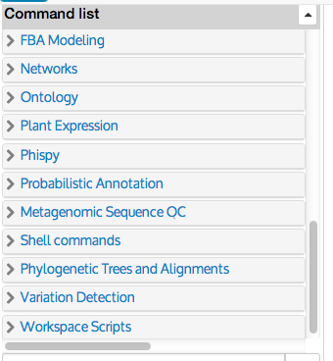
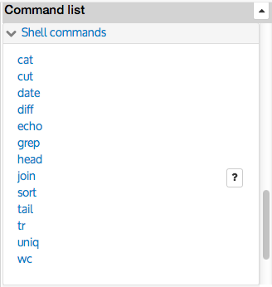
IRIS
http://iris.kbase.us
Shell commands
Hint: You can enlarge font size in the browser to see text better
Click on ‘Shell commands’ in side-bar

Slide 4
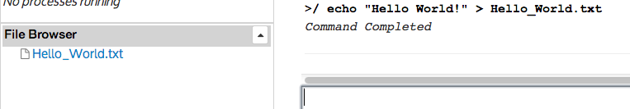
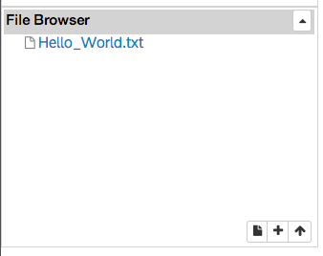
IRIS
http://iris.kbase.us
Redirection and File upload/download
> echo ‘Hello World!’ > Hello_World.txt
Controls allow files to be uploaded/downloaded/edited

Slide 5
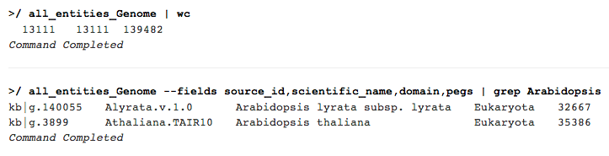
IRIS
http://iris.kbase.us
Central Store
all_entities_Genome –help
all_entities_Genome | wc
all_entities_Genome --fields source_id,scientific_name,domain,pegs| grep Arabidopsis

Slide 6
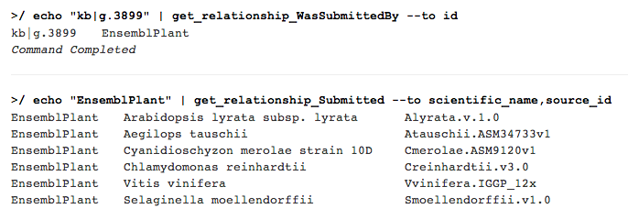
IRIS
http://iris.kbase.us
Relationships (Source)
Two sources of Plant Genomes: Phytozome and EnsemblPlant

Slide 7
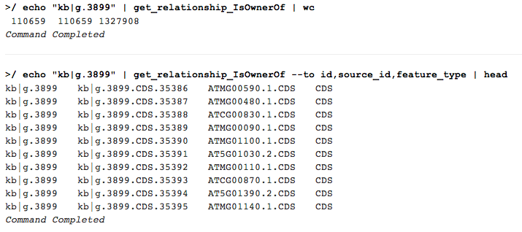
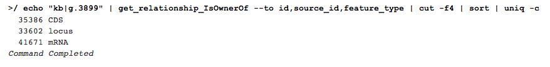
IRIS
http://iris.kbase.us
Relationships (Feature)
Three feature types: locus, mRNA, and CDS

Slide 8
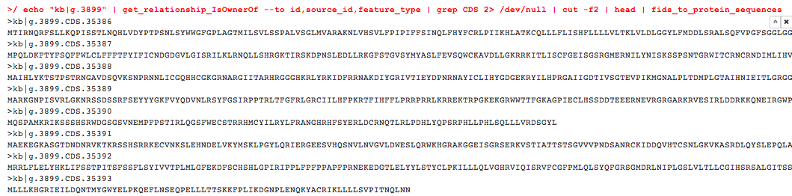
IRIS
http://iris.kbase.us
Sequences
fids_to_protein_sequences

Slide 9
IRIS
http://iris.kbase.us
Gene Ontology Service
fids_to_protein_sequences

Slide 10
IRIS
http://iris.kbase.us
Networks Service
fids_to_protein_sequences

Slide 11
IRIS
http://iris.kbase.us
Plant Expression Service
fids_to_protein_sequences

Slide 12
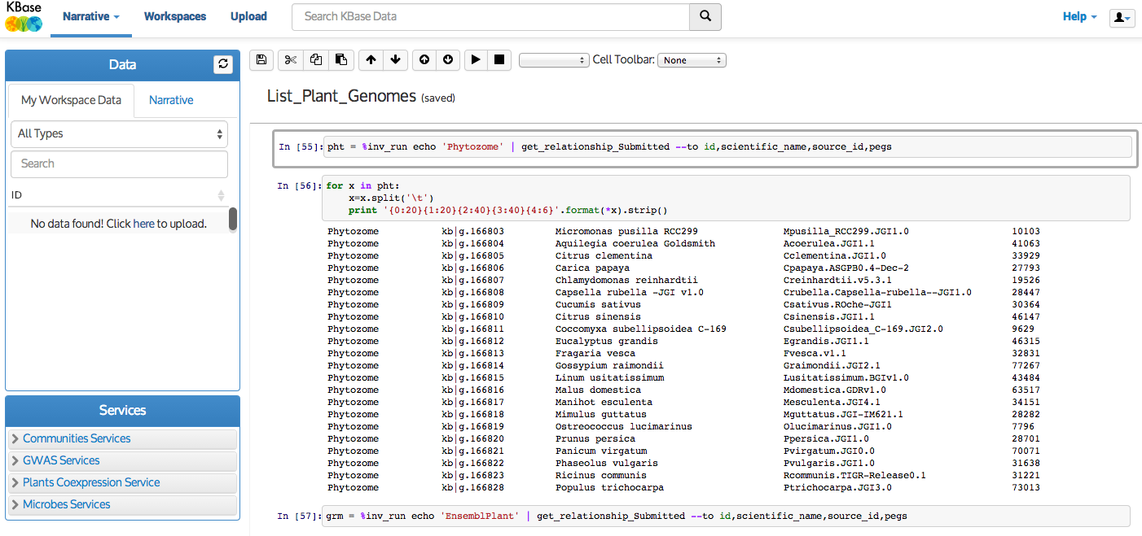
Narrative
http://demo.kbase.us

Slide 13
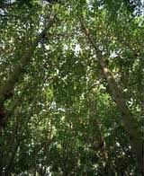
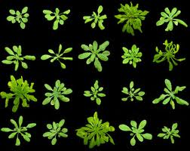
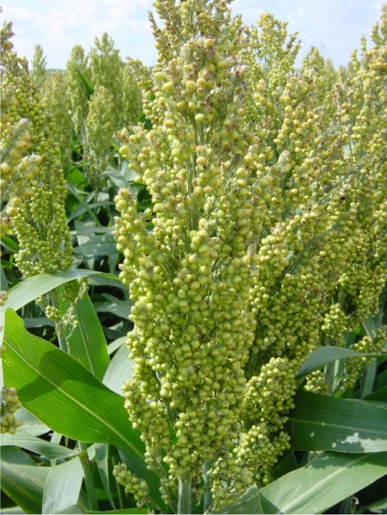
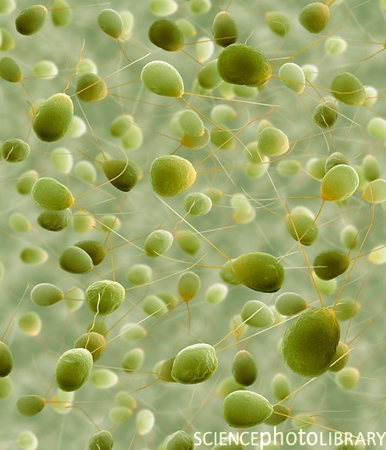
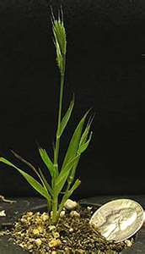
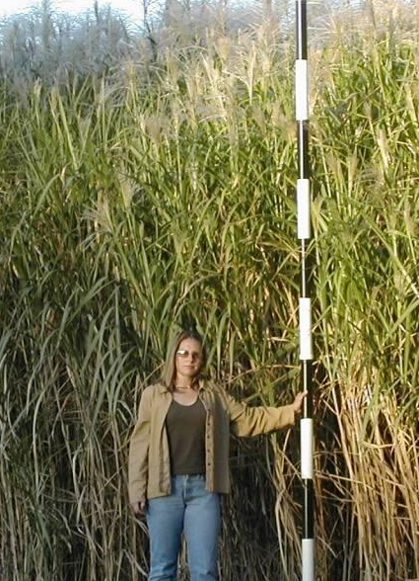
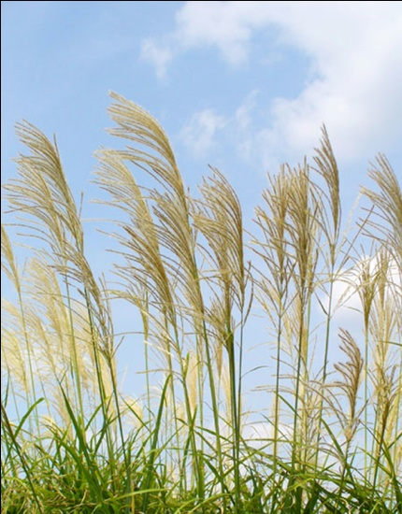
Narrative
Poplar
Arabidopsis
Sorghum
Chlamydomonas
Brachypodium
Miscanthus
Switchgrass

