Slide 1






PRACE boot camp
Edinburgh
Final words and feedback

Slide 2
Best practices for scientific computing
Write programs for people, not computers
Let the computer do the work
Make incremental changes
Don’t repeat yourself (or others)
Plan for mistakes
Optimize software only after it works correctly
Document design and purpose, not mechanics
Collaborate
Greg Wilson, D. A. Aruliah, C. Titus Brown, Neil P. Chue Hong, Matt Davis, Richard T. Guy, Steven H. D. Haddock, Katy Huff, Ian M. Mitchell, Mark Plumbley, Ben Waugh, Ethan P. White, Paul Wilson, Best Practices for Scientific Computing, 26/09/13, http://arxiv.org/abs/1210.0530
Notes:
Scientists spend an increasing amount of time building and using software. However, most scientists are never taught how to do this efficiently. As a result, many are unaware of tools and practices that would allow them to write more reliable and maintainable code with less effort. We describe a set of best practices for scientific software development that have solid foundations in research and experience, and that improve scientists' productivity and the reliability of their software.
1. Write programs for people, not computers
(a) A program should not require its readers to hold more than a handful of facts in memory at once
(b) Make names consistent, distinctive, and meaningful
(c) Make code style and formatting consistent
2. Let the computer do the work.
(a) Make the computer repeat tasks.
(b) Save recent commands in a ﬁle for re-use.
(c) Use a build tool to automate workﬂows.
3. Make incremental changes.
(a) Work in small steps with frequent feedback and course correction.
(b) Use a version control system.
(c) Put everything that has been created manually in version control.
4. Don’t repeat yourself (or others).
(a) Every piece of data must have a single authoritative representation in the system.
(b) Modularize code rather than copying and pasting.
(c) Re-use code instead of rewriting it.
5. Plan for mistakes.
(a) Add assertions to programs to check their operation.
(b) Use an oﬀ-the-shelf unit testing library.
(c) Turn bugs into test cases.
(d) Use a symbolic debugger.
6. Optimize software only after it works correctly.
(a) Use a proﬁler to identify bottlenecks.
(b) Write code in the highest-level language possible.
7. Document design and purpose, not mechanics.
(a) Document interfaces and reasons, not implementations.
(b) Refactor code in preference to explaining how it works.
(c) Embed the documentation for a piece of software in that software.
8. Collaborate.
(a) Use pre-merge code reviews.
(b) Use pair programming when bringing someone new up to speed and when tackling
particularly tricky problems.
(c) Use an issue tracking tool

Slide 3
Ten simple rules for reproducible computational research
For every result, keep track of how it was produced
Avoid manual data manipulation steps
Archive the exact versions of all external programs used
Version control all custom scripts
Record all intermediate results, when possible in standardized formats
For analyses that include randomness, note underlying random seeds
Always store raw data behind plots
Generate hierarchical analysis output, allowing layers of increasing detail to be inspected
Connect textual statements to underlying results
Provide public access to scripts, runs, and results
Geir Kjetil Sandve, Anton Nekrutenko, James Taylor, Eivind Hovig. Ten Simple Rules for Reproducible Computational Research. PLOS Computational Biology, 24/10/13, http://dx.doi.org/10.1371/journal.pcbi.1003285

Slide 4
Overheard at a conference
“Sometimes efficiency is more important than correctness”

Slide 5
Three rules of optimisation
Don't – optimised code is not readable or maintainable code
Don't....yet – designing code is not the same as optimising code
Profile first – anything else is just a guess!
Cautions
“More computing sins are committed in the name of efficiency (without necessarily achieving it) than for any other single reason – Including blind stupidity” (W.A. Wulf)
"We should forget about small efficiencies, say about 97% of the time: Premature optimization is the root of all evil.“ (Don Knuth quoting C.A.R Hoare)
Notes:
Don't - negative effect on readability and maintainability, hardware is cheap, developer time is expensive
Don't ... yet - designing =/= optimizing. Don't optimize until the design is correct!
Profile first - an educated guess is still a guess
http://c2.com/cgi/wiki?RulesOfOptimization
http://blogs.msdn.com/b/audiofool/archive/2007/06/14/the-rules-of-code-optimization.aspx?Redirected=true
"More computing sins are committed in the name of efficiency (without necessarily achieving it) than for any other single reason - including blind stupidity." – W.A. Wulf
"We should forget about small efficiencies, say about 97% of the time: premature optimization is the root of all evil.“ – Don Knuth after C.A.R Hoare.

Slide 6
Have your say…
Iterative development does not just apply to software!
What were the good and bad points about this boot camp?

Slide 7
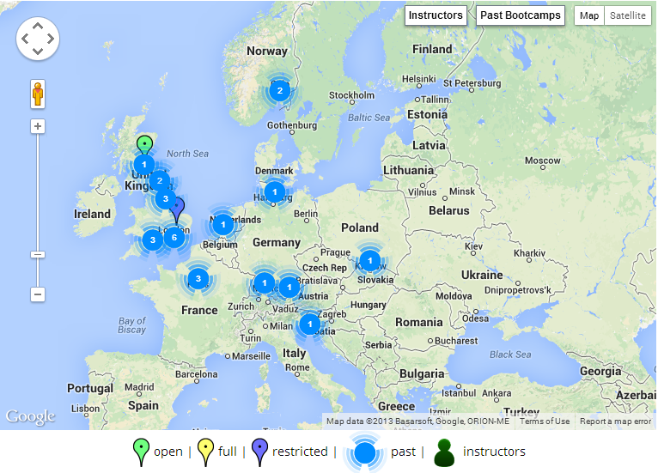



Want to get involved?
Grab us during a break!
admin-uk@software-carpentry.org
http://software-carpentry.org/bootcamps

