Slide 1
Software Carpentry Workshop
July 17-18
Portland, OR

Slide 2
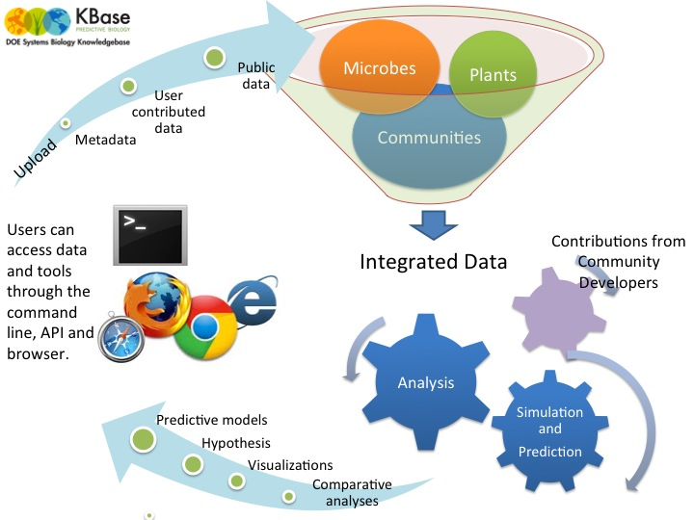
A KBase Primer
KBase is a software and data environment for predictive systems biology.
KBase will serve as a catalyst for biological research, accelerating discovery for DOE missions and providing insights and benefits that can ultimately serve numerous application areas.
How can KBase impact your research?
Integrates diverse data, enabling science and comparisons that were never before possible.
Connects data with a diverse set of powerful computational tools, to enable prediction of biological behavior, to test and generate hypotheses, and to propose new experiments.
Improves the knowledge of gene function and protein behavior in microbes, plants, communities
Permits incorporation of your own data and tools in an open-source, open-architecture framework with access to DOE computing and network
Promotes research collaborations and cooperation on a scale not previously possible.

Slide 3
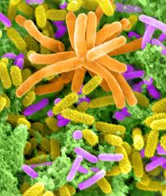
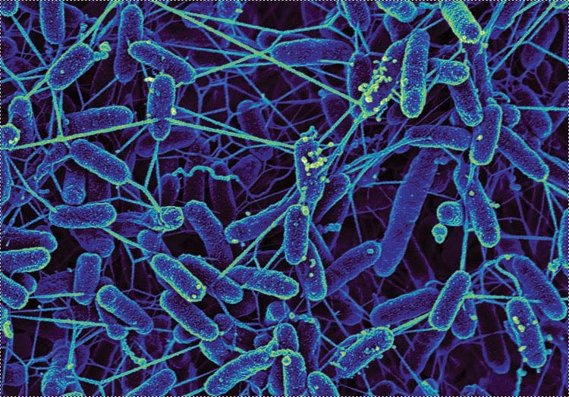

KBase Overview
Knowledgebase enabling predictive systems biology.
Powerful modeling framework.
Community-driven, extensible and scalable open-source software and application system.
Infrastructure for integration and reconciliation of algorithms and data sources.
Framework for standardization, search, and association of data.
Resource to enable experimental design and interpretation of results.
Microbes
Communities
Plants

Slide 4
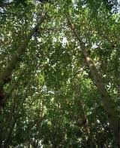
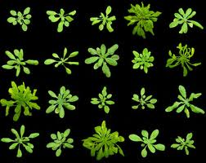
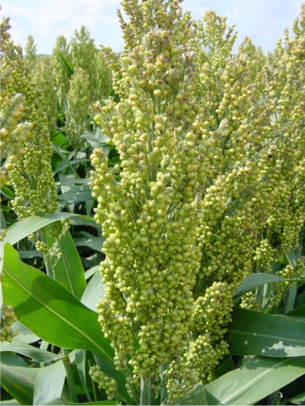
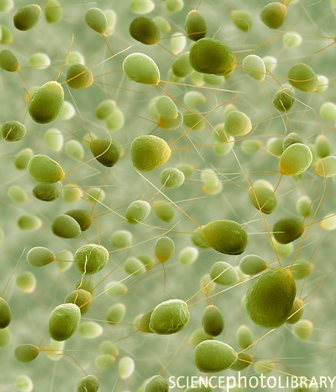
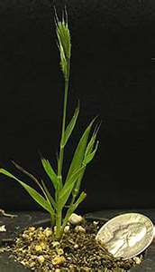
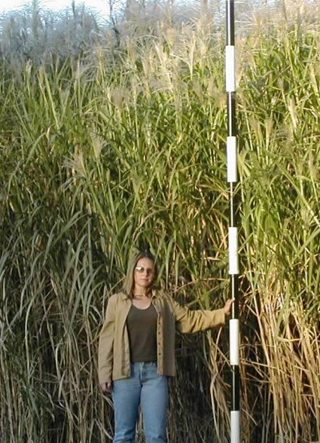
KBase-Plants: Targeted genomes
Poplar
Arabidopsis
Sorghum
Chlamydomonas
Brachypodium
Miscanthus
Switchgrass

Slide 5
KBase-Plants Services:
Providing Plant-specific data and methods:
Central Store
ID Server
Expression
Functional Ortholog Prediction
Interlog Projection
Annotation
FBA Modeling
Ontology
Networks

Slide 6
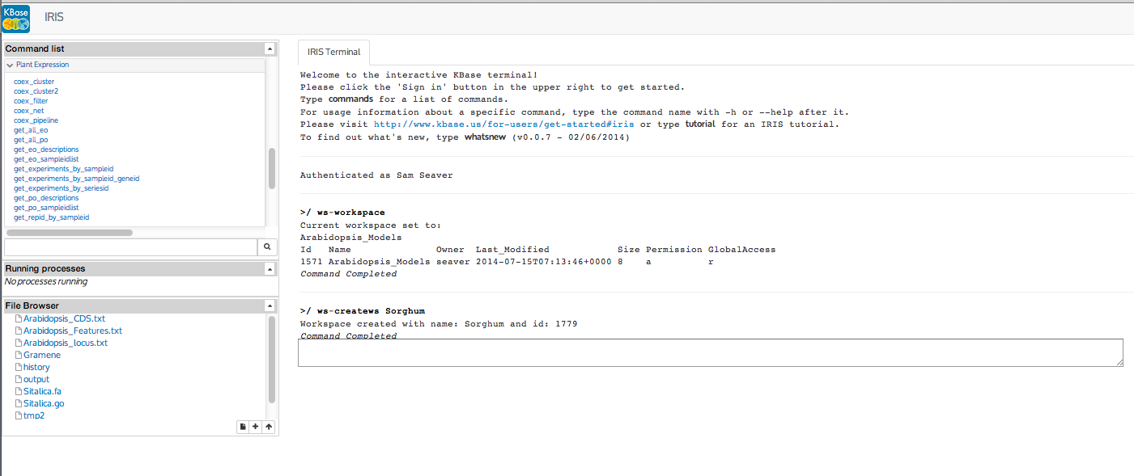
IRIS
http://iris.kbase.us

Slide 7
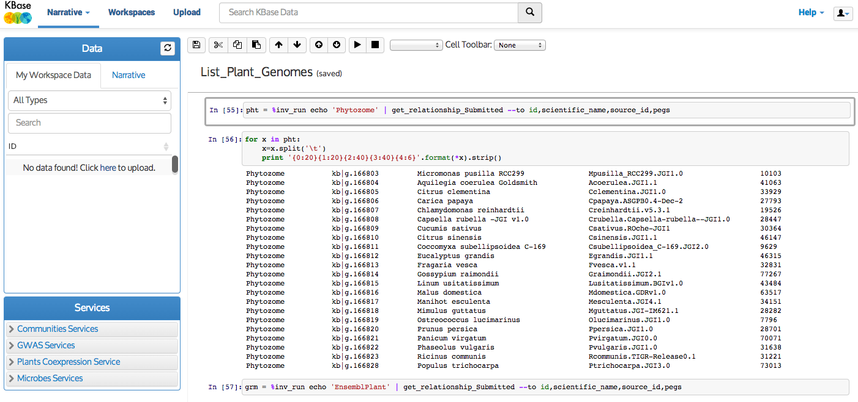
Narrative
http://demo.kbase.us

