Slide 1
a just culture
Learning curves to help implement

Slide 2
Understanding Principles
1. Fairness: Knowing that just culture is about being fair to everyone, not blaming people for honest mistakes, and understanding that sometimes errors happen despite good intentions.
2. Accountability: Learning that while individuals are held accountable for their actions, the focus is on improving systems and processes to prevent future mistakes, rather than punishing individuals.

Slide 3
Training Staff
1. Basic Workshops: Organize basic workshops to explain the idea of a just culture, focusing on fairness, learning from mistakes, and the importance of reporting issues without fear.
2. Regular Refreshers: Schedule regular refresher sessions to keep the concept fresh in everyone's mind and address any new questions or concerns that arise.

Slide 4
Policy Integration
1. Aligning Rules: Adjusting existing rules and guidelines to match just culture principles, ensuring fairness and accountability are embedded in every policy.
2. Clear Communication: Clearly explaining these new or updated policies to all employees so they understand how just culture affects their roles and responsibilities.

Slide 5
Behavioral Shift
1. Encouraging Openness: Teach employees that it's safe to report mistakes without fear of punishment. This helps everyone learn from errors.
2. Fostering Learning: Create an environment where mistakes are seen as opportunities to improve and grow, not just failures.

Slide 6
Leadership Role
1. Leading by Example: Leaders need to show just culture values in their actions, treating everyone fairly and owning up to their mistakes.
2. Encouraging Open Dialogue: Leaders should create a safe space for employees to speak up without fear of punishment, promoting honesty and learning.

Slide 7
Continuous Improvement
1. Regular Reviews: Frequently assess and review how just culture practices are being applied and identify areas for improvement.
2. Feedback Loops: Encourage continuous feedback from employees to make necessary adjustments and enhancements to just culture policies.

Slide 8
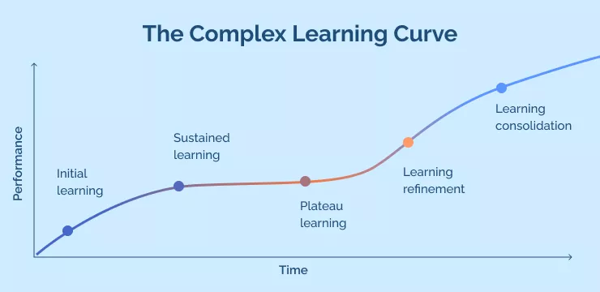
The complex learning curve is harder to learn and needs better tracking of employee performance because employees might have many ups and downs while learning.

Slide 9
Conclusion
At first, it might be hard to change how things are done when starting a just culture. But if you keep trying and don't give up, it gets easier over time, making it simpler to create a workplace where people feel safe to talk about mistakes and learn from them.

