Slide 1
Documentation, code standards and development
Ole-Petter Moe Hansen

Slide 2
Data science covers different activities
Research-like work
Explorative, might lead to a paper/report/powerpoint
Code needs to run once
Maybe someone will try to recreate results/tweak code in the future
Production-like work
Models deployed to a production system
Will keep on working after it is made
Very likely that the software will be changed in the future

Slide 3
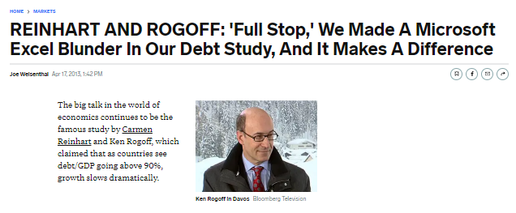
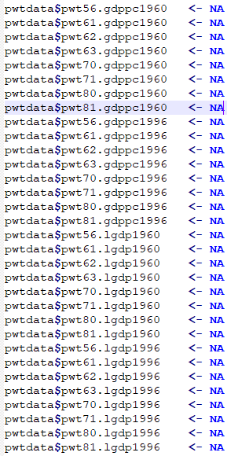
Hopes for our code: Research-like work
https://www.businessinsider.com/reinhart-and-rogoff-admit-excel-blunder-2013-4
Results should be correct,meaning that the code «does what you think it does»
Should be possible to recreate results later, and change code according to future needs (second priority?)

Slide 4
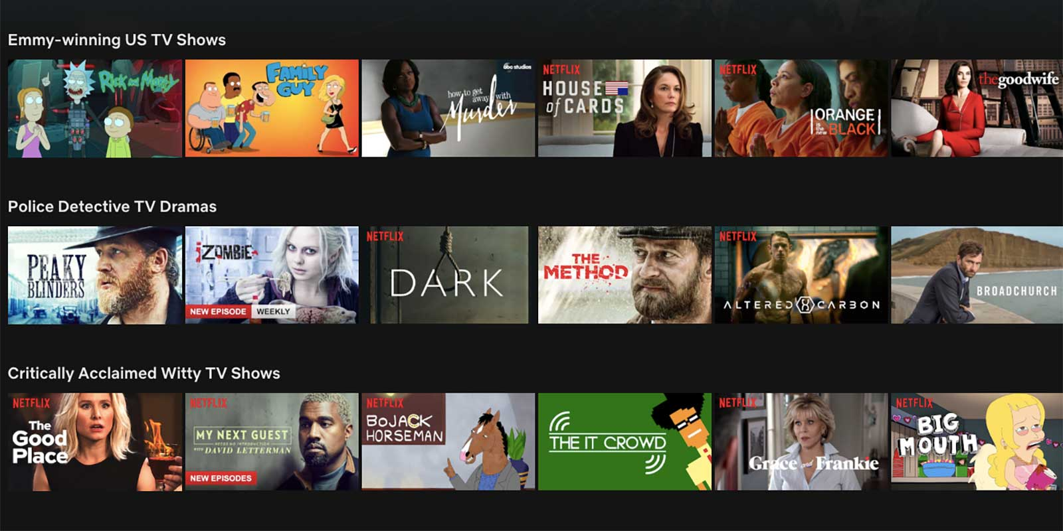
Hopes for our code: Production-like work
Code should produce correct results both now and later
Almost guaranteed that code needs to be changed
Not guaranteeded that the original developer will implement new changes
Therefore:
Software must be written such that it survives changes in developers
Need a governance system (ensuring that it keeps on working, assigned responsibilities, GDPR/legal etc..)
Must be able to change program with changed business needs and/or changed enviroment.

Slide 5
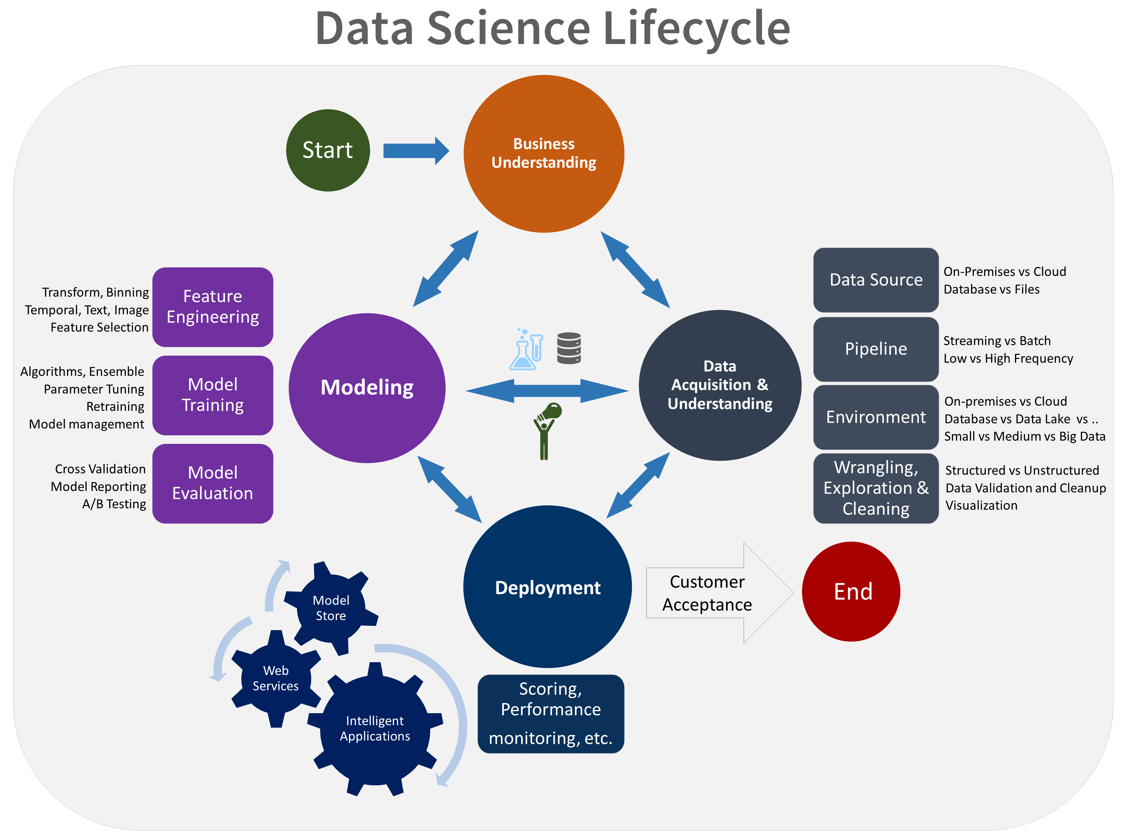
Stylized data science model development
A «serious» data science model deployment typically requires involvement from
Multiple technologies
Domain experts from different teams
NHH offers courses related to «business understanding» and «modeling», maybe fewer on data pipelines and deployment.
Microsoft Team Data Science Process

Slide 6
Software engineering practices
All code version-controlled (git)
Separate environments for development, testing and production
Team standards for code and code changes
Many tests (almost free to write, usually easy to compute, allows for catching errors before they break something else!)
Code is documented and written in such a way that the program can keep on delivering value, even when:
New developers take over responsibility
Features/fixes are added to the software
If software spans different domains, typically also involve cross-team collaboration with experts from different subject fields

Slide 7
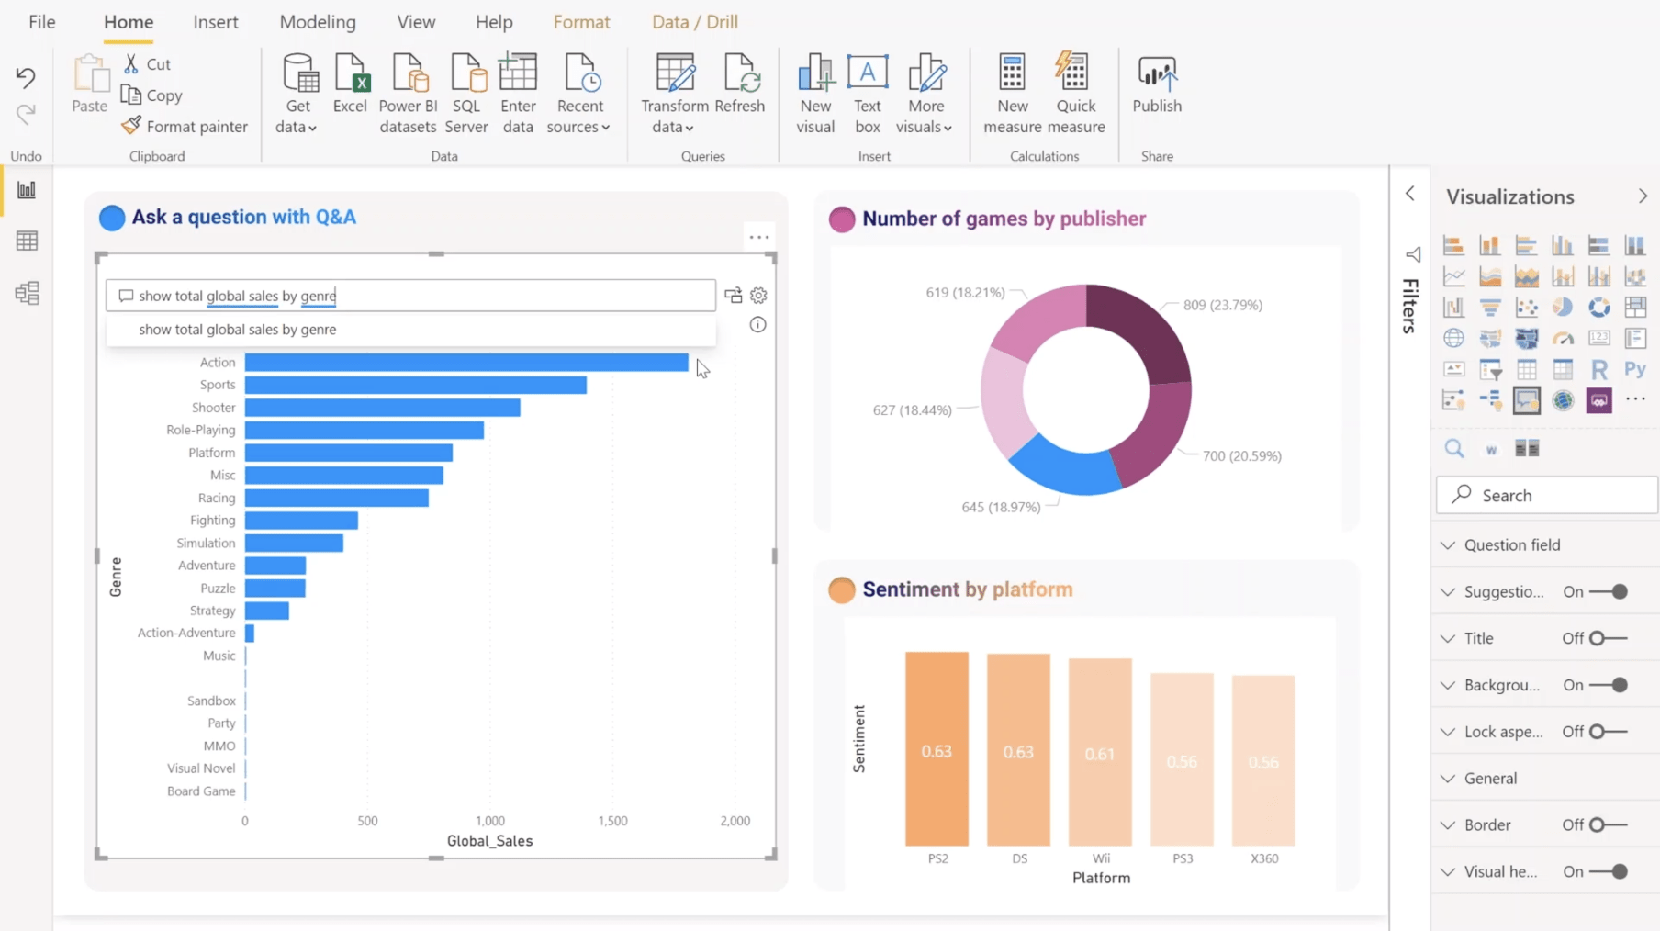
Real-world development
No sharp distinction between production like and research like work in business!
Automated Reports (e.g. powerBI) are deployed to production, will keep on producing results and being used in internal decision making. Typically relies on a lot of «data wrangling», maybe also modeling.
If you make something interesting – you’ll probably be asked to do it again
Scope creep - «can you please add <something> to your <report, model,data set>»

Slide 8
Analysis as software engineering
Statement 1:
Research like work face similar requirements on code quality/documentation/testing as production like work
Statement 2:
Software engineering practices are developed to support requirements of production-like work
Statement 1 and Statement 2 implies:
Research-like work should follow reasonable software engineering practices

Slide 9
Symptoms of «too little software engineering»
Inefficient code
Using tools for tasks they are not designed to handle
Only one key contributor knows how the software works
New developers struggle with taking over responsibility tasks
New functionality is added as «appendix» instead of refactoring code, causing codebase to drift towards an incomprehensible spaghetti.
Fortunately it is possible to write programs that no one else could possibly maintain. Programs can be written that produce results that cannot be predicted from either a quick or even fairly careful inspection of the code. Once you know these techniques and have learned to properly apply them, your job will be secure for as long as your programs are in use
https://support.sas.com/resources/papers/proceedings/proceedings/sugi23/Training/p275.pdf

Slide 10
Writing code according to team standards
There may be a lot of freedom in terms of writing code with similar functionality. Usually there are multiple best practices.
Following the code style standards generally keeps your code more organized, makes it easier to spot bugs, and makes it easier to read.
The Tidyverse style guide is a great place to start. Please read through it!
You can install styler as an add-in to Rstudio, linting your code as you write.
lintr provides tests for a file or a project for adherence to a code standard, and prints out what should be fixed.
(In Tryg, we auto-format code on commits, using similar linter-tools for various languages. Further, tests of code in repository for adherence to standards. See e.g. GitHub Actions.)

Slide 11
Code documentation
Depends on the audience:
For users of a package/function:
What is the purpose of the function, arguments, what is returned. See ?mean for a good example.
See here for great packages for writing documentation of functions.
For developers:
Assume that readers know how to write R.
Do not assume readers know why you are writing things. Write explicitly the purpose of your code.
Comments particularly for «tricks» that are not entirely obvious.
It is hard to know what you should document. Peer review is the best way to adjust the level of documentation.
Remember that structure, style and naming can reduce the need for comments.

Slide 12
Git, project admin, and merge requests
See example from purrr:
Issue created, describing the task to be completed
Branch and pull request created, with 14 commits.
Pull request triggers automatic checks of code
Finally merged
Takeaways:
Issues/milestones/epics work great for organizing the work to be done.
Projects requires some ground rules – e.g. that «main» branch should always be working.
Branches are created for solving specific issues. Keeping issues small and commits organized helps a reviewer understand what is being changed.
Automated checks makes everything easier.
Consider using reviews (example here), for improving code quality, spreading knowledge.

