Slide 1
OWASP Top 10

Slide 2
> whoami
Ecosystem Security Engineer at Atlassian
~4 years in industry
Focus on Application Security
OWASP Melbourne Chapter Co-Lead
@hotpheex

Slide 3
Agenda
1
4
2
5
3
6
Importance of Web Application Security
Avoiding Vulnerabilities
OWASP Top 10
How to Up Your Game
XSS Demo
Questions

Slide 4
Importance of Web Application Security

Slide 5
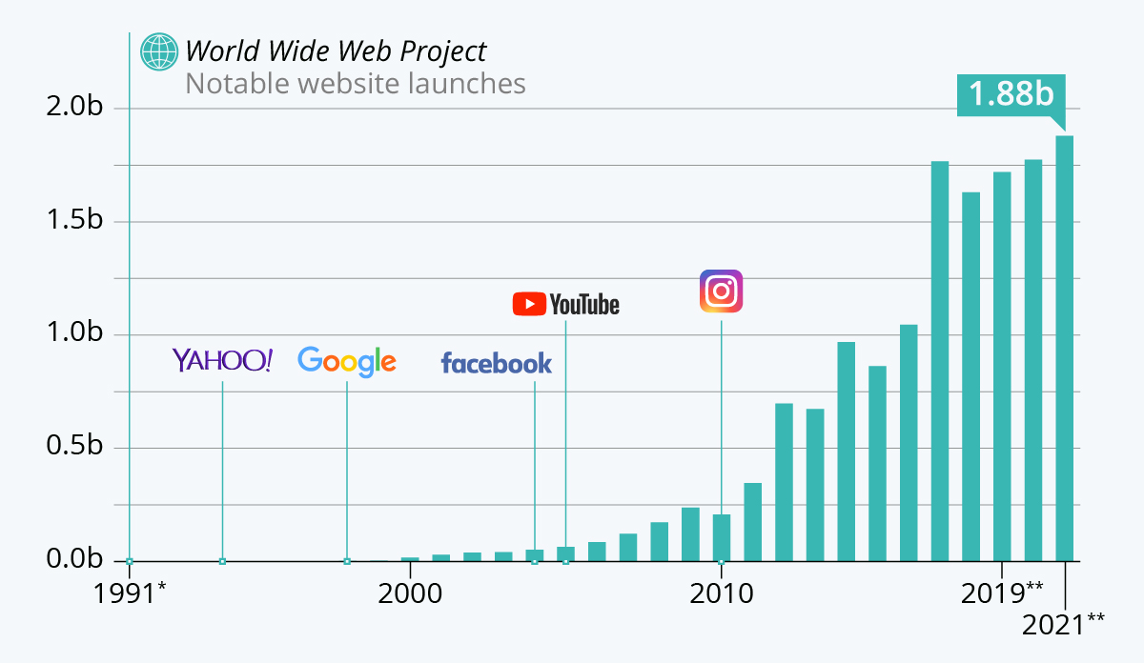
Prevalence of Web Applications
Reliance on web applications have never been higher
Growing rapidly every year
Web Applications:
Public facing websites
Service to service APIs
Mobile Apps
Desktop Applications (Electron)
Web consoles for appliances
Infrastructure managed by cloud hosting (AWS)

Slide 6
(In)security of Web Applications
Security is often an afterthought if prioritised at all
Often once something is shipped it is not well maintained/updated
Applications that are publicly available to the internet are always at risk
Discouraging Statistics:
93% of top 1M sites under protected against XSS (2017, Mozilla)
90% of web applications have known security vulnerabilities (2018, Rapid7)
54% of all web application security vulnerabilities have a public exploit available to hackers. (2018, Imperva)
43% of data breaches could be attributed to web vulnerabilities (2020, Verizon)

Slide 7
OWASP Top 10
2021 Revision

Slide 8

Introduction
Nonprofit foundation
Aims to improve security of software
OWASP Top 10:
Latest version was very recently published
Represents the 10 most critical security risks to web applications
Open source, collaborative project
Data-driven & experience-driven, regularly updated
Very broad categories containing many bug classes and attack techniques

Slide 9
A01 - Broken Access Control
Failing to only allow users to act within their intended permissions
Examples:
Not following “least privilege” when granting User permissions
Bypassing access control checking
(IDOR) Ability to view/edit someone else’s account by knowing its unique identifier

Slide 10
A02 - Cryptographic Failures
Failing to adequately protect sensitive data or secrets from exposure
Examples:
Encryption is not enforced on traffic (HTTP, SMTP, FTP)
Sensitive data like credit cards and passwords are stored insecurely
Crypto keys are weak, re-used or not rotated

Slide 11
A03 - Injection
Injecting unexpected behaviour into interactions with an application. Often when user-supplied data is not properly validated, filtered, or sanitized by the application
Examples:
(XSS) Attacker causes victims browser to execute malicious code when visiting a vulnerable website
(SQLi) Modifying a preset database query by hiding a malicious query in user input
Weakness that lets an attacker run commands on the underlying operating system of a web server

Slide 12
A04 - Insecure Design
Designing a system that has inherent security weaknesses
Examples:
McDonalds self-service kiosks allow customers to order a cheeseburger for free if they order 10 burgers without patties
A popular e-commerce website has no protection against bots, which outbid real users and hurt the reputation of the business
Website allows users to request password resets without confirmation from the registered email address

Slide 13
A05 - Security Misconfiguration
Broadly describes many good best practice configurations to harden web applications from attack
Examples:
Sensitive data is stored in an AWS bucket with publicly accessible permissions
Security settings on servers and applications are not set to secure values
Software is out of date and has known security vulnerabilities

Slide 14
A06 - Vulnerable and Outdated Components
Vulnerabilities exist in third party code you import into your applications, which often come with their own tree of sub-dependencies.
Examples:
Developer does not perform scans for vulnerabilities in their dependencies
Software with vulnerable dependencies are not updated to remediate issues
Fully patched web server uses an added framework that has critical bugs in it

Slide 15
A07 - Identification and Authentication Failures
Weaknesses that make it possible for an attacker to authenticate with another user’s identity
Examples:
Application allows default, weak, or well-known passwords eg. “Password1!”
Does not have multi-factor authentication
When a user logs out, their sessions or authentication tokens are not correctly invalidated

Slide 16
A08 - Software and Data Integrity Failures
Applications or Systems do not securely validate that code has not been tampered with before downloading or running.
Examples:
Device does not verify that a software/firmware update is cryptographically signed before installing
Attackers breach a software company and add malicious backdoors to genuine updates. Thousands of businesses are seriously compromised when they update their software.
SolarWinds, Kaseya breaches

Slide 17
A09 - Security Logging and Monitoring Failures
Failure to collect the data required to detect, escalate and respond to security breaches.
Examples:
Unable to detect suspicious or malicious login attempts
An active security breach is discovered, but there are no historical logs to investigate how the attackers got in
User transaction logs are kept, but their credit card numbers are logged in plaintext

Slide 18
A10 - Server Side Request Forgery
A vulnerability that allows an attacker to trick a web server into making HTTP requests. Occurs when a web app fetches remote resources without validating the address.
Examples:
Server is instructed to make requests to every local IP address to perform a scan of it’s internal network
Read sensitive information by instructing a cloud server instance to make requests to it’s metadata service
Attacker compromises other internal services via a publicly exposed web server to pivot through the internal network

Slide 19
XSS Demo

Slide 20
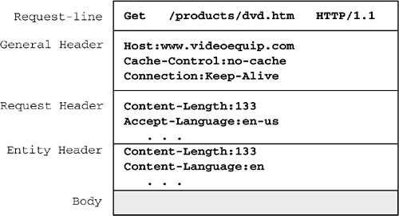
XSS Primer
Assumed Knowledge:
“Man in the middle” proxy (Burpsuite)
Aware of HTML and JavaScript
Basic understanding of HTTP
Cross Site Scripting (XSS):
Type of injection (A03) vulnerability that allows malicious Javascript to be injected into legitimate websites.
Most XSS vulnerabilities are classed as “Medium” risk
Still very common today

Slide 21
Le Demo

Slide 22
Avoiding Vulnerabilities

Slide 23
As an Individual
Even security experts make human mistakes
Treat everything online with healthy paranoia
Be careful which websites you give your data to
Use a different password on every website

Slide 24
As a Developer
Learn about security vulnerabilities for your area
If you know what they look like, you can avoid creating them
Makes you a more valuable, well-rounded developer
Regularly update software components, ideally automated
Learn to write repeatable tests for your code
Unit tests, integration tests, regression tests etc.

Slide 25
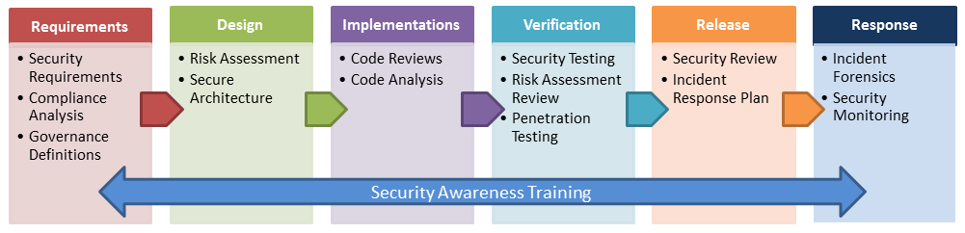
As an Organisation
Get buy-in from organisation for investment in security
Embed security practices in existing software development processes
Train developers to understand and recognise potential security issues
Secure Software Development Lifecycle

Slide 26
How to Up Your Game

Slide 27
Resources
[Free] Kontra OWASP Top 10 exercises
https://application.security
[Free] Portswigger web security training
[Free] Vulnerable Web Applications Directory
OWASP Juice Shop
[Paid] PentesterLab
[Book] Web Application Hacker’s Handbook
[Book] Web Security for Developers

Slide 28

Join the RISC Club
https://risc.melbourne/
LinkedIn: https://www.linkedin.com/company/rmit-information-security-collective
Discord: https://discord.gg/RuywUPahsG
Facebook: https://www.facebook.com/groups/RMITInfoSec/

Slide 29
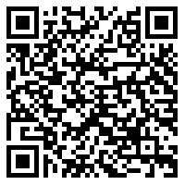
Thank You!

