Slide 1
A 0f910374 Management Journey

Slide 2

whoami
DevSecOps Engineer at Reece Group
OWASP Melbourne Chapter Co-lead
@hotpheex
Drop any questions in #chapter-au-melb

Slide 3
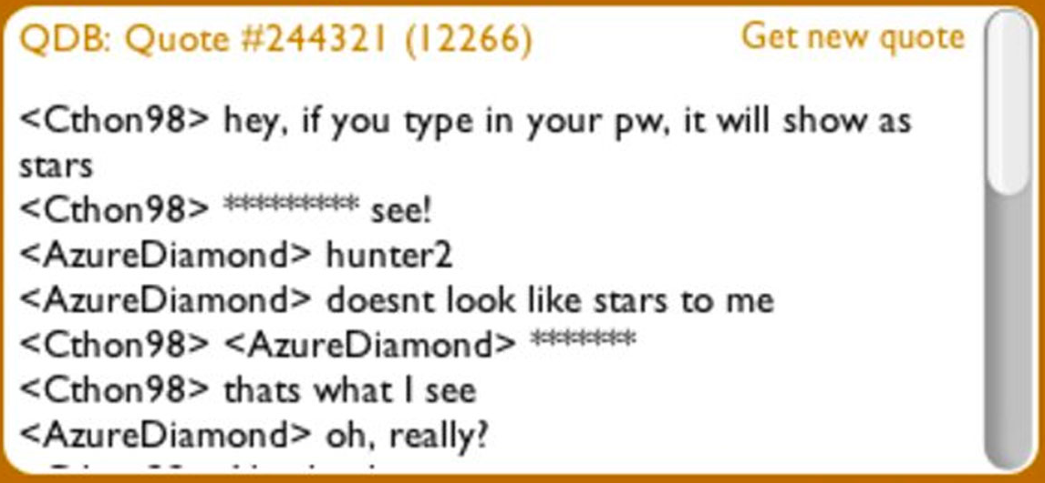
What’s a secret?
Password1!’s
API keys
Encryption keys
SSH private keys
Certificates
Webhooks?

Slide 4
Problems
No secure standard place to store secrets
No mechanism to automatically rotate secrets
Plaintext secrets everywhere
No great solution for k8s secrets
Need to support critical legacy database

Slide 5
Product Choice & Architecture

Slide 6

Hashicorp Vault
Cloud agnostic platform
Battle tested by big name enterprises
Terraform provider
API-first design (CLI, REST API, GUI, Mature SDKs)
Self-managed open-source option
Auditability
Out of the box integrations with most platforms
Highly available, very scalable

Slide 7

Architecture Choices
Git-ops wherever possible
3 standalone clusters (Dev, NonProd, Prod)
AWS KMS Auto-unseal
Self managed OSS deployment on AWS EC2 instances
CloudFormation & Ansible
Ephemeral EC2 instances replaced regularly

Slide 8
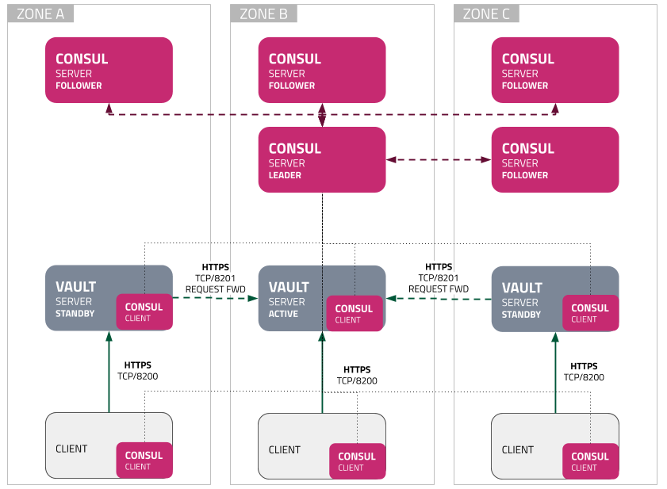
Reference Architecture

Slide 9
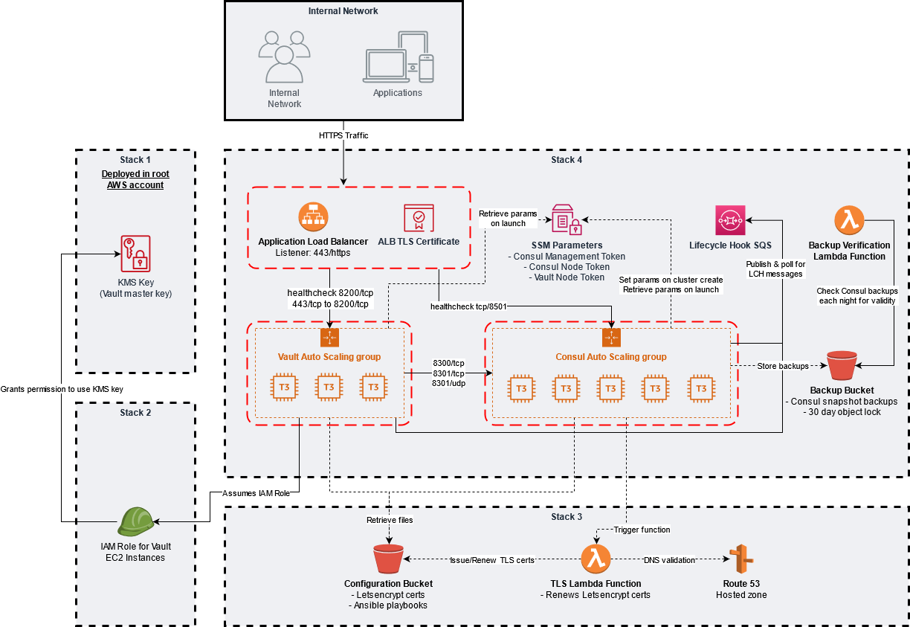

Slide 13
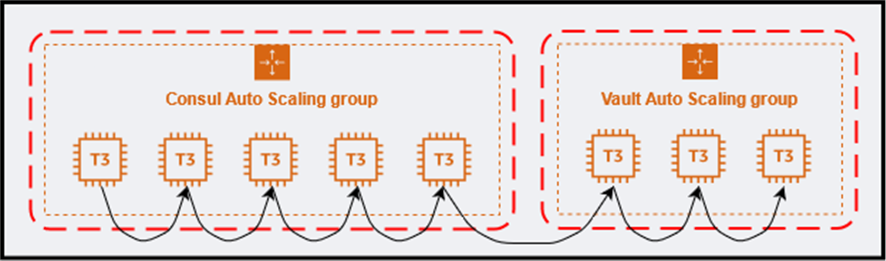
Rolling Replacement

Slide 14
How Vault works

Slide 15
Vault Concepts
Tokens & Policies
Policies define allowed permissions
1+ policies are attached to a token
Auth Backends
OIDC, K8s, AppRole
Secrets Backends
Key/Value, Transit, Database

Slide 16
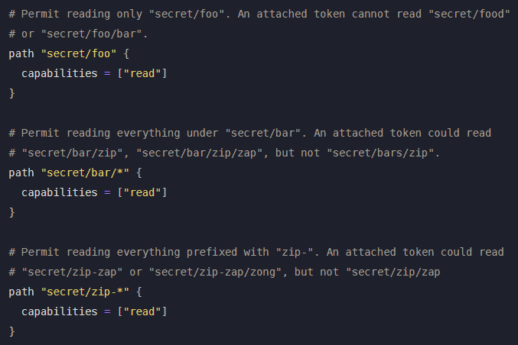
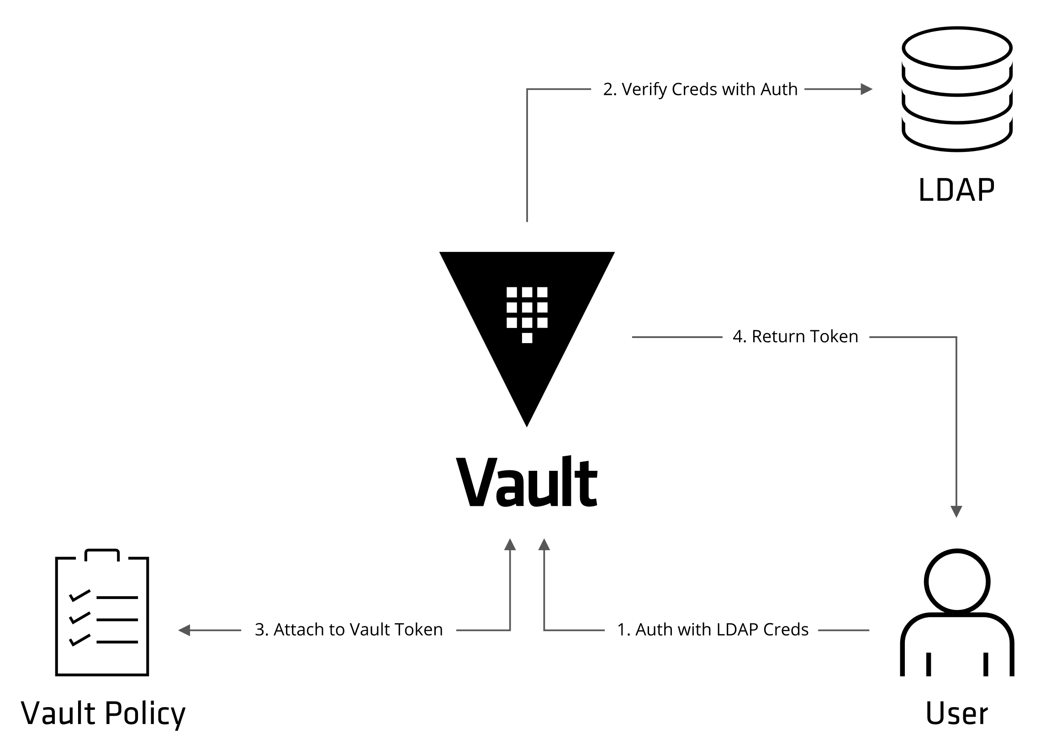
Tokens & Policies

Slide 17
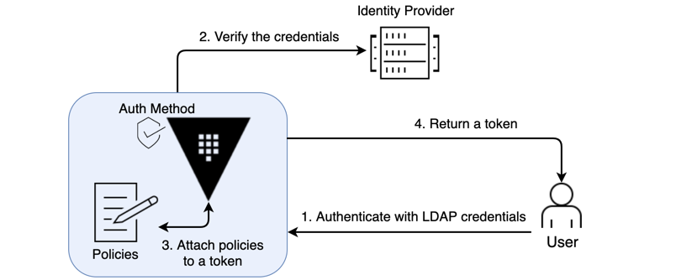
OIDC Auth Method

Slide 18
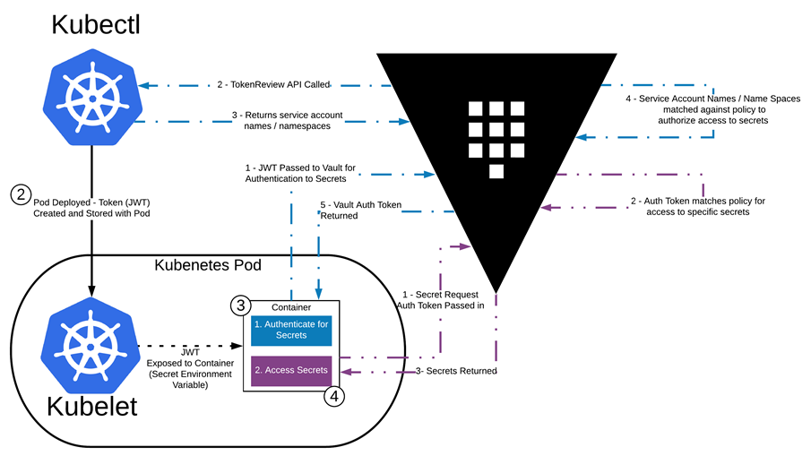
Kubernetes Auth Method

Slide 19
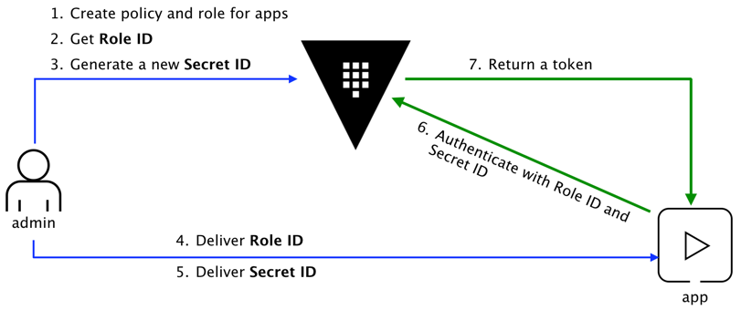
AppRole Auth Method
RoleID / SecretID == Username / Password
CIDR bound SecretIDs & Tokens

Slide 20
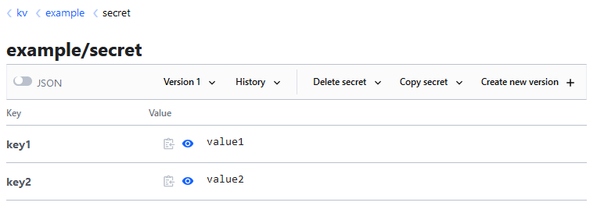
Key/Value Secrets Backend
Path: kv/example/secret

Slide 21
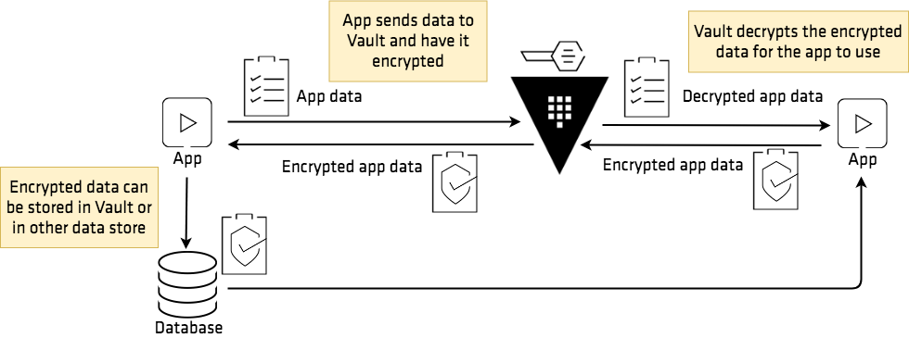
Transit Secrets Backend

Slide 22
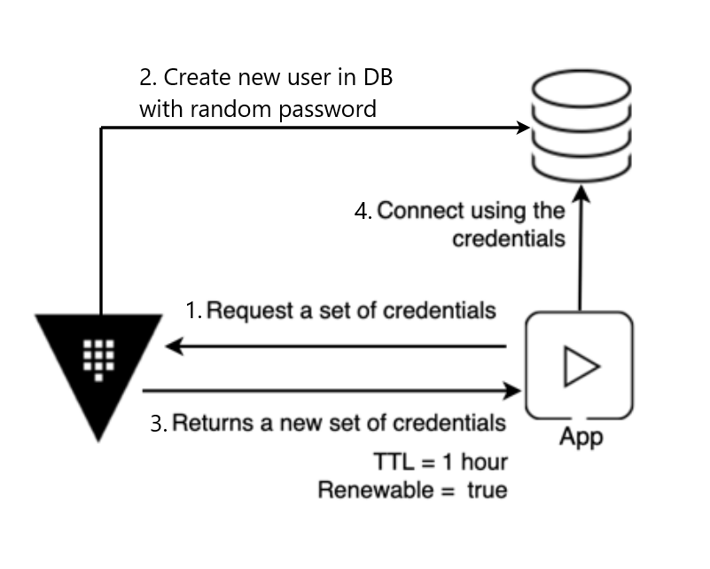
Database Secrets Backend
Dynamic Credentials

Slide 23
Configuration as Code

Slide 24
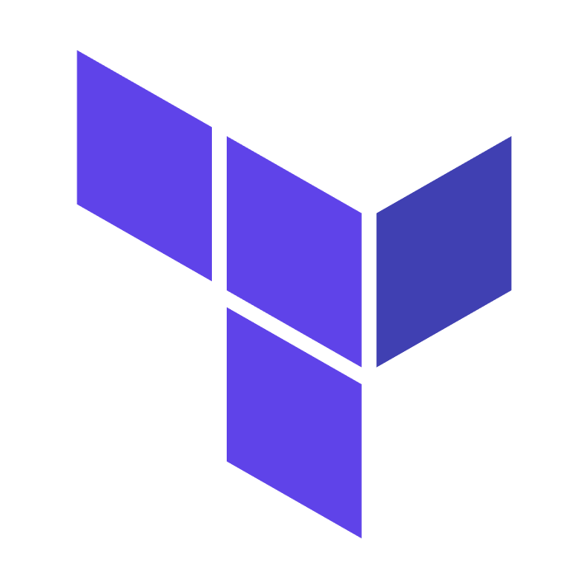
Terraform
Tool for managing infrastructure as code
Built & maintained by Hashicorp
Provider exists for almost all Vault resources
Allows templating, modules, loops, conditional statements …

Slide 25
Benefits of CaC
Automated testing for all changes
Full history of changes, easy rollback
Allows dev teams to self-manage config for their apps
Teams can request more/less permissions with a PR
Takes pressure off Vault admins
Reusable modules for resources configured to our best practice, for teams to easily consume

Slide 26
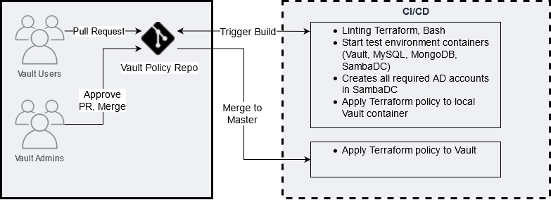
Terraform Change Process

Slide 27
Challenge: Legacy Database

Slide 28

Problems
Legacy database with no OOTB integrations
Passwords are hardcoded and extremely difficult to rotate
Ongoing long-term migration from Legacy to Modern servers
Usernames have a max length of 8 characters
Must be as easy to onboard applications as possible

Slide 29
Solution must support both
Legacy Servers
Modern servers
Old UNIX OS
DB uses OS auth for DB auth
To create a DB user, a user must be created on the OS
Current Linux OS
DB uses AD (LDAP) for auth
To create a DB user, an account must be created in Active Directory

Slide 30
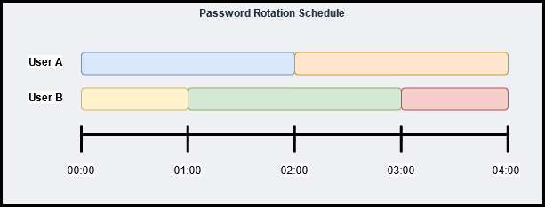
The Game Plan
Use KV store as generic storage for username and password
Hourly rotation with two alternating users
Use AD secrets engine to rotate AD account passwords
Copy new password from AD engine to UNIX server

Slide 31
YAML Manifest of Users
Source of truth for DB users that should exist
Defines which users belong to which applications
Consumed AD, Legacy DB servers to create necessary accounts
Imported by Terraform to automatically provision Vault config
---
example-application:
dbUserA: _abc000a
dbUserB: _abc000b
description: Vault User - Development example-application
example-service:
dbUserA: _abc001a
dbUserB: _abc001b
description: Vault User - Development example-service

Slide 32
Terraform Module
module "legacy_database_nonprod" {
source = "./modules/applications/legacy_db_app"
mappings = yamldecode(file("${path.module}/cloned-yaml-repo/nonprod.yaml"))
environment = "nonprod"
kubernetes_paths = [
vault_auth_backend.kubernetes_nonprod-internal.path,
vault_auth_backend.kubernetes_nonprod-dmz.path
]
ad_config = vault_generic_endpoint.ad_config
}

Slide 33
AD Service Accounts
locals {
accounts_nonprod = flatten([
for application, values in var.mappings : {
dbUserA = values.dbUserA
dbUserB = values.dbUserB
application = application
}
])
}
resource "vault_generic_endpoint" "ad_svc_account_a" {
for_each = {
for user in local.accounts_nonprod : "${user.application}.dbUserA" => user
}
depends_on = [var.ad_config]
path = "ad/roles/${each.value.dbUserA}"
data_json = jsonencode({
service_account_name = "${each.value.dbUserA}@domain.org"
ttl = "90m"
})
}

Slide 34
Kubernetes Auth Roles
resource "vault_policy" "policy" {
for_each = var.mappings
name = "app/legacy_db/${var.environment}/${each.key}"
policy = templatefile(
"${path.module}/../../../policies/templates/legacy_db_application.hcl",
{ environment = var.environment, application = each.key }
)
}
resource "vault_kubernetes_auth_backend_role" "kubernetes_role" {
for_each = {
for role in local.kubernetes_roles : "${role.application}.${role.kubernetes_path}" => role
}
role_name = "${var.environment}_${each.value.application}"
bound_service_account_names = [each.value.application]
backend = each.value.kubernetes_path
bound_service_account_namespaces = ["*"]
token_ttl = 7200
token_policies = compact([
"app/legacy_db/${var.environment}/${each.value.application}"
])
}
path "kv/data/legacy_db/${environment}/${application}" {
capabilities = ["read"]
}

Slide 35
Rotation script (hourly schedule)
Authenticate to Vault with AppRole
Pull down latest YAML manifest & create/delete users
Request new password for oldest user in each pair
Set local user password
Update KV store with username & password

Slide 36
Application Logic
Authenticate to Vault with K8s auth method
Retrieve username & password from KV store
Connect to Database
Query Vault for new username & password every ~30mins
Override DB config with creds (JDBC, Hikari)
If DB connection fails, reach out to Vault for creds

Slide 37
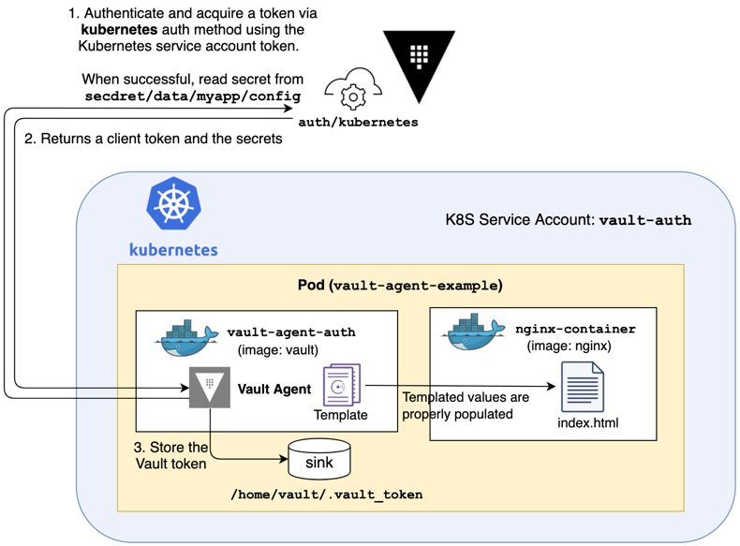
K8s sidecar
sdk
Less code change but still unavoidable
Requires extra containers
Requires more code changes
Doesn’t require extra Vault containers in each pod

Slide 38
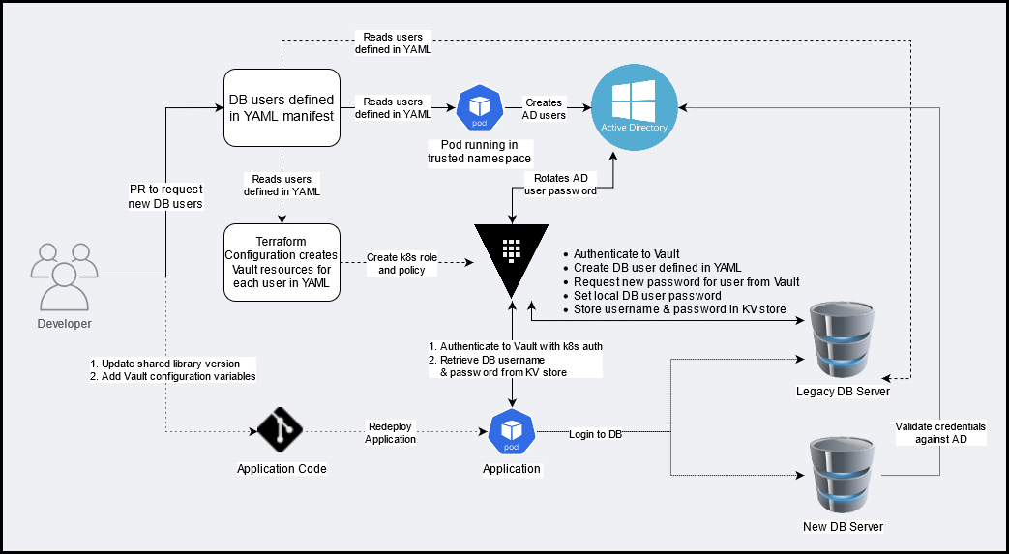

Slide 39
Legacy DB Endstate
DB passwords are no longer stored insecurely
DB passwords only live for 2 hours
Teams can onboard an application in ~2-3 hours with minimal code changes
DBA’s have a source of truth they can use to look up any DB username
Apps will behave the same whether using Legacy or Modern DB servers

Slide 40
Heads Up
Use “Integrated Storage” > Consul
K8s service accounts can be difficult
Very high-risk system
For small cloud-first use cases, using cloud native secrets management & IAM will probably be easier
Would use SaaS if it was available

Slide 41
Thanks for listening!
Questions?

