Slide 1
Secrets Management using HashiCorp’s Vault

Slide 2

whoami
Security Engineer at Atlassian
@hotpheex

Slide 3
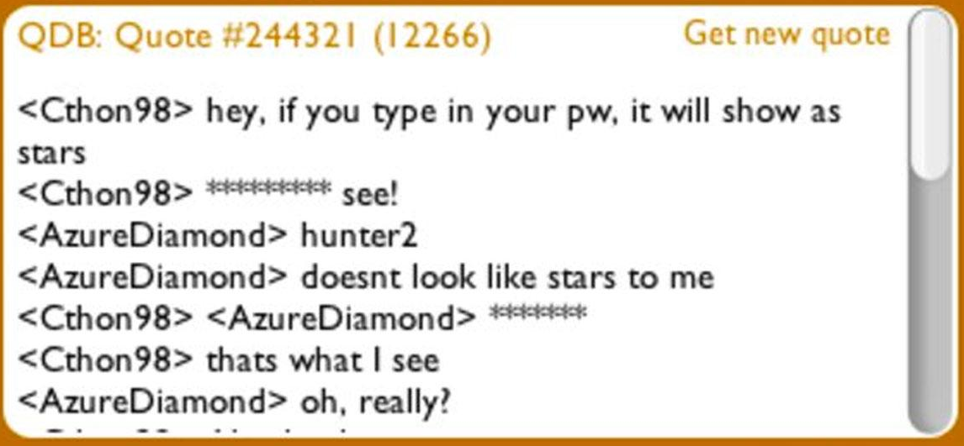
What’s a secret?
Password1!’s
API keys
Encryption keys
SSH private keys
Certificates
Webhooks?

Slide 4
Problems
No secure standard place to store secrets
No mechanism to automatically rotate secrets
Plaintext secrets everywhere
No great solution for k8s secrets
Need to support critical legacy database

Slide 5
Product Choice & Architecture

Slide 6
Market Evaluation
Requirements:
Automated secret retrieval for microservices
Good integrations with Kubernetes, all cloud platforms
Thorough API to allow automation
Automatic secret rotation
High availability
Disaster Recovery
No/low upfront cost commitment
Our Legacy Databases

Slide 7

Hashicorp Vault
Cloud agnostic platform
Battle tested by big name enterprises
Terraform provider
API-first design (CLI, REST API, GUI, Mature SDKs)
Self-managed open-source option
Zero licensing costs to this day
Auditability
Out of the box integrations with most platforms
Highly available deployment options

Slide 8

Architecture Choices
Git-ops wherever possible
3 standalone clusters (Dev, NonProd, Prod)
AWS KMS Auto-unseal
Self managed OSS deployment on AWS EC2 instances
CloudFormation & Ansible
Ephemeral EC2 instances replaced regularly

Slide 9
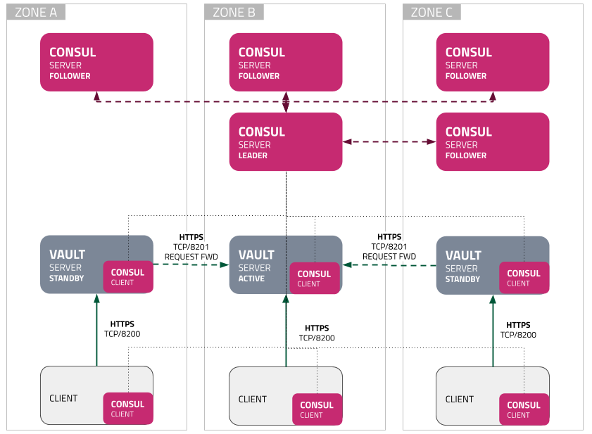
Reference Architecture

Slide 10
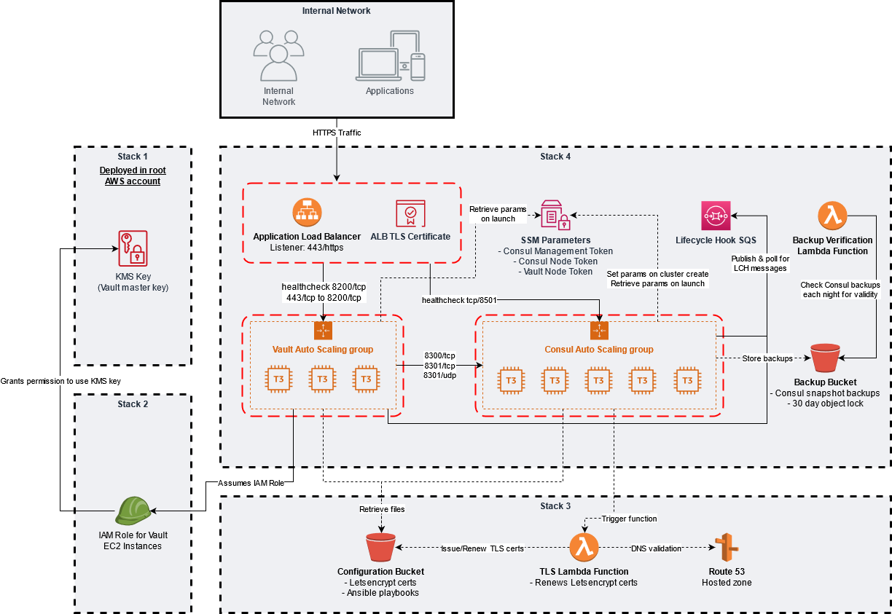

Slide 14
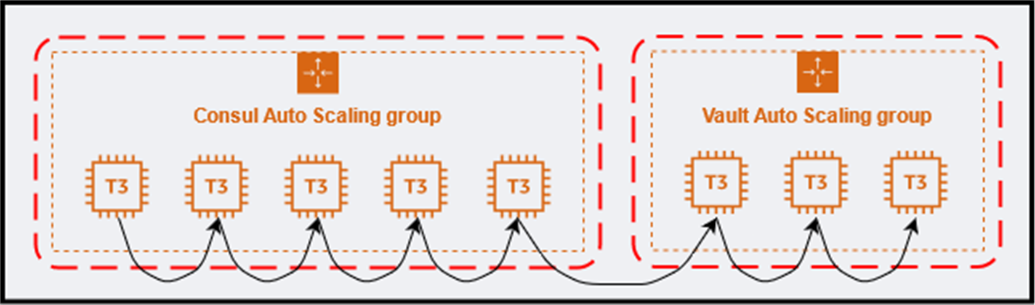
Rolling Replacement

Slide 15
Disaster Recovery
Hourly job on Master Consul node performs snapshot
Written to S3 bucket with 30 day object lock
90 day transition to Glacier storage
CFN/Ansible support automated backup restore
Run a manual cloudformation deployment providing extra parameters (RecoverConsulFrom=<path_to_backup_in_S3>)
Autoscaling does a WillReplace deployment to rebuild all nodes
Once Consul nodes elect a leader, downloads the backup from S3, applies snapshot to the cluster

Slide 16
How Vault works

Slide 17
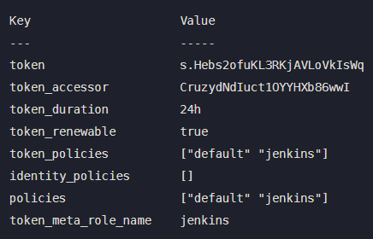
Vault Concepts
Auth Methods:
OIDC
K8s
AppRole
Vault Token
Policies
Secrets Engines:
KV (Key/Value)
Database (MySQL/PostgreSQL)
Transit (Encryption as a service)

Slide 18
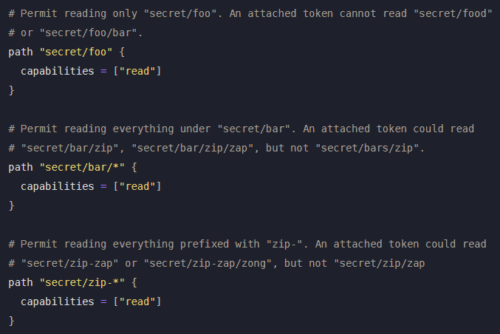
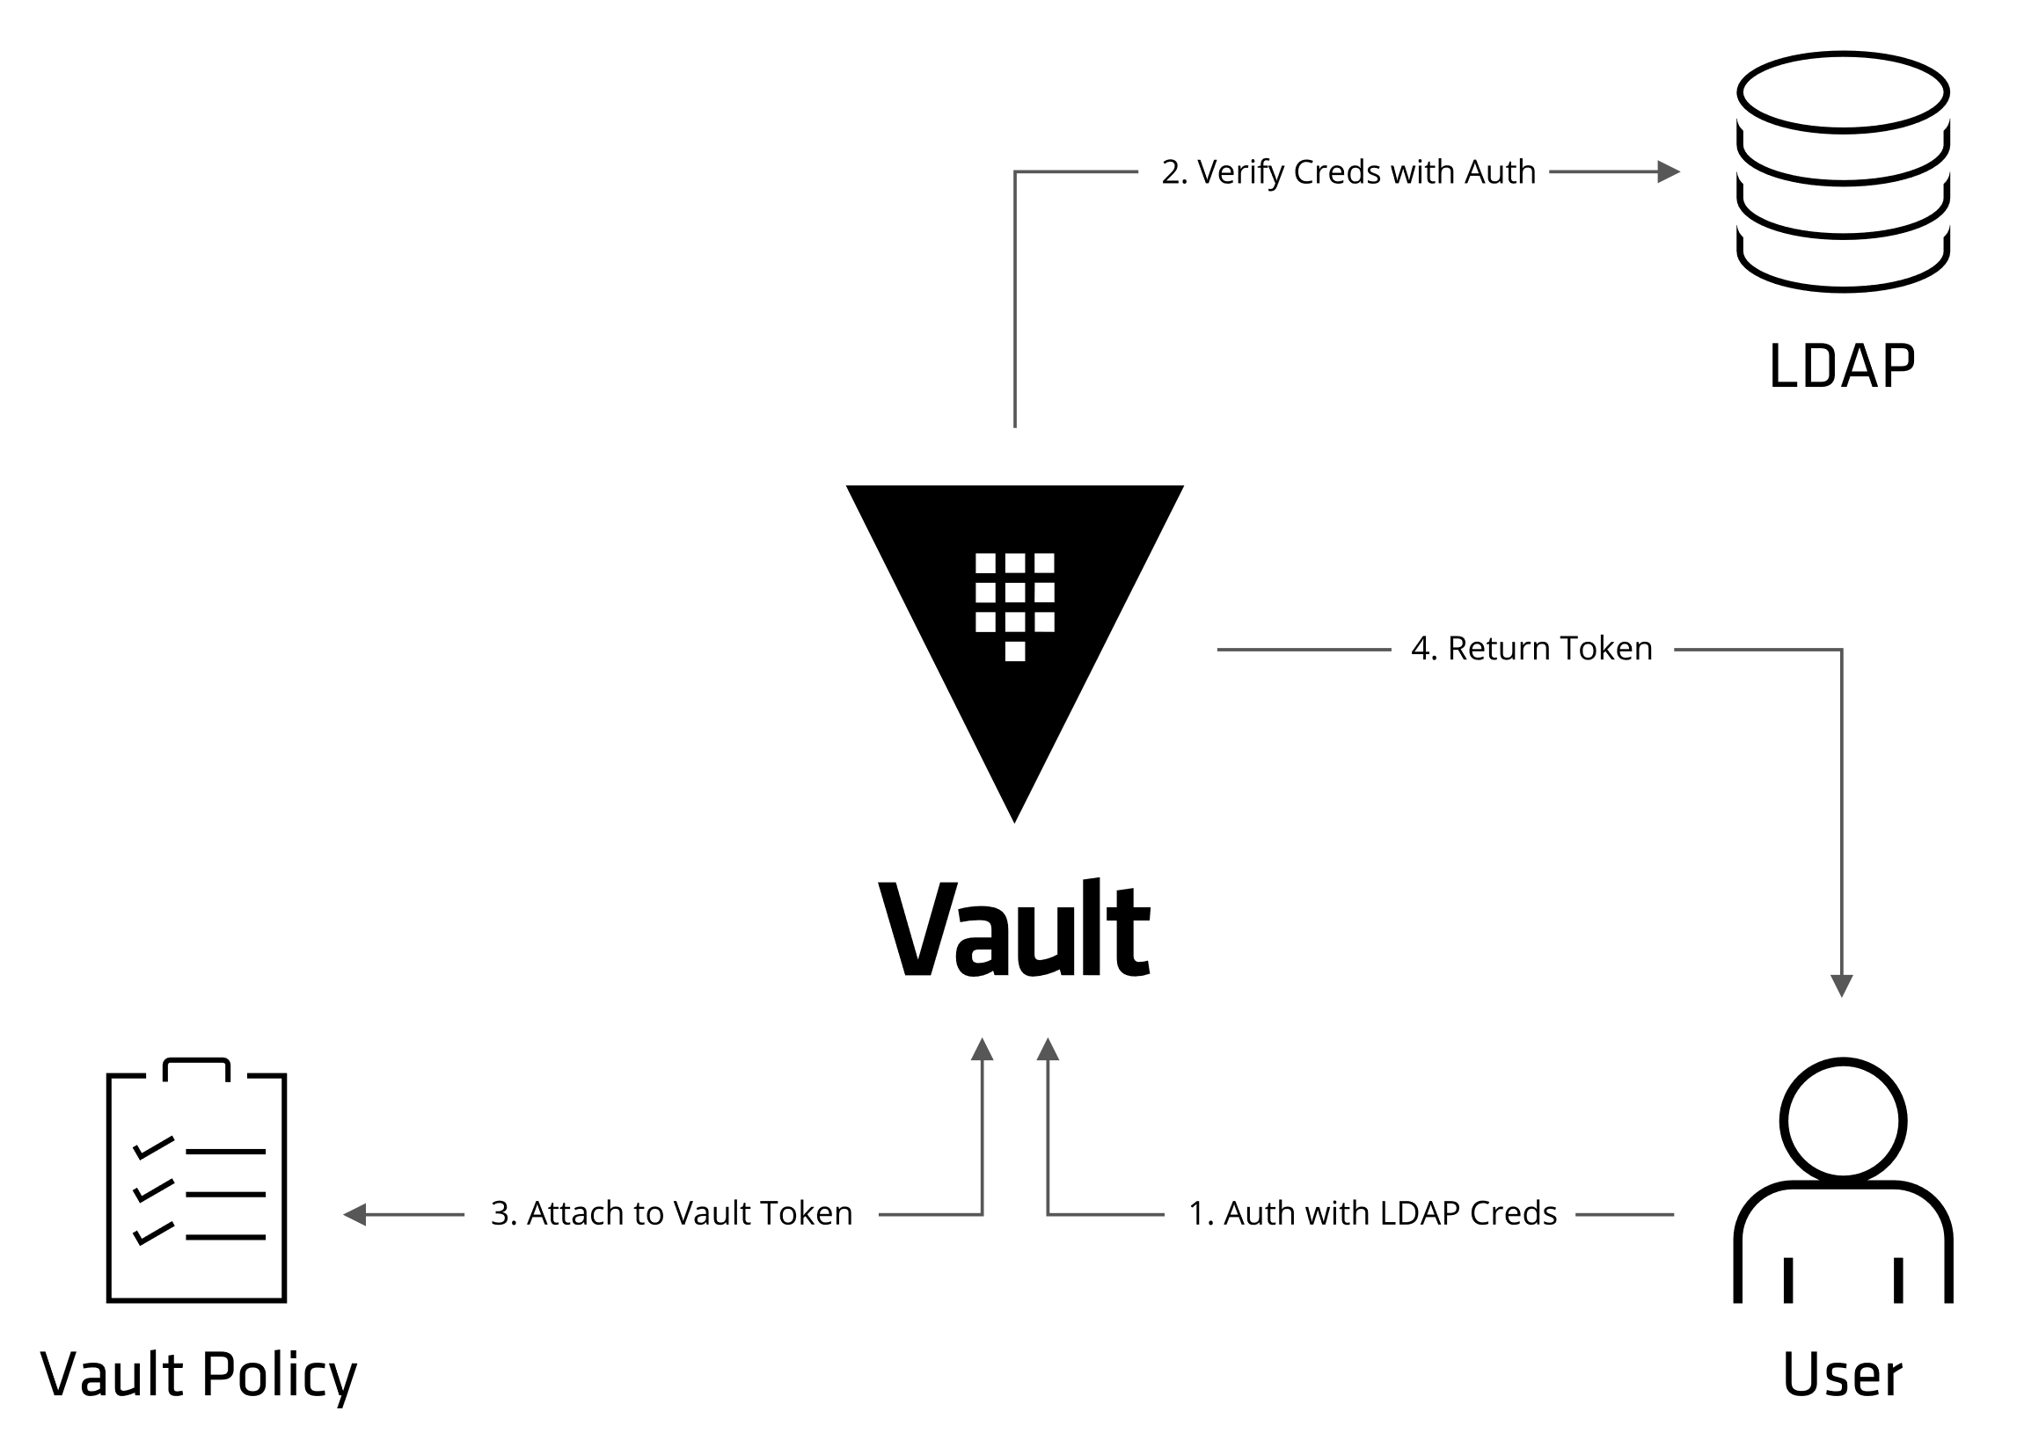
Tokens & Policies

Slide 19
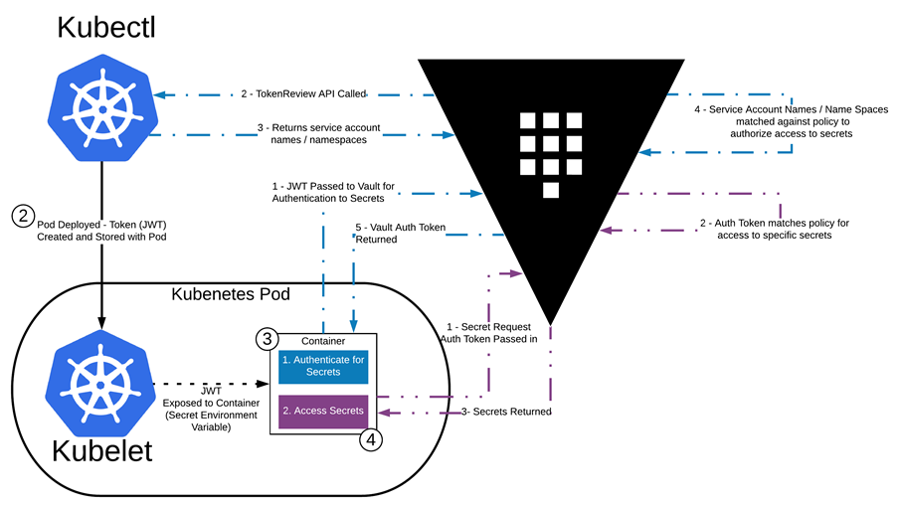
Kubernetes Auth Method

Slide 20
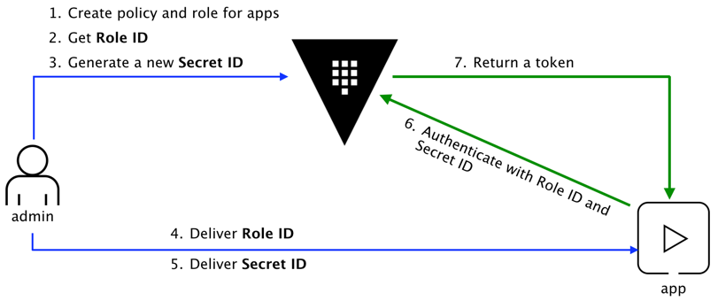
AppRole Auth Method
RoleID / SecretID == Username / Password
IP CIDR bound SecretIDs & Tokens

Slide 21
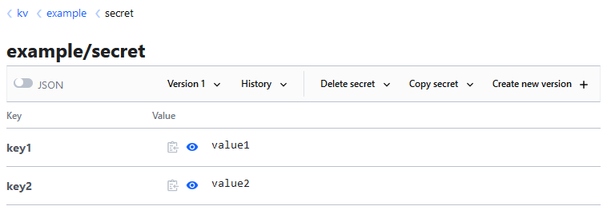
Key/Value Secrets Backend
Path: kv/example/secret

Slide 22
Configuration as Code

Slide 23

Terraform
Tool for managing infrastructure as code
Built & maintained by Hashicorp
Configure Vault itself
Supports almost all Vault resources
Allows for generic API resources for use cases that aren’t supported
Allows templating, modules, loops, conditional statements …
Pretty damn JANK

Slide 24
Benefits of CaC
Automated testing for all changes
Full history of changes, easy rollback
Allows dev teams to self-manage config for their apps
Teams can request more/less permissions with a PR
Takes pressure off Vault admins
Reusable modules for resources configured to our best practice, for teams to easily consume

Slide 25
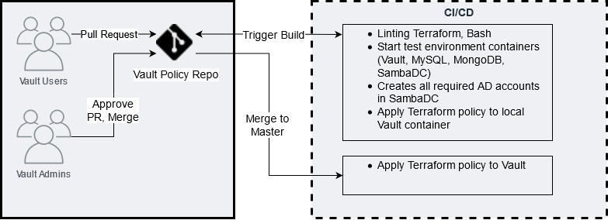
Terraform Change Process

Slide 26
Challenge #1:
Legacy Database Passwords

Slide 27

Problems
Legacy database with no OOTB integrations
Passwords are hardcoded and extremely difficult to rotate
Ongoing long-term migration from Legacy to Modern servers
Usernames have a max length of 8 characters
Must be as easy to onboard applications as possible

Slide 28
Solution must support both
LEGACY SERVERS
MODERN SERVERS
Old UNIX OS
DB uses OS auth for DB auth
To create a DB user, a user must be created on the OS
Current Linux OS
DB uses AD (LDAP) for auth
To create a DB user, an account must be created in Active Directory

Slide 29
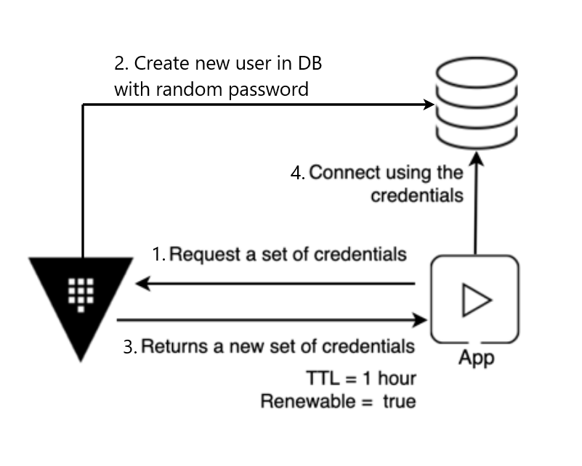
Database Secrets Engine
Dynamic Credentials

Slide 30
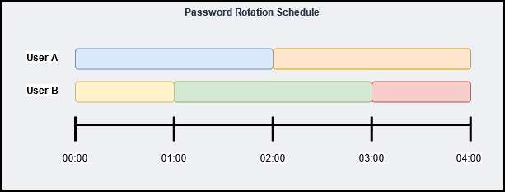
The Game Plan
Use KV store as generic storage for username and password
Hourly rotation with two alternating users
Use AD secrets engine to rotate AD account passwords
Sync passwords from AD engine to UNIX server

Slide 31
YAML Manifest of Users
Source of truth for DB users that should exist
Defines which users belong to which applications
Consumed by AD & Legacy DB servers to create necessary accounts
Imported by Terraform to automatically provision Vault config
---
example-application:
dbUserA: _abc000a
dbUserB: _abc000b
description: Vault User - Development example-application
example-service:
dbUserA: _abc001a
dbUserB: _abc001b
description: Vault User - Development example-service

Slide 32
Legacy Server Rotation script (hourly schedule)
Authenticate to Vault with AppRole
Pull down latest YAML manifest & create/delete users
For each pair of users, select one with the oldest system password
Request new password for oldest user in each pair
AD secrets engine rotates the password
Update password for local user
Update Vault KV store with username & password

Slide 33
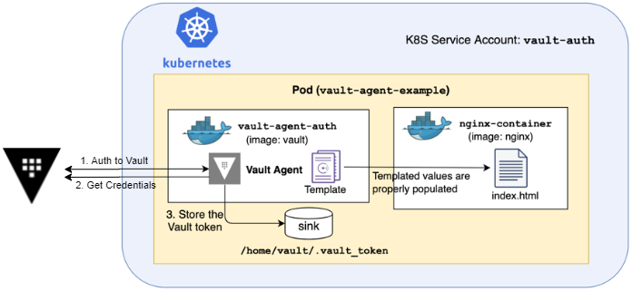
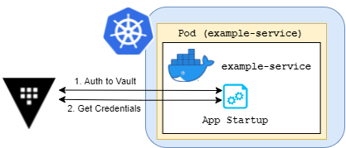
K8s Sidecar
Application
Vault-specific logic separate to application logic
Hashicorp supported sidecar
Code change still required
Requires more code changes
Doesn’t require extra Vault containers in every pod
Allows us to customise Vault-specific logic
Most services already import common internal libraries

Slide 34
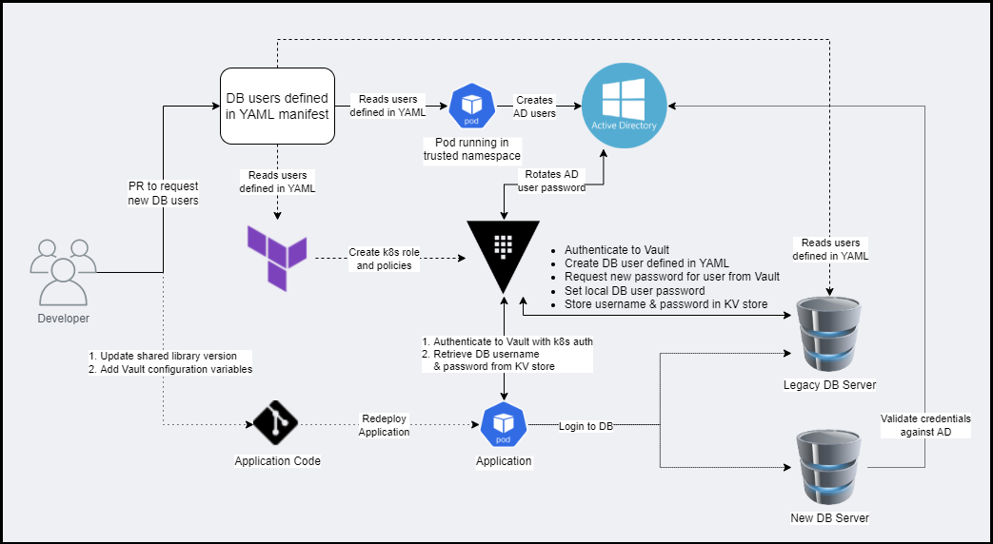

Slide 35
Legacy DB Endstate
DB passwords are no longer stored insecurely
DB passwords only live for 2 hours
Teams can onboard an application in less than an hour, with no code changes
DBA’s have a source of truth they can use to look up any DB username
Apps will behave the same whether using Legacy or Modern DB servers
Developers no longer have access to production DB passwords

Slide 36
Challenge #2:
Human Legacy Database Access

Slide 37
Problems
Developers frequently need access to Nonprod DBs, and Prod DBs in an emergency
Developers have a user manually provisioned on the Legacy DB host
User account passwords are extremely long lived
Far too many Prod DB logins that look like aaron:aaron
Developers often share credentials between themselves
Impossible to audit who is accessing DBs

Slide 38
The Solution
AD Secrets Engine: Service Account Check-Out
Create a “Library” of AD accounts that are allowed to be “borrowed” for a given time limit
Password is only shown to the user who has borrowed the account
Passwords are automatically rotated when “checked-in/returned”
This process would allow us to audit who checks out access to which DB & when
Although for our use-case, the engine itself required some modifications…

Slide 39
The Hack
Passwords have to be synced between AD & Legacy Servers (until DB migration is complete)
Open source to the rescue:
Forked https://github.com/hashicorp/vault-plugin-secrets-ad
Added new /creds endpoint to, which retrieves current account password
Used Vault policies to restrict usage of the new endpoint ONLY to legacy DB server Approles
Added new KSH script to Legacy DB hosts to sync passwords from AD
Installed new custom secrets backend into Vault

Slide 40
But who is “_vxeg003”?
Service accounts in library aren’t tied to any user’s identity
New Audit Lambda Function:
Inspects the status of the library at regular intervals
Maps the Vault token of borrowers to human identity
Records all check-outs in DynamoDB table
If somebody checks-out Production DB creds, alert to Slack

Slide 41
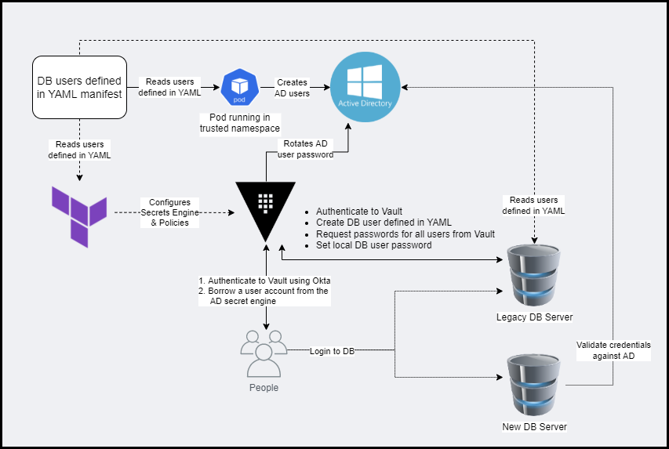

Slide 42

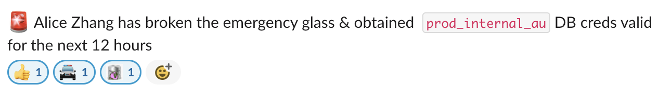
The Results
“Vampire Squid” CLI tool updated to give developers a simple command to retrieve short-lived DB credentials
Developers have easy access to short-lived credentials to access DB’s
Security has full auditibility into who is accessing DB’s & when they accessed it
Once DB migration is complete, custom forked plugin can be retired
Awareness of when somebody accesses a production DB directly

Slide 43
Lessons Learned
Self-managed Consul clusters are a lot of overhead
K8s service accounts can be difficult
Very high-risk system
For single-cloud use cases, using cloud native secrets management & IAM will probably be easier
Most people want to do the right thing, they just need to be provided with a good, well supported option

Slide 44
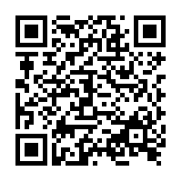
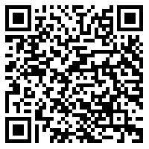
Thanks for listening!
Any Questions?
Vault Blog Post
These Slides

