Slide 1


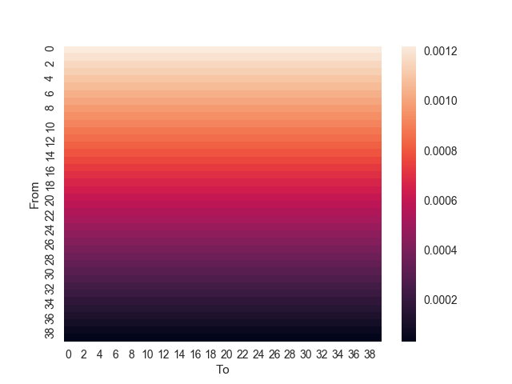
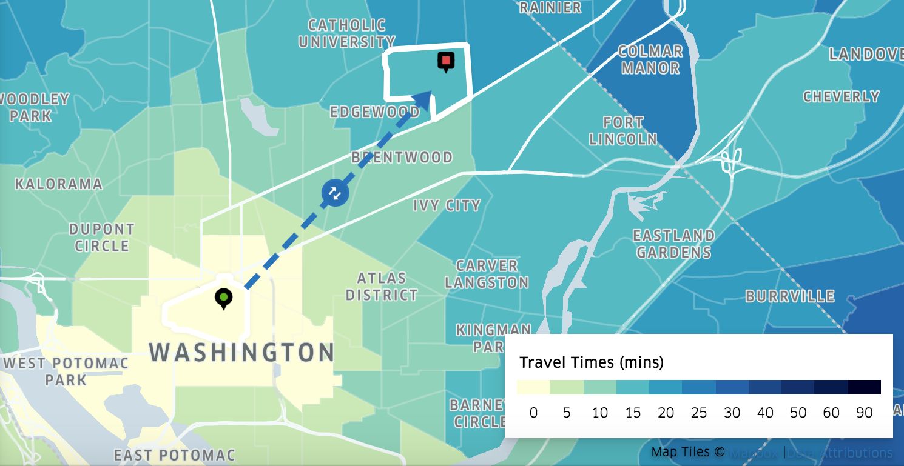
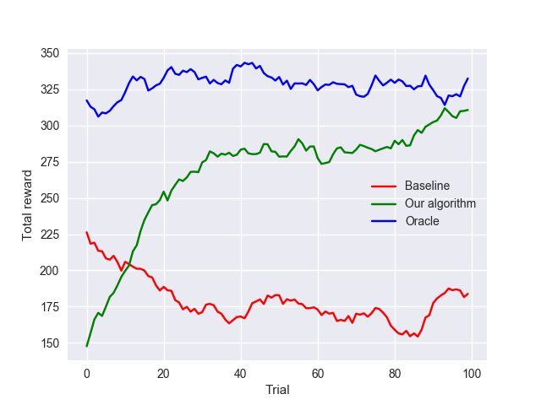
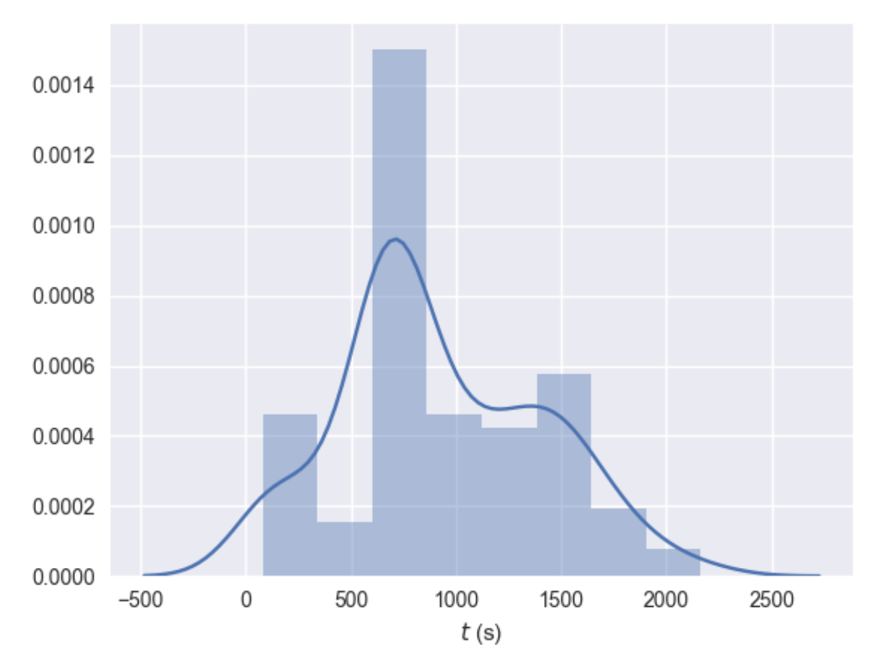
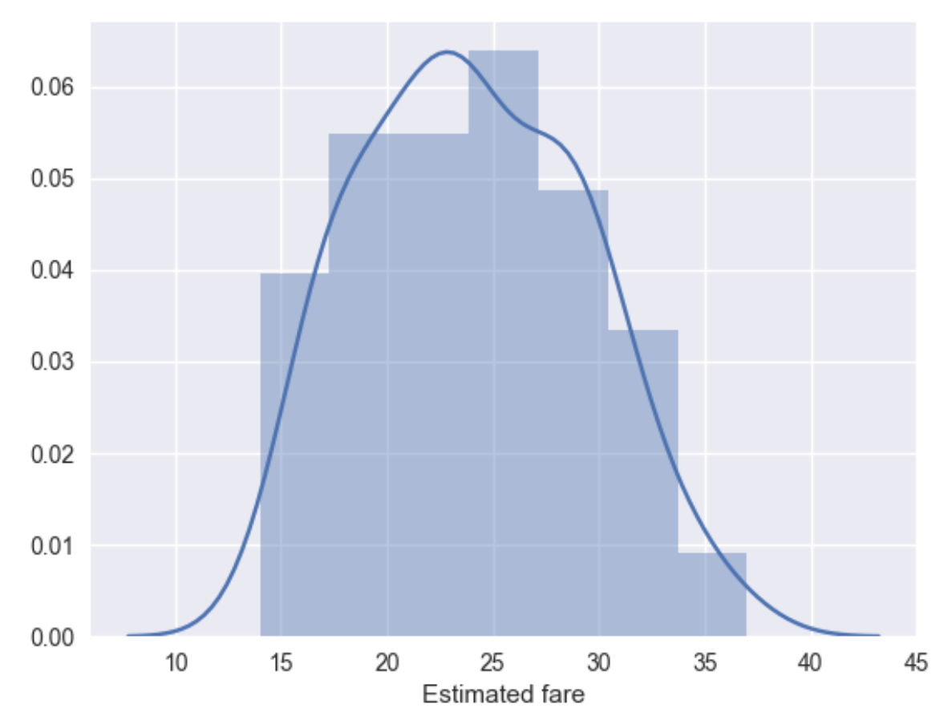
On Demand Transportation Scheduling
Weini Yu, Zhouchangwan Yu, Yutian Li
Introduction
Method
Motivation: better matching needed for riders (demand) and drivers (supply) in on demand transportation service platforms like Uber and Lyft.
Goal: develop an intelligent model that effectively match the customer requests with the drivers in the single vehicle pickup and delivery problem (SVPDP).
Model: Markov Decision Process
Algorithm: Q-learning
State: Driver’s current location
Action: (source, destination) tuple where source is the pick up zone index and destination is the drop off zone index.
Reward: fare − α · travel time
Generation of requests:
Source: lower indices, higher probability.
Destination: uniformly randomly
Favor locations with smaller indices and create an imbalance between states, making some inherently better.
Features
Travel distance: from current location to source, and from source location to destination
Zone: indicator features of current location, source, and destination
Training
S.G.D. using exponential weighted moving average
Discount γ = 0, because driver unaware of legal actions at future states.
Data Acquisition
Map of the city of Washington D.C. discretized into zones, from Uber Movement.
Results and Analysis
Future Work
Baseline: driver randomly picks one request at each step.
Oracle: driver knows true reward function for all requests, and picks greedily
Our Results:
Rather than selecting the first 40 zones in the data set, randomly sample 40 zones to reduce similarity between zones
Define more advanced features
Consider other non-zero values for discount γ
Explore Neural Network instead of handcrafting linear features
Expand the model to accommodate carpool situation
Compare global optimum strategy with Nash Equilibrium
Total rewards:
Baseline: converges to 180
Oracle: converges to 330
Our algorithm: 315
Our model relies on the following types of data, all gathered from Uber APIs.
Location Coordinates: arithmetic mean of the zone coordinates.
Travel Time: average travel time from one zone to another
Fares: estimated fare from one zone to another
As training goes on, our algorithm is slowly approaching the oracle results, 75% higher than the baseline reward and only 5.5% lower than the oracle reward.
References
Achieved good results, almost converging to the oracle.
Q-learning is well suited for the task
State does not matter much because the driver may return to the same spot with drastically different accumulated rewards.
State-action pair conveys much more information.
Relative distance as a feature captures the correlation of distance, fare, and travel time well.
[1] M. Hosny, C. Mumford, The single vehicle pickup and delivery problem with time windows: intelligent operators for heuristic and metaheuristic algorithms. Journal of Heuristics, 2008.
​[2] J. Mrkos, et.al., Liftago On-Demand Transport Dataset and Market Formation Algorithm Based on Machine Learning, 2016.
​ [3] M.Fogleman. Ridesharing Algorithms in TransLoc OnDemand.
Fig1. distribution of traveling time
Fig 2. distribution of estimated fare

