Slide 1
Features
Simple Standard ORM
Full-featured SQL
  Real, Native SQL
  Dynamic SQL
High Performance of MyBatis
Supports Major Databases

Slide 2
DAOs & VOs
A database table or view produces three Java classes.
For example, the table CAR produces:
<table name=”car” />
AbstractCarVO
CarDAO
CarVO

Slide 3
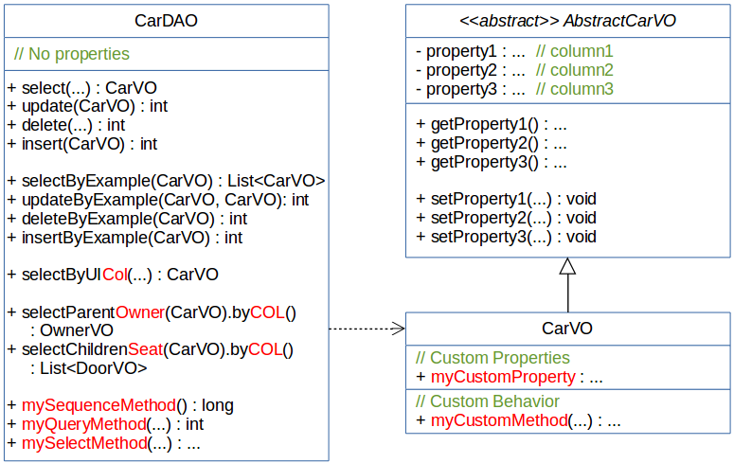
DAOs & VOs

Slide 4
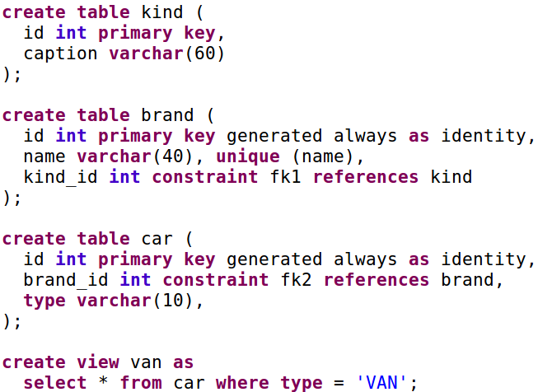
Types of Entities
In HotRod...
<table name=”brand” />
<table name=”car” />
<view name=”van” />
<enum name=”kind” />

Slide 5
Example BrandVO
AbstractBrandVO
<<enum>> Kind
BrandDAO
- id : Integer
- name : String
- kindId : Kind
- id : Integer
- caption : String
+ select()
+ update()
+ delete()
+ insert()
+ selectByExample()
+ updateByExample()
+ deleteByExample()
+ insertByExample()
+ selectByUIName()
+ selectChildrenCar()
+ getId() : Integer
+ getName() : String
+ getKindId() : Kind
+ setId(Integer) : void
+ setName(String) : void
+ setKindId(Kind) : void
BrandVO
+ myCustomProperty : ...
+ myCustomMethod(...) : ...

Slide 6
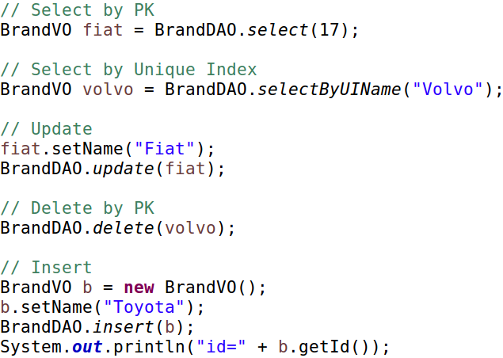
Example - Out of the box CRUD

Slide 7
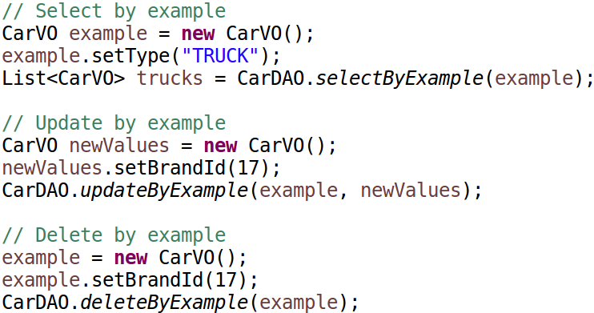
Example - Out of the box By Example

Slide 8
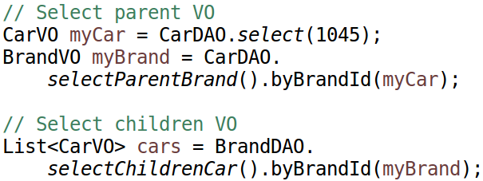
Example - Out of the box FK selects

Slide 9
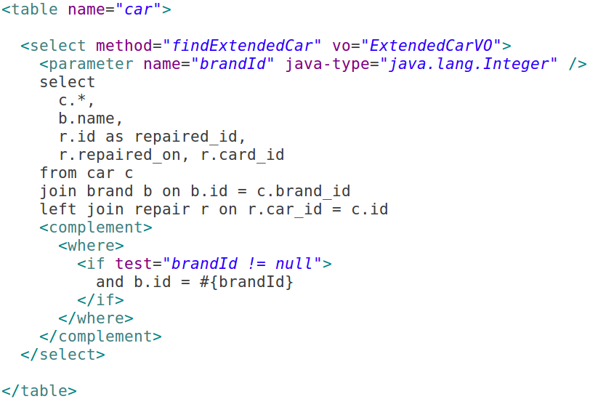
Example - Flat Selects
In HotRod...
ExtendedCarVO
- id : Integer // c.*
- brandId : Integer
- type : String
- name : String // b.name
- repairedId : Integer
- repairedOn : Date
- cardId : Integer
In Java...
List<ExtendedCarVO> extendedCars =
CarDAO.findExtendedCar(23);

Slide 10
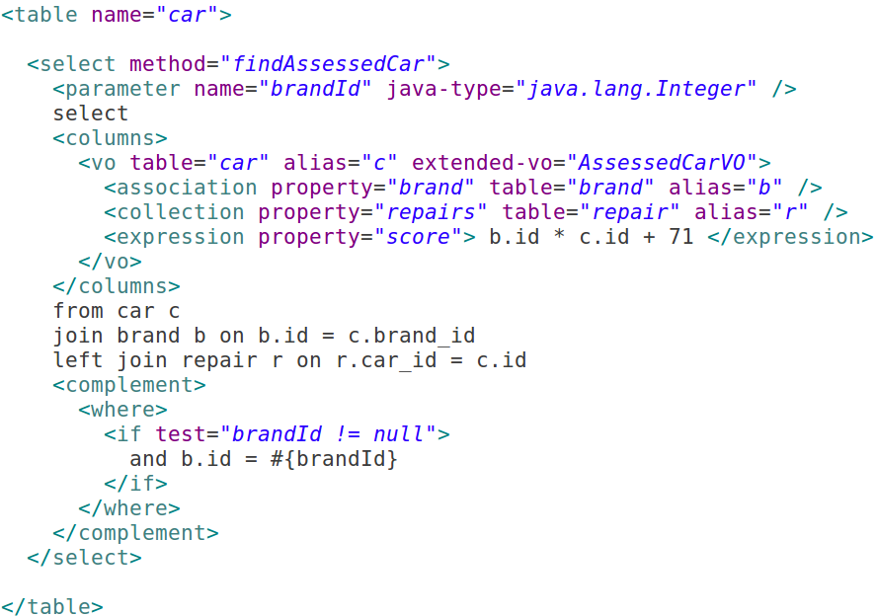
Example - Structured Selects
In HotRod...
In Java...
List<AssessedCarVO> assessedCars =
CarDAO.findAssessedCar(23);

Slide 11
Example - Structured Selects
CarVO
- id : Integer
- brandId : Integer
- type : String
- myCustomProperty : ...
Entity VOs
+ getters/setters
+ myCustomMethod : ...
BrandVO
AssessedCarVO
- brand : BrandVO
- repairs : List<RepairVO>
- score : Double
- myCustomProperty2 : ...
CarVO
+ getters/setters
+ myCustomMethod2 : ...
Fleeting VO

