Slide 1
HotRod - Classic ORM Features
Simple standard ORM implements CRUD, FK navigation, PK autogeneration, and unique constraints.
Supports Oracle, DB2, SAP ASE (ex-Sybase), Microsoft SQL Server, PostgreSQL, MySQL, MariaDB, Derby, HyperSQL, and H2.
Promotes high development speed.
Integrates custom Java code into the model seamlessly.
Excellent tolerance to database model changes.
Supports tables and views.
All the traditional high performance of MyBatis.
Integrates existing MyBatis mappers.

Slide 2
HotRod - Additional ORM Features
Applied SQL features:
  Native, parametric SQL with all specific database tweaks.
  Full support of MyBatis dynamic SQL.
  Automated SQL column discovery.
  Entity SQL selects (use existing entity VOs).
  Automated entity compositions (associations and collections).
Automatic fully-named and fully-typed properties.
Custom property names, types, and data converters.
Out of the box optimistic locking can be activated on any table.
Views are updatable (when supported by the database).
Supports enum tables.
Provides access to database sequences.
Integrates highly tuned custom SQL seamlessly.

Slide 3
DAOs & VOs
A database table or view produces three Java classes.
For example, the table CAR produces:
<table name=”car” />
AbstractCarVO
CarDAO
CarVO

Slide 4
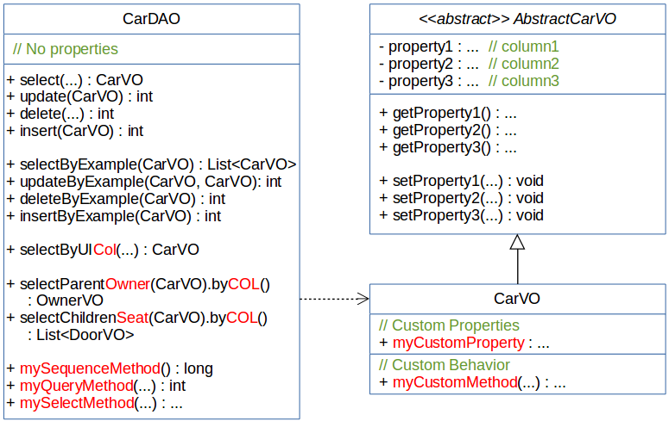
DAOs & VOs - In more detail

Slide 5
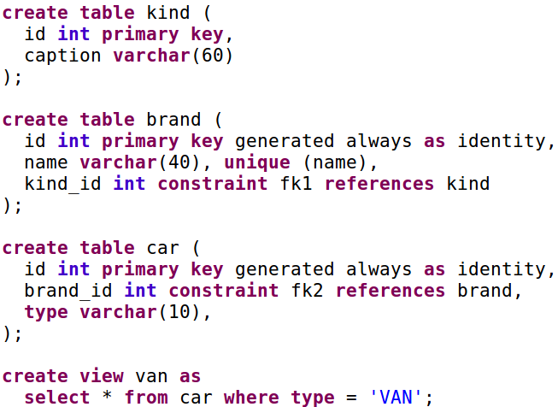
Types of Entities
In HotRod...
<table name=”brand” />
<table name=”car” />
<view name=”van” />
<enum name=”kind” />

Slide 6
Example BrandVO
AbstractBrandVO
<<enum>> Kind
BrandDAO
- id : Integer
- name : String
- kindId : Kind
- id : Integer
- caption : String
+ select()
+ update()
+ delete()
+ insert()
+ selectByExample()
+ updateByExample()
+ deleteByExample()
+ insertByExample()
+ selectByUIName()
+ selectChildrenCar()
+ getId() : Integer
+ getName() : String
+ getKindId() : Kind
+ setId(Integer) : void
+ setName(String) : void
+ setKindId(Kind) : void
The table BRAND
produces the typical
ORM code.
The table KIND is
treated as an enum,
and all it rows become
Java enum values.
Foreign Keys to KIND
simply generate an
enum property in
BRAND.
BrandVO
+ myCustomProperty : ...
+ myCustomMethod(...) : ...

Slide 7
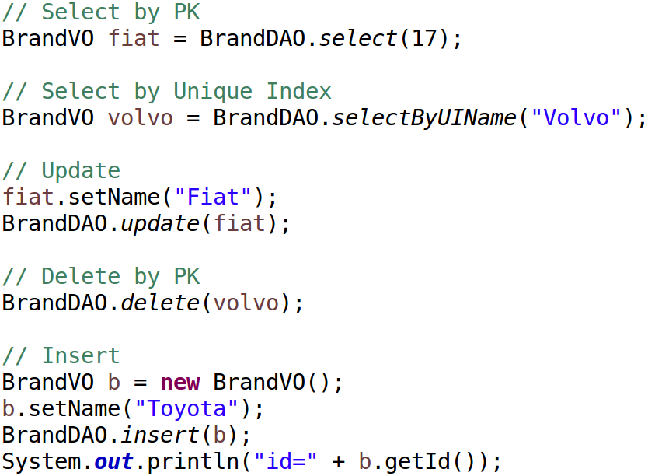
Example - Out of the box CRUD

Slide 8
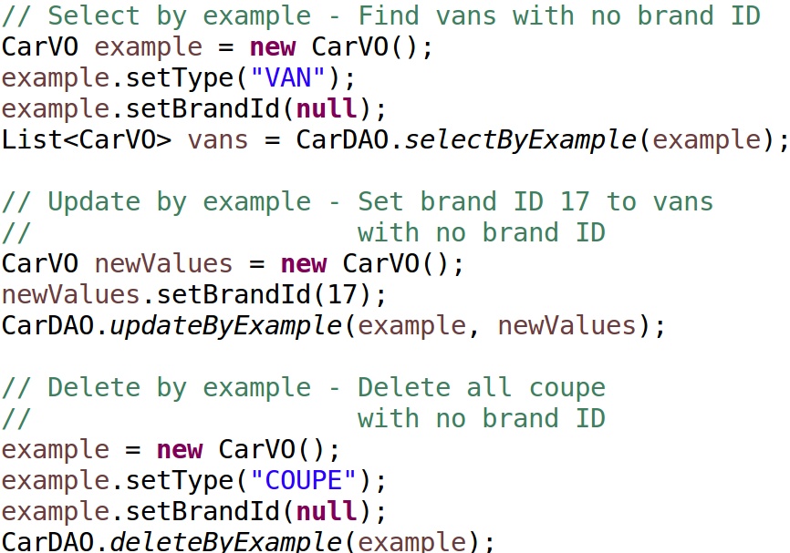
Example - Out of the box By Example

Slide 9
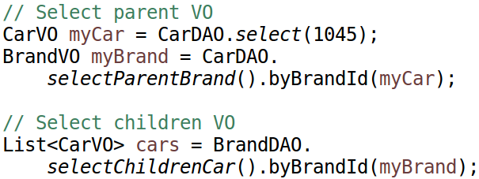
Example - Out of the box
Foreign Keys Navigation

Slide 10
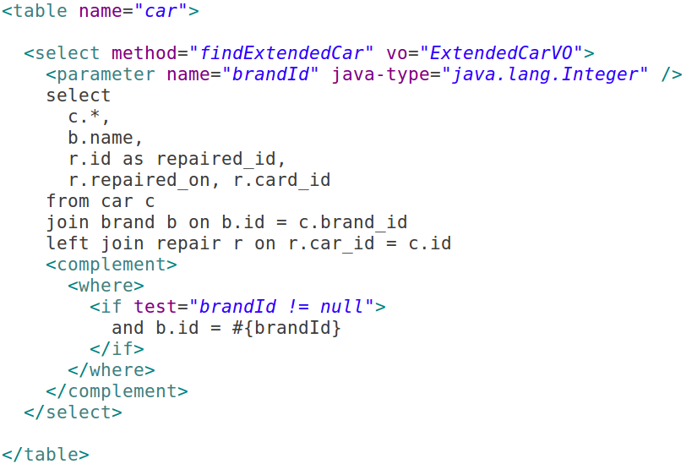
Flat Selects (column auto-discovery)
In HotRod...
(automatically generated VO)
ExtendedCarVO
- id : Integer // c.*
- brandId : Integer
- type : String
- name : String // b.name
- repairedId : Integer
- repairedOn : Date
- cardId : Integer
In Java... it’s a single line of code
List<ExtendedCarVO> extendedCars =
CarDAO.findExtendedCar(23);

Slide 11
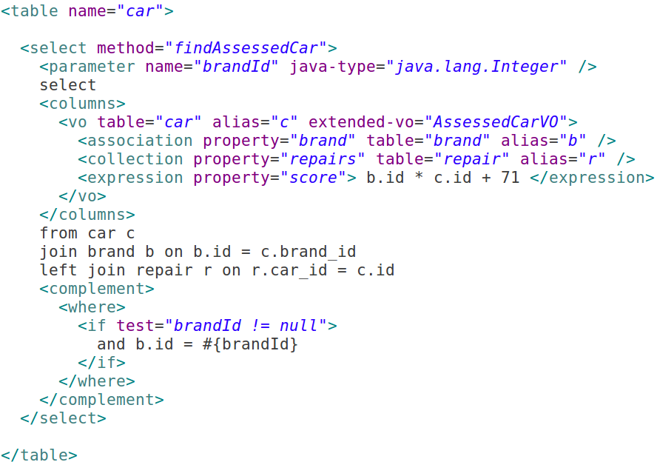
Entity SQL Selects
In HotRod...
In Java... it’s a single line of code
List<AssessedCarVO> assessedCars =
CarDAO.findAssessedCar(23);

Slide 12
Entity SQL Selects - cont
CarVO
- id : Integer
- brandId : Integer
- type : String
- myCustomProperty : ...
Entity VOs
+ getters/setters
+ myCustomMethod : ...
BrandVO
AssessedCarVO
- brand : BrandVO
- repairs : List<RepairVO>
- score : Double
- myCustomProperty2 : ...
RepairVO
+ getters/setters
+ myCustomMethod2 : ...
Fleeting VO
(automatically generated VO)

