Slide 1
Features
Standard ORM
Full-featured SQL
  Real SQL, no abstractions
  Dynamic SQL
  Native SQL
High Performance of MyBatis
Support Major Databases

Slide 2
DAOs & VOs
A database table or view produces several Java classes.
For example, the table CAR produces the classes shown in the right.
<table name=”car” />
AbstractCarVO
CarDAO
CarVO

Slide 3
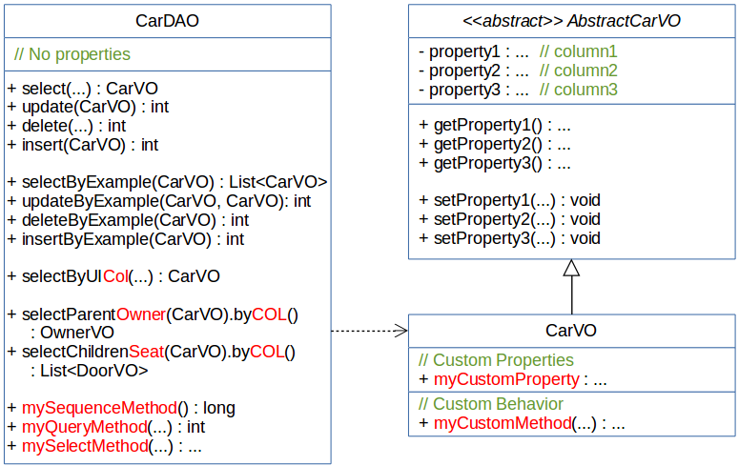
DAOs & VOs

Slide 4
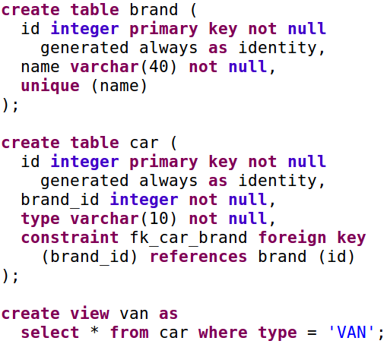
Example - DDL & HotRod
In the database...
In HotRod...
<table name=”brand” />
<table name=”car” />
<view name=”van” />

Slide 5
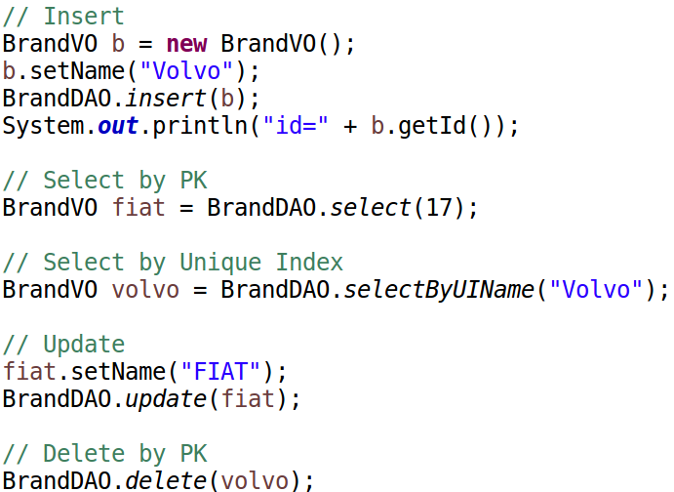
Example - Out of the Box CRUD

Slide 6
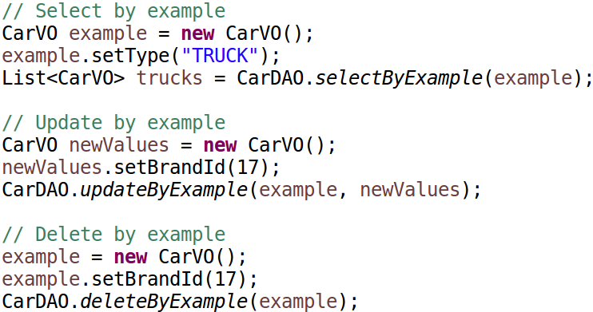
Example - Out of the Box
By Example

Slide 7
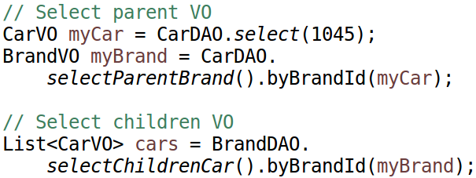
Example - Out of the Box
FK Navigation

Slide 8
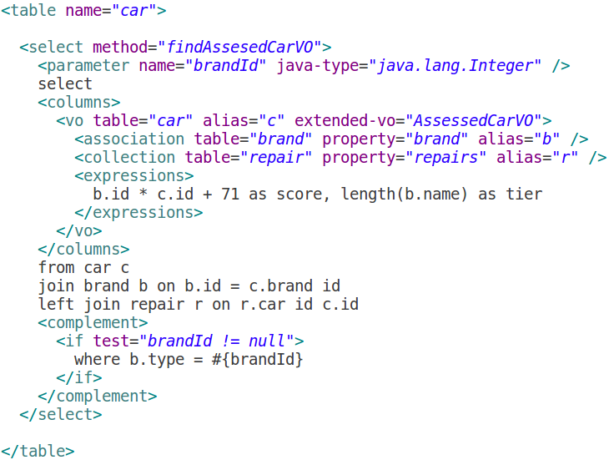
Example - Structured Selects
In HotRod...
In Java...
List<AssessedCarVO> assessed =
CarDAO.findAssesedCarVO(23);

Slide 9
Example - Structured Selects 2

