Slide 1

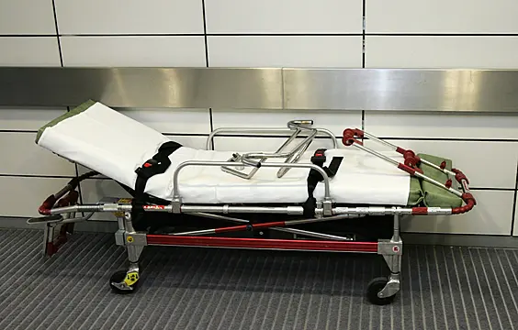
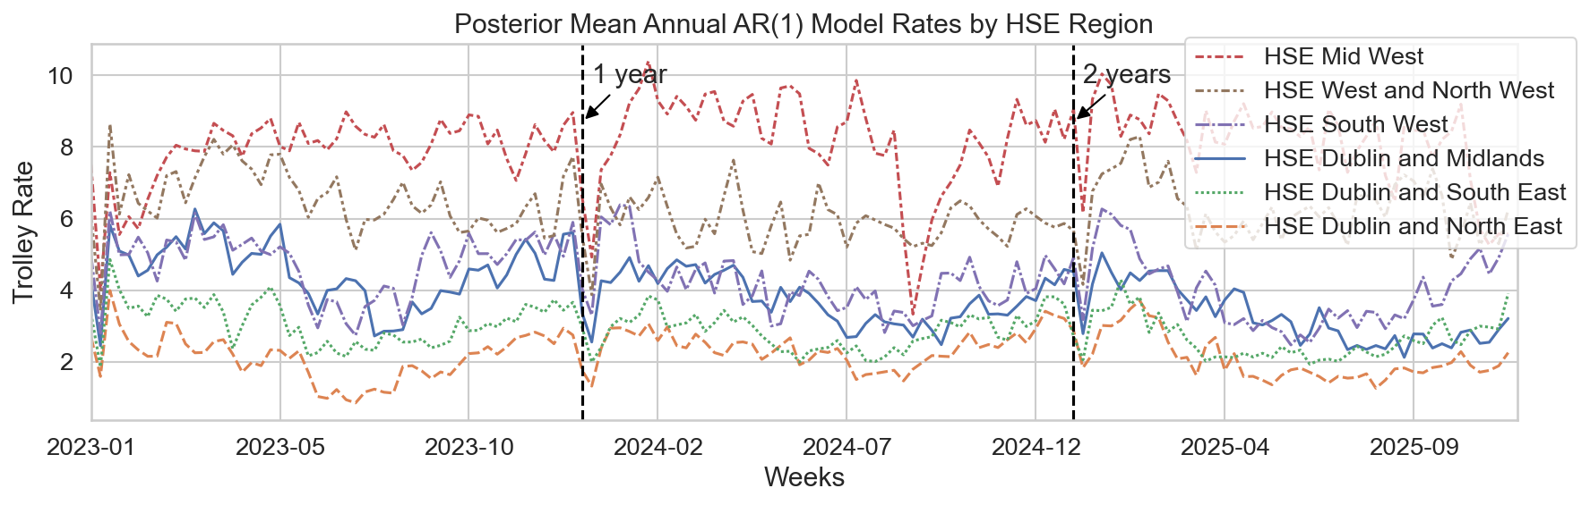
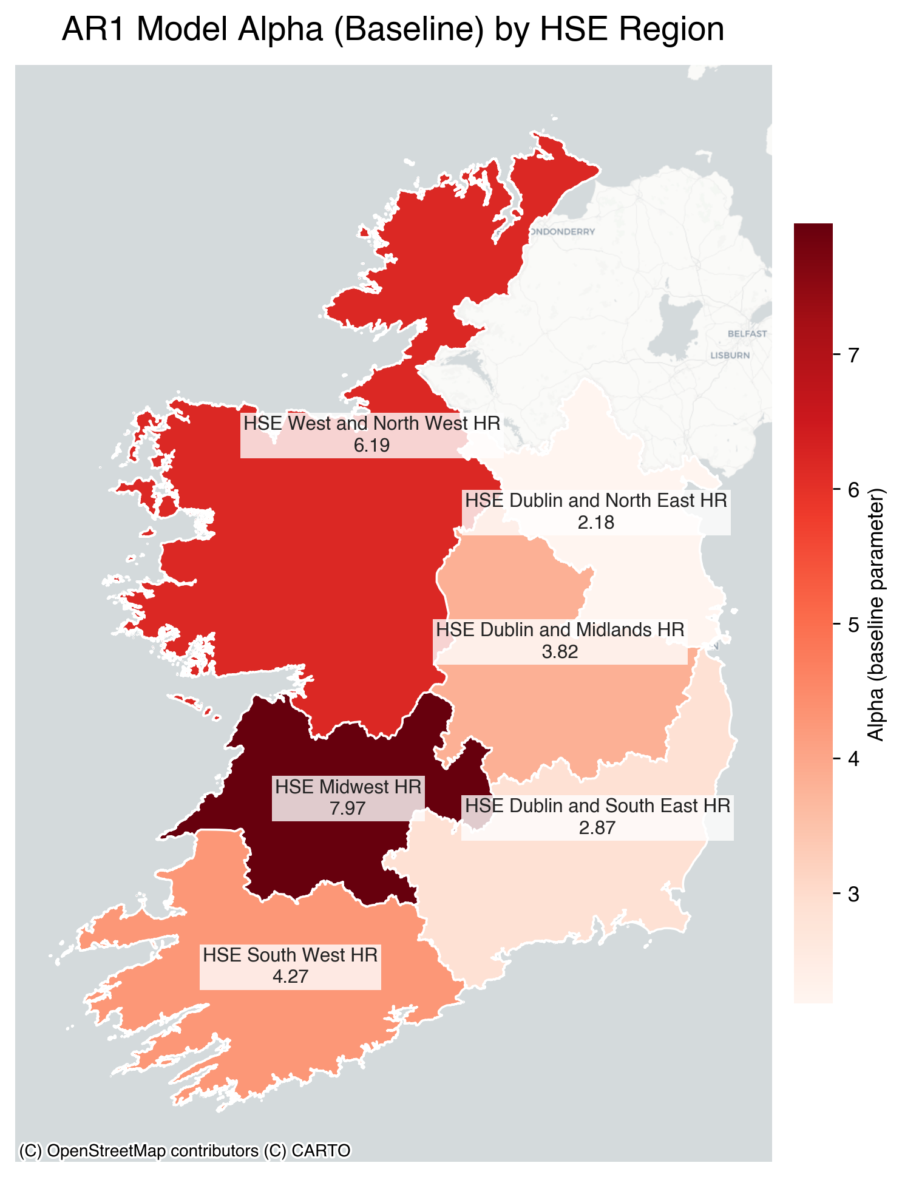
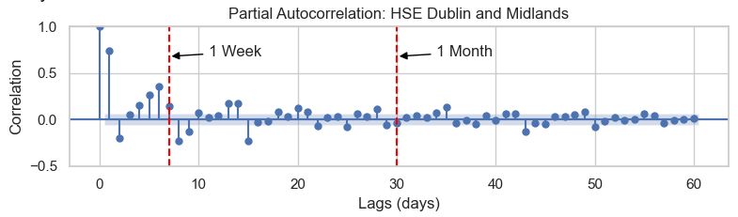
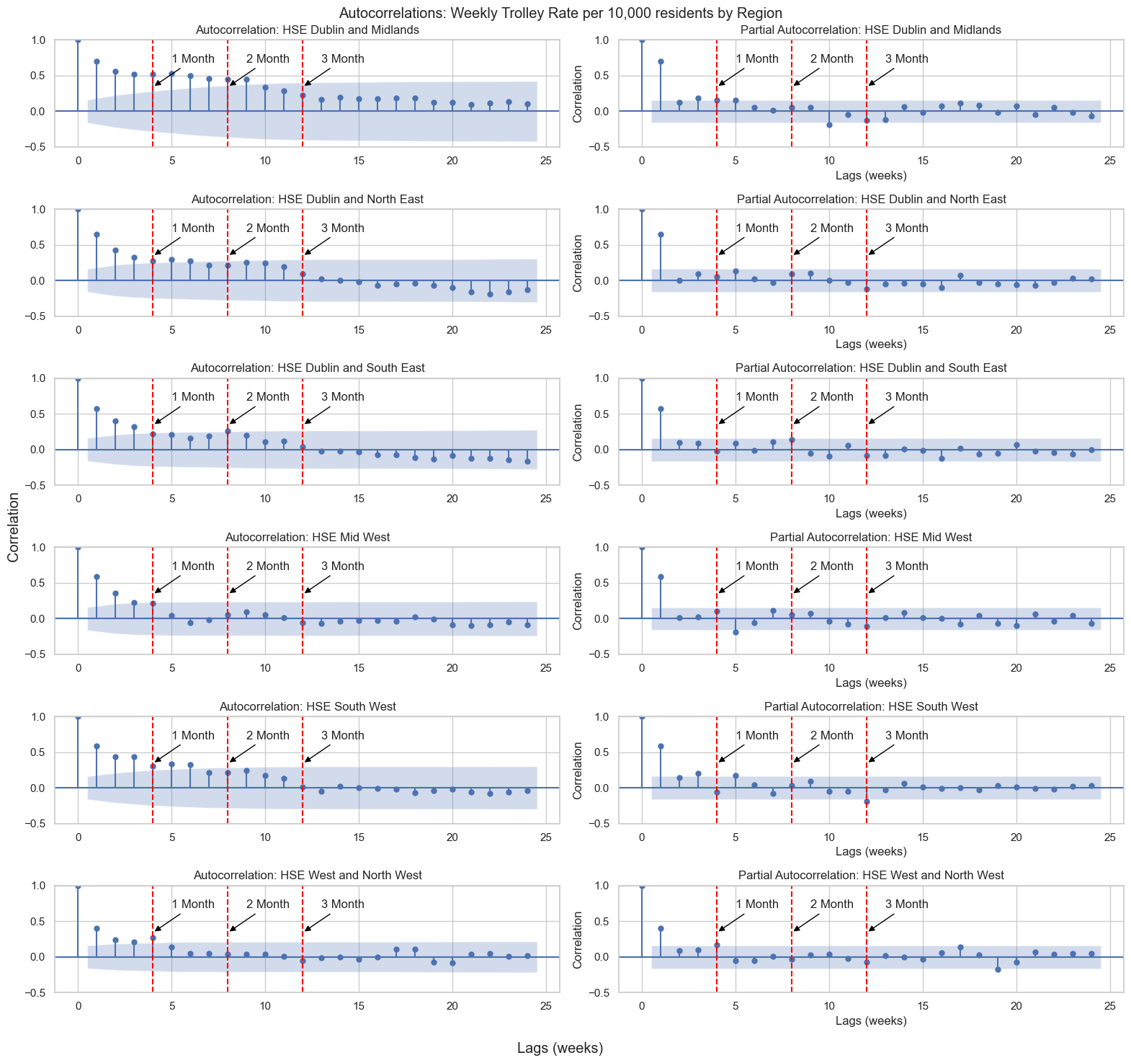
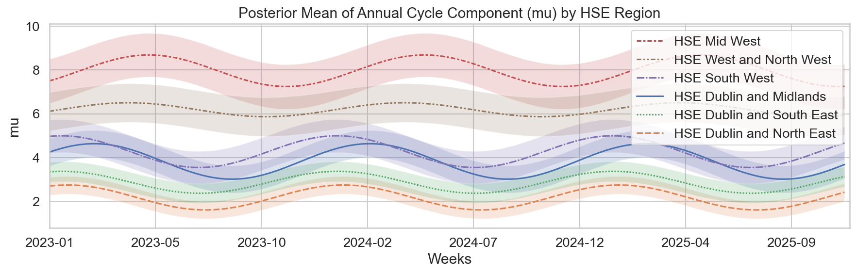
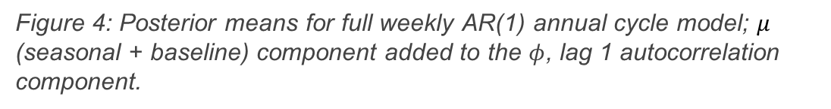
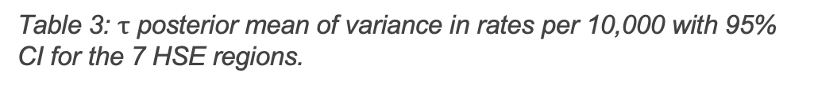

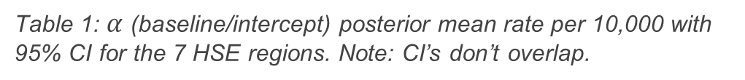


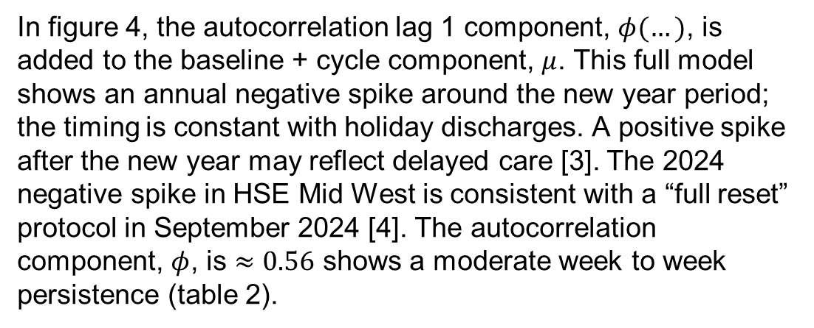
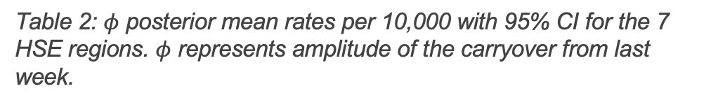
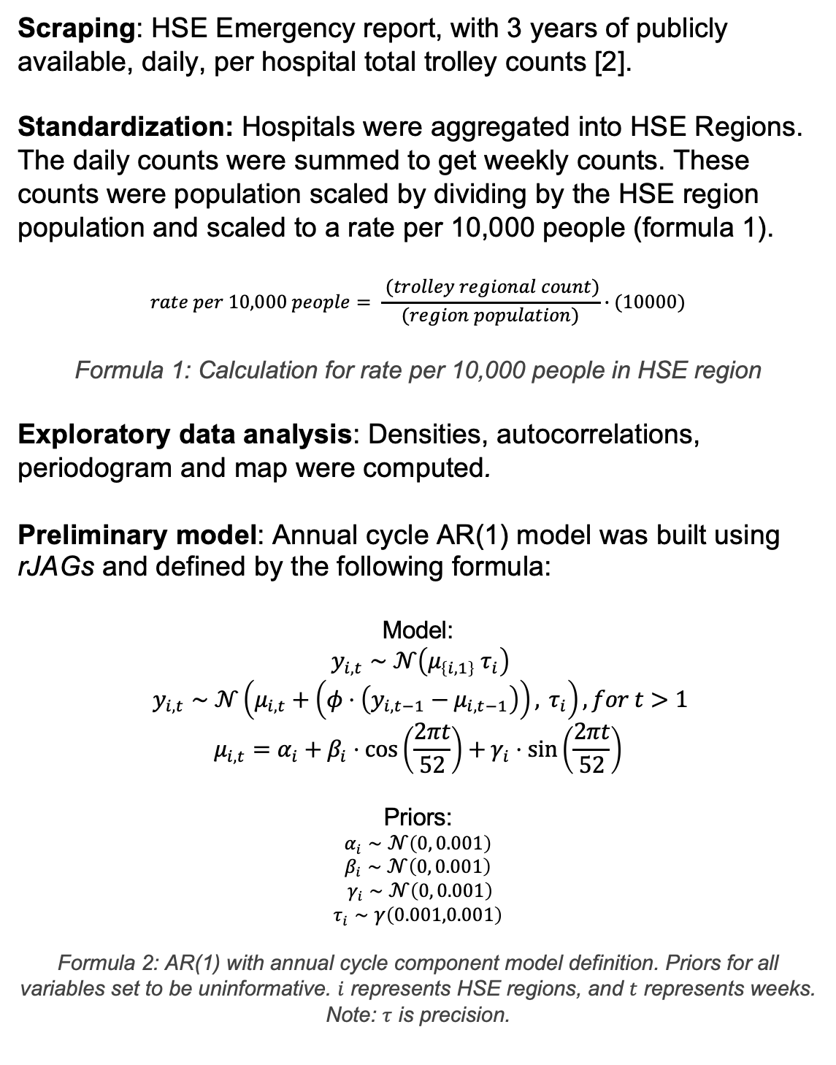
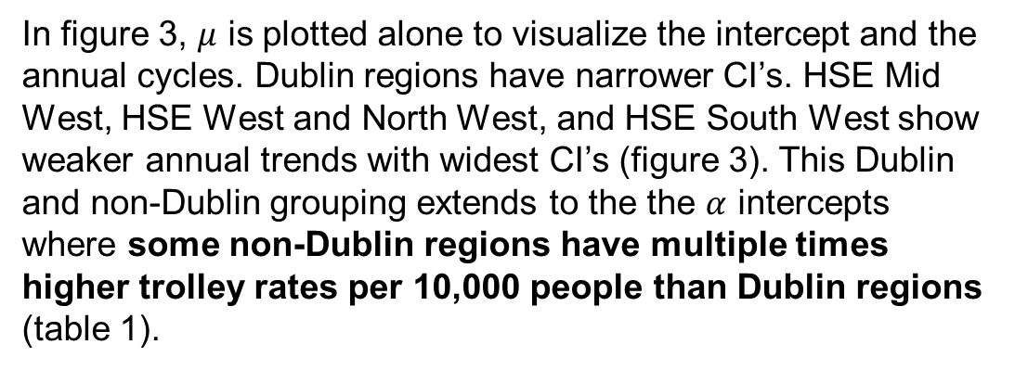

Bayesian modelling On Trolley Counts Across the Irish HSE Health Regions
Lucas Henry¹, Evan Bergin¹
¹School of Mathematical and Statistical Sciences, University of Galway
Introduction
Results
Results ctd.
Overview of Health Regions
In Irish emergency departments it is standard to put patients on trolleys after having been admitted and before being seen. Live daily counts of patients on trolleys are frequently used by policymakers and the media to assess levels of hospital overcrowding [1].
Despite its widespread use, trolley data is typically reported as raw daily counts, offering limited insight into temporal dynamics, uncertainty, or systematic differences across hospital health region populations.
To date, there is limited evidence of studies applying statistical modelling to trolley data to quantify uncertainty, identify systematic patterns, or support robust comparative assessments of hospital pressure.
Initially we wanted to look at cycles in the rate. In figure 1, the daily PACF shows high, significant correlation through the first 7 lags, indicating a strong weekly cycle. To focus on long term trends, weekly trolley rates were used going forward. The weekly PACF shows a significant correlation at lag 1 (figure 2), motivating an AR(1) model.
Figure 4: Posterior means for full weekly AR(1) annual cycle model; $μ$ (seasonal + baseline) component added to the $φ$, lag 1 autocorrelation component.
Mean | 2.5% | 97.5% | Region
7.96 | 7.37 | 8.55 | HSE Mid West
6.18 | 5.67 | 6.7 | HSE West and North West
4.27 | 3.82 | 4.7 | HSE South West
3.82 | 3.45 | 4.18 | HSE Dublin and Midlands
2.87 | 2.6 | 3.13 | HSE Dublin and South East
2.18 | 1.94 | 2.41 | HSE Dublin and North East
Figure 1: PACF of daily on trolley rates per 10,000 residents for HSE Dublin and Midlands. Shaded region is the significance threshold.
$α$:
Table 1: $α$ (baseline/intercept) posterior mean rate per 10,000 with 95% CI for the 7 HSE regions. Note: CI’s don’t overlap.
Methods
:$φ$
Mean | 2.5% | 97.5%
0.56 | 0.50 | 0.62
Scraping: HSE Emergency report, with 3 years of publicly available, daily, per hospital total trolley counts [2].
Standardization: Hospitals were aggregated into HSE Regions. The daily counts were summed to get weekly counts. These counts were population scaled by dividing by the HSE region population and scaled to a rate per 10,000 people (formula 1).
$$rate per 10,000 people= \frac{ (trolley regional count)}{(region population)}∙(10000)$$
Formula 1: Calculation for rate per 10,000 people in HSE region
Exploratory data analysis: Densities, autocorrelations, periodogram and map were computed.
Preliminary model: Annual cycle AR(1) model was built using rJAGs and defined by the following formula:
Model:
$$y_{i,t}∼𝒩\left(μ_{\left\{i,1\right\}} τ_{i}\right)$$
$$y_{i,t}∼𝒩\left(μ_{i,t}+\left(φ⋅\left(y_{i,t−1}−μ_{i,t−1}\right)\right), τ_{i}\right),for t>1$$
$$μ_{i,t}=α_{i}+β_{i}⋅\cos\left(\frac{2πt}{52}\right)+γ_{i}⋅\sin\left(\frac{2πt}{52}\right)$$
Priors:
$$α_{i}∼𝒩\left(0, 0.001\right)$$
$$β_{i}∼𝒩\left(0, 0.001\right)$$
$$γ_{i}∼𝒩\left(0, 0.001\right)$$
$$τ_{i}∼γ\left(0.001,0.001\right)$$
Formula 2: AR(1) with annual cycle component model definition. Priors for all variables set to be uninformative. $i$ represents HSE regions, and $t$ represents weeks. Note: $τ$ is precision.
Table 2: $φ$ posterior mean rates per 10,000 with 95% CI for the 7 HSE regions. $φ$ represents amplitude of the carryover from last week.
Mean | 2.5% | 97.5% | Region
0.39 | 0.31 | 0.48 | HSE Mid West
0.51 | 0.40 | 0.63 | HSE West and North West
0.70 | 0.55 | 0.87 | HSE South West
1.01 | 0.79 | 1.26 | HSE Dublin and Midlands
1.85 | 1.45 | 2.30 | HSE Dublin and South East
2.42 | 1.90 | 3.00 | HSE Dublin and North East
Figure 2: PACF of weekly trolley rates per 10,000 residents for HSE Dublin and Midlands. Shaded region is the significance threshold.
$τ$:
In figure 3, $μ$ is plotted alone to visualize the intercept and the annual cycles. Dublin regions have narrower CI’s. HSE Mid West, HSE West and North West, and HSE South West show weaker annual trends with widest CI’s (figure 3). This Dublin and non-Dublin grouping extends to the the $α$ intercepts where some non-Dublin regions have multiple times higher trolley rates per 10,000 people than Dublin regions (table 1).
Table 3: $τ$ posterior mean of variance in rates per 10,000 with 95% CI for the 7 HSE regions.
Figure 4: The regional map of normalized mean trolley rates per 10,000 people. The regions are defined by the HSE..
Key Takeaways
GITHUB Link
HSE Mid West has the highest regional baseline. Potential Dublin versus Non-Dublin baseline divide.
Moderate system wide week to week persistence.
Some evidence for an annual cycle in Dublin regions.
The code and datasets for this project can be viewed at our GitHub repository here: http://github.com/hotsoupisgood/scraping-hse-trolly-data
Plans for the Future
References
Ongoing work focuses on rigorously significant testing for our existing model and modelling spikes. Extending the analysis from weekly aggregates to daily-level modelling and model selection for a future ARMA model.
Our long term objective is to apply a Bayesian ranking framework[5] to order HSE health regions according to levels of system stress, defined here as sustained or extreme demand for inpatient beds as reflected by elevated trolley counts.
Beyond these frameworks, there is scope to extend the modelling approach for development of live time series models of hospital pressure with an online dashboard.
[1] Health Service Executive (2026) Daily trolley and escalation data. Dublin: Health Service Executive. Available at: https://www.hse.ie/eng/services/news/media/pressrel/trolley-data/ (Accessed: 04 January 2026).
[2] “Urgent and emergency care report (TrolleyGAR),” HSE.ie. https://www2.hse.ie/services/urgent-emergency-care-report/ ‌
[3] Health Service Executive (HSE) (2026) HSE reports 448 people currently hospitalised with respiratory illness. 19 January. Available at: https://about.hse.ie/news/hse-reports-448-people-currently-hospitalised-with-respiratory-illness/ (Accessed: 28 January 2026).
[4] Health Information and Quality Authority (HIQA) (2025) Work stream 1 – Policy Review: A summary of the key health system and policy recommendations and decisions that have impacted urgent and emergency healthcare services in the HSE Mid West health region (2000–2024). 30 September. Limerick: HIQA Page 54. Available at: https://www.hiqa.ie/sites/default/files/2025-09/MWR/WS1-Policy_Review.pdf (Accessed: 28/01/2026).
[5] C. MacDermott, C. J. Scarrott, and J. Ferguson, “Bayes-ically fair: A Bayesian Ranking of the Olympic Medal Table,” Oct. 16, 2025, arXiv: arXiv:2510.14723. doi: 10.48550/arXiv.2510.14723.
Figure 3: Posterior means for $μ$ component of weekly AR(1) annual cycle model with shaded 95% credible intervals.
In figure 4, the autocorrelation lag 1 component, $φ(…)$, is added to the baseline + cycle component, $μ$. This full model shows an annual negative spike around the new year period; the timing is constant with holiday discharges. A positive spike after the new year may reflect delayed care [3]. The 2024 negative spike in HSE Mid West is consistent with a “full reset” protocol in September 2024 [4]. The autocorrelation component, $φ$, is $≈0.56$ shows a moderate week to week persistence (table 2).

