Slide 1
Behavioral Patterns
The Command Patterns

Slide 2
Intent
Encapsulate a request as an object, thereby letting you parameterize clients with different requests, queue or log requests, and support undoable operations.

Slide 3
Motivation
A Command Pattern allows requests to an object to exist as an object.
What does that mean?
It means that if you send a request for some function to an object, the command object can house that request inside the object.
This is useful in the case of undoing or redoing some action, or simply storing an action in a request queue on an object.
When you send the request, it is stored in the object.
Then later, if you need to access that same request, or apply the request or some method on the request to an object, you can use the request object instead of calling the object's method directly.

Slide 4
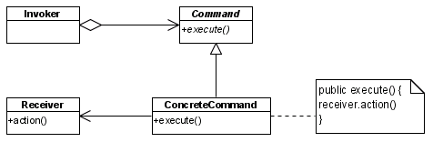
Structure

Slide 5
Structure
The Command pattern has three main components:
  Invoker. The Invoker holds a command and can get the Command to execute a request by calling the execute method.
  Command. The command is an object that encapsulates a request to the receiver. Command declares an interface for all commands, providing a simple execute() method which asks the Receiver of the command to carry out an operation.
  Receiver. The receiver is the component that is acted upon by each request.
  The ConcreteCommand defines a binding between the action and the receiver. When the Invoker calls execute the ConcreteCommand will run one or more actions on the Receiver.

Slide 6
Example - Bank Transactions
A software developer wants to develop a bank transaction system which can log the transactions in a queue and undo any transaction
Initially, there are two kinds of transactions: withdraw and deposit
New kind of transactions should be easily added in the future

Slide 7
Example - Bank Transactions without Command Pattern
import java.util.Stack;
public class MainNoCommand {
public static void main(String[] args) {
double [] balance = {100.0, 200.0};
double amount;
Account acc[] = new Account[2];
Stack commandStack = new Stack();
for (int i = 0; i < acc.length; i++) {
acc[i] = new Account(i, balance[i]);
}

Slide 8
Example - Bank Transactions without Command Pattern
// execute the commands in order
System.out.println("Execute Comannds Begin");
amount = 30.0;
// deposit command
System.out.println("---Deposit Transaction---");
System.out.println(acc[0]);
System.out.println("Deposit Amount = " + amount);
acc[0].deposit(amount);
System.out.println("After deposit, balance = " + acc[0].getBalance());
System.out.println("----End------");
// save the deposit command in the stack for undo
commandStack.push(new Double(amount));
commandStack.push(acc[0]);
commandStack.push("deposit");
commandStack
“deposit”
acc[0]
30.0
Top

Slide 9
Example - Bank Transactions without Command Pattern
amount = 40.0;
// withdraw command
System.out.println("---Withdraw Transaction---");
System.out.println(acc[1]);
System.out.println("Withdraw Amount = " + amount);
acc[1].withdraw(amount);
System.out.println("After uithdraw, balance = " + acc[1].getBalance());
System.out.println("----End------");
// save the withdraw command in the stack for undo
commandStack.push(new Double(amount));
commandStack.push(acc[1]);
commandStack.push("withdraw");
System.out.println();
commandStack
Top
“withdraw”
acc[1]
40.0
“deposit”
acc[0]
30.0

Slide 10
Example - Bank Transactions without Command Pattern
commandStack
System.out.println("Undo Commands Begin");
// undo the commands
while (!commandStack.empty()) {
// get the latest command in the stack
String c = (String) commandStack.pop();
if (c.equals("deposit")) {
Account account = (Account) commandStack.pop();
amount = ((Double) commandStack.pop()).doubleValue();
System.out.println("---Undo Deposit Transaction---");
System.out.println(account);
System.out.println("Deposit Amount = " + amount);
account.withdraw(amount);
System.out.println("After undo deposit, balance = " + account.getBalance());
System.out.println("----End------");
}
Top
“withdraw”
acc[1]
40.0
“deposit”
acc[0]
30.0

Slide 11
Example - Bank Transactions without Command Pattern
else if (c.equals("withdraw")) {
Account account = (Account) commandStack.pop();
amount = ((Double) commandStack.pop()).doubleValue();
System.out.println("---Undo Withdraw Transaction---");
System.out.println(account);
System.out.println("Withdraw Amount = " + amount);
account.deposit(amount);
System.out.println("After undo withdraw, balance = " + account.getBalance());
System.out.println("----End------");
} // if
} // while
} // main
} // class

Slide 12
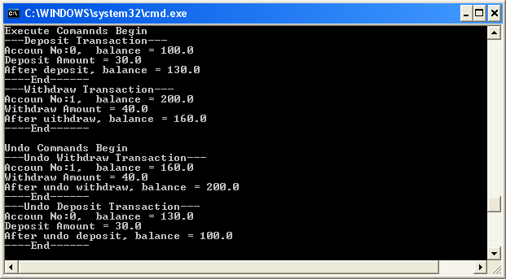
Example - Bank Transactions without Command Pattern

Slide 13
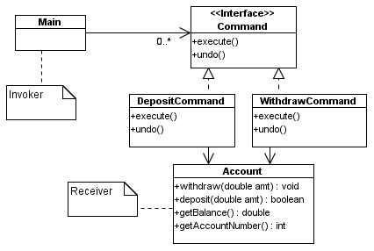
Example - Bank Transactions

Slide 14
Example - Bank Transactions
import java.util.Stack;
public class Main {
public static void main(String[] args) {
double [] balance = {100.0, 200.0};
double [] amt = {50.0, 20.0};
Account acc[] = new Account[2];
Command[] com = new Command[4];
Stack commandStack = new Stack();
for (int i = 0; i < acc.length; i++) {
acc[i] = new Account(i, balance[i]);
}
com[0] = new DepositCommand(acc[0], 30.0);
com[1] = new WithdrawCommand(acc[1], 40.0);
com[2] = new WithdrawCommand(acc[0], 20.0);
com[3] = new DepositCommand(acc[1], 30.0);

Slide 15
Example - Bank Transactions
// execute the commands in order
System.out.println("Execute Commands Begin");
for (int i = 0; i < com.length; i++) {
com[i].execute();
commandStack.push(com[i]); // add the command in the stack
}
System.out.println();
System.out.println("Undo Commands Begin");
// undo the commands
while (!commandStack.empty()) {
// get the latest command in the stack
Command c = (Command) commandStack.pop();
// undo the latest command
c.undo();
}
}
} // Main

Slide 16

Example - Bank Transactions
public interface Command {
public void execute();
public void undo();
}

Slide 17
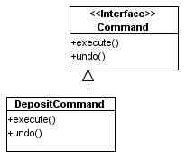
Example - Bank Transactions
public class DepositCommand implements Command {
Account acc;
double amount;
public DepositCommand(Account account, double amt) {
this.acc = account;
this.amount = amt;
}
public void execute() {
System.out.println("---Deposit Transaction---");
System.out.println(acc);
System.out.println("Deposit Amount = " + amount);
acc.deposit(amount);
System.out.println("After deposit, balance = " + acc.getBalance());
System.out.println("----End------");
}

Slide 18
Example - Bank Transactions
public void undo() {
System.out.println("---Undo Deposit Transaction---");
System.out.println(acc);
System.out.println("Deposit Amount = " + amount);
acc.withdraw(amount);
System.out.println("After undo deposit, balance = " + acc.getBalance());
System.out.println("----End------");
} // DepositCommand
}

Slide 19
Example - Bank Transactions
public class Account {
protected int accountNumber;
protected double balance;
public Account(int accNo, double bal) {
accountNumber = accNo;
balance = bal;
}
public int getAccountNumber() { return accountNumber; }
public double getBalance() { return balance; }

Slide 20
Example - Bank Transactions
public boolean withdraw(double amt) {
if (amt <= balance)
{
balance = balance - amt;
return true;
} else
return false;
}
public void deposit(double amt) {
balance = balance + amt;
}
public String toString() {
return "Accoun No:" + accountNumber + ", balance = " + balance;
}
} // Account

Slide 21
Bank Transactions - Sample run
Execute Comannds Begin
---Deposit Transaction---
Accoun No:0, balance = 100.0
Deposit Amount = 30.0
After deposit, balance = 130.0
----End------
---Withdraw Transaction---
Accoun No:1, balance = 200.0
Withdraw Amount = 40.0
After uithdraw, balance = 160.0
----End------
---Withdraw Transaction---
Accoun No:0, balance = 130.0
Withdraw Amount = 20.0
After uithdraw, balance = 110.0
----End------
---Deposit Transaction---
Accoun No:1, balance = 160.0
Deposit Amount = 30.0
After deposit, balance = 190.0
----End------

Slide 22
Bank Transactions - Sample run
Undo Commands Begin
---Undo Deposit Transaction---
Accoun No:1, balance = 190.0
Deposit Amount = 30.0
After undo deposit, balance = 160.0
----End------
---Undo Withdraw Transaction---
Accoun No:0, balance = 110.0
Withdraw Amount = 20.0
After undo uithdraw, balance = 130.0
----End------
---Undo Withdraw Transaction---
Accoun No:1, balance = 160.0
Withdraw Amount = 40.0
After undo uithdraw, balance = 200.0
----End------
---Undo Deposit Transaction---
Accoun No:0, balance = 130.0
Deposit Amount = 30.0
After undo deposit, balance = 100.0
----End------

Slide 23
Example – GUI Actions
When you build a Java user interface, you provide menu items, buttons, and checkboxes and so forth to allow the user to tell the program what to do.
When a user selects one of these controls, the program receives an ActionEvent, which it must trap by subclassing, the actionPerformed event.
Let's suppose we build a very simple program that allows you to select the menu items File | Open and File | Exit, and click on a button marked Red which turns the background of the window red.

Slide 24
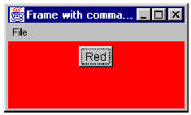
GUI Actions : The Sample Screen

Slide 25
GUI Actions : The Code Fragments
The program consists of the File Menu object with the mnuOpen and mnuExit MenuItems added to it. It also contains one button called btnRed.
A click on any of these causes an actionPerformed event that we can trap with the following code:

Slide 26
GUI Actions : The actionPerformed() Logic
public void actionPerformed(ActionEvent e) {
  Object obj = e.getSource();
  if(obj == mnuOpen)
  fileOpen(); //open file
  if (obj == mnuExit)
  exitClicked(); //exit from program
  if (obj == btnRed)
  redClicked(); //turn red
  }
}

Slide 27
GUI Actions : The three private methods
private void exitClicked() {
System.exit(0);
}
//-----------------------------------------
private void fileOpen() {
  FileDialog fDlg = new FileDialog(this, "Open a file",
  FileDialog.LOAD);
  fDlg.show();
}
//-----------------------------------------
private void redClicked() {
  p.setBackground(Color.red);
}

Slide 28
The Problems
Now, as long as there are only a few menu items and buttons, this approach works fine, but when you have dozens of menu items and several buttons, the actionPerformed code can get pretty unwieldy.
In addition, this really seems a little inelegant, since we'd really hope that in an object-oriented language like Java, we could avoid a long series of if statements to identify the selected object.
Instead, we'd like to find a way to have each object receive its commands directly.

Slide 29
Solution: Apply Common Pattern
One way to assure that every object receives its own commands directly is to use the Command object approach.
A Command object always has an Execute() method that is called when an action occurs on that object.
Most simply, a Command object implements at least the following interface:

Slide 30
A Simple Command object Interface
public interface Command {
public void Execute();
}
The objective of using this interface is to reduce the actionPerformed method to:
public void actionPerformed(ActionEvent e) {
Command cmd = (Command)e.getSource();
cmd.Execute();
}

Slide 31
The Result
We can provide an Execute method for each object which carries out the desired action.
Keeping the knowledge of what to do inside the object where it belongs, instead of having another part of the program make these decisions.
One important purpose of the Command pattern is to keep the program and user interface objects completely separate from the actions that they initiate.

Slide 32
Building Command Objects
There are several ways to go about building Command objects for a program like this and each has some advantages.
We'll start with the simplest one: deriving new classes from the MenuItem and Button classes and implementing the Command interface in each.

Slide 33
The Red Button Command Object
Here are examples of extensions to the Button and Menu classes for our simple program:
class btnRedCommand extends Button implements Command {
public btnRedCommand(String caption) {
    super(caption); //initialize the button
}
  public void Execute() {
  p.setBackground(Color.red);
  }
}

Slide 34
The File Exit Command Object
class fileExitCommand extends MenuItem implements Command {
  public fileExitCommand(String caption) {
  super(caption); //initialize the Menu
  }
  public void Execute() {
  System.exit(0);
  }
}

Slide 35
Problem
Mixing the interface object and the control object is not a good idea. Why?
Need to separate the command object from the invoking client.

Slide 36
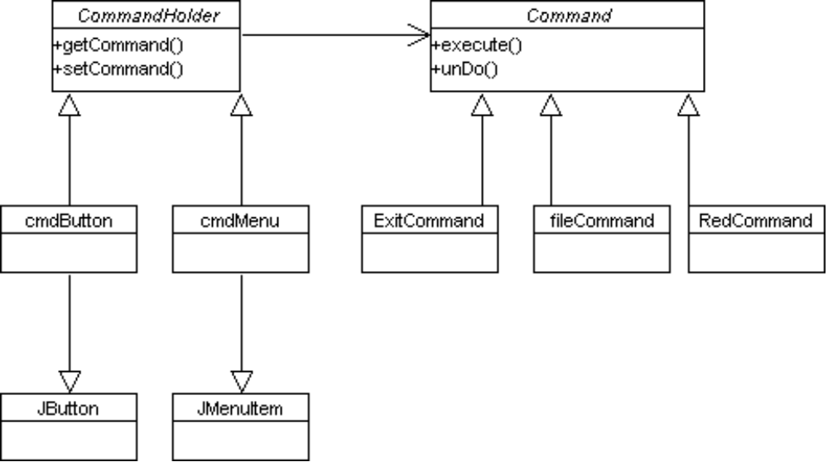
The Solution

Slide 37
The Solution (Cont)
public interface CommandHolder {
public void setCommand(Command comd);
public Command getCommand();
}
public class cmdMenu extends JMenuItem implements CommandHolder {
protected Command menuCommand;
protected JFrame frame;
public cmdMenu(String name, JFrame frm) {
super(name);
frame = frm;
}
public void setCommand(Command comd) {
menuCommand = comd;
}

Slide 38
The Solution (Cont)
public Command getCommand() {
return menuCommand;
}
}
The ActionListener:
public void actionPerformed(ActionEvent e) {
CommandHolder obj = (CommandHolder) e.getSource();
obj.getCommand().execute();
}

Slide 39
The Solution (Cont)
public Command getCommand() {
return menuCommand;
}
}

Slide 40
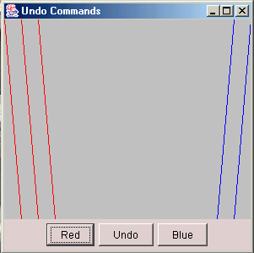
A Simple Drawing Tool with Undo

Slide 41
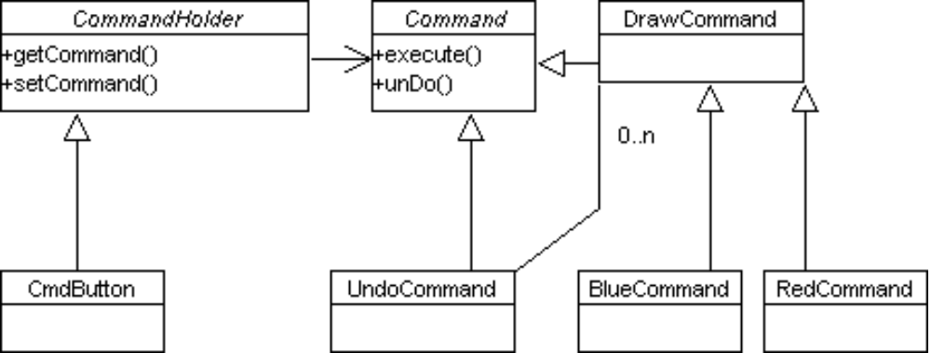
A Simple Drawing Tool with Undo

Slide 42
A Simple Drawing Tool with Undo
ActionListener:
public void actionPerformed(ActionEvent e) {
CommandHolder cmdh = (CommandHolder)e.getSource ();
Command cmd = cmdh.getCommand ();
u_cmd.add (cmd); //add to list
cmd.Execute (); //and execute
}

Slide 43
A Simple Drawing Tool with Undo
public class drawCommand implements Command {
protected Vector drawList;
protected int x, y, dx, dy;
protected Color color;
protected JPanel p;
public drawCommand(JPanel pn) {
drawList = new Vector();
p = pn; //save panel we draw on
}
//------------------------------------
public void Execute() {
drawList.add(new drawData(x, y, dx, dy));
x += dx; //increment to next position
y += dy;
p.repaint();
}

Slide 44
A Simple Drawing Tool with Undo
//------------------------------------
public void unDo() {
int index = drawList.size() -1;
//remove last-drawn line from list
if(index >= 0) {
drawData d = (drawData)drawList.elementAt (index);
drawList.remove (index);
x = d.getX ();
y = d.getY ();
}
p.repaint();
}

Slide 45
A Simple Drawing Tool with Undo
//------------------------------------
public void draw(Graphics g) {
//draw all remaining lines in list
//called by panel's paint method
Dimension sz = p.getSize();
g.setColor (color);
for (int i=0; i < drawList.size (); i++) {
drawData d = (drawData)drawList.elementAt (i);
g.drawLine (d.getX (), d.getY (),
d.getX()+dx, d.getY()+sz.height );
}
}
}

Slide 46
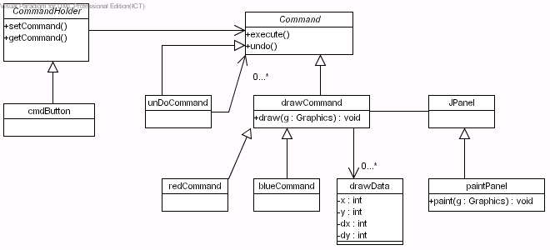
A Simple Drawing Tool with Undo

Slide 47
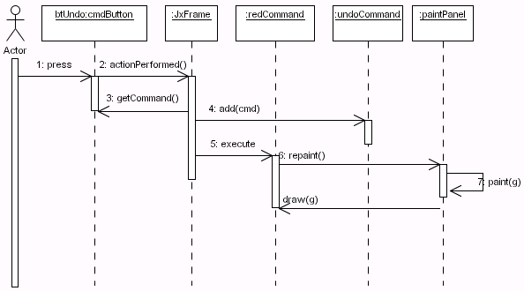
A Simple Drawing Tool with Undo

Slide 48
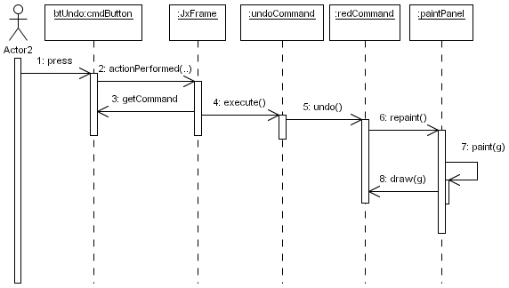
A Simple Drawing Tool with Undo

