Slide 1
Factory Patterns

Slide 2
Problem in Object Creation
Consider to use Vector instead of LinkedList for the following program:
import java.util.*;
public class Main {
public void anOperation1() {
AbstractList list = new LinkedList();
list.add("123");
list.add("456");
System.out.println(list);
}
public void anOperation2() {
AbstractList list = new LinkedList();
list.add("abc");
System.out.println(list);
list.remove(new String());
}
public static void main(String args[])
{
Main m = new Main();
m.anOperation1();
m.anOperation2();
}
}

Slide 3
Problem in Object Creation
The above program is not closed for modification. Why?
Needs to find and replace all occurrence of “new LinkedList()” to “new Vector()”.
Time consuming and error-prone!
Solution: identify the code which may be changed and separate it out.

Slide 4
Identify Codes Which May Change
import java.util.*;
public class Main {
public void anOperation1() {
AbstractList list = new LinkedList();
list.add("123");
list.add("456");
System.out.println(list);
}
public void anOperation2() {
AbstractList list = new LinkedList();
list.add("abc");
System.out.println(list);
list.remove(new String());
}
Codes which may be changed to “new Vector()”

Slide 5
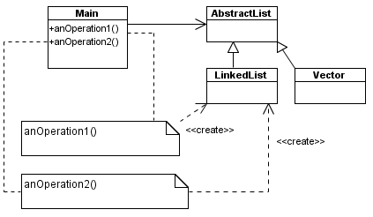
Problem Dependences
Dependence which causes the problem

Slide 6
Apply Open-Closed Principle
Separate the object creation codes (“new LinkedList()” ).
Where to put the codes?
The object creation codes should be put into a new method, e.g.
  public AbstractList createList() { return new LinkedList(); }
Now, the problem is where should this new method reside? Two choices:
  in the class which uses it or
  in a separate class

Slide 7
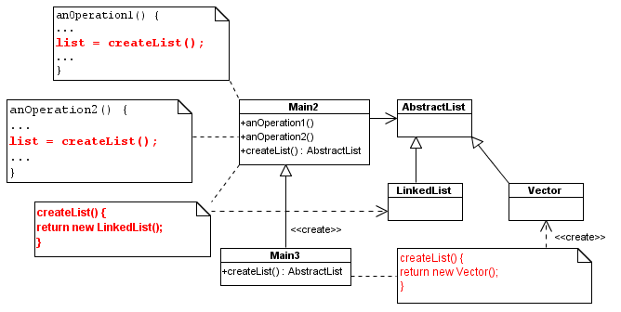
Factory Method
CreateList() is defined in the same class.
The class (Main) which uses the product (Linked List) is also the class which creates the product (Linked List).

Slide 8
Codes after Applying Factory Method
Main2.java:
import java.util.*;
public class Main2 {
public void anOperation1() {
AbstractList list = createList();
list.add("123");
list.add("456");
System.out.println(list);
}
public void anOperation2() {
AbstractList list = createList();
list.add("abc");
System.out.println(list);
list.remove(new String());
}
// Factory method
AbstractList createList() {
return new LinkedList();
}
public static void main(String
args[])
{
Main2 m = new Main2();
m.anOperation1();
m.anOperation2();
}
}

Slide 9
Codes after Applying Factory Method
Main3.java:
import java.util.*;
public class Main3 extends Main2 {
public static void main(String args[]) {
Main3 m = new Main3();
m.anOperation1();
m.anOperation2();
}
AbstractList createList() { // overides superclass method
System.out.println("Create Vector");
return new Vector();
}
}

Slide 10
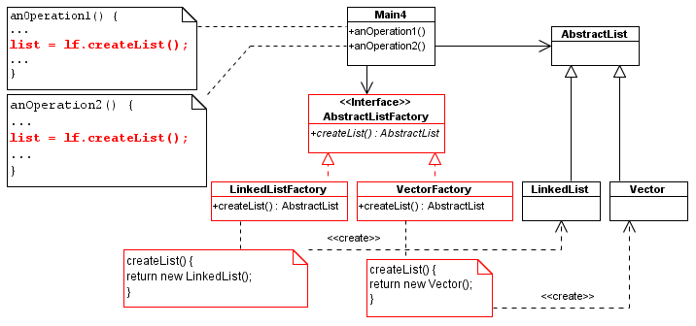
Abstract Factory Method
The factory method (createList()) is separated from the class which uses the method.

Slide 11

Codes after Applying Abstract Factory
Main4.java:
import java.util.*;
public class Main4 {
AbstractListFactory lf = new VectorFactory();
public void anOperation1() {
AbstractList list = lf.createList();
list.add("123");
list.add("456");
System.out.println(list);
}
public void anOperation2() {
AbstractList list = lf.createList();
list.add("abc");
System.out.println(list);
list.remove(new String());
}
public static void main(String args[])
{
Main4 m = new Main4();
m.anOperation1();
m.anOperation2();
}
}

Slide 12

Codes after Applying Abstract Factory
AbstractFactory.java:
import java.util.*;
public interface AbstractListFactory {
public AbstractList createList();
}

Slide 13
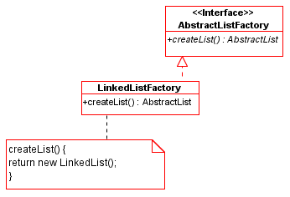
Codes after Applying Abstract Factory
LinkedListFactory.java:
import java.util.*;
public class LinkedListFactory implements AbstractListFactory {
public AbstractList createList() {
System.out.println("create linked list");
return new LinkedList();
}
}

Slide 14
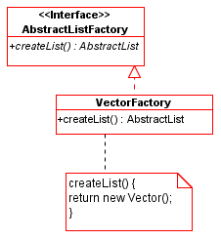
Codes after Applying Abstract Factory
VectorFactory.java:
import java.util.*;
public class VectorFactory implements AbstractListFactory {
public AbstractList createList() {
System.out.println("create vector");
return new Vector();
}
}

Slide 15
Factory Patterns
Factory patterns are examples of creational patterns.
Creational patterns abstract the object instantiation process.
They hide how objects are created and help make the overall system independent of how its objects are created and composed.
Class creational patterns use inheritance to decide the object to be instantiated
  ➔ Factory Method
Object creational patterns delegate the instantiation to another object
  ➔ Abstract Factory

Slide 16
Factory Patterns
All OO languages have an idiom for object creation. In Java this idiom is the new operator.
Creational patterns allow us to write methods that create new objects without explicitly using the new operator.
This allows us to write methods that can instantiate different objects and that can be extended to instantiate other newly-developed objects, all without modifying the method's code! (Quick! Name the principle involved here!)

Slide 17
The Factory Method Pattern
Intent - Define an interface for creating an object, but let subclasses decide which class to instantiate. Factory Method lets a class defer instantiation to subclasses.
Applicability - Use the Factory Method pattern in any of the following situations:
  A class can't anticipate the class of objects it must create
  A class wants its subclasses to specify the objects it creates

Slide 18
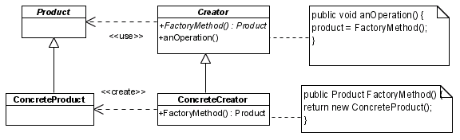
The Factory Method Pattern
Structure

Slide 19
The Factory Method Pattern
Participants
  Product defines the interface for the type of objects the factory method creates
  ConcreteProduct implements the Product interface
  Creator declares the factory method, which returns an object of type Product
  ConcreteCreator overrides the factory method to return an instance of a ConcreteProduct.
Collaborations
  Creator relies on its subclasses to implement the factory method so that it returns an instance of the appropriate ConcreteProduct.

Slide 20
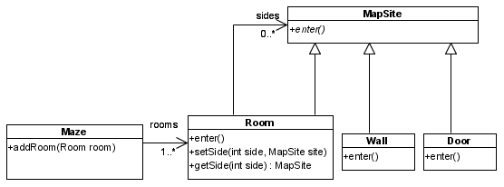
Factory Method Example 1
Consider this maze game:

Slide 21
Factory Method Example 1
Here's a MazeGame class with a createMaze() method:
  /**
  * MazeGame.
  */
  public class MazeGame {
    // Create the maze.
    public Maze createMaze() {
      Maze maze = new Maze();
      Room r1 = new Room(1);
      Room r2 = new Room(2);
      Door door = new Door(r1, r2);
      maze.addRoom(r1);
      maze.addRoom(r2);

Slide 22
Factory Method Example 1
    r1.setSide(MazeGame.North, new Wall());
    r1.setSide(MazeGame.East, door);
    r1.setSide(MazeGame.South, new Wall());
    r1.setSide(MazeGame.West, new Wall());
    r2.setSide(MazeGame.North, new Wall());
    r2.setSide(MazeGame.East, new Wall());
    r2.setSide(MazeGame.South, new Wall());
    r2.setSide(MazeGame.West, door);
    return maze;
  }
}

Slide 23
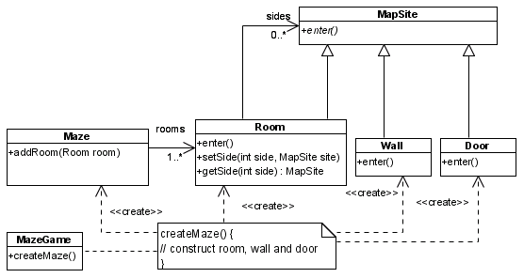
Factory Method Example 1
Problematic Dependences

Slide 24
Factory Method Example 1
The problem with this createMaze() method is its inflexibility.
What if we wanted to have enchanted mazes with EnchantedRooms and EnchantedDoors? Or a secret agent maze with DoorWithLock and WallWithHiddenDoor?
What would we have to do with the createMaze() method? As it stands now, we would have to make significant changes to it because of the explicit instantiations using the new operator of the objects that make up the maze. How can we redesign things to make it easier for createMaze() to be able to create mazes with new types of objects?

Slide 25
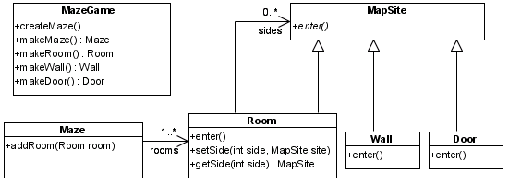
Factory Method Example 1
Solution
Factory Methods

Slide 26
Factory Method Example 1
public class MazeGame {
public final static int North = 0;
public final static int South = 1;
public final static int West = 2;
public final static int East = 3;
// factory methods
public Maze makeMaze() {return new Maze();}
public Room makeRoom(int n) {
return new Room(n);
}
public Wall makeWall() {return new Wall();}
public Door makeDoor(Room r1, Room r2)
{return new Door(r1, r2);}

Slide 27
Factory Method Example 1
Call factory methods to create the required products!
public Maze createMaze() {
Maze maze = makeMaze();
Room r1 = makeRoom(1);
Room r2 = makeRoom(2);
Door door = makeDoor(r1, r2);
maze.addRoom(r1);
maze.addRoom(r2);
r1.setSide(MazeGame.North, makeWall());
r1.setSide(MazeGame.East, door);
r1.setSide(MazeGame.South, makeWall());
r1.setSide(MazeGame.West, makeWall());
r2.setSide(MazeGame.North, makeWall());
r2.setSide(MazeGame.East, makeWall());
r2.setSide(MazeGame.South, makeWall());
r2.setSide(MazeGame.West, door);
return maze;
}

Slide 28
Factory Method Example 1
public static void main(String args[]) {
MazeGame mg = new MazeGame();
Maze maze = mg.createMaze();
System.out.println(maze);
}
}

Slide 29
Factory Method Example 1
We made createMaze() just slightly more complex, but a lot more flexible!
Consider this EnchantedMazeGame class:
  public class EnchantedMazeGame extends MazeGame {
  public Room makeRoom(int n)
  {return new EnchantedRoom(n);}
  public Wall makeWall() {return new EnchantedWall();}
  public Door makeDoor(Room r1, Room r2)
  {
  return new EnchantedDoor(r1, r2);}
  }
The createMaze() method of MazeGame is inherited by EnchantedMazeGame and can be used to create regular mazes or enchanted mazes without modification!

Slide 30
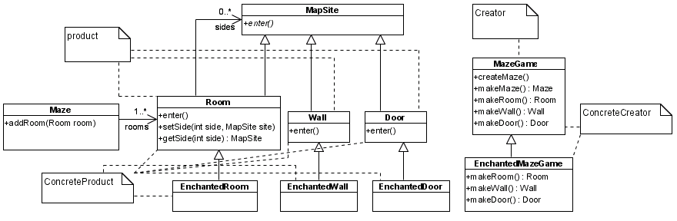
Factory Method Example 1

Slide 31
Factory Method Example 1
The reason this works is that the createMaze() method of MazeGame defers the creation of maze objects to its subclasses.
That's the Factory Method pattern at work!
In this example, the correlations are:
Creator => MazeGame
ConcreteCreator => EnchantedMazeGame (MazeGame is also a ConcreteCreator)
Product => MapSite
ConcreteProduct => Wall, Room, Door, EnchantedWall, EnchantedRoom, EnchantedDoor

Slide 32
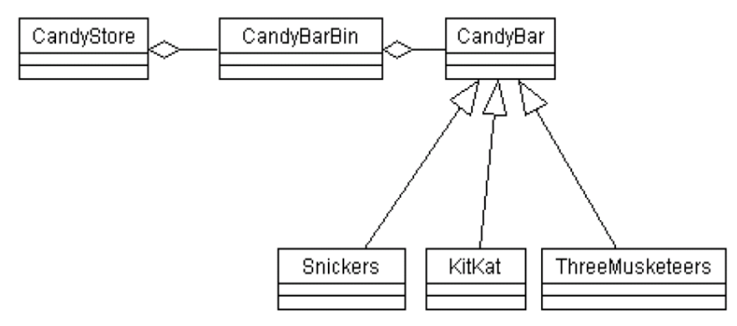
Factory Method Example 2
Consider the following class hierarchy:

Slide 33
Factory Method Example 2
Each CandyBarBin can hold zero or more candy bars, but all the candy bars in one bin are of the same type. (In this case, we say that each bin is a homogeneous container.) We want to write a restock() method for a CandyBarBin, such that when the number of candy bars drops below a certain level, the restock method will add one candy bar of the proper type to the bin.
(Yes, it's silly to add just one candy bar during a restock operation, but it's easy to add a simple loop in the code to restock by a fixed amount.)

Slide 34
Factory Method Example 2
We could have a String attribute of CandyBarBin telling us what type of candy bar the bin holds:
// CandyBarBin.
public class CandyBarBin {
private String cbType; // CandyBar Type
public CandyBarBin(String cbType) {
this.cbType = cbType;}
public void restock() {
if (getAmountInStock() < LowStockLevel) {
if (cbType.equals("Snickers"))
add(new Snickers());
else if (cbType.equals("KitKat"))
add(new KitKat());
else if (cbType.equals("ThreeMusketeers"))
add(new ThreeMusketeers());
}
}

Slide 35
Factory Method Example 2
I trust you are shuddering with revulsion right now just looking at the above code! Does this restock() method satisfy the Open-Closed Principle? Nope! If we want to sell a new type of candy bar, we have to modify the restock() method.
Whenever we have an if-else statement of this sort, deciding what to do based on alternatives represented by the state of an object, it’s a sure sign that polymorphism can come to the rescue!

Slide 36
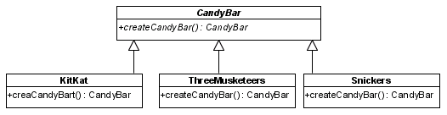
Factory Method Example 2
Solution

Slide 37
Factory Method Example 2
First, let’s have CandyBar provide a factory method for creation of candy bars:
  public class CandyBar {
  // Factory Method.
  public CandyBar createCandyBar()
  {return new CandyBar();}
  ...
  }
Now each CandyBar subclass can provide the correct implementation of the createCandyBar() method. For example, here is the KitKat class:
  public class KitKat extends CandyBar {
  // Factory Method.
  public Candybar createCandyBar()
  {return new KitKat();}
  }

Slide 38
Factory Method Example 2
Now CandyBarBin can look like this:
public class CandyBarBin {
private CandyBar cb;
public CandyBarBin(CandyBar cb) {this.cb = cb;}
public void restock() {
if (getAmountInStock() < LowStockLevel) {
add(cb.createCandyBar());
}
}

Slide 39
The Factory Method Pattern
Benefits:
  Code is made more flexible and reusable by the elimination of instantiation of application-specific classes
  Code deals only with the interface of the Product class and can work with any ConcreteProduct class that supports this interface
Liabilities:
  Clients might have to subclass the Creator class just to instantiate a particular ConcreteProduct
Implementation Issues:
  Creator can be abstract or concrete
  Should the factory method be able to create multiple kinds of products? If so, then the factory method has a parameter (possibly used in an if-else!) to decide what object to create. We could override this factory method in a subclass to try to avoid OCP problems.

Slide 40
The Abstract Factory Pattern
Intent
Provide an interface for creating families of related or dependent objects without specifying their concrete classes.
The Abstract Factory pattern is very similar to the Factory Method pattern.
The main difference between the two is that with the Abstract Factory pattern, a class delegates the responsibility of object instantiation to another object via composition whereas the Factory Method pattern uses inheritance and relies on a subclass to handle the desired object instantiation.
Actually, the delegated object frequently uses factory methods to perform the instantiation!

Slide 41
The Abstract Factory Pattern
Applicability
Use the Abstract Factory pattern in any of the following situations:
  A system should be independent of how its products are created, composed, and represented
  A class can't anticipate the class of objects it must create
  A system must use just one of a set of families of products
  A family of related product objects is designed to be used together, and you need to enforce this constraint

Slide 42
Real Life Examples of Product Families
Mobile phone and its accessories: charger, cover, etc
GUI Libraries, e.g. AWT Components (Button, Frame, etc.) should not be mixed with Swing Components (JFrame, JButton, etc.)
A car body and its engine, wheels, etc.

Slide 43
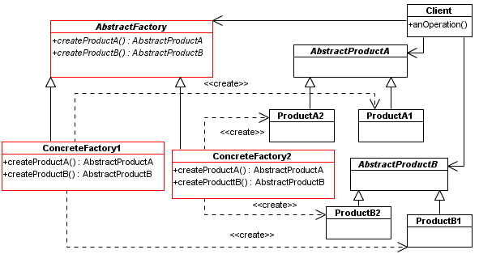
The Abstract Factory Pattern
Structure

Slide 44
The Abstract Factory Pattern
Participants
  AbstractFactory declares an interface for operations that create abstract product objects
  ConcreteFactory implements the operations to create concrete product objects
  AbstractProduct declares an interface for a type of product object
  ConcreteProduct defines a product object to be created by the corresponding concrete factory and implements the AbstractProduct interface
  Client uses only interfaces declared by AbstractFactory and AbstractProduct classes

Slide 45
The Abstract Factory Pattern
Collaborations
  Normally a single instance of a ConcreteFactory class is created at runtime. (This is an example of the Singleton Pattern.)
  This concrete factory creates product objects having a particular implementation. To create different product objects, clients should use a different concrete factory.
  AbstractFactory defers creation of product objects to its ConcreteFactory
Common Terminology Usage
  Anytime we delegate object creation to a contained object we our using the Abstract Factory pattern
  But we tend to just say that “we are using a factory.”

Slide 46
Abstract Factory Example 1
Let's see how an Abstract Factory can be applied to the MazeGame
First, we'll write a MazeFactory class as follows:
  // MazeFactory.
  public class MazeFactory {
    public Maze makeMaze() {return new Maze();}
    public Room makeRoom(int n)
    {return new Room(n);}
    public Wall makeWall() {return new Wall();}
    public Door makeDoor(Room r1, Room r2)
    {return new Door(r1, r2);}
  }
Note that the MazeFactory class is just a collection of factory methods!
Also, note that MazeFactory acts as both an AbstractFactory and a ConcreteFactory.

Slide 47
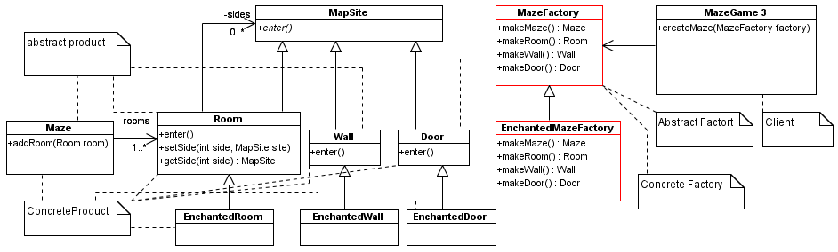
Abstract Factory Example 1

Slide 48
Abstract Factory Example 1
Now the createMaze() method of the MazeGame class takes a MazeFactory reference as a parameter:
  public class MazeGame {
  public Maze createMaze(MazeFactory factory) {
    Maze maze = factory.makeMaze();
    Room r1 = factory.makeRoom(1);
    Room r2 = factory.makeRoom(2);
    Door door = factory.makeDoor(r1, r2);
    maze.addRoom(r1);
    maze.addRoom(r2);
    r1.setSide(MazeGame.North, factory.makeWall());
    r1.setSide(MazeGame.East, door);

Slide 49
Abstract Factory Example 1
    r1.setSide(MazeGame.South, factory.makeWall());
    r1.setSide(MazeGame.West, factory.makeWall());
    r2.setSide(MazeGame.North, factory.makeWall());
    r2.setSide(MazeGame.East, factory.makeWall());
    r2.setSide(MazeGame.South, factory.makeWall());
    r2.setSide(MazeGame.West, door);
    return maze;
  }
}
Note how createMaze() delegates the responsibility for creating maze objects to the MazeFactory object

Slide 50
Abstract Factory Example 1
We can easily extend MazeFactory to create other factories:
public class EnchantedMazeFactory extends MazeFactory {
  public Room makeRoom(int n)
  {return new EnchantedRoom(n);}
  public Wall makeWall() {return new EnchantedWall();}
  public Door makeDoor(Room r1, Room r2)
  {return new EnchantedDoor(r1, r2);}
}
In this example, the correlations are:
  AbstractFactory => MazeFactory
  ConcreteFactory => EnchantedMazeFactory (MazeFactory is also a ConcreteFactory)
  AbstractProduct => MapSite
  ConcreteProduct => Wall, Room, Door, EnchantedWall, EnchantedRoom, EnchantedDoor
  Client => MazeGame

Slide 51
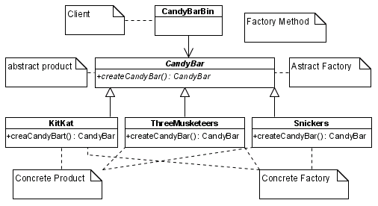
Abstract Factory Example 2

Slide 52
Abstract Factory Example 2
Let’s revisit our Candy Store. At one point we had:
public class CandyBarBin {
  private CandyBar cb;
  public CandyBarBin(CandyBar cb) {this.cb = cb;}
  public void restock() {
    if (getAmountInStock() < LowStockLevel) {
      add(cb.createCandyBar());
    }
  }
}
We are delegating the creation of CandyBar objects to our contained CandyBar member, cb, which acts as a concrete factory of CandyBar objects. And the createCandyBar method is a Factory Method of CandyBar, whose proper implementation is provided by the subclass of CandyBar we are actually using!

Slide 53
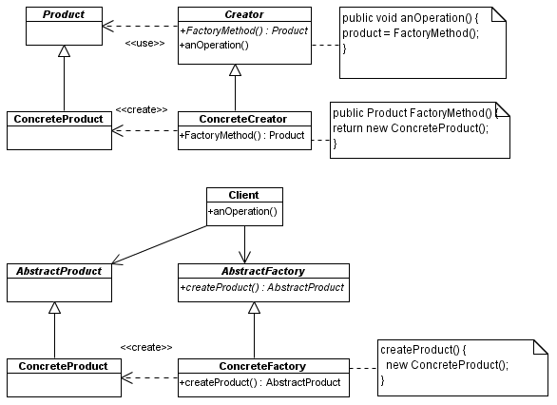
Comparison of Factory Method & Abstract Factory
Factory Method Design Pattern
Abstract Factory Design Pattern

Slide 54
Comparison of Factory Method & Abstract Factory
 | Factory Method | Abstract Factory
1 | The same class creates and uses the product. | the client uses the factory class to creates the product.
2 | Suitable for creating independent products | Suitable for creating a set of dependent/compatible products, e.g. Java AWT GUI components or Java Swing GUI components
3 | Change the product created by overriding the factory method in the subclass of Creator | Change the product created by changing the associated factory class.

