Slide 1
CS-338 Intro to the Theory of Computation
Lecture #10
Undecidability
Prof Pietro S. Oliveto Department of Computer Science and Engineering Southern University of Science and Technology (SUSTech)
olivetop@sustech.edu.cn https://faculty.sustech.edu.cn/olivetop
Office: Room 113
CS338: Introduction to the Theory of Computation
1

Slide 2
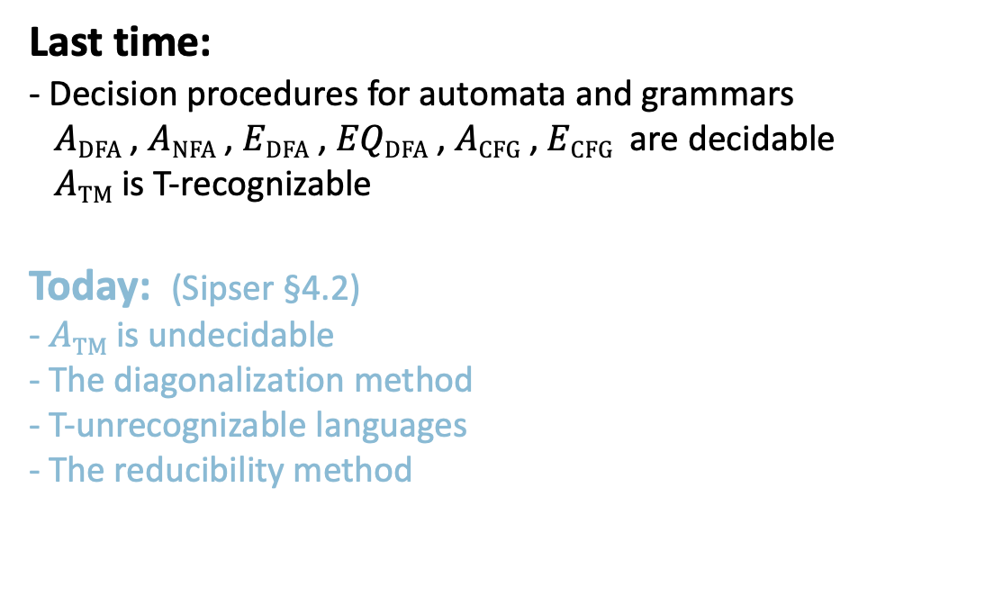
Overview
Last time: - Decision procedures for automata and grammars
$A\text{DFA}$ , $A\text{NFA}$ , $E\text{DFA}$ , $EQ\text{DFA}$ , $A\text{CFG}$ , $E\text{CFG}$ are decidable
$A\text{TM}$ is T-recognizable
Today: (Sipser §4.2) - $A\text{TM}$ is undecidable
- The diagonalization method
- T-unrecognizable languages
- The reducibility method
2

Slide 3
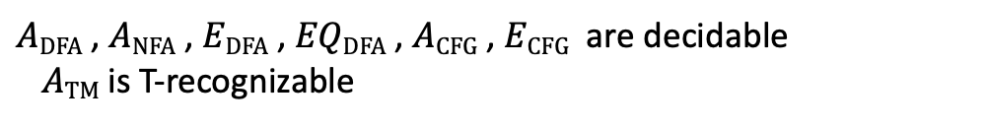
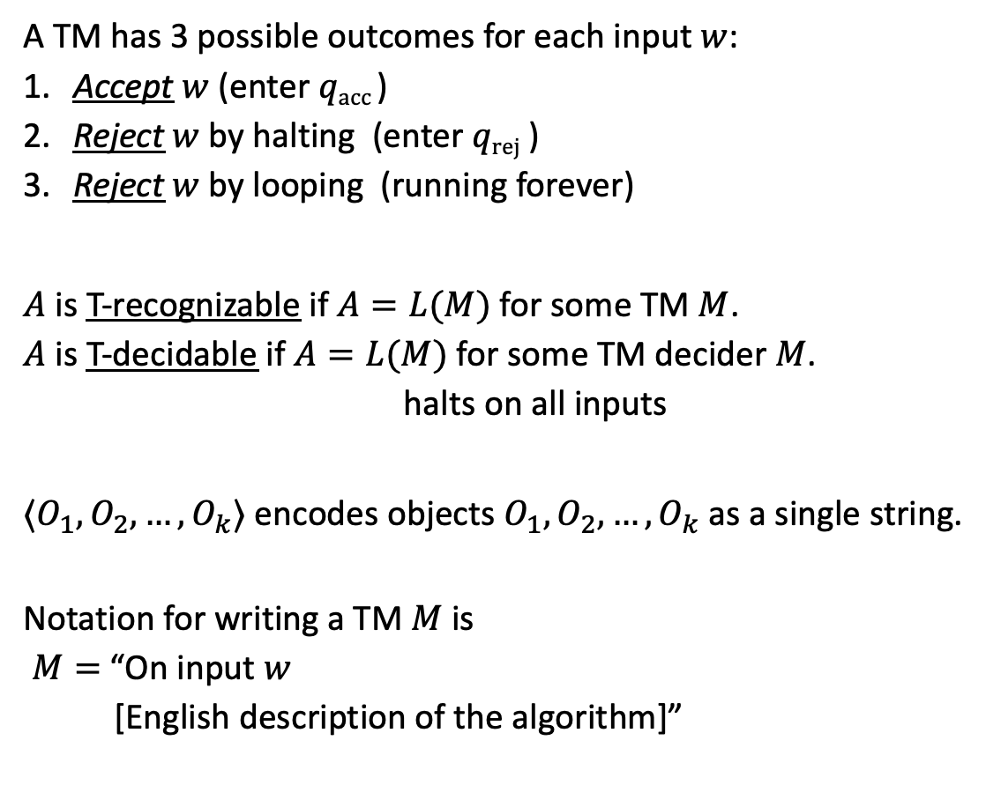
TMs and Encodings – review
A TM has 3 possible outcomes for each input $w$:
Accept $w$ (enter $q\text{acc}$)
Reject $w$by halting (enter $q\text{rej}$ )
Reject $w$by looping (running forever)
$A$ is T-recognizable if $A=L(M)$ for some TM $M$.
$A$ is T-decidable if $A=L(M)$ for some TM decider $M$.
halts on all inputs
$〈O_{1}, O_{2}, …, O_{k}〉$ encodes objects $O_{1}, O_{2}, …, O_{k}$ as a single string.
Notation for writing a TM $M$ is
$M=$ “On input $w$
[English description of the algorithm]”
$A\text{DFA}$ , $A\text{NFA}$ , $E\text{DFA}$ , $EQ\text{DFA}$ , $A\text{CFG}$ , $E\text{CFG}$ are decidable
$A\text{TM}$ is T-recognizable

Slide 4
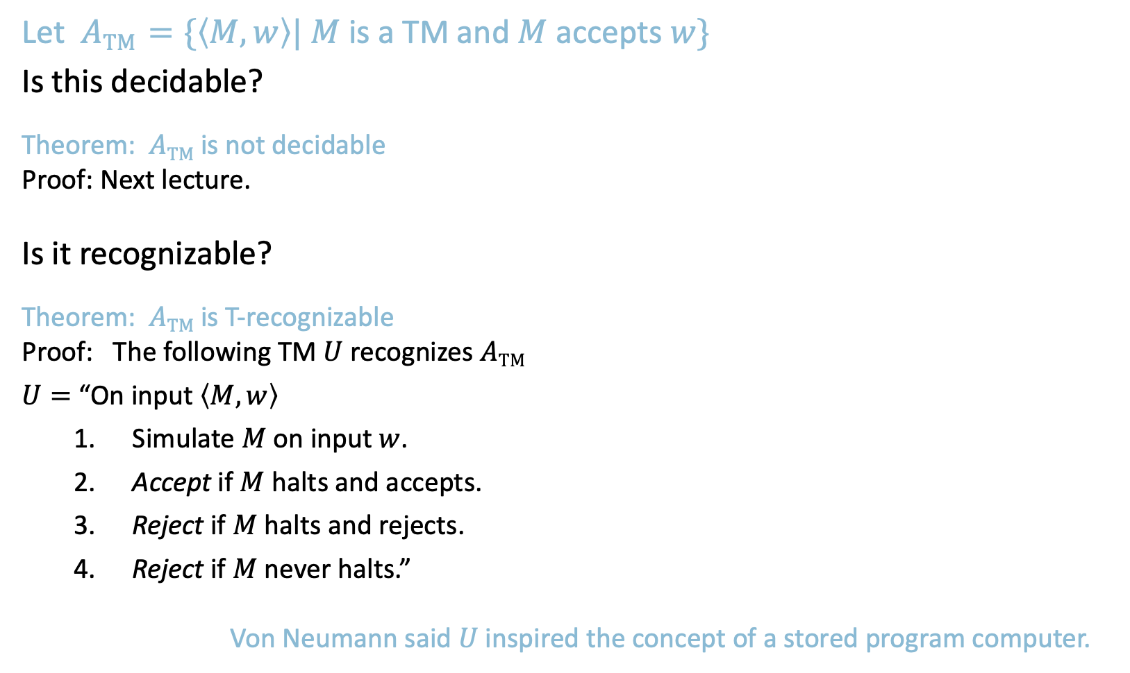


Acceptance Problem for TMs
The acceptance problem for a TM is that of determining whether a Turing machine accepts a given string.
Let $A\text{TM}$ $=\{〈M,w〉| M$ is a TM and $M$ accepts $w\}$
Is this decidable?
Theorem: $A\text{TM}$is not decidable
Proof: Next lecture.
Is it recognizable?
Theorem: $A\text{TM}$is T-recognizable
Proof: The following TM $U$ recognizes $A\text{TM}$
$U=$ “On input $〈M,w〉$
Simulate $M$ on input $w$.
Accept if $M$ halts and accepts.
Reject if $M$ halts and rejects.
Reject if $M$ never halts.”
Von Neumann said $U$inspired the concept of a stored program computer.
Turing’s original “Universal Computing Machine”
(capable of simulating another TM from the description of that machine)
Description of $M$, input $w$
$$U$$
Not a legal TM action.
14

Slide 5
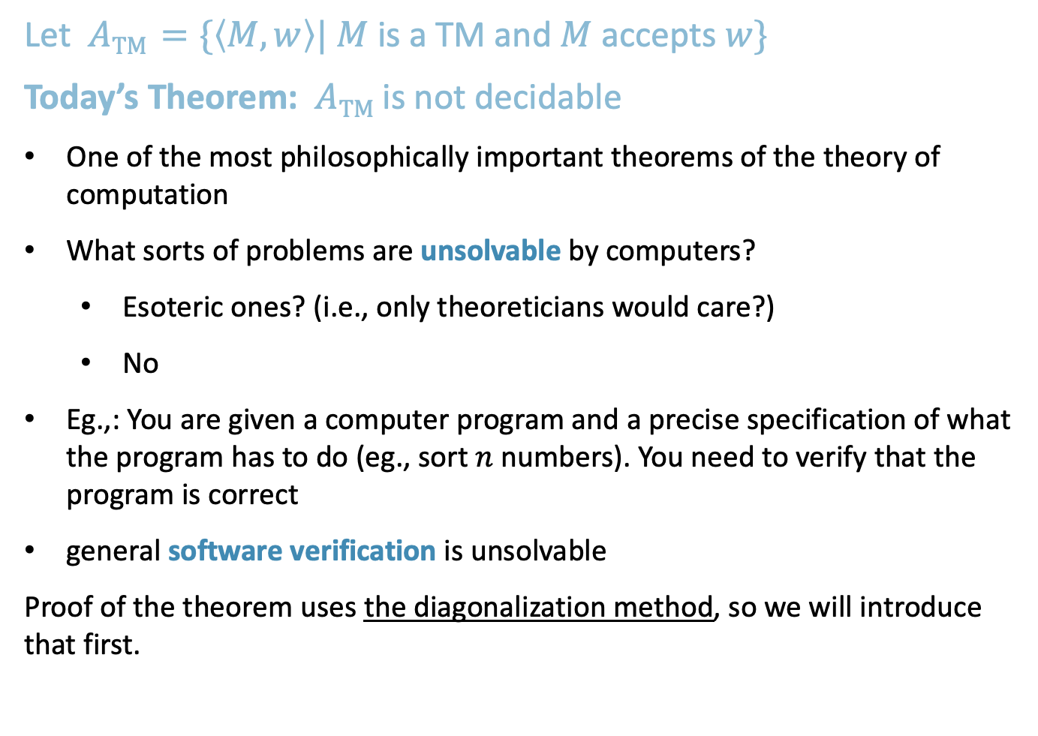
Recall: Acceptance Problem for TMs
Let $A\text{TM}$ $=\{〈M,w〉| M$ is a TM and $M$ accepts $w\}$
Today’s Theorem: $A\text{TM}$is not decidable
One of the most philosophically important theorems of the theory of computation
What sorts of problems are unsolvable by computers?
Esoteric ones? (i.e., only theoreticians would care?)
No
Eg.,: You are given a computer program and a precise specification of what the program has to do (eg., sort $n$ numbers). You need to verify that the program is correct
general software verification is unsolvable
Proof of the theorem uses the diagonalization method, so we will introduce that first.
3

Slide 6

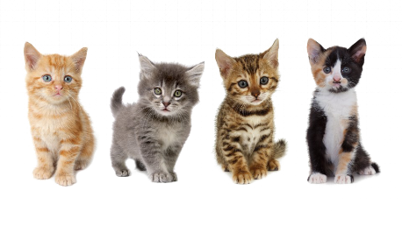







The Size of Infinity
How to compare the relative sizes of infinite sets?
Cantor (~1890s) had the following idea.
Defn: Say that set $A$ and $B$ have the same size if there is a one-to-one and onto function $f:A→B$
Informally, two sets have the same size if we can pair up their members.
This definition works for finite sets.
Apply it to infinite sets too.
$$x≠y→$$
$$f\left(x\right)≠f\left(y\right)$$
“injective”
Range $(f)=B$ “surjective”
We call such an $f$ a 1-1 correspondence
$f$:
4

Slide 7




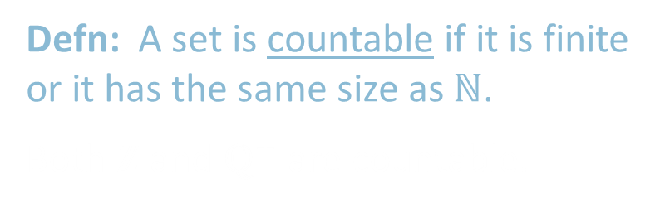


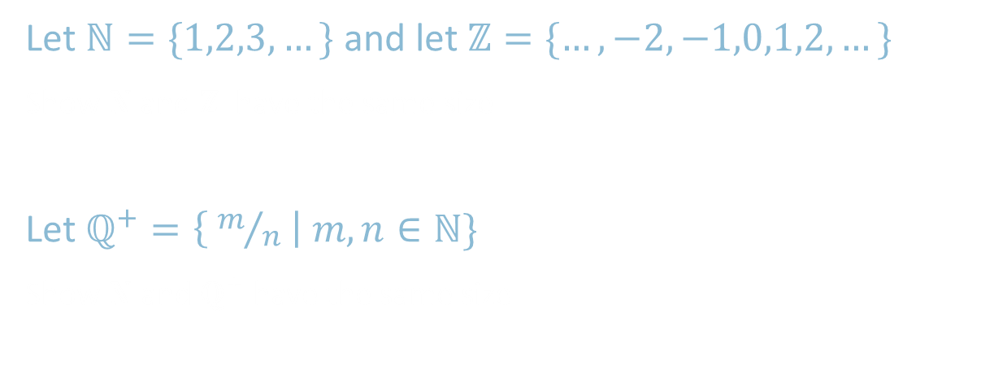

Countable Sets
Let $ℕ=\{1,2,3,…\}$ and let $ℤ=\{…,−2,−1,0,1,2,…\}$
Show $ℕ$and $ℤ$ have the same size
Let $ℚ^{+}=\left\{ m/n \right| m,n∈ℕ\}$
Show $ℕ$ and $ℚ^{+}$ have the same size
$$n$$ | $$f(n)$$
1 | 0
2 | -1
3 | 1
4 | -2
5 | 2
6 | -3
7 | 3
$⋮$ | $⋮$
$$ℕ$$
$$ℤ$$
$$n$$ | $$f(n)$$
1 | 1/1
2 | 2/1
3 | 1/2
4 | 3/1
5 | 3/2
6 | 2/3
7 | 1/3
$⋮$ | $⋮$
$$ℚ^{+}$$ | 1 | 2 | 3 | 4 | …
1 | 1/1 | 1/2 | 1/3 | 1/4
2 | 2/1 | 2/2 | 2/3 | 2/4 | …
3 | 3/1 | 3/2 | 3/3 | 3/4
4 | 4/1 | 4/2 | 4/3 | 4/4
$$⋮$$ |  | $$⋮$$
$$ℕ$$
$$ℚ^{+}$$
Defn: A set is countable if it is finite or it has the same size as $ℕ$.
Both $ℤ$ and $ℚ^{+}$ are countable.
5

Slide 8
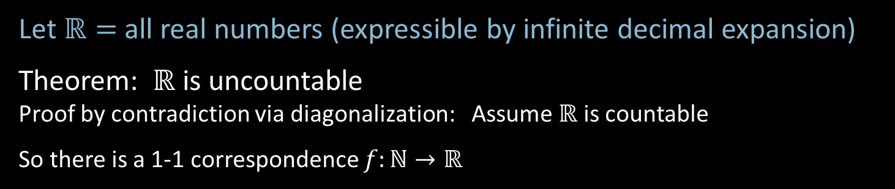



$ℝ$ is Uncountable – Diagonalization
Let $ℝ=$all real numbers (expressible by infinite decimal expansion)
Theorem: $ℝ$ is uncountable
Proof by contradiction via diagonalization: Assume $ℝ$ is countable
So there is a 1-1 correspondence $f:ℕ→ℝ$
$$n$$ | $$f(n)$$
1 | 2.718281828…
2 | 3.141592653…
3 | 0.000000000…
4 | 1.414213562…
5 | 0.142857242…
6 | 0.207879576…
7 | 1.234567890…
$⋮$ | $$⋮$$
Demonstrate a number $x∈ℝ$ that is missing from the list.
$x=$ 0.8516182…
differs from the $n$^{th} number in the $n$^{th} digit so cannot be the $n$^{th} number for any $n$.
Hence $x$ is not paired with any $n.$ It is missing from the list.
Therefore $f$ is not a 1-1 correspondence.
7
≠4
≠7
≠0
≠2
≠5
≠9
≠8
4
0
2
5
9
8
Diagonalization
6

Slide 9
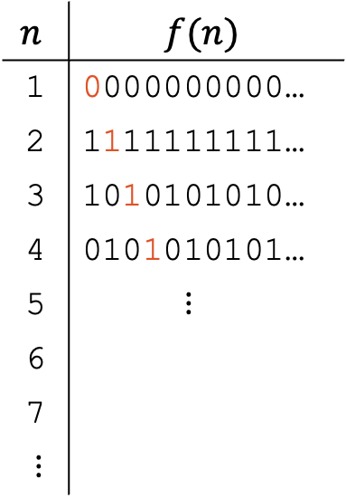

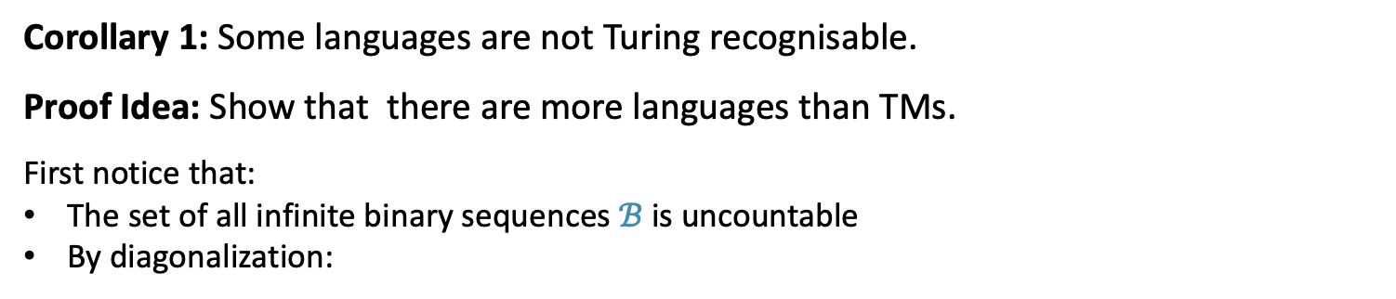
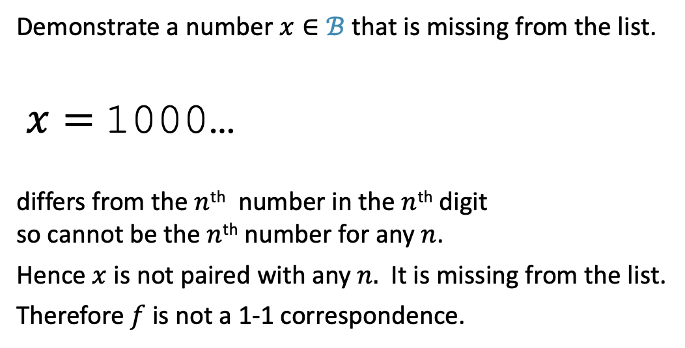
$ℝ$ is Uncountable – Corollary (1)
Corollary 1: Some languages are not Turing recognisable.
Proof Idea: Show that there are more languages than TMs.
First notice that:
The set of all infinite binary sequences $ℬ$ is uncountable
By diagonalization:
$$n$$ | $$f(n)$$
1 | 0000000000…
2 | 1111111111…
3 | 1010101010…
4 | 0101010101…
5 | $⋮$
6
7
$⋮$
Demonstrate a number $x∈ℬ$ that is missing from the list.
$x=$ 1000…
differs from the $n$^{th} number in the $n$^{th} digit so cannot be the $n$^{th} number for any $n$.
Hence $x$ is not paired with any $n.$ It is missing from the list.
Therefore $f$ is not a 1-1 correspondence.
7

Slide 10
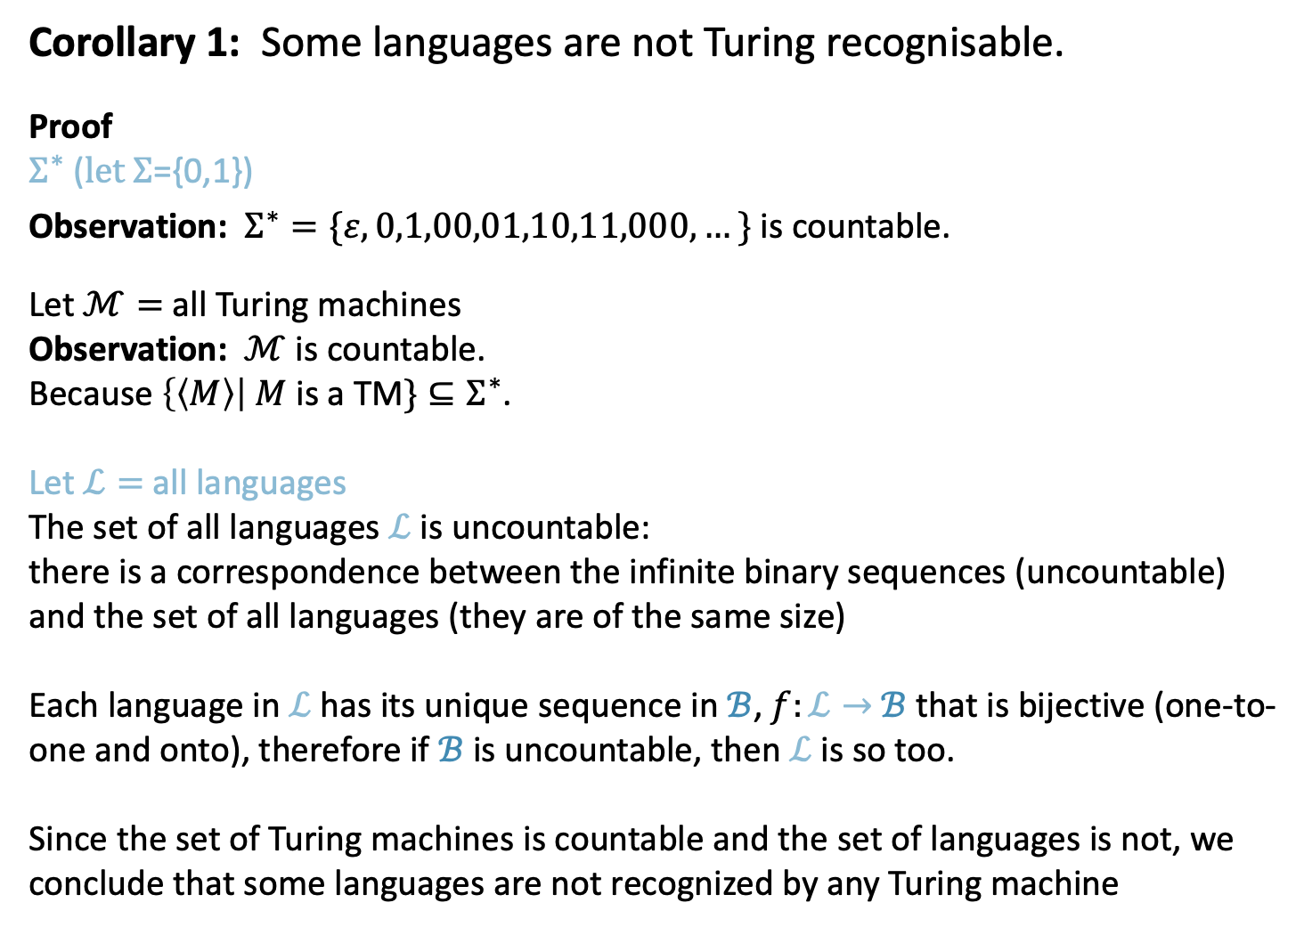

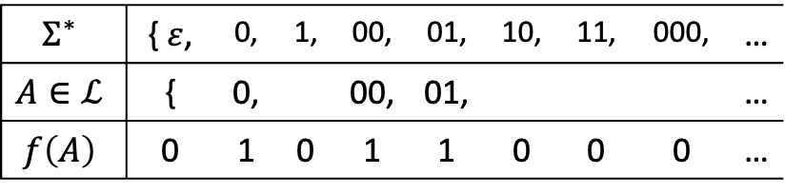
$ℝ$ is Uncountable – Corollary (2)
Corollary 1: Some languages are not Turing recognisable.
Proof
$Σ^{∗}$ ($let Σ$={0,1})
Observation: $Σ^{∗}=\{ε, 0,1,00,01,10,11,000, …\}$ is countable.
Let $ℳ=$all Turing machines
Observation: $ℳ$ is countable.
Because $\left\{〈M〉\right| M$ is a TM$\}⊆Σ^{∗}$.
Let $ℒ=$all languages
The set of all languages $ℒ$ is uncountable:
there is a correspondence between the infinite binary sequences (uncountable) and the set of all languages (they are of the same size)
Each language in $ℒ$ has its unique sequence in $ℬ$, $f:ℒ→$ $ℬ$ that is bijective (one-to-one and onto), therefore if $ℬ$ is uncountable, then $ℒ$ is so too.
Since the set of Turing machines is countable and the set of languages is not, we conclude that some languages are not recognized by any Turing machine
$$Σ^{∗}$$ | {$ε$, | 0, | 1, | 00, | 01, | 10, | 11, | 000, | …
$$A∈ℒ$$ | { | 0, |  | 00, | 01, |  |  |  | …
$$f\left(A\right)$$ | 0 | 1 | 0 | 1 | 1 | 0 | 0 | 0 | …
8

Slide 11
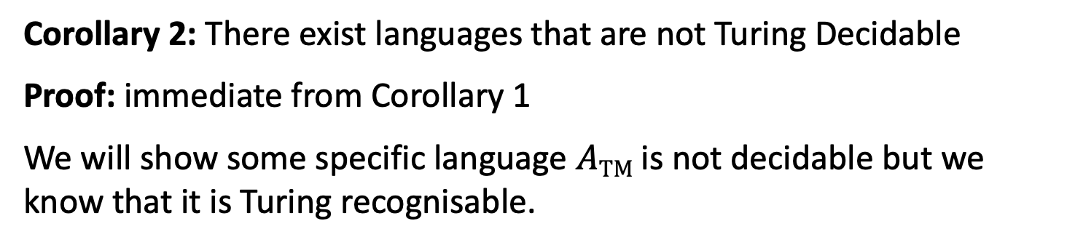

$ℝ$ is Uncountable – Corollary 2
Corollary 2: There exist languages that are not Turing Decidable
Proof: immediate from Corollary 1
We will show some specific language $A\text{TM}$ is not decidable but we know that it is Turing recognisable.
9

Slide 12


$A\text{TM}$ is undecidable
Recall $A\text{TM}$ $=\{〈M,w〉| M$ is a TM and $M$ accepts $w\}$
Theorem: $A\text{TM}$is not decidable
Proof by contradiction: Assume some TM $H$ decides $A\text{TM}$.
So $H$ on $〈M,w〉=\left\{\begin{aligned}\text{Accept} \text{if} M \text{accepts} w \\ \text{Reject} \text{if} \text{not} \end{aligned}\right.$
Use $H$ to construct TM $D$
$D=$“On input $〈M〉$
1. Simulate $H$ on input $〈M,〈M〉〉$
2. Accept if $H$ rejects. Reject if $H$ accepts.”
$D$ accepts $〈M〉$ iff $M$ doesn’t accept $〈M〉$ .
$D$ accepts $〈D〉$ iff $D$ doesn’t accept $〈D〉$ .
Contradiction.
Why is this proof a diagonalization?
10

Slide 13
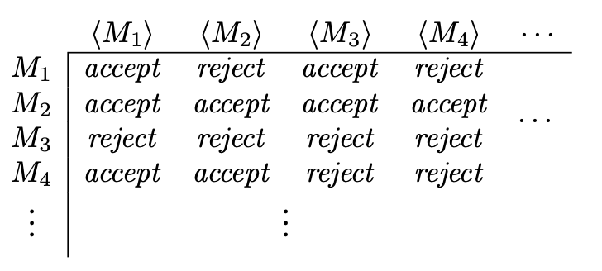
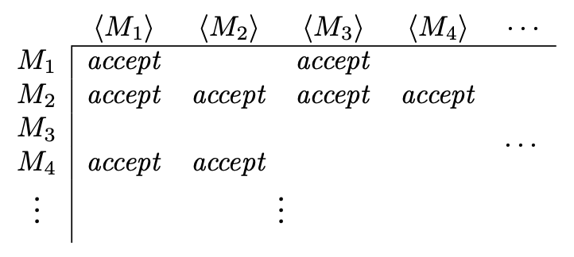
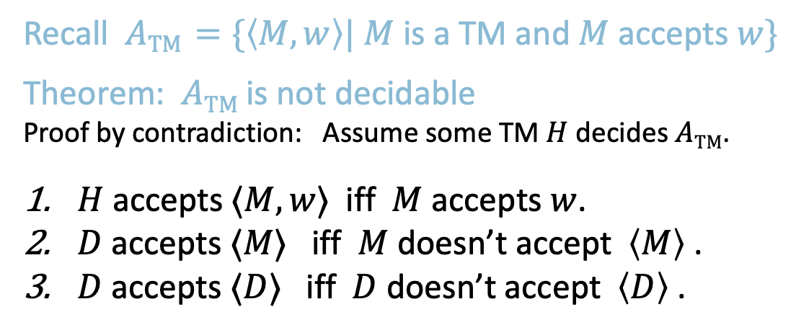
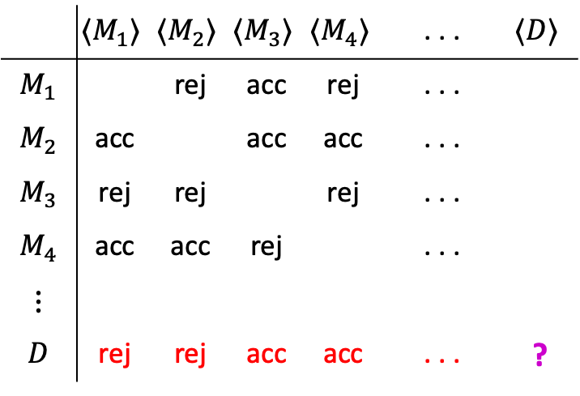
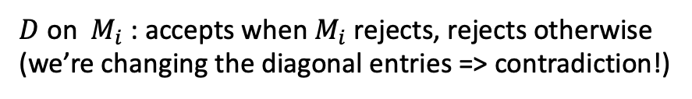
$A\text{TM}$ is undecidable
Recall $A\text{TM}$ $=\{〈M,w〉| M$ is a TM and $M$ accepts $w\}$
Theorem: $A\text{TM}$is not decidable
Proof by contradiction: Assume some TM $H$ decides $A\text{TM}$.
$H$ accepts $〈M,w〉$ iff $M$ accepts $w$.
$D$ accepts $〈M〉$ iff $M$ doesn’t accept $〈M〉$ .
$D$ accepts $〈D〉$ iff $D$ doesn’t accept $〈D〉$ .
$H$ on$M_{i}$: accepts when $M$ accepts, rejects otherwise
$D$on ${ M}_{i}$ : accepts when${ M}_{i}$ rejects, rejects otherwise (we’re changing the diagonal entries => contradiction!)
Why is this proof a diagonalization?
All TMs
All TM descriptions:
$M_{i}$ on $w$: Either accepts, or empty if rejects or loops
 | $$〈M_{1}〉$$ | $$〈M_{2}〉$$ | $$〈M_{3}〉$$ | $$〈M_{4}〉$$ | . . . | $$〈D〉$$
$$M_{1}$$ |  | rej | acc | rej | . . .
$$M_{2}$$ | acc |  | acc | acc | . . .
$$M_{3}$$ | rej | rej |  | rej | . . .
$$M_{4}$$ | acc | acc | rej |  | . . .
$$⋮$$ |  |  | $$⋮$$
$$D$$ | rej | rej | acc | acc | . . . | ?
acc
acc
rej
rej
11

Slide 14
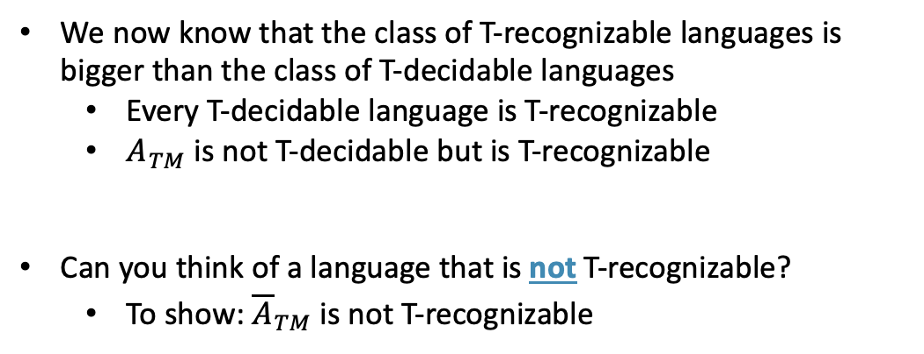
Summary
We now know that the class of T-recognizable languages is bigger than the class of T-decidable languages
Every T-decidable language is T-recognizable
$A_{TM}$ is not T-decidable but is T-recognizable
Can you think of a language that is not T-recognizable?
To show: ${\overline{A}}_{TM}$ is not T-recognizable
T-recognizable
T-decidable
CFLs
regular
12

Slide 15
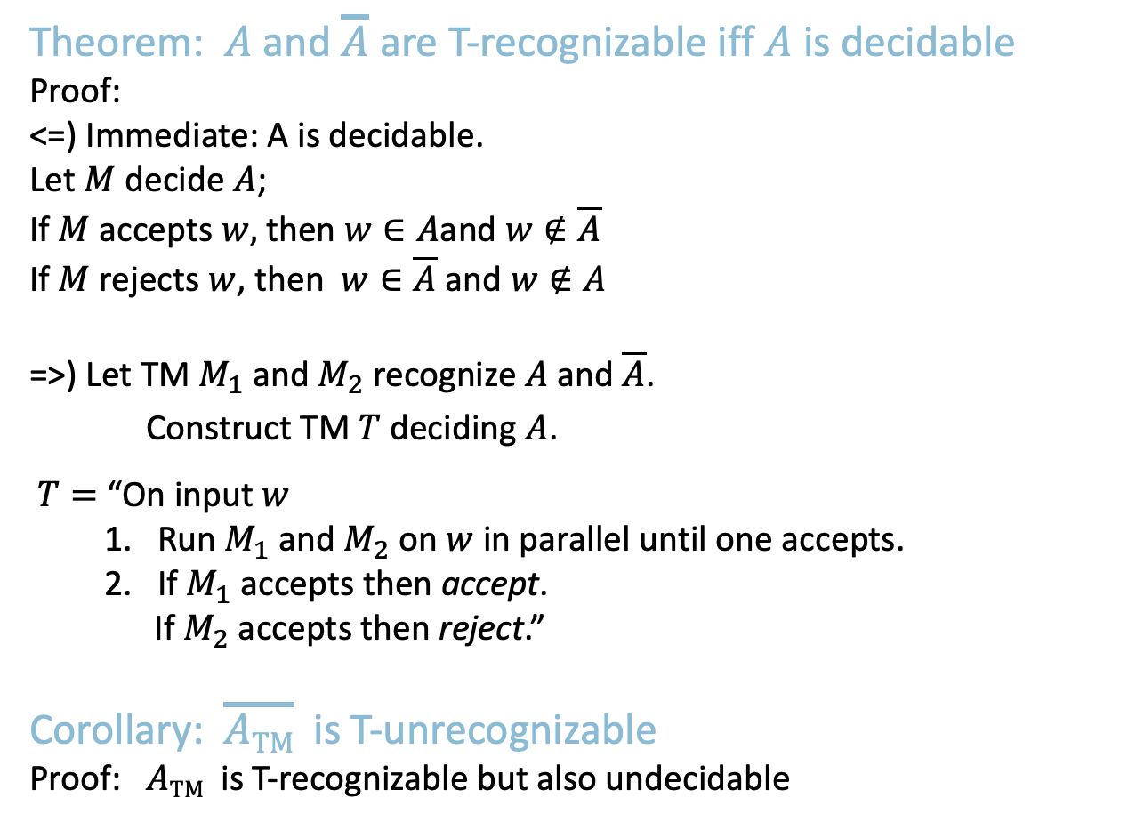



$\overline{A\text{TM}}$ is T-unrecognizable
Theorem: $A$ and $\overline{A}$ are T-recognizable iff $A$ is decidable
Proof:
<=) Immediate: A is decidable.
Let $M$ decide $A$;
If $M$ accepts $w,$ then $w∈A$and $w∉\overline{A}$
If $M$ rejects $w$, then $w∈\overline{A}$ and $w∉A$
=>) Let TM $M_{1}$ and $M_{2}$ recognize $A$ and $\overline{A}$.
Construct TM $T$ deciding $A$.
$T=$ “On input $w$
1. Run $M_{1}$ and $M_{2}$ on $w$ in parallel until one accepts.
2. If $M_{1}$ accepts then accept. If $M_{2}$ accepts then reject.”
Corollary: $\overline{A\text{TM}}$ is T-unrecognizable
Proof: $A\text{TM}$ is T-recognizable but also undecidable
Complement of T-recognizable = co-T-recognizable
T-recognizable
$$\overline{A\text{TM}}$$
$A\text{TM}$
decidable
13

Slide 16
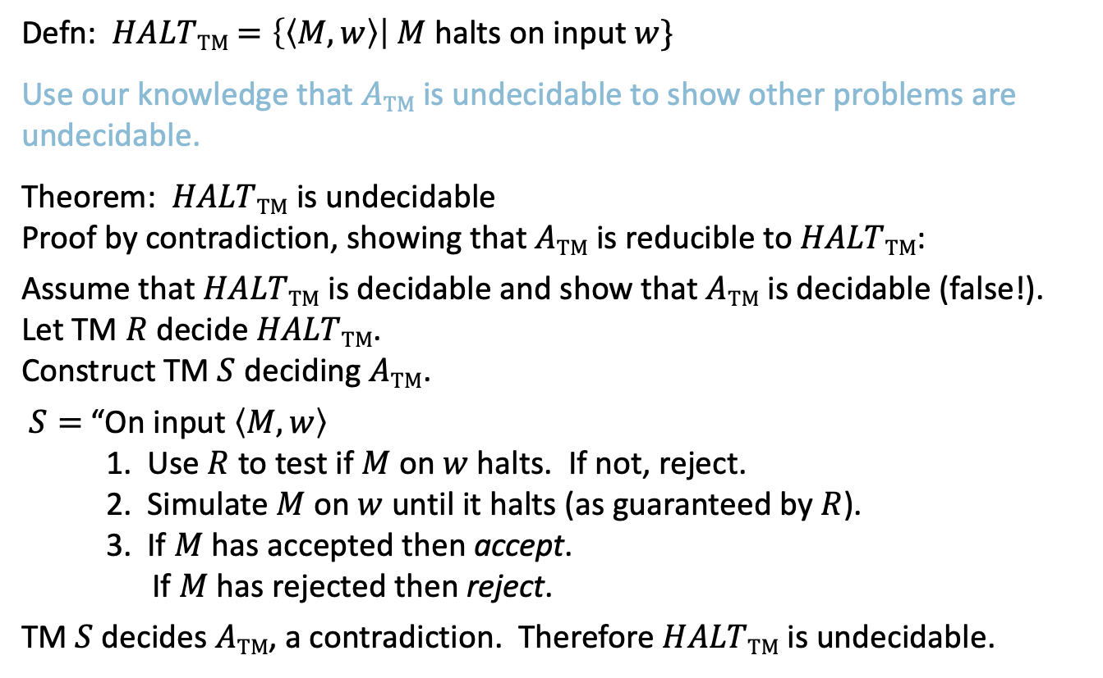
The Reducibility Method
Defn: $HALT\text{TM}$ $=\left\{〈M,w〉\right| M$halts on input $w\}$
Use our knowledge that $A\text{TM}$ is undecidable to show other problems are undecidable.
Theorem: $HALT\text{TM}$ is undecidable
Proof by contradiction, showing that $A\text{TM}$ is reducible to $HALT\text{TM}$:
Assume that $HALT\text{TM}$ is decidable and show that $A\text{TM}$ is decidable (false!).
Let TM $R$ decide $HALT\text{TM}$.
Construct TM $S$ deciding $A\text{TM}$.
$S=$ “On input $〈M,w〉$
1. Use $R$ to test if $M$ on $w$ halts. If not, reject.
2. Simulate $M$ on $w$ until it halts (as guaranteed by $R$).
3. If $M$ has accepted then accept. If $M$ has rejected then reject.
TM $S$ decides $A\text{TM}$, a contradiction. Therefore $HALT\text{TM}$ is undecidable.
14

Slide 17

Quick review of today
Showed that $ℕ$ and $ℝ$ are not the same size to introduce the Diagonalization Method.
$A\text{TM}$ is undecidable.
If $A$ and $\overline{A}$ are T-recognizable then $A$ is decidable.
$\overline{A\text{TM}}$ is T-unrecognizable.
Introduced the Reducibility Method to show that $HALT\text{TM}$ is undecidable.
15

Slide 18
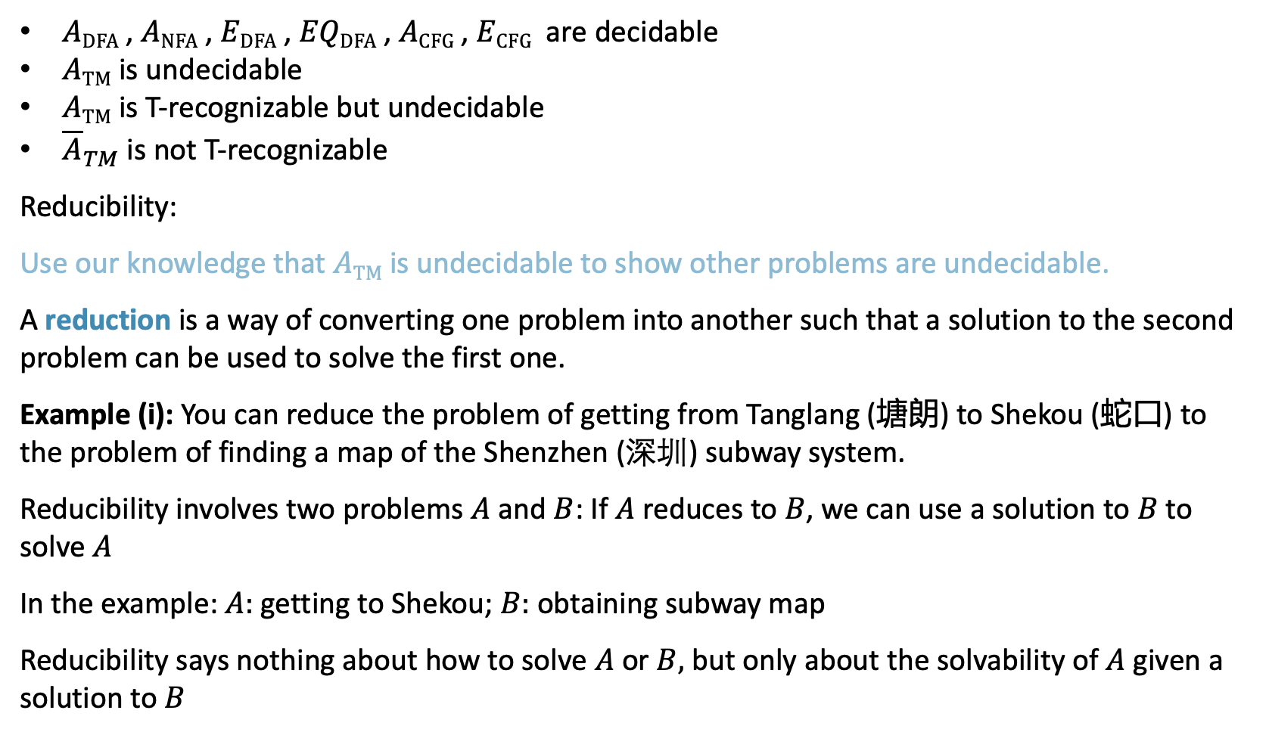
The Reducibility Method (1)
$A\text{DFA}$ , $A\text{NFA}$ , $E\text{DFA}$ , $EQ\text{DFA}$ , $A\text{CFG}$ , $E\text{CFG}$ are decidable
$A\text{TM}$ is undecidable
$A\text{TM}$ is T-recognizable but undecidable
${\overline{A}}_{TM}$ is not T-recognizable
Reducibility:
Use our knowledge that $A\text{TM}$ is undecidable to show other problems are undecidable.
A reduction is a way of converting one problem into another such that a solution to the second problem can be used to solve the first one.
Example (i): You can reduce the problem of getting from Tanglang (塘朗) to Shekou (蛇口) to the problem of finding a map of the Shenzhen (深圳) subway system.
Reducibility involves two problems $A$ and $B$: If $A$ reduces to $B$, we can use a solution to $B$ to solve $A$
In the example: $A:$ getting to Shekou; $B:$ obtaining subway map
Reducibility says nothing about how to solve $A$ or $B,$ but only about the solvability of $A$ given a solution to $B$

Slide 19
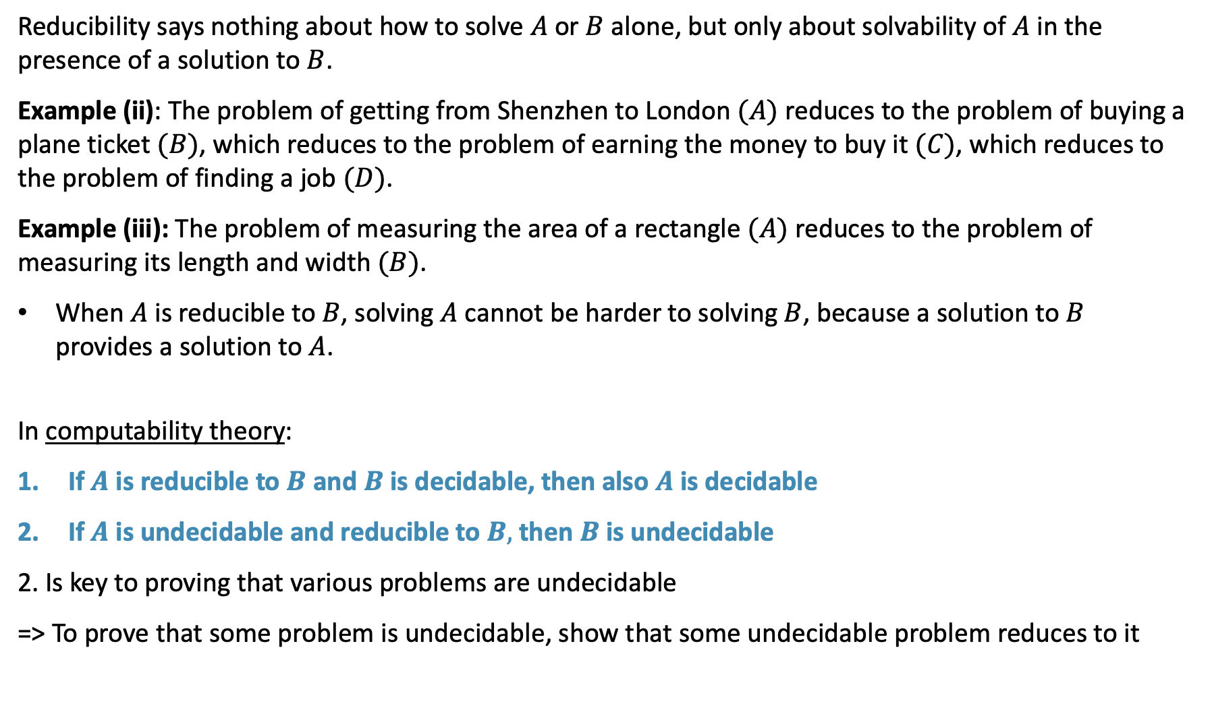
The Reducibility Method (2)
Reducibility says nothing about how to solve $A$ or $B$ alone, but only about solvability of $A$ in the presence of a solution to $B$.
Example (ii): The problem of getting from Shenzhen to London $(A)$ reduces to the problem of buying a plane ticket $(B)$, which reduces to the problem of earning the money to buy it $(C)$, which reduces to the problem of finding a job $(D)$.
Example (iii): The problem of measuring the area of a rectangle $(A)$ reduces to the problem of measuring its length and width $(B)$.
When $A$ is reducible to $B$, solving $A$ cannot be harder to solving $B$, because a solution to $B$ provides a solution to $A$.
In computability theory:
If $A$ is reducible to $B$ and $B$ is decidable, then also $A$ is decidable
If $A$ is undecidable and reducible to $B,$ then $B$ is undecidable
2. Is key to proving that various problems are undecidable
=> To prove that some problem is undecidable, show that some undecidable problem reduces to it

Slide 20
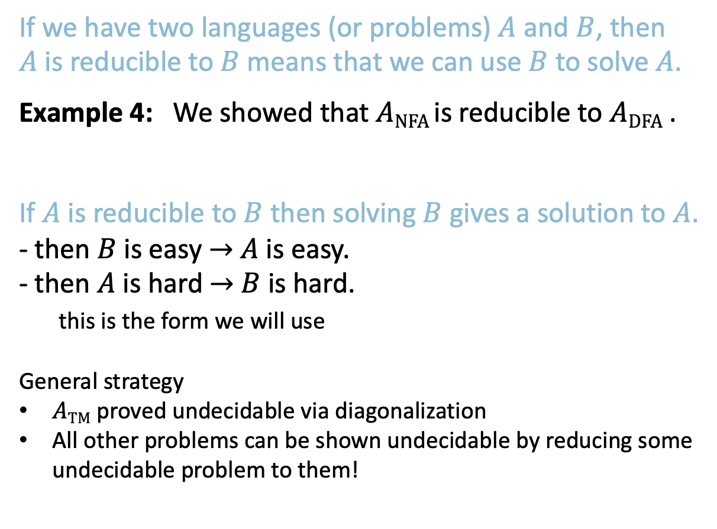
Reducibility – Concept Overview
If we have two languages (or problems) $A$ and $B$, then $A$ is reducible to $B$ means that we can use $B$ to solve $A$.
Example 4: We showed that $A\text{NFA}$is reducible to $A\text{DFA}$ .
If $A$ is reducible to $B$ then solving $B$ gives a solution to $A$.
- then $B$ is easy $→$ $A$ is easy.
- then $A$ is hard $→$ $B$ is hard.
this is the form we will use
General strategy
$A\text{TM}$ proved undecidable via diagonalization
All other problems can be shown undecidable by reducing some undecidable problem to them!
5

Slide 21

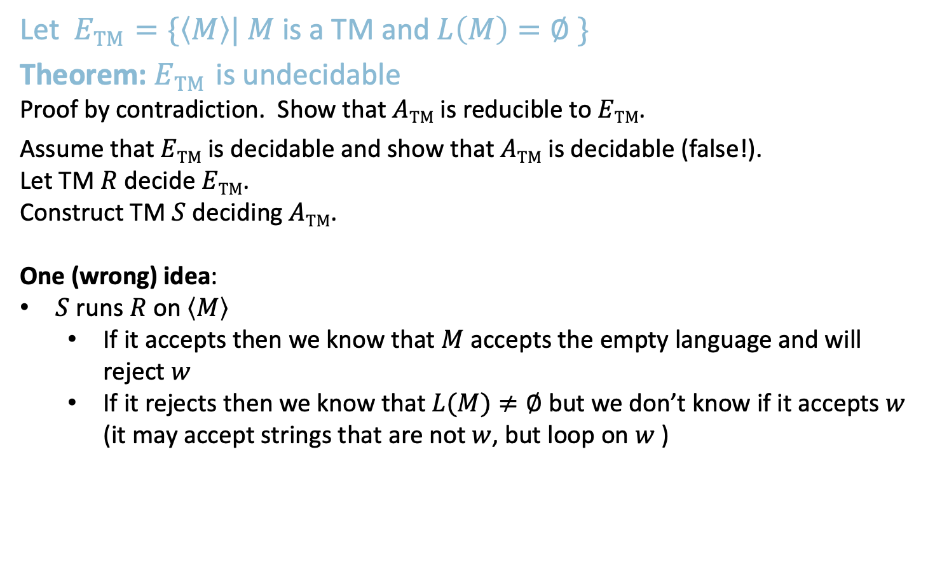
$E\text{TM}$ is undecidable
Let $E\text{TM}$ $=\{〈M〉| M$ is a TM and $L\left(M\right)=∅ \}$
Theorem: $E\text{TM}$ is undecidable
Proof by contradiction. Show that $A\text{TM}$ is reducible to $E\text{TM}$.
Assume that $E\text{TM}$ is decidable and show that $A\text{TM}$ is decidable (false!).
Let TM $R$ decide $E\text{TM}$.
Construct TM $S$ deciding $A\text{TM}$.
One (wrong) idea:
$S$ runs $R$ on$〈M〉$
If it accepts then we know that $M$ accepts the empty language and will reject $w$
If it rejects then we know that $L(M)≠∅$ but we don’t know if it accepts $w$ (it may accept strings that are not $w$, but loop on $w$ )
6

Slide 22
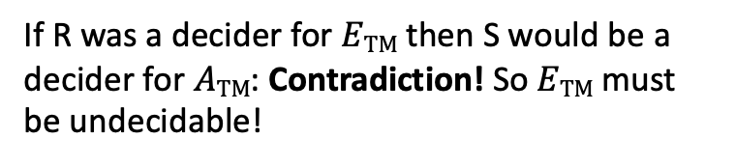
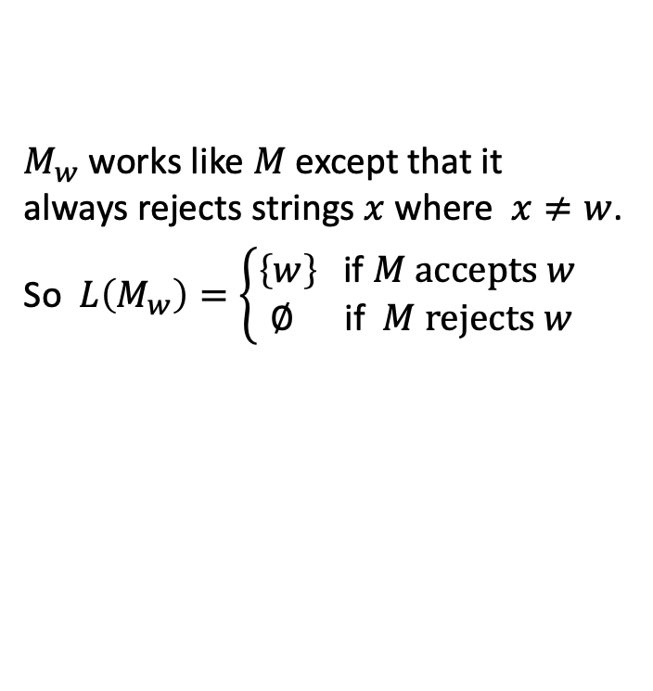
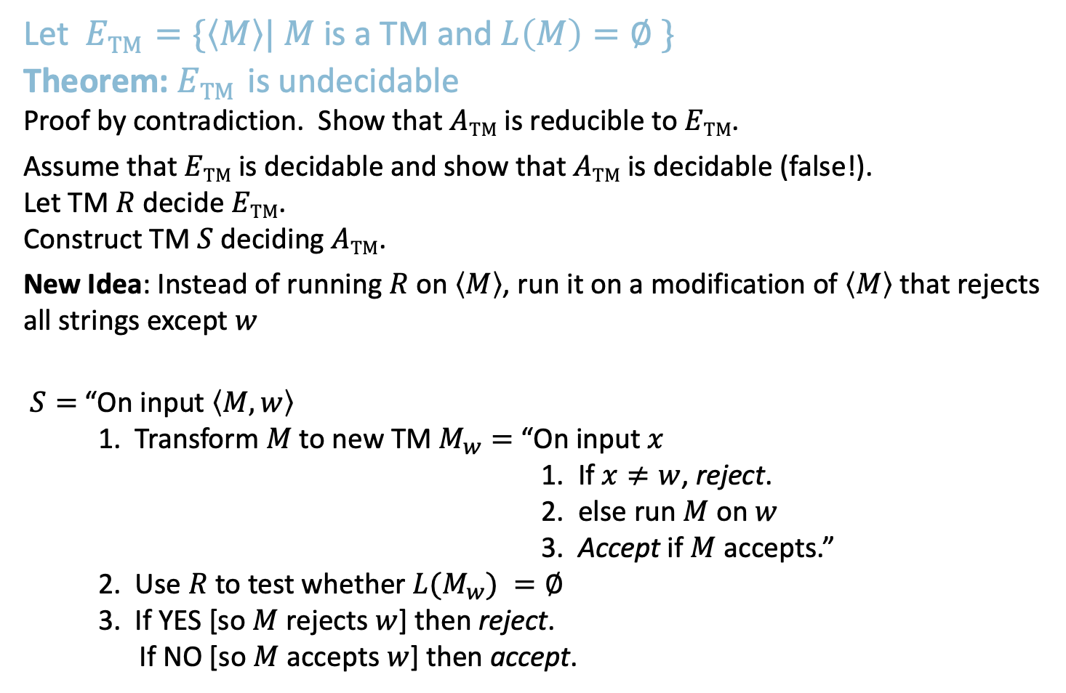
$E\text{TM}$ is undecidable
Let $E\text{TM}$ $=\{〈M〉| M$ is a TM and $L\left(M\right)=∅ \}$
Theorem: $E\text{TM}$ is undecidable
Proof by contradiction. Show that $A\text{TM}$ is reducible to $E\text{TM}$.
Assume that $E\text{TM}$ is decidable and show that $A\text{TM}$ is decidable (false!).
Let TM $R$ decide $E\text{TM}$.
Construct TM $S$ deciding $A\text{TM}$.
New Idea: Instead of running $R$ on $〈M〉$, run it on a modification of $〈M〉$ that rejects all strings except $w$
$S=$ “On input $〈M,w〉$
1. Transform $M$ to new TM $M_{w}=$ “On input $x$
1. If $x≠w$, reject.
2. else run $M$ on $w$
3. Accept if $M$ accepts.”
2. Use $R$ to test whether $L(M_{w}) =∅$
3. If YES [so $M$ rejects $w$] then reject. If NO [so $M$ accepts $w$] then accept.
$M_{w}$ works like $M$ except that it always rejects strings $x$ where $x≠w$.
So $L\left(M_{w}\right)=\left\{\begin{aligned}\left\{w\right\} \text{if} M accepts w \\ ∅ \text{if} M rejects w\end{aligned}\right.$
If R was a decider for $E\text{TM}$ then S would be a decider for $A\text{TM}$: Contradiction! So $E\text{TM}$ must be undecidable!
7

Slide 23

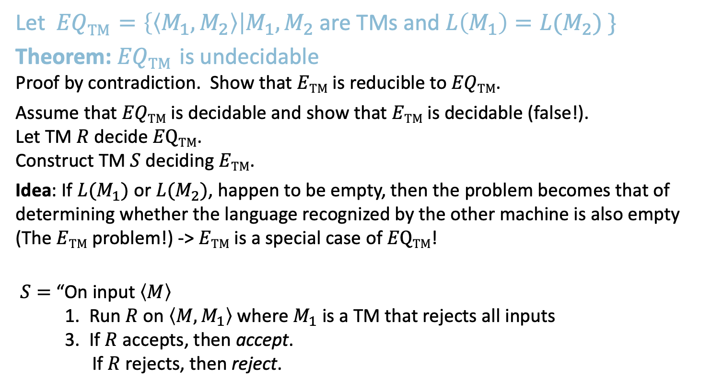
$EQ\text{TM}$ is undecidable
Let $EQ\text{TM}$ $=\left\{〈M_{1},M_{2}〉\right|M_{1},M_{2}$ are TMs and $L\left(M_{1}\right)=L(M_{2}) \}$
Theorem: $EQ\text{TM}$ is undecidable
Proof by contradiction. Show that $E\text{TM}$ is reducible to $EQ\text{TM}$.
Assume that $EQ\text{TM}$ is decidable and show that $E\text{TM}$ is decidable (false!).
Let TM $R$ decide $E\text{Q}\text{TM}$.
Construct TM $S$ deciding $E\text{TM}$.
Idea: If ${L(M}_{1})$ or ${L(M}_{2})$, happen to be empty, then the problem becomes that of determining whether the language recognized by the other machine is also empty (The $E\text{TM}$ problem!) -> $E\text{TM}$ is a special case of $E\text{Q}\text{TM}$!
$S=$ “On input $〈M〉$
1. Run $R$ on $〈M,M_{1}〉$ where $M_{1}$ is a TM that rejects all inputs
3. If $R$ accepts, then accept. If $R$ rejects, then reject.
If R was a decider for $EQ\text{TM}$ then S would be a decider for $E\text{TM}$: Contradiction! So $EQ\text{TM}$ must be undecidable!
8

Slide 24

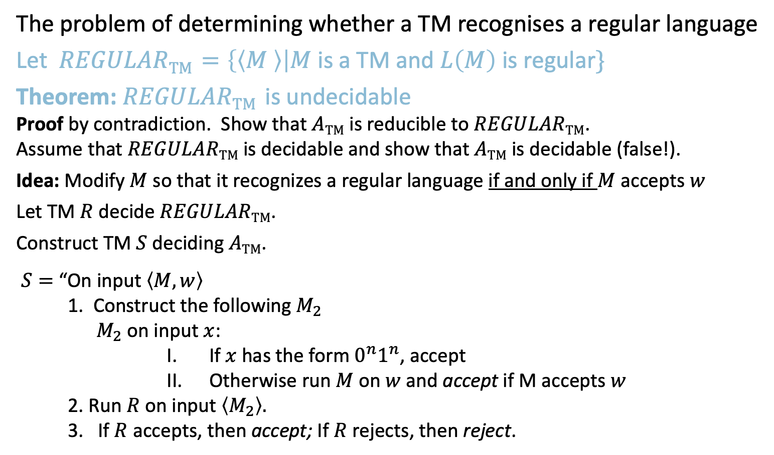

Is $REGULAR\text{TM}$ decidable?
The problem of determining whether a TM recognises a regular language
Let $REGULAR\text{TM}$ $=\left\{〈M 〉\right|M$ is a TM and $L\left(M\right)$ is regular$\}$
Theorem: $REGULAR\text{TM}$ is undecidable
Proof by contradiction. Show that $A\text{TM}$ is reducible to $REGULAR\text{TM}$.
Assume that $REGULAR\text{TM}$ is decidable and show that $A\text{TM}$ is decidable (false!).
Idea: Modify $M$ so that it recognizes a regular language if and only if $M$ accepts $w$
Let TM $R$ decide $REGULAR\text{TM}$.
Construct TM $S$ deciding $A\text{TM}$.
$S=$ “On input $〈M,w〉$
1. Construct the following $M_{2}$
$M_{2}$ on input $x$:
If $x$has the form $0^{n}1^{n}$, accept
Otherwise run $M$on $w$and accept if M accepts $w$
2. Run $R$on input $〈M_{2}〉.$
3. If $R$ accepts, then accept; If $R$ rejects, then reject.
$M_{2}$accepts $Σ^{∗}$ if M accepts $w$.
Otherwise it accepts $\left\{0^{n}1^{n} \right| n ≥0\}$
So if R accepts it means that M accepts $w$ because otherwise $M_{2}$ would reject as $M_{2}$ would accept a non-regular language!
If R was a decider for $REGULAR\text{TM}$ then $S$ would be a decider for A$\text{TM}$: Contradiction! So $REGULAR\text{TM}$ must be undecidable!
9

Slide 25
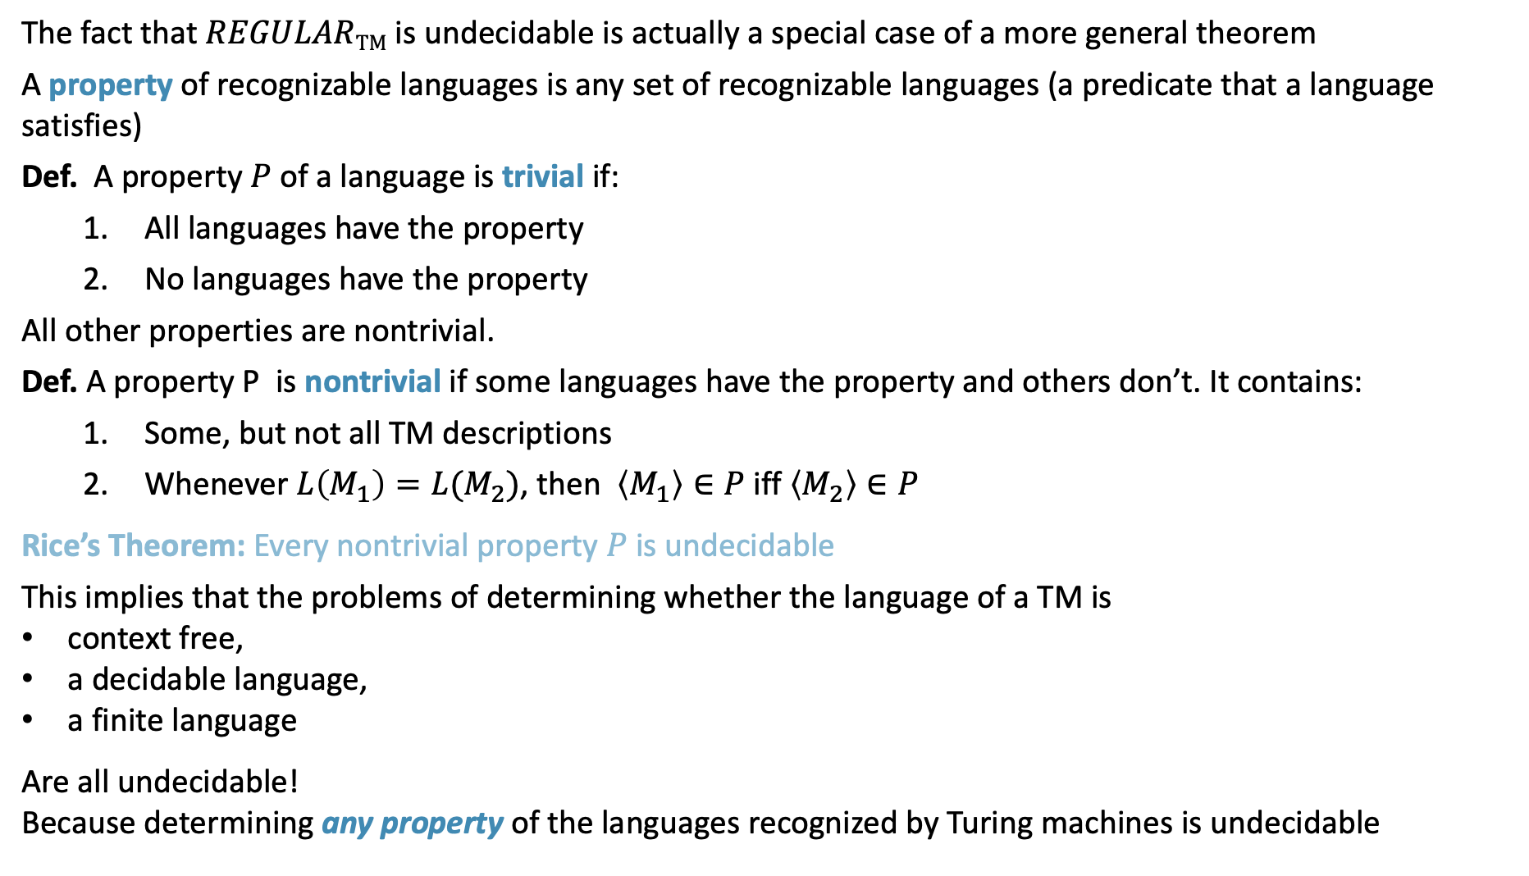
Rice’s Theorem
The fact that $REGULAR\text{TM}$ is undecidable is actually a special case of a more general theorem
A property of recognizable languages is any set of recognizable languages (a predicate that a language satisfies)
Def. A property $P$ of a language is trivial if:
All languages have the property
No languages have the property
All other properties are nontrivial.
Def. A property P is nontrivial if some languages have the property and others don’t. It contains:
Some, but not all TM descriptions
Whenever $L\left(M_{1}\right)=L(M_{2})$, then $〈M_{1}〉∈P$ iff $〈M_{2}〉∈P$
Rice’s Theorem: Every nontrivial property $P$ is undecidable
This implies that the problems of determining whether the language of a TM is
context free,
a decidable language,
a finite language
Are all undecidable! Because determining any property of the languages recognized by Turing machines is undecidable
10

Slide 26
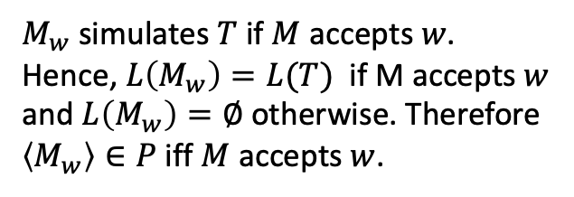
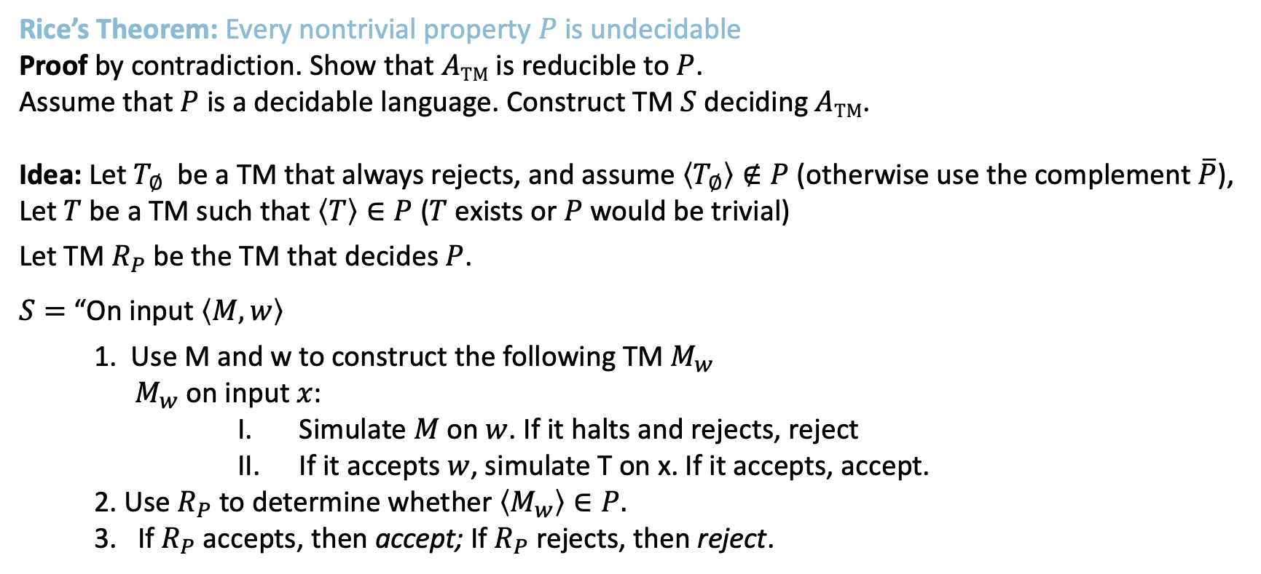
Rice’s Theorem: Proof
Rice’s Theorem: Every nontrivial property $P$ is undecidable
Proof by contradiction. Show that $A\text{TM}$ is reducible to $P$.
Assume that $P$ is a decidable language. Construct TM $S$ deciding $A\text{TM}$.
Idea: Let $T_{∅}$ be a TM that always rejects, and assume $〈T_{∅}〉∉P$ (otherwise use the complement $\overline{P}$),
Let $T$ be a TM such that $〈T〉∈P$ ($T$ exists or $P$ would be trivial)
Let TM $R_{P}$ be the TM that decides $P$.
$S=$ “On input $〈M,w〉$
1. Use M and w to construct the following TM $M_{w}$
$M_{w}$ on input $x$:
Simulate $M$ on $w$. If it halts and rejects, reject
If it accepts $w$, simulate T on x. If it accepts, accept.
2. Use $R_{P}$ to determine whether $〈M_{w}〉∈P.$
3. If$R_{P}$ accepts, then accept; If$R_{P}$ rejects, then reject.
$M_{w}$simulates $T$ if $M$ accepts $w$.
Hence, $L\left(M_{w}\right)=L(T)$ if M accepts $w$ and $L\left(M_{w}\right)=∅$ otherwise. Therefore $〈M_{w}〉∈P$ iff $M$ accepts $w$.
If $R_{P}$ was a decider for $P$ then $S$ would be a decider for A$\text{TM}$: Contradiction! So $P$ must be undecidable!
11

Slide 27
MIT OpenCourseWare
https://ocw.mit.edu
18.404J Theory of Computation
Fall 2020
For information about citing these materials or our Terms of Use, visit: https://ocw.mit.edu/terms.

