Slide 1
COMPLETE PARKING SYSTEM
To improve the district shared parking and individual parking slot search.
By: Bo Wang
Haiwen Shi
Zhuoer Wang

Slide 2
The goal of the project
Identify individual empty parking slots
Identify occupancy of the parking space/garage
Low power consumption with accuracy
Low overall cost:
Low cost for equipment
Low cost for installation

Slide 3
Approaches to achieve the goal
We plan to implement two of the goals stated in the specification.
Occupancy counter at the gateway: Two pairs of laser transmitter and receiver with some space in between to differentiate pedestrian and car.
Individual parking slot identification: RFID tag and RFID router
All of the above can be tracked on the website that we develop.

Slide 4
Equipment we will be using
Occupancy counter:
Laser transmitter/receiver pairs * 2
Arduino Yun * 1
Parking slot identification:
RFID Router (Speed Impinj R1000) and Antenna * 1
RFID Tag (provided by TAs)* N

Slide 5
Laser is introduced
Why?
The bouncing effects of the ultrasonic distance sensors can hugely affect our data. More specifically, the first sensor’s signal can affect the second sensor’s result.
Laser transmitter/receiver is independent from each other, thus more reliable data for our system.

Slide 6
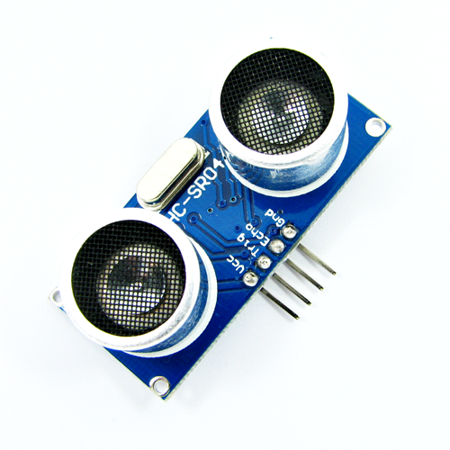
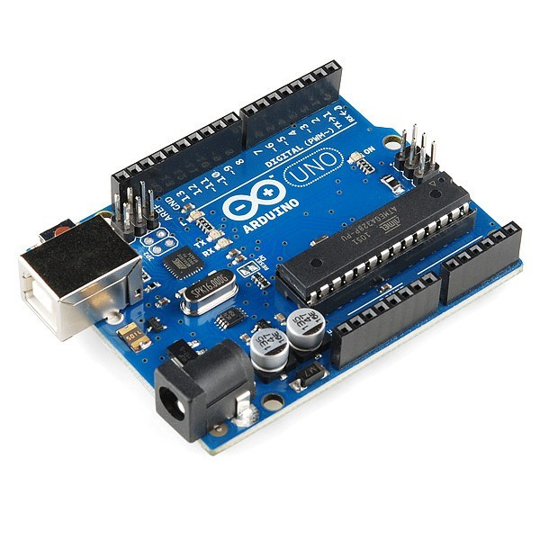
Equipment we will be using
Occupancy counter:
Laser transmitter/receiver pairs * 2
Arduino Yun * 1

Slide 7
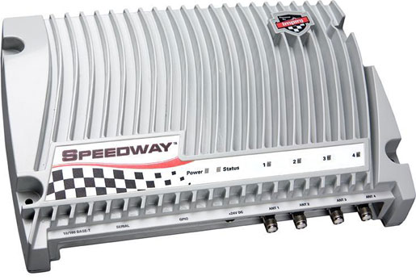
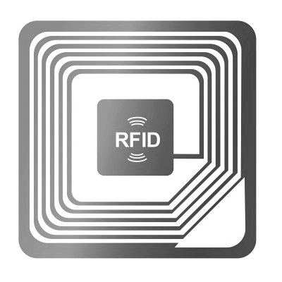
Equipment we will be using
Parking slot identification:
RFID Router (Speed Impinj R1000) and Antenna * 1
RFID Tag (provided by TAs)* N

Slide 8
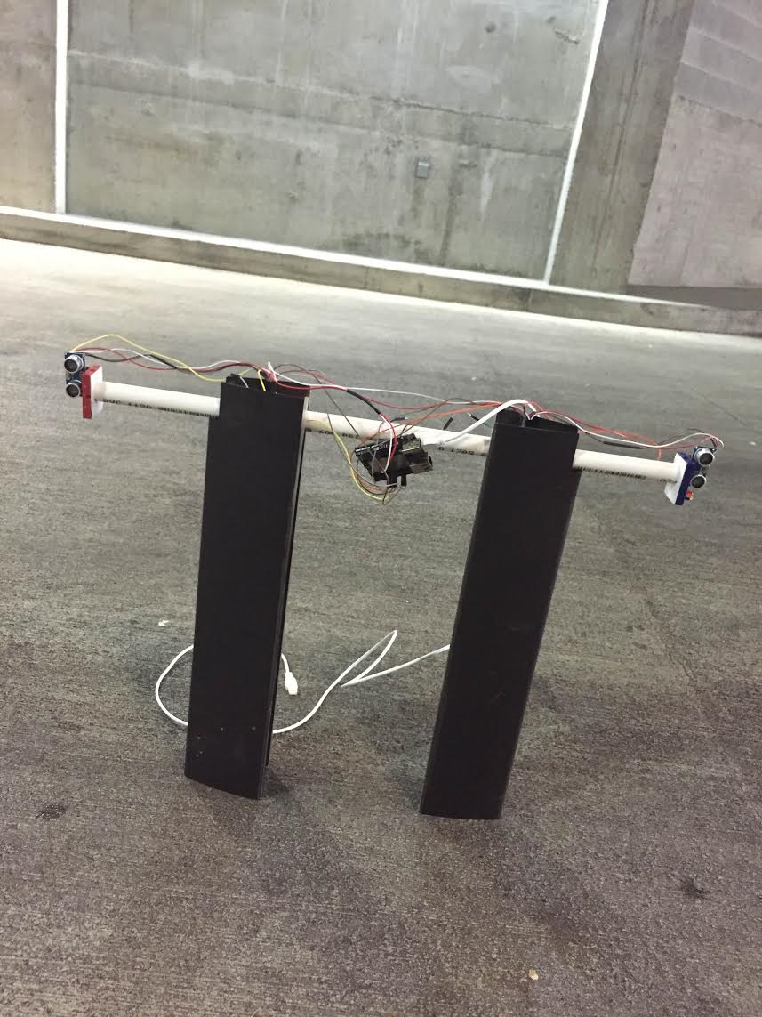
Setup

Slide 9
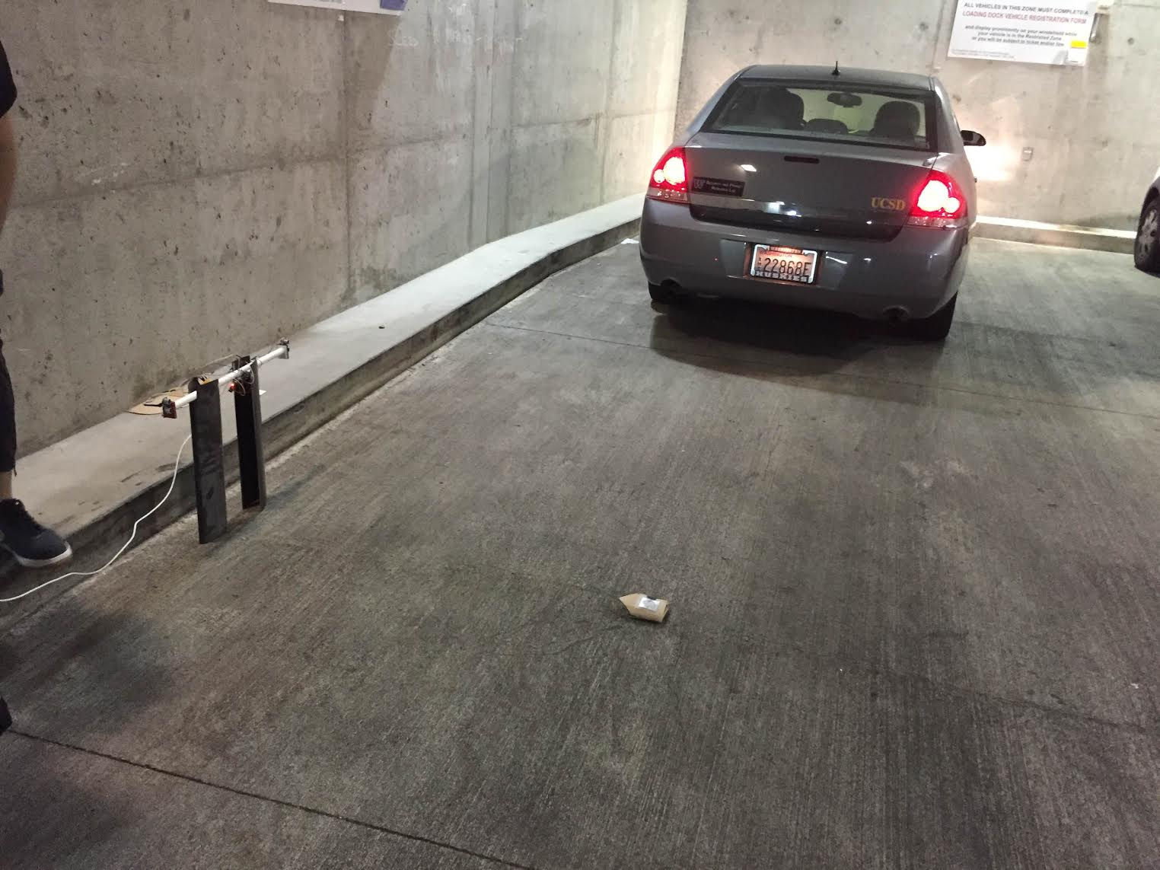
Setup

Slide 10
Implementation and idea
Set two laser transmitter/receiver pairs on one side of the gate
Set two mirrors on the other side of the gate
The light transmitted from the transmitter will be reflected by the mirror exactly into the receiver(by adjusting the angle and position)
Once a car is going in/out, the light should be blocked by the car, thus our server will get one signal for each car going in/out
The block pattern has different certain modes between the cars and pedestrians by placing the two pairs with some distance
For cars: 0-0 1-0 1-1 0-1 0-0 or the other way around
For pedestrians: 0-0 1-0 0-1 0-0 or the other way around

Slide 11
Key point of differentiating
To differentiate cars and pedestrian, the key factor is the distance between the pairs of the laser chips.
The cars can block both the laser lights at the same time, while the pedestrian can’t.
There are circumstances where the pedestrian can block both light at the same time, like when several people go in/out one by one.
So, in the future, we might add more pairs of laser chips to make the system more accurate.

Slide 12
Implementation and idea
RFID system is fairly simple.
Attach a RFID tag on the ground for each individual parking spot
If our antenna can get the signal back, that means the spot is available.
We used the sllurp library for this purpose. The sllurp library implements the twisted factory and spits out data on an event base. We originally had the modified code to send the request on each tag read. This results in slow response on our Server’s status update. Hence we decided to throttle the request by detecting changes in parking slot status. This made our system to update in real time.

Slide 13
Simple Web Front End
We have a simple proof of concept web front end to collaborate our two systems. The front end is written with Python Flask. It consists of login/register/admin/summary/tracker pages. Summary page shows the statistics of total number of cars coming in and going out from the garage. Tracker page shows the status for individual spots. Admin page can manage tag addition and deletion (For tracker). Tags need to be recorded in database before running the system. Both summary and tracker page shows real time information.
The RFID tracker system is connected directly to the host computer via Ethernet. The Laser summary system is connected from serial to the host computer and routed to the server from a simple serial->web proxy. All data are then sent from the host computer to the remote server.

Slide 14
Test results of milestone
The demo result for the milestone didn’t work very well.
-Why?
-Because the car is made of metal, and thus reflecting the laser light into the receiver and all the data can go wrong!

Slide 15
Solution
We cannot change the fact that cars are made of metal.
So how do we resolve this issue?
We physically removed the receiver from the laser chip and put the receiver on the other side. It means we replace the previous mirrors with the receivers.
Now, although the cars can still reflect the laser light, but our receiver can’t see the light from the other side.

Slide 16
Assumptions and limitations in our project
For detection at gate:
After the experiment, we found out our sensor is very good to detect the distance. However, there are some limitation if the object has been detected with some angle.
Secondly, ultrasonic wave will bouncing around and keep stay in the space for a relatively long time which will affect our measurement. By switching to a infrared or laser beam break, we will be able to fix the problem.

Slide 17
Assumptions and limitations in our project
For Individual Parking slot detection:
RFID router is major limitation for our system. We can lower the cost by increasing the range of each antenna or by switching this router with some other device that is cheaper.
After the experiment, we found the angle of how we place the antenna will dramatically affect the range to detect the RFID tag. However, our antenna and tag has a really long range, hence one antenna can cover approximately 4 spots. If we use multiple antennas over the single router, it can cover even wider range.

Slide 18
Advantages of the project
Low Installation Fee
Large Coverage
Low average cost for individual parking slot.
Precise detection

Slide 19
Cost estimation
Laser chip: $8 * 2
RFID Router: Approximately $1000 * N / 4
RFID Antenna: Approximately $300 * N
RFID Tag: $ 0.1 each
Arduino Yun: $70

