Slide 1
Window 588, updated as of January 5, 2022
ThinkStation Desktop Workstations
Add Windows 11 on ThinkStation P350 Tiny
Add NVIDIA T1000 4GB on ThinkStation P350 Tiny
Add NVIDIA RTX A2000 on ThinkStation P520c / P520 / P720 / P920
ThinkPad Mobile Workstations
No major update in this release
Planed Updates in Next Release
No major update in next release. I will work on new products including ThinkStation P360 Tiny / ThinkStation P360 Tower / ThinkStation P16s Gen 1 (Intel) / ThinkPad P14s Gen 3

Slide 2
Quick Links
ThinkStation specification collection (PDF)
ThinkPad specification collection (PDF)
PSREF Website

Slide 3
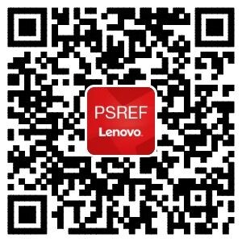

iOS
Android
Get PSREF App

Slide 4

Meet Workstation PSREF on Teams

Slide 5

Any Feedback or Suggestions, Please Send Me an Email

