Slide 1
Window 593, updated as of April 20, 2022
ThinkStation Desktop Workstations
Add ThinkStation P620 Refresh 4.0
AMD Ryzen Threadripper PRO 5000 Series processors
Windows 11
NVIDIA T400 4GB / T1000 8GB / RTX A2000 12GB / RTX A4500
4TB M.2 SSD for onboard M.2 slots
Add NVIDIA T400 4GB / T1000 8GB / RTX A2000 12GB to ThinkStation P350 Tower / P350 SFF
Add rear Thunderbolt 4 option to ThinkStation P350 Tiny / P350 Tower / P350 SFF
Add Windows 11 to ThinkStation P520c / P520 / P720 / P920
ThinkPad Mobile Workstations
New product release
ThinkPad P14s Gen 3
ThinkPad P16s Gen 1 (Intel)
Planed Updates in Next Release
New options for workstation PSREF please visit Workstation PSREF Teams
New product release
ThinkStation P360 Ultra
ThinkPad P1 Gen 5
ThinkPad P15v Gen 3 (Intel)
ThinkPad T15p Gen 3
ThinkPad P16s Gen 1 (AMD)
PSREF Development Progress (Please visit Workstation PSREF on Teams for more information)
Final version of ThinkPad P16s Gen 1 (AMD) PSREF spec has been ready
Finish final version of PSREF spec for ThinkPad P1 Gen 5 / P15v Gen 3 / T15p Gen 3 within this week
Finish draft version of PSREF spec for ThinkStation P360 Ultra before April 27

Slide 2
Quick Links
ThinkStation specification collection (PDF)
ThinkPad specification collection (PDF)
PSREF Website

Slide 3
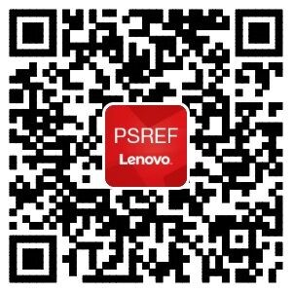

iOS
Get PSREF App
Android

Slide 4

Meet Workstation PSREF on Teams

Slide 5

Any Feedback or Suggestions, Please Send Me an Email

