Slide 1
Window 592, updated as of March 9, 2022
ThinkStation Desktop Workstations
Add Windows 11 to ThinkStation P350 Tower
Add NVIDIA T400 4GB to ThinkStation P348 Tower / P520c / P520 / P720 / P920
Add NVIDIA T1000 8GB to ThinkStation P340 Tiny / P350 Tiny / P348 Tower / P520c / P520 / P720 / P920
Add NVIDIA RTA A2000 12GB and A4500 20GB to ThinkStation P520c / P520 / P720 / P920
Add MT7921 to ThinkStation P348 Tower / P350 Tower / P350 SFF
ThinkPad Mobile Workstations
Add Wired Ethernet with non-side docking port information to ThinkPad P14s Gen 2 (Intel) / P15s Gen 2
Planed Updates in Next Release
New product release: ThinkPad P14s Gen 3 / P16s Gen 1 (Intel)
New product release: ThinkStation P360 Tower / P360 Tiny
Add AMD Ryzen Threadripper PRO 5000WX Series Processors to ThinkStation P620
Add 4TB M.2 2280 PCIe Gen 4x4 Performance NVMe Opal SSD to ThinkStation P620
Add Windows 11 to ThinkStation P340 Tower / P340 SFF / P620
Add rear 2x USB-C Gen 2 options to ThinkStation P620
Add MT7921 to ThinkStation P340 Tower / P340 SFF
PSREF Development Progress (Please visit Workstation PSREF on Teams for more information)

Slide 2
Quick Links
ThinkStation specification collection (PDF)
ThinkPad specification collection (PDF)
PSREF Website

Slide 3
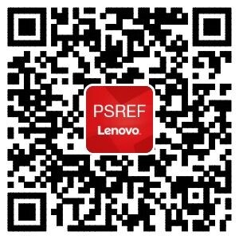

iOS
Get PSREF App
Android

Slide 4

Meet Workstation PSREF on Teams

Slide 5

Any Feedback or Suggestions, Please Send Me an Email

