Slide 1
Window 590, updated as of February 16, 2022
ThinkStation Desktop Workstations
No Major updates in this release
ThinkPad Mobile Workstations
Add Docking information to all alive ThinkPad Mobile Workstations
Update microphone information on ThinkPad P15 Gen 2 / P17 Gen 2 / T15g Gen 2
Planed Updates in Next Release
Add Windows 11 to ThinkStation P350 Tower
Add NVIDIA T400 4GB to ThinkStation P348 Tower / P520c / P520 / P720 / P920
Add NVIDIA T1000 8GB to ThinkStation P340 Tiny / P350 Tiny / P348 Tower / P520c / P520 / P720 / P920
Add NVIDIA RTA A2000 12GB and A4500 20GB to ThinkStation P520c / P520 / P720 / P920
Add MT7921 to ThinkStation P348 Tower / P350 Tower / P350 SFF
Add Intel Pentium G6405 to ThinkStation P348 Tower (TBD)
Add Wired Ethernet w/o side docking port information to ThinkPad P14s Gen 2 (Intel) / P15s Gen 2
PSREF Development Progress (Please visit Workstation PSREF on Teams for more information)
ThinkPad P14s Gen 3 and ThinkPad P16s Gen 1 final version will be ready within this week
Update Workstation PSREF Plan, add ThinkStation P360 Ultra announcement date

Slide 2
Quick Links
ThinkStation specification collection (PDF)
ThinkPad specification collection (PDF)
PSREF Website

Slide 3
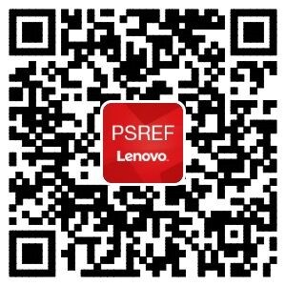

iOS
Get PSREF App
Android

Slide 4
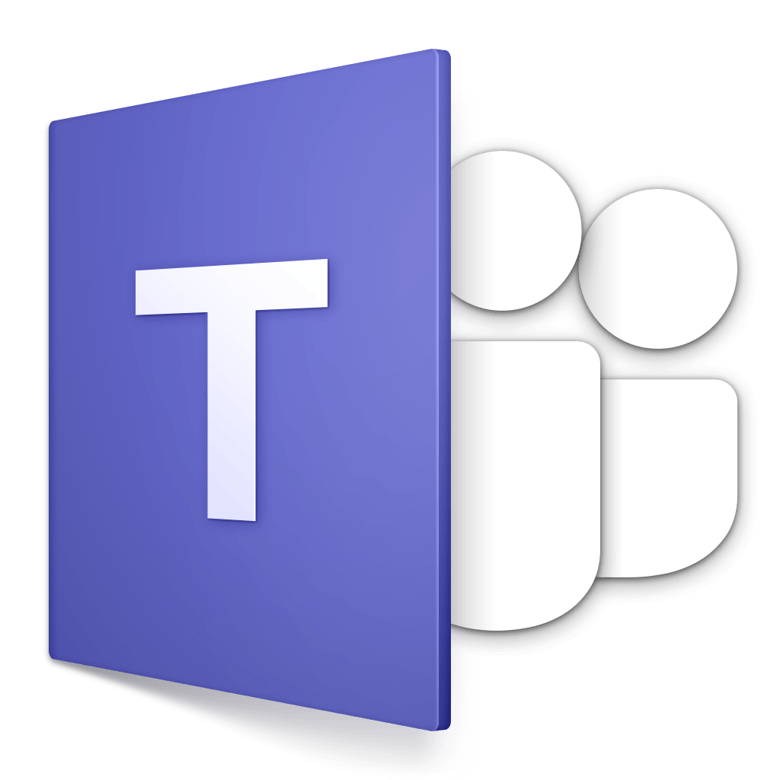
Meet Workstation PSREF on Teams

Slide 5

Any Feedback or Suggestions, Please Send Me an Email

