Slide 1
Window 587, updated as of December 15, 2021
ThinkStation Desktop Workstations
Add NVIDIA Quadro P2000 on ThinkStation P340 Tower
Add NVIDIA RTX A2000 on ThinkStation P340 Tower / P350 SFF
ThinkPad Mobile Workstations
Add Windows 11 on ThinkPad P14s Gen 2 (Intel) / P15s Gen 2 / P15v Gen 2 / P17 Gen 2 / T15g Gen 2
Add Non- Onboard Ethernet information on ThinkPad P14s Gen 2 (Intel) / P15s Gen 2
Planed Updates in Next Release
Add Windows 11 on ThinkStation P350 Tiny
Add Linux (detailed information is TBD) on ThinkStation P348
Add NVIDIA T1000 4GB on ThinkStation P350 Tiny
Add NVIDIA RTX A2000 on ThinkStation P520c / P520 / P720 / P920
I noticed that some existing processors for ThinkStation P920 are “re-released”, I will work on this matter to determine if PSREF should be updated

Slide 2
Quick Links
ThinkStation specification collection (PDF)
ThinkPad specification collection (PDF)
PSREF Website

Slide 3
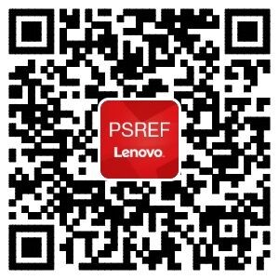

iOS
Android
Get PSREF App

Slide 4

Meet Workstation PSREF on Teams

Slide 5

Any Feedback or Suggestions, Please Send Me an Email

