Slide 1
ThinkStation Desktop Workstations
Add NVIDIA Quadro P2000 on ThinkStation P340 Tower
Add NVIDIA RTX A2000 on ThinkStation P340 Tower / P350 SFF
ThinkPad Mobile Workstations
Add Windows 11 on ThinkPad P14s Gen 2 (Intel) / P15s Gen 2 / P15v Gen 2 / P17 Gen 2 / T15g Gen 2
Add Non- Onboard Ethernet information on ThinkPad P14s Gen 2 (Intel) / P15s Gen 2
PSREF Website

Slide 2
Quick Links
ThinkStation specification collection (PDF)
ThinkPad specification collection (PDF)
PSREF Website

Slide 3
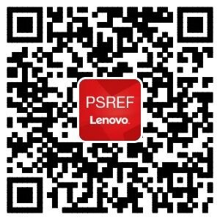

iOS
Android
Get PSREF App

Slide 4

Meet Workstation PSREF on Teams

Slide 5

Any Feedback or Suggestions, Please Send Me an Email

