Slide 1
Commercial Presentation Development of an application for the autocorrection of bank checks

Slide 2






Team Members
Youssef MANSOUR
Molka MRAD
Houssem OUERDIANE
Dhia BEN AMOR
Haithem GHARBI
Aicha CHAABA

Slide 3
Introduction
01

Slide 4


Problematic
Client
Bank Agent
Non-matching amount in letters and in numbers
Syntax Mistakes
Invalid date
Forgetting to fill a part of the check
Cross-outs
Unreadable handwriting
Diffrent types of checks
Different format of writing,dimesion,colors,police,language,…
Slow processing

Slide 5
Traditionnal Process
A bank agent responsible for the validation of the check
Long waiting lines
A complex procedure that takes a lot of time with very possible human mistakes

Slide 6
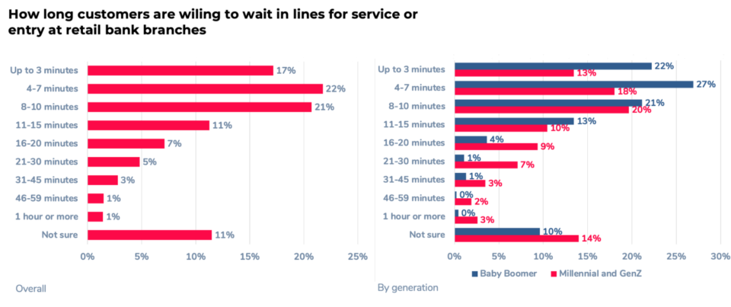

Slide 7
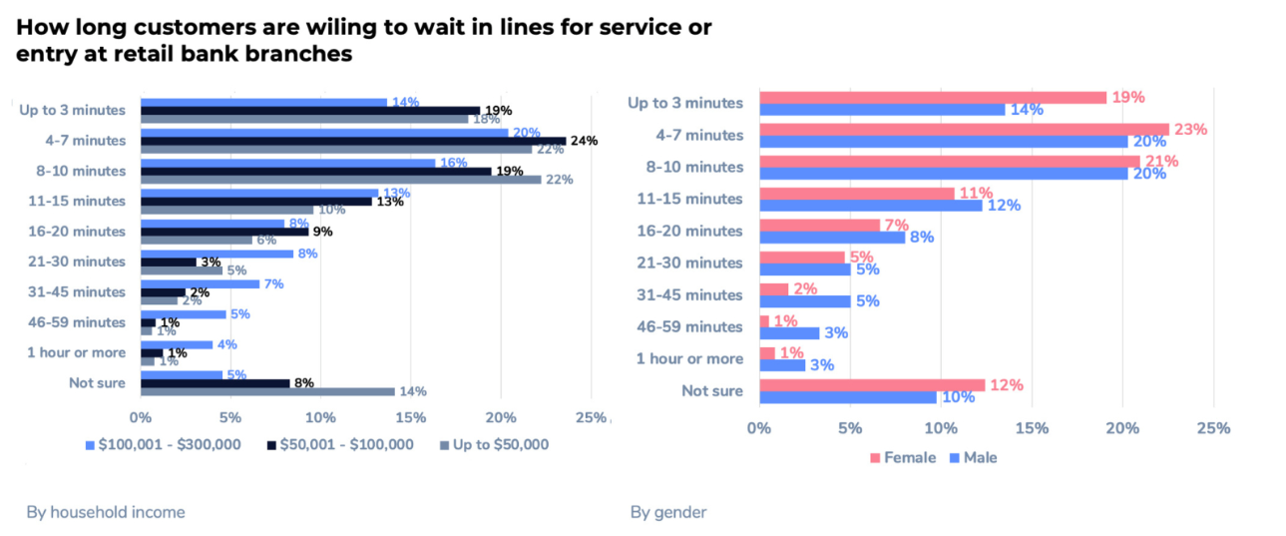

Slide 8
Business Objectives
02

Slide 9
Achieve the autocorrection of the amount in a check
Manipulate a huge amount of data
Assure the security in the whole process

Slide 10
Detection of the different parts of the check
Comparison between the amount in numbers and the amount in letters
Verifying the validity of the date (the check expires after 3 years and a week)

Slide 11
Check the existence of the signature and its validity
Identify the language written in the check
Identify different handwritings

Slide 12
Data Science Objectives
03

Slide 13




Data Preprocessing
Data Science Objectives
Data Segmentation
Model Building

Slide 14
Potential Risks & Risk Management
04

Slide 15

Potential Risks
Confidentiality of bank clients
Diversity of check layouts
Budget limits
Security of the system
High-availability of the server

Slide 16
Solutions
05

Slide 17
Client
Bank Agent
Automatic Identification of the diffrent parts of the check using Artificial Intelligence
Detection of anomalies
Classification of the checks by their validity
Notify the client about his account transactions
Graphical presentation of deposits and retreats
Suggestions regarding the client’s account balance
2-way Confirmation for the cashing of a check

Slide 18
Application’s features
06

Slide 19

Achieve the autocorrection of the amount in a check
Manipulate a huge amount of data
Assure the security in the whole process

Slide 20
Detection of the different parts of the check
Comparison between the amount in numbers and the amount in letters
Verifying the validity of the date (the check expires after 3 years and a week)

Slide 21
Check the existence of the signature and its validity
Identify the language written in the check
Identify different handwritings

Slide 22
Process’s Description
07

Slide 23

The process
01
02
03
04
The client walks in the bank and inserts his check in an ATM-like machine
The screen on the machine shows different details about the transaction such as the client’s balance, the reciever’s name,...
The client confirms the deposit of the check
The machine prints a reciept and memorizes the process in the server’s cloud

Slide 24
Scientific Poster
08

Slide 26
Commercial Video
09

Slide 27
Conclusion & Prespectives
10
Lien GITHUB: https://github.com/haythemGHA/SimpleHTR

Slide 28
Thanks!
Do you have any questions?

