Slide 1
SP-Project
FourYear Transforms

Slide 2
Part-2

Slide 3
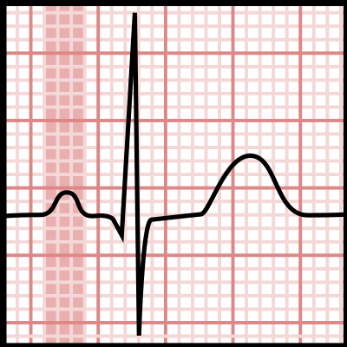
Problem statement
We are given 3 ECG waves, out of which 2 are noisy
We are tasked to find out the heart rate estimations per minute for each of these ECG waves.

Slide 4
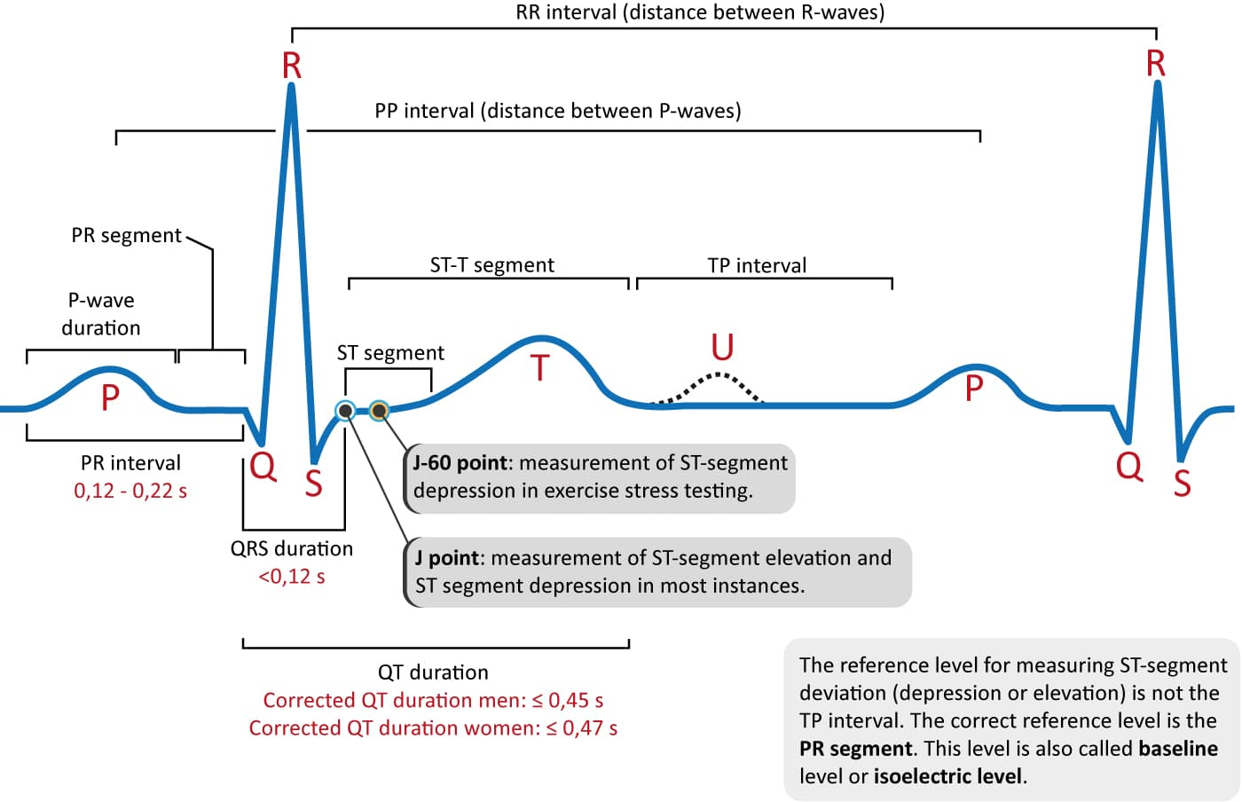
HR from ECG
In every task we have to find out the heart rate (HR) estimation from ECG wave(s).
From ECG graph we can deduce the heart rate by finding out the RR interval
HR = 60/RR_interval

Slide 5
ECG_HRConverter
To help with this task, we made a function named ECG_HRConverter.
This function finds R peaks using findpeaks function in matlab and then calculates the heart rate.
This heart rate is averaged out every minute and populates a vector which will be our output

Slide 6
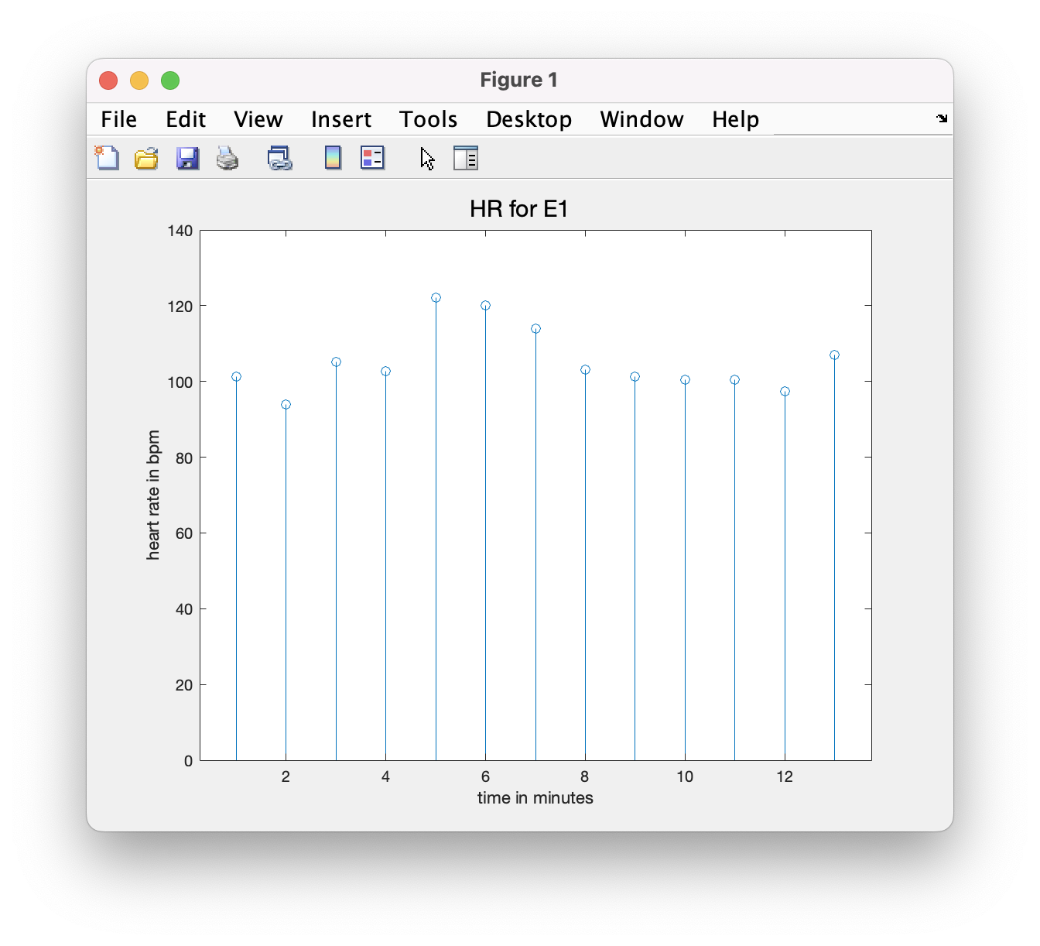
Task-1
In this task we are required to find out HR for a non noisy ECG E1.
This is a straight forward task, when we employ our custom built function.

Slide 7
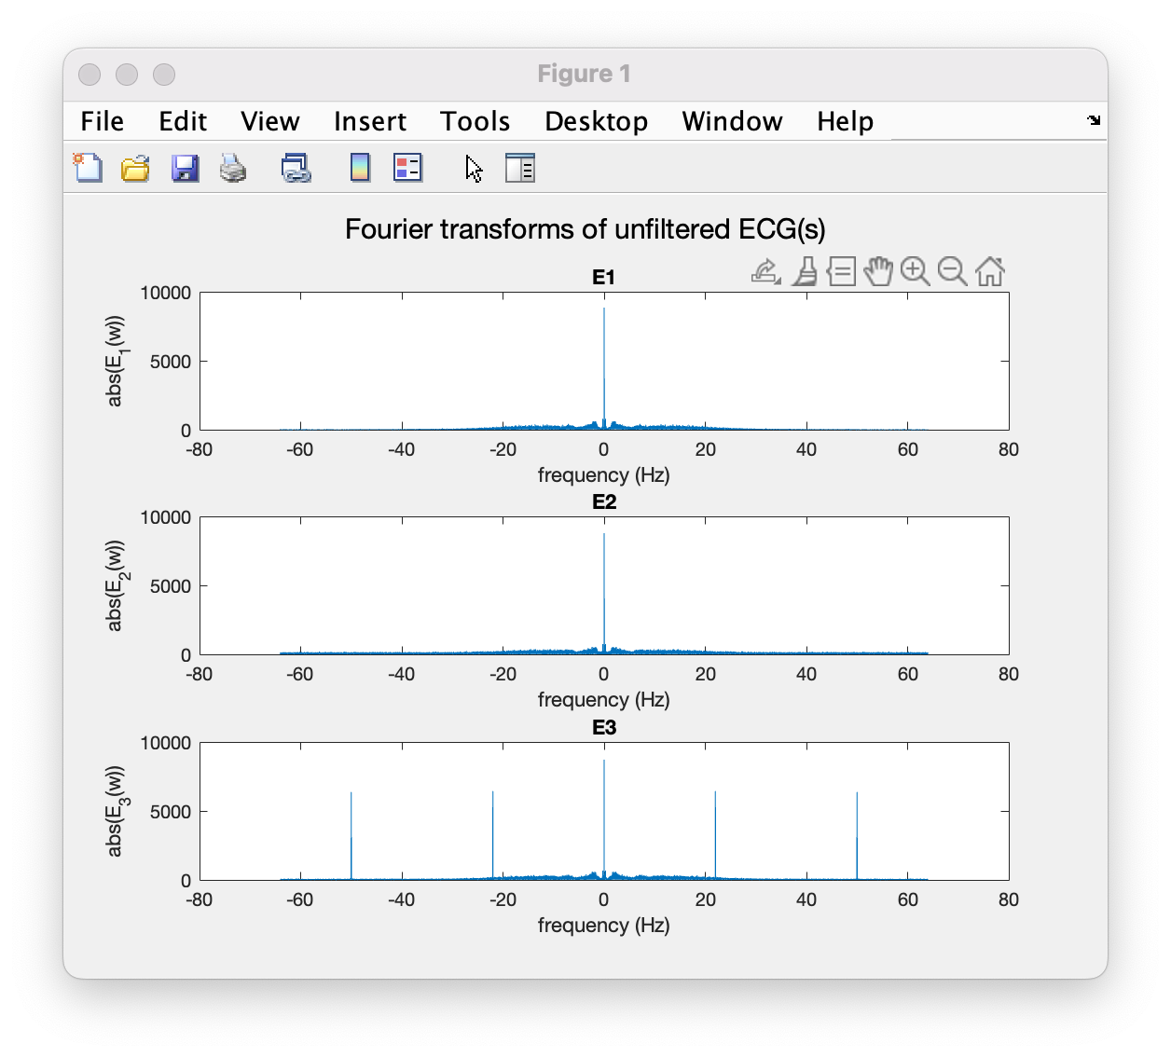
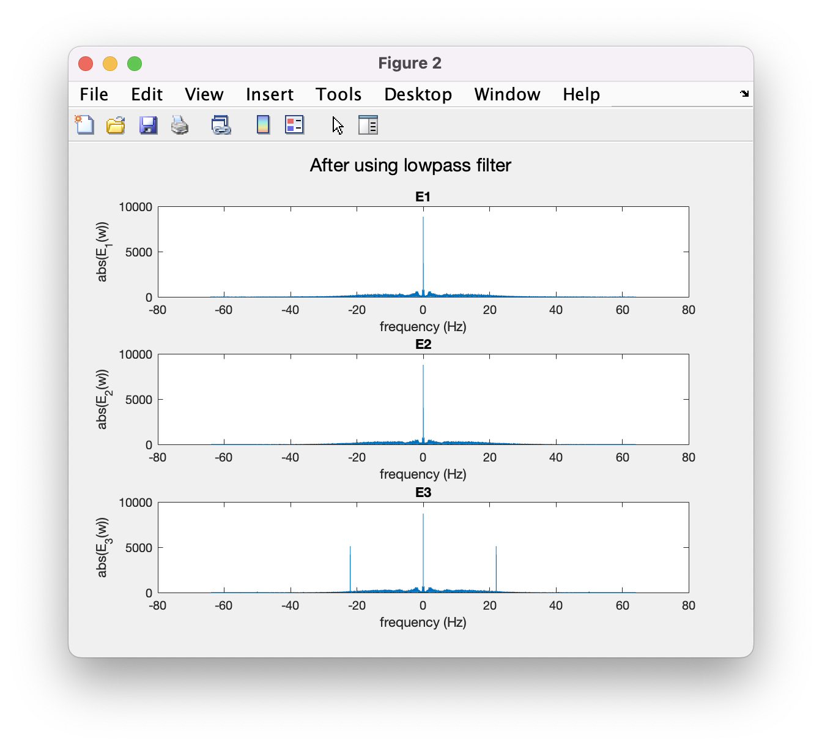
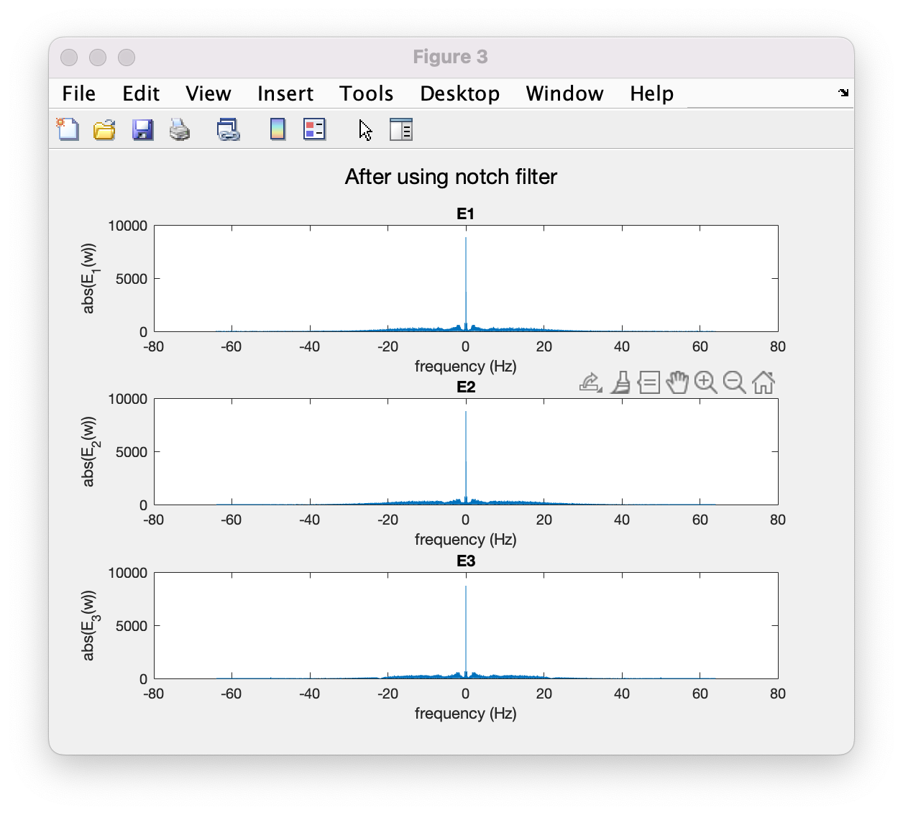
Task-2
Both E2 and E3 signals are noisy. This becomes apparent when we take a look at its FFT.
A low pass filter with cutoff frequency 30hz is enough to filter E2
An additional notch filter for 22hz is employed for E3.

Slide 8
