Slide 1
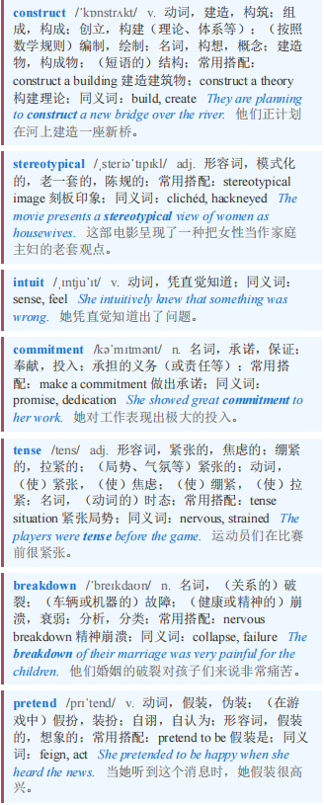
BARTLEBY 巴托比
【1】If you had to construct a really bad way to make an important decision, you might come up with something like the stereotypical job interview. You must intuit a complete stranger’s ability and character in a small window of time, before making a commitment that could last decades. Some candidates will be so tense that asking them how their journey was will cause them to have a nervous breakdown. Everyone will be pretending to be someone they are not.
如果你必须想出一种非常糟糕的方式来做一个重要决定，你可能会想出类似那种老套的求职面试的方式。在做出一个可能持续数十年的承诺之前，你必须在很短的时间内凭直觉判断一个完全陌生之人的能力和性格。有些候选人会非常紧张，以至于问他们旅途如何都会让他们精神崩溃。每个人都会假装成另一个自己。

Slide 2

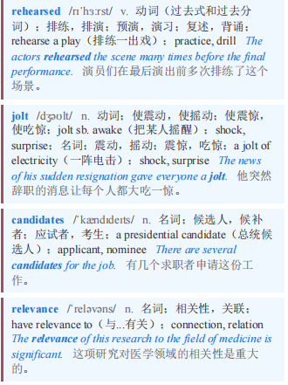
BARTLEBY 巴托比
【2】Most of your questions will be entirely predictable; most of the answers will have been rehearsed. To jolt candidates out of their comfort zones, you will ask one or two questions that bear no relevance to anything. If you were a cat trapped in a washing machine, how would you escape? If Jesus were asked who he would most like to have at a dinner party, why should he pick you?
你的大多数问题都完全可以预测；大多数答案也都经过了预演。为了让候选人脱离舒适区，你会问一两个与任何事情都无关的问题。如果你是一只被困在洗衣机里的猫，你会如何逃脱？如果耶稣被问到他最希望谁来参加晚宴，他为什么要选你？

Slide 3
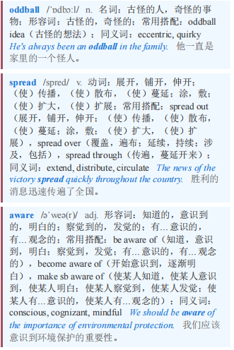
BARTLEBY 巴托比
【3】Even with these oddball questions, the spread of AI tools means you cannot be totally sure that a human is the one answering. Jonathan Black, who runs the careers service at Oxford University, tells the story of a student asking an employer to repeat something “because the computer didn’t hear it”. To cap it all, you will be aware that you haven’t had lunch and still have another five interviews to do that day.
即使有这些古怪的问题，人工智能工具的普及意味着你无法完全确定是人类在回答。牛津大学职业服务中心负责人乔纳森·布莱克讲述了一个学生让雇主重复某事的故事，“因为电脑没听到”。最糟糕的是，你会意识到自己还没吃午饭，而且当天还有另外五场面试要参加。

Slide 4

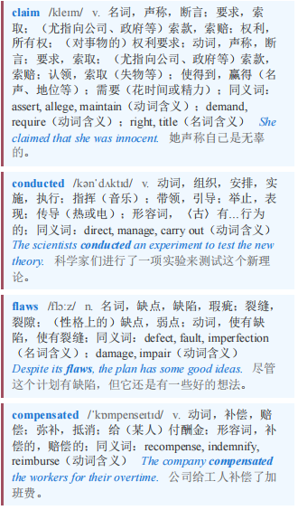
BARTLEBY 巴托比
【4】If this sounds like an irretrievably broken process, then the truth is more complex. Interviews have a reasonable claim to be the most useful part of the selection process. But they have to be conducted in the right way. And their flaws must be compensated for.
如果这听起来像是一个无可挽回的失败过程，那么事实更为复杂。面试有充分的理由被认为是选拔过程中最有用的部分。但必须以正确的方式进行面试。而且必须弥补其缺陷。

Slide 5
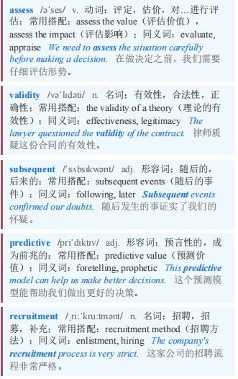
BARTLEBY 巴托比 本课程来自公众号：熊猫外刊精读
【5】Researchers try to assess the validity of selection processes by correlating the scores that successful candidates get during an application with their subsequent performance in their new jobs. A meta-analysis of such research, published in 2022 by Paul Sackett of the University of Minnesota and his co-authors, found that structured job interviews have the most predictive value of any recruitment method, ahead of things like assessment centres or psychometric tests.
研究人员试图通过将成功候选人在申请过程中获得的分数与其在新工作中的后续表现相关联，来评估选拔过程的有效性。明尼苏达大学的保罗·萨克特（Paul Sackett）及其合著者在2022年发表的一项对此类研究的元分析发现，结构化工作面试在所有招聘方法中具有最高的预测价值，超过了评估中心或心理测试等方法。

Slide 6
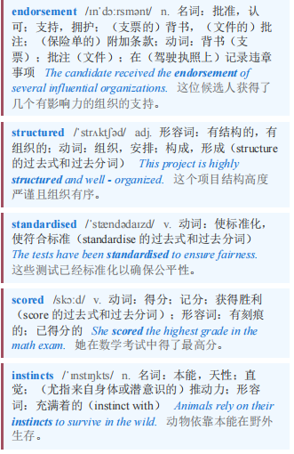
BARTLEBY 巴托比
【6】There are two big caveats to this endorsement of interviews, however. The first is the importance of the word “structured”. According to Winfred Arthur of Texas A&M University, that usually means a standardised set of job-related questions which are put to every candidate and each of which is scored according to an agreed system. (You could still ask that question about the cat in the washing machine, in other words, but you had better have a clear idea of what counts as a good answer and why.) An unstructured interview, in which hiring managers make things up on the fly and reach decisions based on gut instincts, has less than half the predictive validity of a structured one.
然而，对面试的这种认可有两个重要的注意事项。第一个是“结构化”这个词的重要性。根据德克萨斯农工大学的温弗雷德·亚瑟的说法，这通常意味着一套标准化的与工作相关的问题，每个候选人都会被问到这些问题，并且每个问题都根据一个商定的系统进行评分。（换句话说，你仍然可以问关于洗衣机里的猫的那个问题，但你最好清楚地知道什么算作一个好答案以及为什么。）在非结构化面试中，招聘经理即兴发挥并根据直觉做出决定，其预测效度不到结构化面试的一半。

Slide 7
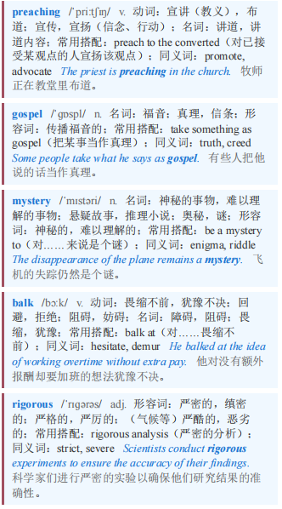
BARTLEBY 巴托比
【7】People have been preaching the gospel of structured interviews for so long that the mystery is why they are not more common. Perhaps interviewers worry that predictable questions are likely to tell them less, even though successful firms like Amazon go out of their way to offer advice on what candidates can expect in an interview. Perhaps managers balk at the time and thought required to construct a truly rigorous process, even though few decisions are regretted as much as a bad hire.
人们宣扬结构化面试的好处已经很久了，奇怪的是它为何没有更普遍。也许面试官担心可预测的问题可能让他们了解到的信息更少，尽管像亚马逊这样成功的公司会特意就候选人在面试中可能遇到的情况提供建议。也许经理们对构建一个真正严谨的流程所需的时间和精力望而却步，尽管很少有决策会像糟糕的招聘那样令人后悔。

Slide 8
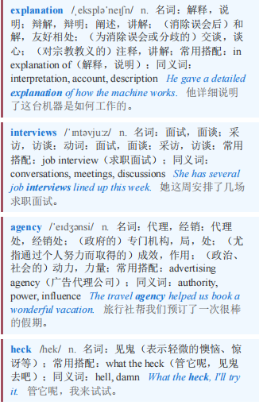
BARTLEBY 巴托比
【8】Mr Arthur’s best explanation is that structured interviews remove a sense of agency from interviewers. “You’re saying you can’t ask the questions you want…and they’re going to say to you: ‘What the heck? What am I a manager for?’ ”
亚瑟先生的最佳解释是，结构化面试剥夺了面试官的一种能动性。“你是在说你不能问自己想问的问题……然后他们会对你说：‘搞什么？那我当经理是为了什么？’”

Slide 9
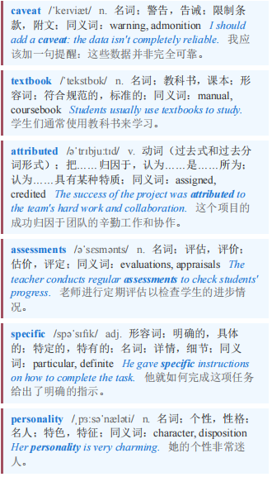
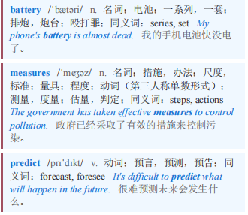
BARTLEBY 巴托比
【9】The second caveat is that even textbook interviews are not that good at predicting how candidates will do. According to Chris Hartwell of Utah State University, the research suggests that less than 20% of a person’s actual job performance can be attributed to scores in a structured interview. So it makes sense to layer lots of other assessments on top: specific personality tests, work samples and the like. Mr Hartwell says that a battery of measures might together be able to predict as much as 30-40% of a candidate’s eventual performance, an outcome he describes as “not great, but not bad”.
第二个需要注意的是，即使是规范的面试在预测候选人表现方面也并非那么出色。犹他州立大学的克里斯·哈特韦尔表示，研究表明，一个人实际工作表现中只有不到20%可以归因于结构化面试的分数。所以在其基础上叠加许多其他评估是有意义的：特定的个性测试、工作样本等等。哈特韦尔先生说，一系列措施加在一起或许能够预测候选人最终表现的30% - 40%，他将这一结果描述为“不算太好，但也不算太差”。

Slide 10
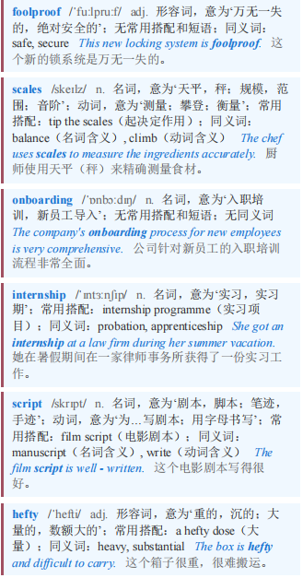
BARTLEBY 巴托比 本课程来自公众号：熊猫外刊精读
【10】That’s because there is no foolproof way to judge an unfamiliar job candidate. Firms can tip the scales towards success once someone has joined, by offering proper onboarding and training. They can ensure that known quantities are in the running for jobs, by investing in internship programmes and encouraging existing employees to apply for open positions. But if you are interviewing a stranger for a job, it is best done with a script, a scoring system and a hefty dose of realism. No question.
这是因为没有万无一失的方法来评判一个不熟悉的求职者。一旦有人入职，公司可以通过提供适当的入职培训和在职培训来增加成功的几率。他们可以通过投资实习项目和鼓励现有员工申请空缺职位，确保已知的合适人选参与求职竞争。但如果你正在面试一个陌生的求职者，最好使用脚本、评分系统和大量的现实考量。毫无疑问。

