Slide 1
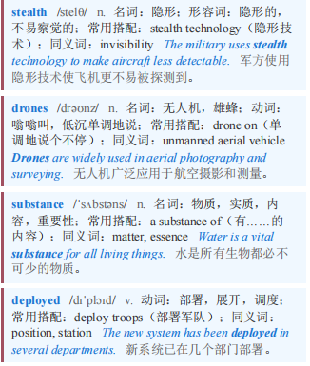
European defence 欧洲防务
【1】THE MENTION of modern warfare may call to mind stealth jets and drones. Yet today’s armed forces still rely on a substance deployed on battlefields since before the first world war.
提到现代战争，人们可能会想到隐形战斗机和无人机。然而，如今的军队仍然依赖一种自第一次世界大战前就被部署在战场上的物质。

Slide 2
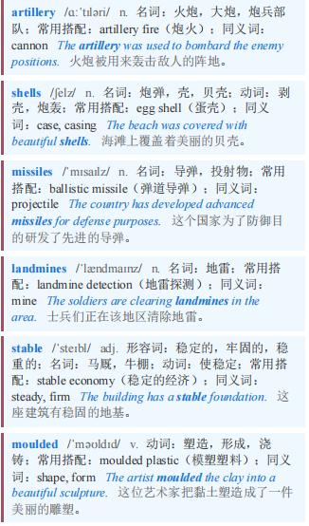

European defence 欧洲防务
Trinitrotoluene (TNT), an explosive used in artillery shells, missiles and landmines, is stable, easily moulded and much cheaper than newer substitutes.
三硝基甲苯（TNT）是一种用于炮弹、导弹和地雷的炸药，它性能稳定、易于塑形，而且比新型替代品便宜得多。

Slide 3
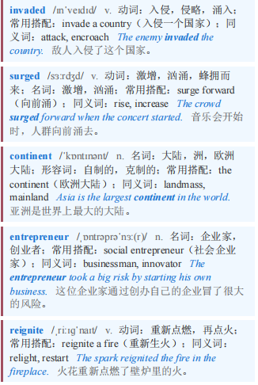
European defence 欧洲防务
Since Russia invaded Ukraine in 2022, demand for it in Europe has surged. But since the end of the cold war most of the continent’s TNT factories have closed. Joakim Sjoblom, a Swedish entrepreneur, is hoping to reignite the industry.
自2022年俄罗斯入侵乌克兰以来，欧洲对它的需求激增。但自冷战结束以来，欧洲大陆的大多数TNT工厂都已关闭。瑞典企业家约阿基姆·斯约布洛姆希望重振这一行业。

Slide 4
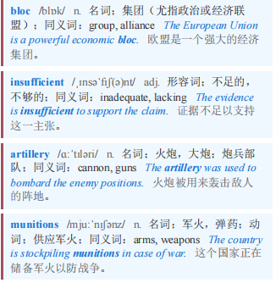
European defence 欧洲防务
【2】Before the war in Ukraine, Poland’s Nitro-Chem, the only TNT-maker left in the EU, could meet the bloc’s needs. But its capacity of around 12,000 tonnes a year, half of which is sold outside Europe, is now insufficient. The EU aims to source 2m 155mm artillery shells at home each year. That alone requires 20,000 tonnes of tnt. Add other munitions and civilian demand, and the total required might exceed 30,000 tonnes.
在乌克兰战争爆发前，波兰的尼卓化学公司（Nitro-Chem）是欧盟唯一一家TNT制造商，能够满足欧盟的需求。但该公司每年约1.2万吨的产能（其中一半销往欧洲以外地区）如今已不够用。欧盟的目标是每年在本土采购200万枚155毫米炮弹。仅这一项就需要2万吨TNT。再加上其他弹药和民用需求，总需求量可能超过3万吨。

Slide 5
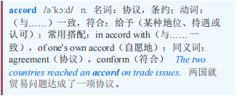
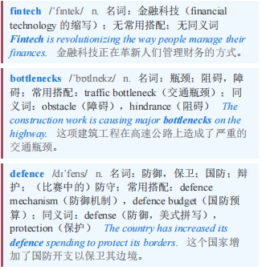
European defence 欧洲防务
【3】The EU could rely more on imports from India, Vietnam and elsewhere, but that would not accord with its efforts to encourage members to buy weapons locally. Enter Mr Sjoblom. After selling his fintech in 2024, the year Sweden joined NATO, he turned his attention to bottlenecks in the defence industry.
欧盟可以更多地依赖从印度、越南和其他地方的进口，但这与其鼓励成员国在本地购买武器的努力不符。于是斯约布洛姆先生登场了。2024年，瑞典加入北约的那一年，他卖掉了自己的金融科技公司，随后将注意力转向了国防工业的瓶颈问题。

Slide 6
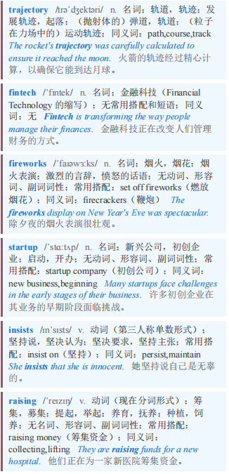
European defence 欧洲防务
【4】A trajectory from fintech to fireworks may seem odd, but founding Sweden Ballistics (Swebal) was not so different from any other startup, he insists. Both required raising money and finding the right people.
从金融科技到烟花的发展轨迹可能看起来很奇怪，但他坚称，创立瑞典弹道公司（Swebal）与其他任何初创企业并没有太大不同。两者都需要筹集资金和找到合适的人。

Slide 7
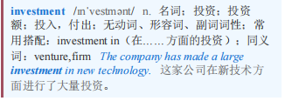
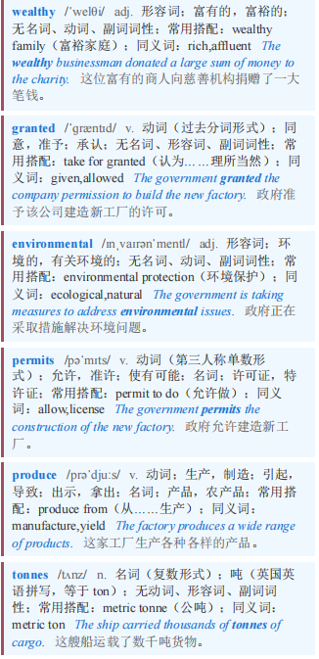
European defence 欧洲防务
For the cash, he has turned to the investment funds of wealthy Swedish families, which will provide the €90m ($106m) needed to build his factory. On December 17th Swebal was granted environmental permits allowing it to break ground. The site will open in 2028 and produce 4,500 tonnes of TNT a year.
为了筹集资金，他求助于瑞典富裕家庭的投资基金，这些基金将提供建造工厂所需的9000万欧元（1.06亿美元）。12月17日，Swebal获得了环境许可，允许其破土动工。该工厂将于2028年开业，每年生产4500吨TNT。

Slide 8
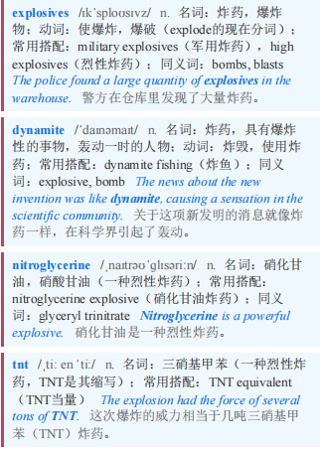
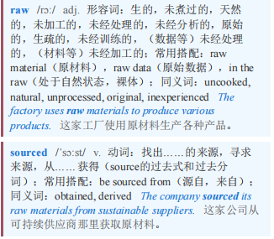
European defence 欧洲防务 本课程来自公众号：熊猫外刊精读
【5】As for the people, it helps that Sweden has a long history of making explosives. Swebal’s plant will be just 3km from Alfred Nobel’s old dynamite factory in the country’s explosives belt. The local government and population are supportive. With three firms nearby making nitroglycerine (which gives dynamite its bang) for civilian use, Swebal will be able to tap trained workers (the chemical process for making tnt is similar). All raw materials can be sourced within 550km.
对于民众来说，瑞典有着悠久的制造炸药的历史，这是有帮助的。斯韦巴尔（Swebal）的工厂距离阿尔弗雷德·诺贝尔（Alfred Nobel）在该国“炸药带”的旧炸药工厂仅3公里。当地政府和民众都表示支持。附近有三家公司为民用生产硝化甘油（它使炸药具有爆炸力），斯韦巴尔将能够招募到训练有素的工人（制造TNT的化学过程与之类似）。所有原材料都可以在550公里范围内获取。

Slide 9
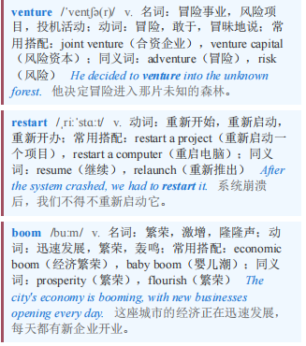
European defence 欧洲防务
【6】Swebal is not alone. Forcit, a Finnish company, plans a €200m investment in a new TNT plant on its country’s west coast, and a Czech-Greek joint venture is spending €83m to restart a factory near Athens. Even so, Europe will be short. To set off a TNT boom, it needs more bright sparks like Mr Sjoblom.
斯韦巴尔并非个例。芬兰公司福西特计划在该国西海岸投资2亿欧元新建一座梯恩梯（TNT）工厂，一家捷克-希腊合资企业正斥资8300万欧元重启雅典附近的一家工厂。即便如此，欧洲仍将面临短缺。要引发梯恩梯热潮，欧洲需要更多像斯约布洛姆先生这样的“火花”。

