Slide 1
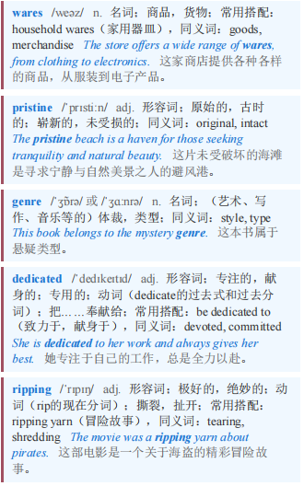
Bags not it 包不太行
【1】Those lucky enough to find designer wares under the Christmas tree this year will, for the most part, try hard to keep them in pristine condition. Yet an increasingly popular genre of online videos is dedicated to ripping them apart.
今年那些足够幸运在圣诞树下找到名牌商品的人，在很大程度上会努力让它们保持崭新的状态。然而，一种越来越流行的网络视频类型却致力于将它们拆开。

Slide 2
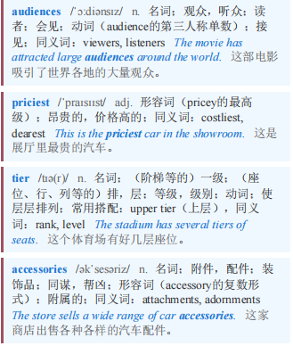
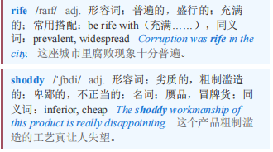
Bags not it 包不太行
Creators such as “Tanner Leatherstein” and “Fabricateurialist” show their audiences that even the priciest tier of clothes and accessories is rife with loose heel caps and shoddy stitching.
像“坦纳·莱瑟斯泰因”和“织物制造主义者”这样的创作者向他们的观众展示，即使是最昂贵的服装和配饰，也充斥着松动的鞋跟盖和劣质的缝线。

Slide 3
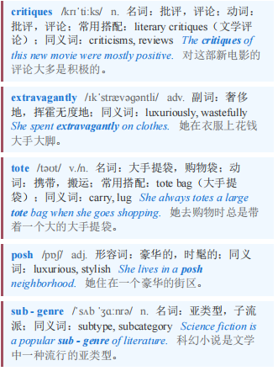
Bags not it 包不太行
【2】The most popular critiques by far—and the ones that worry luxury brands the most—are of their extravagantly priced handbags. A video of dye melting off a $2,000 tote from Goyard, a maker of posh leather goods, was watched 3.2m times this year. In a widely viewed sub-genre on TikTok, a short-video app, Chinese manufacturers claim (usually incorrectly) that various luxury bags are made in their country for pennies on the dollar.
到目前为止，最受欢迎——也是最让奢侈品牌担忧的批评——是针对它们价格过高的手提包。今年，一个关于高档皮具制造商高雅德（Goyard）一款售价2000美元的托特包掉色的视频被观看了320万次。在短视频应用TikTok上一个观看量很高的子类别中，中国制造商声称（通常是错误地）各种奢侈品牌的包都是在他们国家以极低的成本生产的。

Slide 4
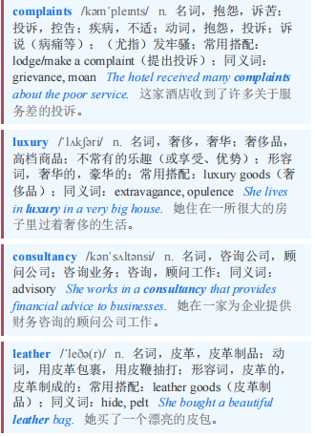
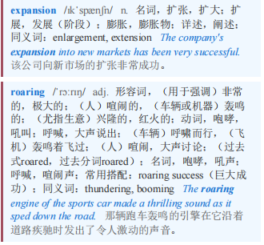
Bags not it 包不太行
【3】complaints about handbags are particularly concerning for luxury companies because they have been so central to their success. Often they are a brand’s best-known—and priciest—product. According to Bain, a consultancy, such leather goods accounted for 25-30% of the expansion in the global market for luxury items between 2019 and 2023, a period of roaring growth during which the industry’s total sales rose from €284bn to €369bn ($434bn).
对于奢侈品公司来说，关于手提包的投诉尤其令人担忧，因为手提包一直是它们成功的核心。通常，手提包是一个品牌最知名——也是最昂贵——的产品。咨询公司贝恩（Bain）的数据显示，2019年至2023年期间，这类皮革制品在全球奢侈品市场的扩张中占比25%-30%。在这段迅猛增长的时期，该行业的总销售额从2840亿欧元增至3690亿欧元（合4340亿美元）。

Slide 5
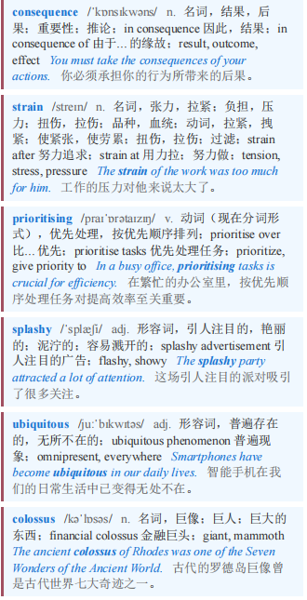
Bags not it 包不太行
【4】Lately, however, the handbag business has taken a beating. Partly that is a consequence of the strain on middle-class wallets. It also reflects shifts in consumer preferences. Some well-heeled shoppers are prioritising splashy experiences over the designer wares that have become increasingly ubiquitous in recent years. LVMH, the industry’s colossus, now offers big-spending clients the chance to sleep in Christian Dior’s original studio.
然而，近来手提包业务受到了冲击。部分原因是中产阶级钱包吃紧。这也反映了消费者偏好的转变。一些富有的购物者更看重引人注目的体验，而非近年来日益普遍的设计师品牌商品。该行业巨头路威酩轩集团（LVMH）现在为高消费客户提供在克里斯汀·迪奥（Christian Dior）的原始工作室住宿的机会。

Slide 6
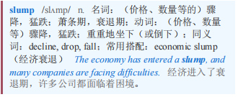
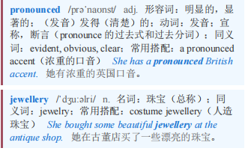
Bags not it 包不太行 本课程来自公众号：熊猫外刊精读
【5】Yet the slump in spending on luxury handbags has been especially pronounced, even as categories such as beauty and jewellery have continued to grow.
然而，即使美容和珠宝等品类持续增长，奢侈品手袋的消费下滑尤其显著。

Slide 7
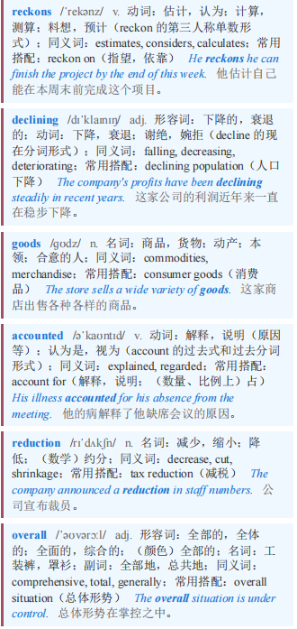
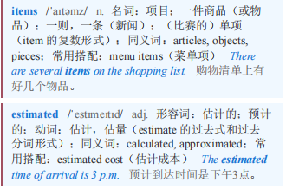
Bags not it 包不太行
Bain reckons that declining sales of leather goods accounted for three-fifths of the reduction in overall spending on luxury items since 2023, to an estimated €358bn this year.
贝恩公司估计，自2023年以来，皮具销售下滑占奢侈品总消费减少量的五分之三，今年奢侈品总消费预计为3580亿欧元。

Slide 8
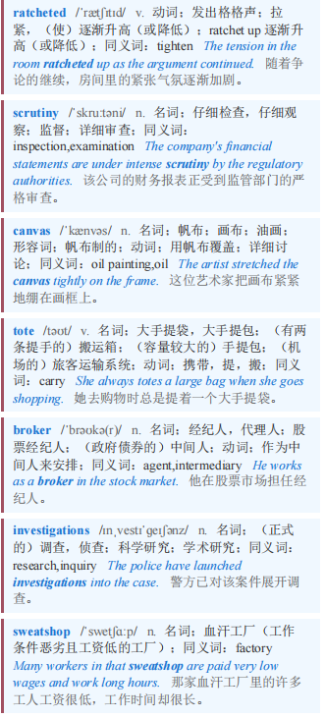
Bags not it 包不太行
【6】Luxury brands, which ratcheted up prices for their handbags during the post-pandemic spending boom, have invited greater scrutiny of their quality. Shoppers eyeing Louis Vuitton’s Speedy 30 canvas tote will need to pay more than twice what they would have in 2019. The typical price of a luxury handbag has risen from between eight and 12 times the production cost to roughly 15 times, says Luca Solca of Bernstein, a broker. A series of investigations by the Italian government into sweatshop-like conditions in the country’s supply chain for luxury fashion have also not helped the industry’s reputation.
奢侈品牌在疫情后消费热潮期间提高了手袋价格，这引发了人们对其质量的更多审视。想买路易威登Speedy 30帆布手提包的顾客，如今需要支付的价格是2019年时的两倍多。经纪公司伯恩斯坦的卢卡·索尔卡表示，奢侈手袋的典型价格已从生产成本的8至12倍涨至约15倍。意大利政府对该国奢侈时尚供应链中类似血汗工厂的状况展开的一系列调查，也对该行业的声誉无益。

Slide 9
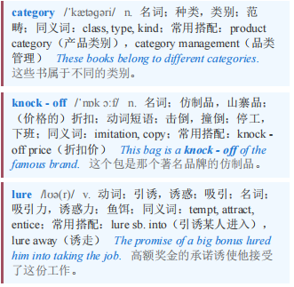
Bags not it 包不太行
【7】Meanwhile, those coveting a fancy handbag now have more alternatives. Online marketplaces for secondhand luxury goods are growing quickly. Vestiaire Collective, one such platform, says that handbags are its best-selling category, accounting for more than two-fifths of the value of purchases. Decent quality knock-offs known as “superfakes” have also lured some one-time luxury clients.
与此同时，那些觊觎高档手提包的人现在有了更多选择。二手奢侈品在线市场发展迅速。Vestiaire Collective 就是这样一个平台，它表示手提包是其最畅销的品类，占购买价值的五分之二以上。质量不错的仿制品，也就是所谓的“超级假货”，也吸引了一些曾经购买奢侈品的客户。

Slide 10
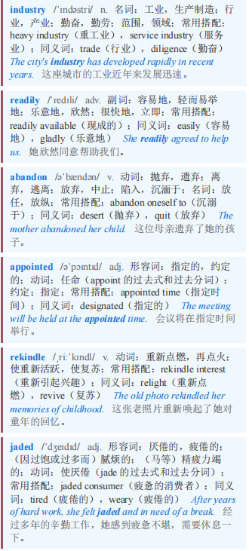
Bags not it 包不太行
【8】The luxury industry will not readily abandon the cash cow that is the cowhide bag. Nearly every major European label appointed a new designer this year, and will be hoping that the handbags that appear in stores in 2026 will rekindle interest from jaded shoppers.
奢侈品行业不会轻易放弃作为摇钱树的牛皮包。今年，几乎每个欧洲大牌都任命了一位新设计师，并希望2026年在门店上架的手袋能重新唤起审美疲劳的购物者的兴趣。

Slide 11
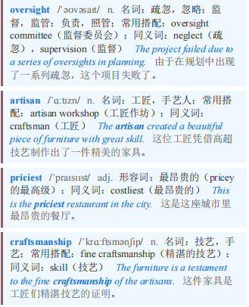
Bags not it 包不太行 本课程来自公众号：熊猫外刊精读
Brands such as Chanel and Prada have been working to fix quality issues by taking stakes in leather manufacturers and tightening oversight of production. Hermès has avoided quality concerns by having a single artisan produce its priciest handbags, including the Birkin, from start to finish. Its sales of leather goods rose by 13% year on year in the quarter from July to September. craftsmanship, it seems, still pays.
香奈儿和普拉达等品牌一直通过入股皮革制造商并加强对生产的监督来解决质量问题。爱马仕通过让一名工匠从头到尾制作包括铂金包在内的最昂贵手袋，避免了质量问题。在7月至9月的季度里，其皮具销售额同比增长了13%。看来，工艺仍然是有回报的。

