Slide 1
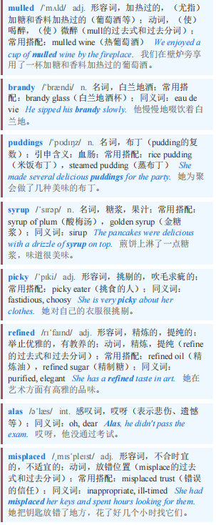
Well informed 消息灵通
【1】This is the time of year for mulled wine, sweet brandy and puddings drenched in syrup. Some people may tell you that you can limit the damage by being picky about which type of sugar you eat. Avoid refined white sugar, they will say, and search out the healthier “natural” stuff instead, such as raw sugar or honey. alas, the advice is misplaced—the type of sugar you eat won’t make any difference to your health. What could, though, is how you eat it.
这是一年中适合喝热红酒、甜白兰地和吃浸满糖浆的布丁的时节。有些人可能会告诉你，通过挑剔所吃的糖的种类，你可以减少危害。他们会说，避免精制白糖，转而寻找更健康的“天然”糖，比如原糖或蜂蜜。唉，这个建议不得要领——你吃的糖的种类对你的健康不会有任何影响。不过，可能有影响的是你吃糖的方式。

Slide 2

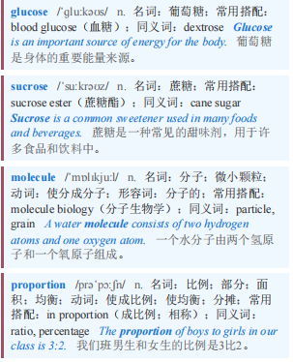
Well informed 消息灵通
【2】More than 250 different types of sugar can appear on food labels. But whether you see sugar (eg, brown, coconut, cane or crystal), nectar or syrup (eg, corn, maple, agave or grape), their sweetness usually comes from the same two main molecules: fructose and glucose. When they are bound together in equal proportions, they form sucrose—familiar plain white sugar.
超过250种不同类型的糖会出现在食品标签上。但无论你看到的是糖（如红糖、椰糖、蔗糖或冰糖）、花蜜还是糖浆（如玉米糖浆、枫糖浆、龙舌兰糖浆或葡萄汁），它们的甜味通常都来自两种相同的主要分子：果糖和葡萄糖。当它们以相等的比例结合在一起时，就形成了蔗糖——我们熟悉的普通白糖。

Slide 3
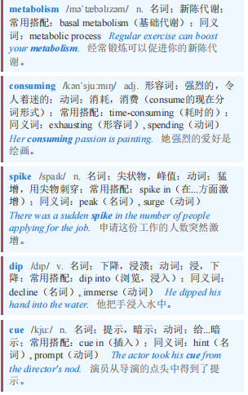
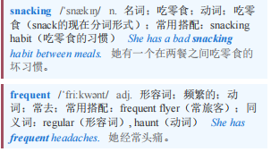
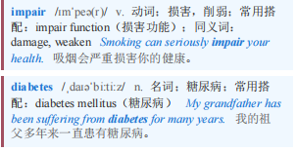
Well informed 消息灵通
【3】Glucose is the body’s main source of fuel, used for metabolism within cells. consuming lots at once will cause a spike of it in your blood, which is then followed by a sharp dip that will make you hungry (cue snacking). Over time, frequent spikes can also impair blood-glucose control and lead to diabetes.
葡萄糖是身体的主要能量来源，用于细胞内的新陈代谢。一次性摄入大量葡萄糖会导致血糖飙升，随后急剧下降，这会让你感到饥饿（促使你吃零食）。随着时间的推移，频繁的血糖飙升也会损害血糖控制并导致糖尿病。

Slide 4
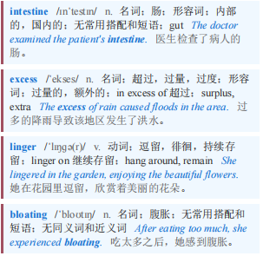
Well informed 消息灵通
【4】Fructose, found mainly in fruits and honey, is much sweeter and does not cause spikes because it first has to be processed into glucose, and other compounds, inside the intestine and the liver. excess fructose, though, is turned into fat by the liver and, in some people who cannot deal with this sugar well, lots of unabsorbed fructose may linger in the gut, feeding harmful bacteria and causing bloating and other problems. So a useful strategy, when consuming sugar in any form, is to eat it slowly.
果糖主要存在于水果和蜂蜜中，甜度高得多，而且不会导致血糖飙升，因为它首先必须在肠道和肝脏内被加工成葡萄糖和其他化合物。然而，过量的果糖会被肝脏转化为脂肪，而且在一些不能很好处理这种糖的人身上，大量未被吸收的果糖可能会在肠道内滞留，为有害细菌提供养分，并导致腹胀和其他问题。因此，在食用任何形式的糖时，一个有用的策略是慢慢吃。

Slide 5
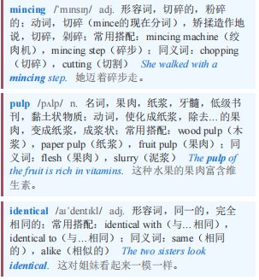
Well informed 消息灵通 本课程来自公众号：熊猫外刊精读
【5】Another tip is to avoid drinking your sugar. Having a sugary drink is worse than eating the same amount of sugar as part of food, simply because drinking allows more sugar to be gulped down faster. Fruit juice is best avoided—mincing and separating the fruit sugar from the pulp leaves behind a cocktail of glucose and fructose that is almost identical to plain white sugar. A glass of orange juice typically has nearly as much sugar as a glass of Coca-Cola of the same size.
另一个建议是避免喝含糖饮料。喝含糖饮料比吃含有相同量糖分的食物更糟糕，仅仅是因为喝会让人更快地吞下更多的糖。最好避免喝果汁——将水果切碎并将果糖从果肉中分离出来，会留下一杯几乎与普通白糖相同的葡萄糖和果糖混合物。一杯橙汁通常和一杯同样大小的可口可乐含有几乎相同量的糖。

Slide 6
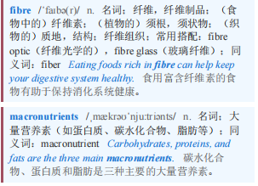
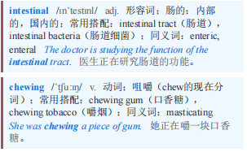
Well informed 消息灵通
【6】By contrast, you would struggle to eat three oranges in one sitting (the number you would need for a glass of orange juice), due to the fibre of the pulp. It helps that both fructose and glucose are absorbed more slowly when they are consumed with fibre, or alongside protein or fat (cake with nuts, say). All these macronutrients interfere with the sugar’s access to the intestinal wall and also make you feel fuller for longer. chewing also slows down the speed at which sugars reach the stomach.
相比之下，你很难一次吃下三个橙子（一杯橙汁所需的橙子数量），因为果肉中的纤维。当果糖和葡萄糖与纤维一起摄入，或者与蛋白质或脂肪一起摄入时（比如有坚果的蛋糕），它们的吸收速度会更慢，这是有帮助的。所有这些大量营养素都会干扰糖分进入肠壁，还会让你更长时间有饱腹感。咀嚼也会减缓糖分到达胃部的速度。

Slide 7
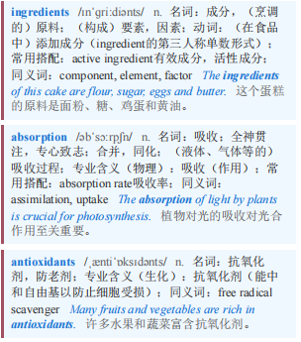
Well informed 消息灵通
【7】Other ingredients in “natural” sugars are unlikely to make them any healthier. Date sugar, which is just ground dried dates, has some fibre; in some brands, it makes up around 10% of the weight, though this is too little to affect the speed of sugar absorption by the gut. Honey has some minerals and antioxidants but you would need to eat several jars of it to get the same amounts you would get from a cup of blueberries.
“天然”糖中的其他成分不太可能使它们更健康。椰枣糖，就是磨碎的干椰枣，含有一些纤维；在某些品牌中，它约占重量的10%，尽管这太少了，不足以影响肠道吸收糖分的速度。蜂蜜含有一些矿物质和抗氧化剂，但你需要吃几罐蜂蜜才能获得与一杯蓝莓相同的量。

Slide 8
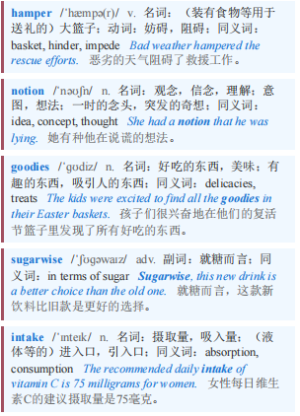
Well informed 消息灵通 本课程来自公众号：熊猫外刊精读
【8】Unless your Christmas hamper is a fruit basket, the notion that any of its goodies is healthier than others, sugarwise, is sadly untrue. But there are ways to be smart about your sugar intake—eat slowly, in the form of cakes, ideally with lots of nuts. Happy holidays.
除非你的圣诞礼盒是一个水果篮，否则从糖分含量来看，认为其中任何一种食品比其他食品更健康的想法，遗憾的是并不正确。但有一些方法可以让你明智地摄入糖分——慢慢吃，以蛋糕的形式吃，理想情况下搭配大量坚果。节日快乐。

