Slide 1

Education policy 教育政策
【1】ELDON, IOWA, rarely bustles. “We’re on top of a hill, in the middle of nowhere, surrounded by corn,” explains James Craig, the superintendent of the area’s school district, which has about 1,000 pupils. But on Mondays, the schools are particularly quiet. Only the teachers are at the primary school, learning a new maths curriculum. Since 2022 the district has worked on a four-day week schedule. “I couldn’t be happier,” Mr Craig says, “everyone is thriving.” Giving students Mondays off has led to better attendance, behaviour and mental health, he thinks.
爱荷华州的埃尔登很少热闹起来。“我们在山顶上，在偏僻之地，周围都是玉米地，”该地区学区的负责人詹姆斯·克雷格解释道，该学区约有1000名学生。但在周一，学校尤其安静。只有老师们在小学里，学习新的数学课程。自2022年以来，该学区实行每周四天的工作制。“我再高兴不过了，”克雷格先生说，“每个人都在蓬勃发展。”他认为，给学生周一放假，提高了出勤率、改善了行为表现和心理健康状况。

Slide 2

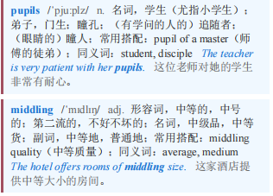
Education policy 教育政策
【2】Across America, more schools are embracing four-day weeks. Over 2,100 schools operate that way and every state west of the Mississippi now allows it. Created in order to either save money or attract teachers, four-day school weeks were previously a rural phenomenon. But they are now reaching into more towns and cities. In November voters in Independence, a suburb of Kansas City, Missouri, opted to keep its 14,000 pupils on a four-day school week. Unsurprisingly, teachers and students love it. Parents, too, have embraced the chance to spend more time at home. But for educational outcomes, the policy gets middling marks.
在美国各地，越来越多的学校采用每周四天的上学制。超过2100所学校以这种方式运作，现在密西西比河以西的每个州都允许这样做。每周四天上学制的设立是为了省钱或吸引教师，以前这是农村地区的现象。但如今它正延伸到更多的城镇。11月，密苏里州堪萨斯城郊区独立市的选民选择让其1.4万名学生继续实行每周四天上学制。不出所料，教师和学生都很喜欢这种制度。家长们也欣然接受有更多时间待在家里的机会。但就教育成果而言，这项政策得分中等。

Slide 3
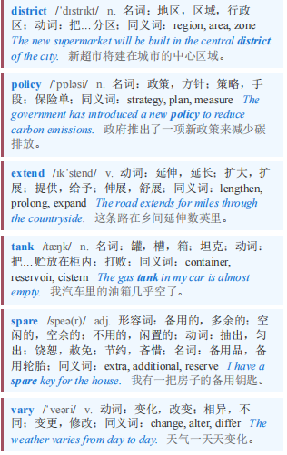
Education policy 教育政策
【3】How much less teaching takes place during a four-day week depends on each district’s policy. Generally, schools extend the four remaining days by just less than an hour, according to a study by RAND, a think-tank. How schools use the spare day also varies: some offer tutoring or child care, while others (such as those run by Mr Craig) do not offer much or anything.
每周四天制中教学时间减少多少取决于每个学区的政策。智库兰德公司的一项研究表明，一般来说，学校会将剩下的四天每天延长不到一小时。学校如何利用这空闲的一天也各不相同：有些学校提供辅导或托儿服务，而另一些学校（比如克雷格先生管理的学校）则提供得很少或什么都不提供。

Slide 4
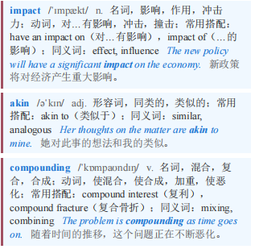
Education policy 教育政策
【4】So what is the impact of all of this? Start with test scores. The effect “is not huge”, says Emily Morton of NWEA, an education-research firm. “But it’s not nothing,” akin to students being two to seven weeks behind where they would be otherwise. This is not felt equally—students in rural schools and schools that kept the same amount of teaching do better. Academics worry about compounding negative results as pupils go through school without ever having a full week.
那么这一切会有什么影响呢？从考试成绩说起。教育研究公司西北测评协会（NWEA）的埃米莉·莫顿说，影响“不是很大”。“但也不是毫无影响”，这相当于学生比正常情况落后了两到七周。这种影响并不是均匀分布的——农村学校和保持相同教学量的学校的学生表现更好。学者们担心，随着学生在整个学业生涯中从未完整地上过一周课，负面结果会不断累积。

Slide 5

Education policy 教育政策 本课程来自公众号：熊猫外刊精读
【5】Despite this, educators are effusive about the impact of short-weeks on classroom atmosphere. One teacher told researchers that students were less “burned out”. Karl Janson, a retired superintendent who took two school districts in Missouri four-day, said behaviour improved and severe discipline problems fell by half. Some studies are more equivocal. One looking at Oklahoma’s four-day schools did find that they had less fighting and bullying. But the RAND survey found that though parents and teachers perceived higher morale, surveys showed it was no different from full-time schools. And despite advocates’ hopes, research shows short weeks have not significantly improved attendance.
尽管如此，教育工作者对短周制对课堂氛围的影响还是赞不绝口。一位老师告诉研究人员，学生们不那么“筋疲力尽”了。卡尔·詹森是一位退休的学监，他曾让密苏里州的两个学区实行四天制，他说学生的行为有所改善，严重的纪律问题减少了一半。一些研究的结论更为模糊。一项针对俄克拉荷马州四天制学校的研究确实发现，这些学校的打架和欺凌行为有所减少。但兰德公司的调查发现，尽管家长和老师认为士气有所提高，但调查显示这与全日制学校并无不同。而且，尽管倡导者抱有希望，但研究表明短周制并没有显著提高出勤率。

Slide 6
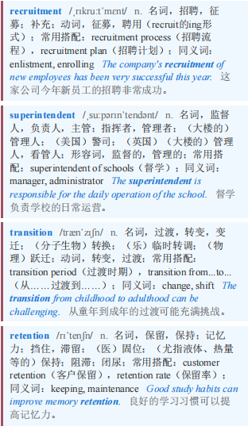
Education policy 教育政策
【6】The policy does not save districts much money, typically no more than 2.5% of their budget. Their motivation has been to address problems in teacher recruitment, explains Gregg Klinginsmith, a superintendent in Warren County, Missouri. He contrasts his area to the nearby St Louis suburbs, which “pay very, very well… Our community very much values low taxes.” He cites data that the transition to the four-day week has led to an increase in teachers sticking around. But broad studies show that four-day weeks do not significantly improve rural teacher retention.
这项政策并没有为学区节省太多资金，通常不超过其预算的2.5%。密苏里州沃伦县的一位学监格雷格·克林金斯密斯解释说，他们这么做的动机是为了解决教师招聘方面的问题。他将自己所在地区与附近的圣路易斯郊区进行了对比，圣路易斯郊区“薪资待遇非常非常好……我们的社区非常看重低税收。”他引用数据称，改为每周四天工作制后，留下来的教师增多了。但广泛的研究表明，每周四天工作制并不能显著提高农村地区教师的留存率。

Slide 7
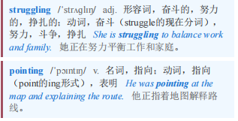
Education policy 教育政策
【7】Some worry about children who are falling through the cracks. “We’re not finding and reaching the families that might be struggling,” says Emily Tomayko of Montana State University, pointing to kids in single-parent families.
一些人担心那些被忽视的孩子。蒙大拿州立大学的艾米丽·托迈科说：“我们没有找到那些可能正在挣扎的家庭，也没有接触到他们。”她指的是单亲家庭的孩子。

Slide 8

Education policy 教育政策 本课程来自公众号：熊猫外刊精读
【8】Losing a day of child care might not work outside rural areas. But so far, parents are among the biggest supporters of four-day weeks. Nine primary-school parents out of ten told RAND they were satisfied and nearly as many would probably or definitely choose to keep it. (Some 95% of high-school pupils felt similarly.) “Our lives are less stressful, ” one parent said. “I feel like my kids are just happier.”
在农村地区以外，取消一天的儿童保育服务可能行不通。但到目前为止，父母是每周四天工作制的最大支持者之一。十分之九的小学家长告诉兰德公司，他们对此感到满意，而且几乎同样多的人可能会或肯定会选择继续保持这种模式。（约95%的高中生也有类似感受。）“我们的生活压力更小了，”一位家长说，“我觉得我的孩子们更快乐了。”

