Slide 1
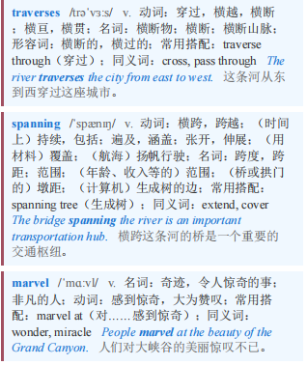
Road pricing 道路收费
【1】Drive south out of Chicago and you can, for the reasonable fee of $7.80, experience crossing the longest bridge in the midwestern United States. The Skyway traverses the Calumet river to connect the city to the Indiana border. The spanning highway is, in its own way, a marvel of engineering. Financial engineering, that is.
从芝加哥向南行驶，只需支付7.80美元的合理费用，你就可以体验穿越美国中西部最长的桥梁。这条高架公路横跨卡柳梅特河，将芝加哥市与印第安纳州边界连接起来。从某种程度上说，这条横跨两地的公路是工程学上的奇迹。不过，这里说的是金融工程学。

Slide 2
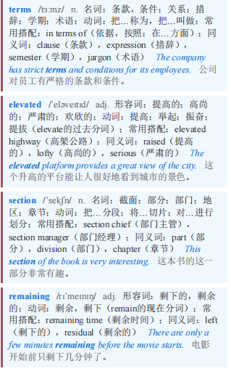
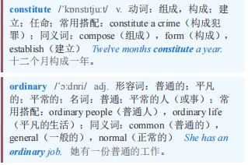
Road pricing 道路收费
【2】Except in legal terms, the Skyway is not really a bridge. The elevated section that goes over the Calumet is less than a mile long. The remaining seven miles constitute a perfectly ordinary highway.
除了在法律层面，天桥其实并不是一座真正的桥。横跨卡柳梅特河的高架部分不到一英里长。剩下的七英里则构成了一条完全普通的公路。

Slide 3
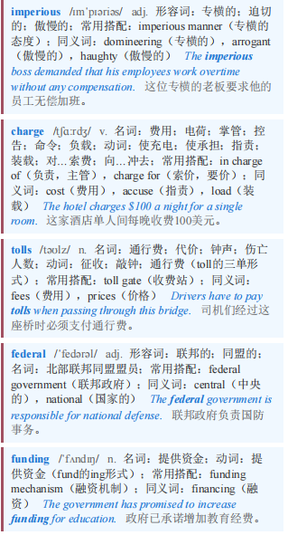
Road pricing 道路收费
By calling it a bridge when it was built in the 1950s, Richard J. Daley, the imperious mayor of Chicago, was able to charge tolls without giving up federal highway funding, which required states not to charge drivers to use the roads it paid for.
20世纪50年代建造它时，专横的芝加哥市长理查德·J·戴利称其为桥，这样他就能在不放弃联邦公路资金的情况下收取通行费，因为联邦公路资金要求各州不得向使用其资助道路的司机收费。

Slide 4
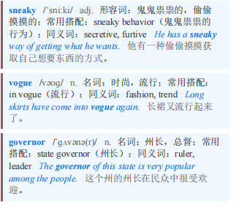
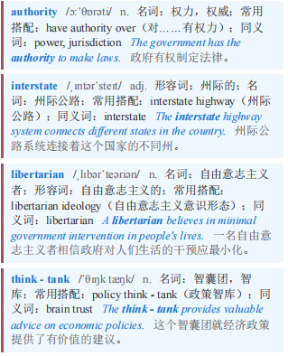
Road pricing 道路收费
【3】Generations ago, to raise tolls a politician had to be sneaky. Nowadays, they are in vogue. In June Mike Braun, the governor of Indiana, signed a law giving the state the authority to raise tolls on all of its existing interstate highways. No state has previously tried that, says Robert Poole, a transportation expert at the Reason Foundation, a libertarian think-tank.
几代人以前，政治家要提高通行费就得偷偷摸摸。如今，提高通行费很时髦。6月，印第安纳州州长迈克·布劳恩签署了一项法律，赋予该州提高所有现有州际公路通行费的权力。自由意志主义智库“理性基金会”的交通专家罗伯特·普尔表示，此前没有哪个州尝试过这样做。

Slide 5
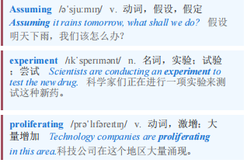
Road pricing 道路收费
【4】For now, drivers pay to access just 6,300 miles of America’s 160,000 or so miles of highway. But, says Mr Poole, the share may be about to grow rapidly. Assuming the federal government goes along with it, Indiana’s experiment could lead to toll roads proliferating across the United States.
目前，司机只需付费就能使用美国约16万英里高速公路中的6300英里。但普尔先生表示，这一比例可能很快就会大幅上升。如果联邦政府同意，印第安纳州的试验可能会导致收费公路在美国各地激增。

Slide 6
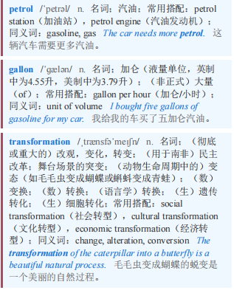
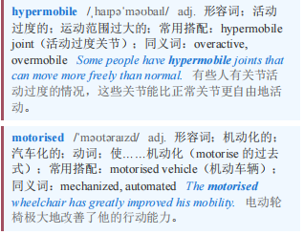
Road pricing 道路收费 本课程来自公众号：熊猫外刊精读
【5】The reason why federal law banned states from collecting tolls on interstates was that drivers had already paid for the roads by means of a tax on petrol (or gasoline). In 1956, when the Federal-Aid Highway Act passed, for every gallon drivers bought, three cents (or $0.36 today) went into a “federal highway trust fund”. The fund raised enough money to build out the federal highway system, enabling the transformation of America into a hypermobile, motorised society.
联邦法律禁止各州在州际公路上收取通行费的原因是，司机们已经通过对汽油征税的方式为道路建设支付了费用。1956年，《联邦资助公路法案》通过时，司机每购买一加仑汽油，就有三美分（相当于如今的0.36美元）进入“联邦公路信托基金”。该基金筹集到了足够的资金来建设联邦公路系统，使美国转变为一个高度流动的机动化社会。

Slide 7
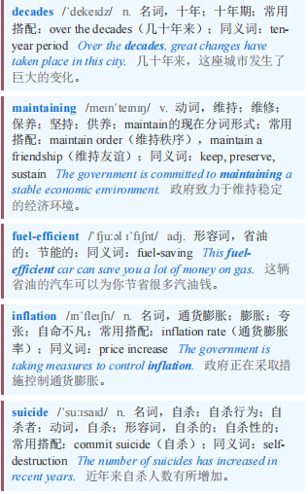
Road pricing 道路收费
【6】The problem is that the model no longer works. Over the decades, the cost of maintaining roads and highways has risen, even as cars have become more fuel-efficient. And raising gas taxes, even just in line with inflation, is generally considered to be political suicide.
问题在于这种模式不再奏效。几十年来，维护道路和高速公路的成本不断上升，尽管汽车变得更加省油。而且提高汽油税，哪怕只是与通货膨胀同步，通常也被认为是政治自杀。

Slide 8
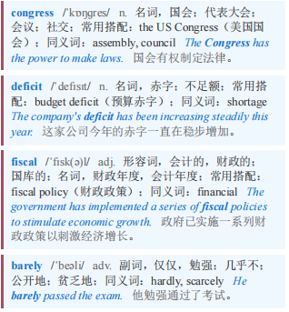
Road pricing 道路收费
The last time congress did it was in 1993. The result is a giant deficit. In fiscal 2024, the federal government spent $27bn more on maintaining roads than it collected in tax. At the state and local levels, fuel taxes covered barely a quarter of road spending.
国会最后一次这样做是在1993年。结果就是出现了巨额赤字。在2024财年，联邦政府在道路维护上的支出比税收收入多270亿美元。在州和地方层面，燃油税仅覆盖了道路支出的四分之一。

Slide 9
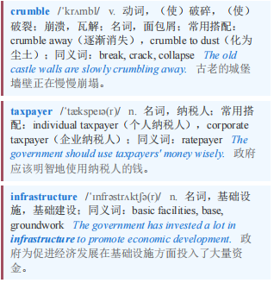
Road pricing 道路收费
【7】Unless something is done, either the roads will crumble or the general taxpayer will have to pay the bill. Hence tolling. Jim Pressel, the Indiana state representative who sponsored the new law, says his state is facing a $2bn deficit in its roads-maintenance fund. Tolls, he argues, are the fairest way available to rebuild or expand the roads. Out of state drivers often “do not stop and buy as much as a Snickers bar, let alone buy gas to pay for the infrastructure that they’re using”, he says.
除非采取措施，否则要么道路会破败不堪，要么普通纳税人将不得不为此买单。因此要收取通行费。印第安纳州众议员吉姆·普雷塞尔（Jim Pressel）是这项新法律的提案人，他表示该州的道路维护基金面临着20亿美元的赤字。他认为，通行费是重建或扩建道路的最公平方式。他说，外州司机经常“连一块士力架巧克力棒都不买，更不用说买汽油来为他们使用的基础设施付费了”。

Slide 10
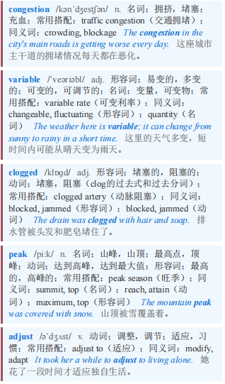
Road pricing 道路收费
【8】By deterring some drivers, tolls also limit congestion. Some of the most successful projects have been “express” lanes added to highways where drivers pay variable rates to skip traffic. California State Route 91, a famously clogged highway in Los Angeles, has a toll lane with high peak prices and where the cost to enter it can adjust as often as every three minutes, according to traffic levels. These sorts of projects are expanding.
通过阻止一些司机上路，收费也限制了交通拥堵。一些最成功的项目是在高速公路上增加“快速”车道，司机支付可变费用以避开交通拥堵。加利福尼亚州91号公路是洛杉矶一条著名的拥堵公路，它有一条收费车道，高峰时段价格很高，而且进入该车道的费用可以根据交通流量每三分钟调整一次。这类项目正在不断扩展。

Slide 11
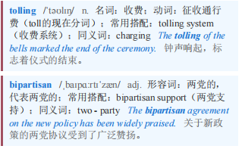
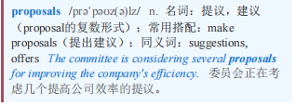
Road pricing 道路收费 本课程来自公众号：熊猫外刊精读
【9】Most tolling projects have bipartisan support. Democrats backed Mr Pressel’s proposals in Indiana. As there, Republican states tend to be eager tollers. Florida has more toll roads by distance than any other state; Texas is second. As the Republican Party embraces populism, however, this is changing. In New York City, congestion pricing has been fought by almost all Republicans in the state. On coming to office, Donald Trump attempted to shut it down (although he has not succeeded so far). Normal toll roads are under threat too. Many Republicans would like to buy back pay-to-drive roads and make them free. Rather than charging drivers to use the infrastructure they rely on, the state would take over private assets, give them away and make people queue.
大多数收费项目都得到了两党的支持。民主党人支持普雷塞尔在印第安纳州的提议。在那里，共和党执政的州往往热衷于收费。按里程计算，佛罗里达州的收费公路比其他任何州都多；得克萨斯州位居第二。然而，随着共和党接受民粹主义，这种情况正在发生变化。在纽约市，拥堵收费遭到了该州几乎所有共和党人的反对。唐纳德·特朗普上任时试图叫停它（尽管到目前为止他还没有成功）。普通收费公路也受到了威胁。许多共和党人希望回购收费公路并使其免费。该州不会向依赖基础设施的司机收费，而是会接管私人资产，免费提供并让人们排队。

