Slide 1
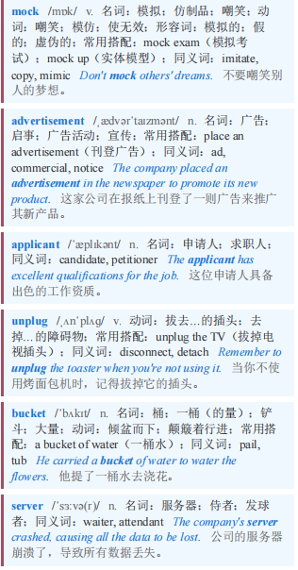
Artificial intelligence 人工智能
【1】A mock job advertisement that has done the rounds recently calls for a “killswitch engineer” for OpenAI, maker of ChatGPT. The description requires the successful applicant to stand by servers all day and unplug them “if this thing turns on us”. Useful skills include the ability to “throw a bucket of water on the servers, too. Just in case.”
最近流传的一则模拟招聘广告，为ChatGPT的开发者OpenAI招聘“紧急制动工程师”。招聘描述要求成功应聘者整日守在服务器旁，“如果这东西背叛我们”，就拔掉服务器的插头。有用的技能还包括“也能往服务器上泼一桶水。以防万一”。

Slide 2
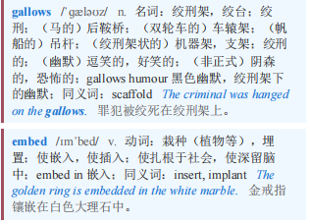
Artificial intelligence 人工智能
【2】Despite widespread fears of job losses owing to the rise of artificial-intelligence (AI) agents, it is not all gallows humour. The technology is already creating new roles—to train agents, embed them in organisations and ensure that they behave. Many of these new jobs, moreover, require uniquely human skills.
尽管人们普遍担心由于人工智能（AI）代理的兴起会导致失业，但这并非全是悲观的调侃。这项技术已经在创造新的角色——培训代理、将它们嵌入组织并确保它们的行为得当。此外，这些新工作中的许多都需要独特的人类技能。

Slide 3
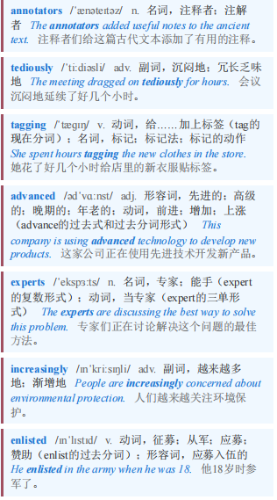
Artificial intelligence 人工智能
【3】Start with data annotators. No longer are they merely low-paid gig workers tediously tagging images. As AI models have become more advanced, experts in subjects such as finance, law and medicine have increasingly been enlisted to help train them.
从数据标注员开始。他们不再仅仅是拿着低薪、乏味地给图像打标签的零工。随着人工智能模型变得愈发先进，金融、法律和医学等学科的专家越来越多地被招募来帮助训练这些模型。

Slide 4
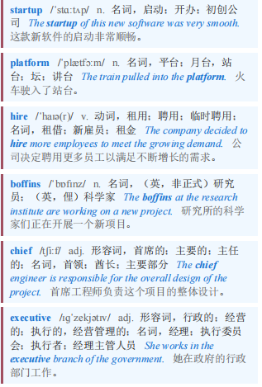
Artificial intelligence 人工智能
Mercor, a startup that has built a platform to hire boffins to help build bots, was recently valued at $10bn. Brendan Foody, its chief executive, says they earn $90 an hour on average.
Mercor是一家初创公司，它搭建了一个平台，用于雇佣专家来帮助打造机器人，该公司最近估值达到100亿美元。其首席执行官布伦丹·富迪表示，他们平均每小时能挣90美元。

Slide 5
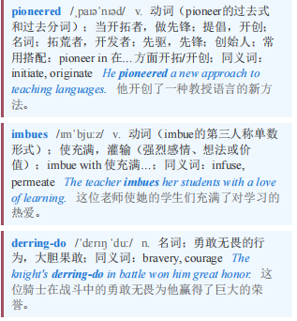
Artificial intelligence 人工智能
【4】Once bots are trained, teams of so-called forward-deployed engineers (FDEs) are needed to embed them into organisations. Palantir, a software giant that pioneered the concept, imbues them with derring-do. “In the beginning, it was just us. Two engineers dropped into a military base near Kandahar, handed minimal-but-clear marching orders from Palo Alto: ‘Go there and win,’” starts a typical blogpost by a former Palantir FDE.
一旦机器人经过训练，就需要所谓的前沿部署工程师（FDE）团队将它们嵌入组织。开创这一概念的软件巨头帕兰提尔（Palantir）赋予了他们无畏精神。“一开始，只有我们。两名工程师被派往坎大哈附近的一个军事基地，从帕洛阿尔托得到的行军命令虽简短但明确：‘去那里并取得胜利’，”一位前帕兰提尔前沿部署工程师在一篇典型的博客文章中写道。

Slide 6
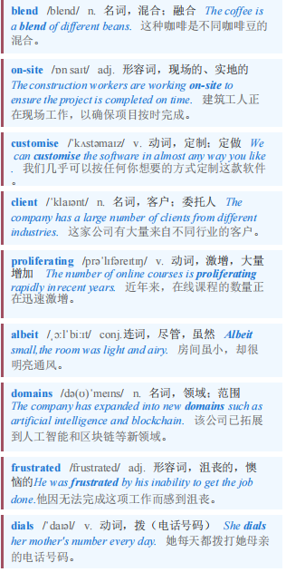
Artificial intelligence 人工智能 本课程来自公众号：熊猫外刊精读
【5】In practice, their jobs are a blend of developer, consultant and salesman. They work on-site to customise AI tools for a client and get them up and running. FDEs are proliferating, albeit from a low base. Garry Tan, the boss of YCombinator, a startup factory, said recently that its young companies had 63 job postings for FDEs, up from four last year. As AI agents spread, their makers need to understand the human-facing domains in which their tools operate. A programmer who builds a customer-service agent, for instance, needs to have a feel for why a frustrated customer dials zero just to yell at a human.
实际上，他们的工作融合了开发人员、顾问和销售人员的角色。他们在现场工作，为客户定制人工智能工具并使其启动和运行。尽管起步基数较低，但现场开发工程师（FDEs）的数量正在激增。初创企业孵化器 YCombinator 的老板加里·谭（Garry Tan）最近表示，其旗下的年轻公司为现场开发工程师发布了 63 个职位，而去年只有 4 个。随着人工智能代理的普及，其开发者需要了解他们的工具所应用的面向人类的领域。例如，开发客户服务代理的程序员需要了解为什么沮丧的客户拨打零号键只是为了对人类大喊大叫。

Slide 7
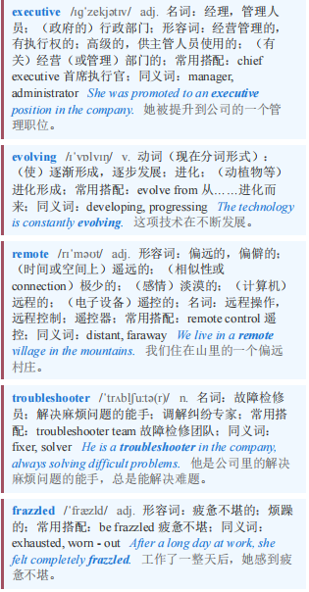
Artificial intelligence 人工智能
【6】Himanshu Palsule, chief executive of Cornerstone OnDemand, a skills-development company, uses Waymo, a fast-growing robotaxi firm, as an example of how the job of a developer is evolving. Waymo’s cars drive themselves from start to finish. But what if they break down, locking their passengers inside? Then comes the need for what he calls “the guy—or gal—in the sky”, a remote human troubleshooter who needs to understand not just the technology, but also how to handle frazzled passengers.
技能开发公司Cornerstone OnDemand的首席执行官希曼舒·帕尔苏莱（Himanshu Palsule）以快速发展的机器人出租车公司Waymo为例，说明开发者的工作是如何演变的。Waymo的汽车从头到尾都是自动驾驶。但如果它们抛锚，把乘客锁在里面怎么办？那么就需要他所说的“空中的那个家伙——或者姑娘”，一个远程的人工故障排除员，他不仅需要了解技术，还需要知道如何应对烦躁的乘客。

Slide 8
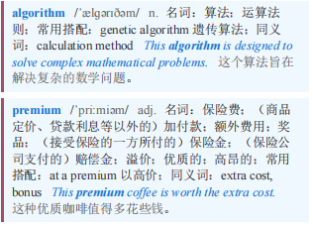
Artificial intelligence 人工智能
Software engineers, Mr Palsule says, used to be sought after for their coding abilities, not their bedside manner. No longer. Writing code can now be done by an algorithm. “Your personality is where your premium is.”
帕尔苏莱先生说，软件工程师过去因其编码能力而受到追捧，而不是因为他们的“床边态度”（此处指对待人的态度，用“床边态度”是一种形象比喻）。现在不再是这样了。现在代码可以由算法来编写。“你的个性就是你的溢价所在。”

Slide 9
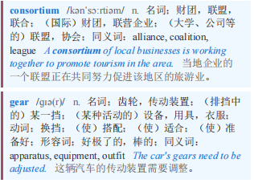
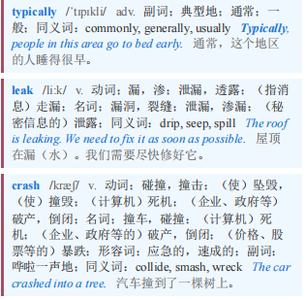
Artificial intelligence 人工智能
【7】Then there is the task of setting rules to ensure that AI agents do not bring chaos. The AI Workforce consortium, a research group led by Cisco, a maker of networking gear, recently examined 50 IT jobs across rich countries. The fastest growing, even more so than AI programmers, was AI risk-and-governance specialists, who are typically involved in ensuring that bots do not leak data or cause a company’s operations to crash, among other things.
接下来是制定规则以确保人工智能代理不会带来混乱的任务。由网络设备制造商思科牵头的研究小组人工智能劳动力联盟最近对富裕国家的50个信息技术工作岗位进行了研究。增长最快的，甚至比人工智能程序员还要快的，是人工智能风险与治理专家，他们通常参与确保机器人不会泄露数据或导致公司运营崩溃等事务。

Slide 10
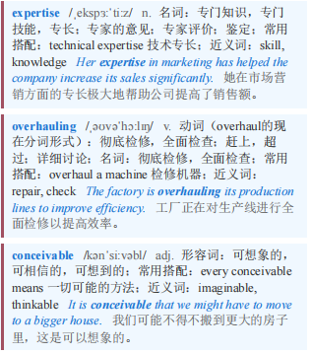
Artificial intelligence 人工智能 本课程来自公众号：熊猫外刊精读
【8】Responsible for bringing all these roles together is the chief AI officer, an increasingly popular addition to the c-suite as chief executives look to assure their boards that they are taking the technology very seriously indeed. chief AI officers usually combine technical expertise with deep knowledge of a particular industry and a record of overhauling corporate processes. It is not a job for the faint-hearted. The typical large enterprise uses as many as 11 generative-AI models, according to IBM, an IT company, and is constantly being bombarded by vendors trying to sell agents for every conceivable function. Those in charge may already feel like reaching for that killswitch.
将所有这些角色整合在一起的负责人是首席人工智能官。随着首席执行官们希望向董事会保证他们确实非常重视这项技术，首席人工智能官在高管层中越来越受欢迎。首席人工智能官通常将技术专长与对特定行业的深入了解以及改革企业流程的记录相结合。这不是胆小者能胜任的工作。据信息技术公司IBM称，典型的大型企业使用多达11种生成式人工智能模型，并且不断受到供应商的轰炸，这些供应商试图为每一种可以想象到的功能销售代理。那些负责人可能已经想要按下那个紧急关闭按钮了。

