Slide 1
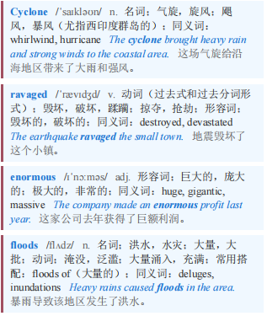
Cyclone Senyar in Indonesia 印度尼西亚的塞尼亚尔气旋
【1】Three weeks have passed since Cyclone Senyar ravaged Sumatra in western Indonesia, bringing enormous floods.
气旋“森亚尔”肆虐印度尼西亚西部的苏门答腊岛，引发了巨大的洪水，至今已过去三周。

Slide 2
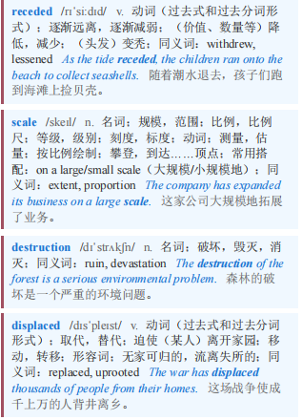
Cyclone Senyar in Indonesia 印度尼西亚的塞尼亚尔气旋
But only in mid-December, as the waters have receded, has the scale of the destruction become clear. More than 1,000 people have been killed, around 150,000 homes damaged and nearly 1m people displaced. scientists have described the storm as a once-in-70-year event.
但直到12月中旬，随着洪水退去，破坏的规模才变得清晰起来。超过1000人丧生，约15万所房屋受损，近100万人流离失所。科学家称这场风暴是70年一遇的事件。

Slide 3

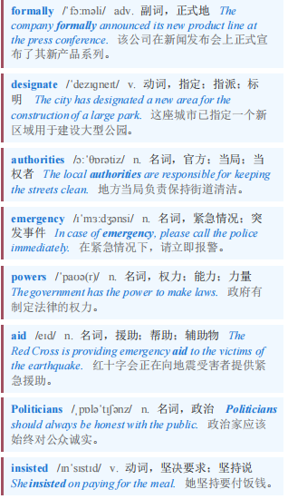
Cyclone Senyar in Indonesia 印度尼西亚的塞尼亚尔气旋
【2】And yet it is not a national disaster—or at least not by the standards of the government in Jakarta, the capital. Officials have declined to formally designate it as one, even though doing so would hand authorities emergency powers and, importantly, make it much easier for them to accept foreign aid. Politicians including Prabowo Subianto, the president, have insisted that Indonesia does not need outside help.
然而，这并不是一场国家灾难——或者至少按照首都雅加达政府的标准来说不是。官员们拒绝正式将其指定为一场灾难，尽管这样做会赋予当局紧急权力，而且重要的是，会让他们更容易接受外国援助。包括总统普拉博沃·苏比安托在内的政客们坚称，印度尼西亚不需要外部帮助。

Slide 4
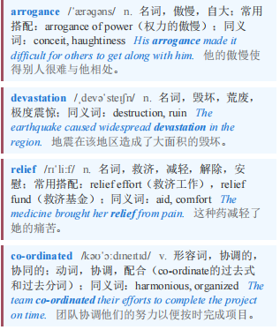
Cyclone Senyar in Indonesia 印度尼西亚的塞尼亚尔气旋
【3】“The arrogance of this government has cost lives,” says Farwiza Farhan, who heads HAkA, an NGO working in Aceh, a province in Sumatra. When the floods struck, the head of Indonesia’s disaster agency suggested the devastation was not as bad as it looked on social media (he later apologised). relief efforts have been slow and poorly co-ordinated, says Ms Farhan.
在苏门答腊岛亚齐省工作的非政府组织HAkA负责人法尔维扎·法尔汉说：“本届政府的傲慢已经造成了人员伤亡。”洪水来袭时，印尼灾害管理机构负责人表示，灾情并不像社交媒体上看起来那么严重（他后来道了歉）。法尔汉女士说，救援工作进展缓慢，协调不力。

Slide 5

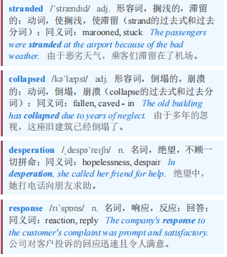
Cyclone Senyar in Indonesia 印度尼西亚的塞尼亚尔气旋
【4】Officials think it will cost 52trn rupiah ($3.1bn) to rebuild damaged homes and infrastructure. For now, several communities remain stranded by collapsed roads and bridges, hundreds of people are still missing and diseases are spreading. Residents in Aceh have started hoisting white flags outside their homes as a symbol of their desperation and their anger at the central government’s response.
官员们认为，重建受损的房屋和基础设施将花费52万亿卢比（31亿美元）。目前，一些社区因道路和桥梁坍塌而陷入困境，数百人仍然失踪，疾病也在蔓延。亚齐的居民已经开始在自家门外升起白旗，以此表达他们的绝望以及对中央政府应对措施的愤怒。

Slide 6
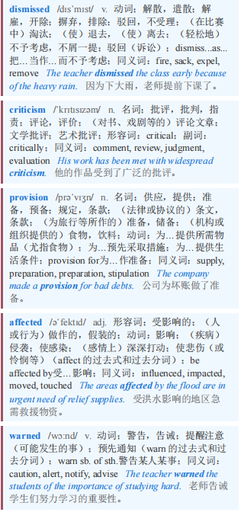
Cyclone Senyar in Indonesia 印度尼西亚的塞尼亚尔气旋 本课程来自公众号：熊猫外刊精读
【5】Mr Prabowo has dismissed some of the criticism as lies spread by foreign forces that, he says, have never liked Indonesia. He has apologised for delays in the provision of services and assistance to affected regions, but has also warned Indonesians that he does not have a “staff of Moses” that he can use to fix things straightaway.
普拉博沃先生驳斥了一些批评，称其为外国势力散布的谎言，他说这些外国势力从未喜欢过印度尼西亚。他为向受影响地区提供服务和援助的延迟道歉，但也警告印度尼西亚人，他没有一根“摩西的权杖”可以立即解决问题。

Slide 7
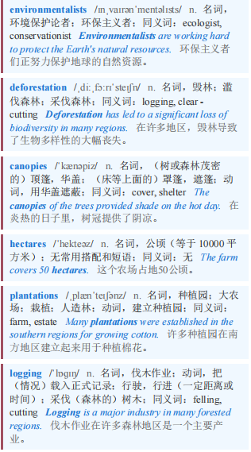
Cyclone Senyar in Indonesia 印度尼西亚的塞尼亚尔气旋
【6】environmentalists say work to prevent the next such disaster needs to start immediately—and that none of it is magic. They say deforestation worsened the floods. Tree canopies collect water; tree roots stop soil sliding away. But since 2001 Sumatra has lost 4.4m hectares of forest, an area roughly the size of Denmark, mostly to palm-oil plantations and illegal logging.
环保主义者表示，防止下一次此类灾难的工作需要立即启动——而且这其中没有任何神奇之处。他们说，森林砍伐加剧了洪水。树冠可以收集水分；树根可以防止土壤流失。但自2001年以来，苏门答腊岛已经失去了440万公顷的森林，面积大致相当于丹麦，这些森林大多变成了棕榈油种植园，或是因非法伐木而消失。

Slide 8
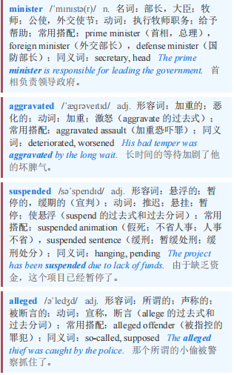
Cyclone Senyar in Indonesia 印度尼西亚的塞尼亚尔气旋
【7】Indonesia’s forests minister has admitted that poor forest management aggravated the floods. The environment ministry has suspended the operations of firms alleged to have cleared forest in areas where they took place.
印度尼西亚林业部长承认，糟糕的森林管理加剧了洪水。环境部已暂停了被指控在洪水发生地区砍伐森林的公司的运营。

Slide 9

Cyclone Senyar in Indonesia 印度尼西亚的塞尼亚尔气旋
Yet environmentalists question the government’s sincerity. Mr Prabowo raised eyebrows among them when he said, in a speech given during the height of the flooding on December 5th, that Indonesia was lucky to be “blessed” with palm oil.
然而，环保人士质疑政府的诚意。12月5日洪水最严重时，普拉博沃先生在一次演讲中表示，印度尼西亚很幸运“有幸”拥有棕榈油，这让他们感到惊讶。

Slide 10
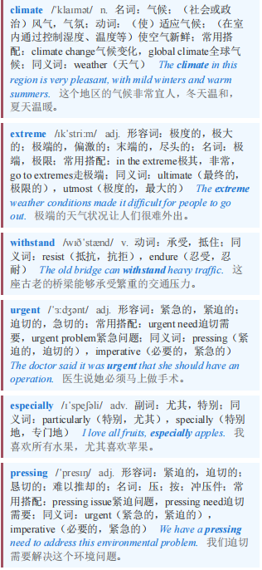
Cyclone Senyar in Indonesia 印度尼西亚的塞尼亚尔气旋
【8】As climate change makes extreme weather more common, efforts to prevent and withstand disasters are growing more urgent everywhere. But the need in Indonesia is especially pressing.
随着气候变化使极端天气变得更加常见，各地预防和抵御灾害的努力变得愈发紧迫。但印度尼西亚的需求尤为迫切。

Slide 11
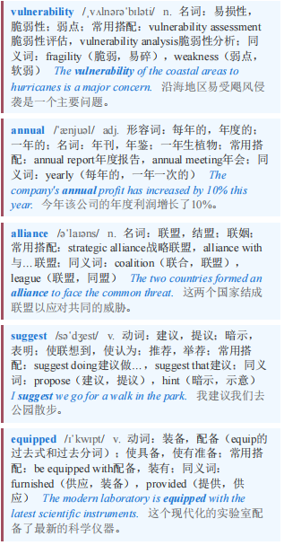
Cyclone Senyar in Indonesia 印度尼西亚的塞尼亚尔气旋 本课程来自公众号：熊猫外刊精读
It ranks third globally in its vulnerability to natural disasters, according to an annual report from an alliance of German NGOs. The events in Sumatra suggest that it is badly equipped to handle the storms still to come.
根据德国非政府组织联盟的一份年度报告，该国在自然灾害脆弱性方面全球排名第三。苏门答腊的事件表明，它在应对即将到来的风暴方面严重缺乏应对能力。

