Slide 1

Private Information Retrieval
Content may be borrowed from other resources.
See the last slide for acknowledgements!
Amir Houmansadr
CS660: Advanced Information Assurance
Spring 2015

Slide 2
AOL search data scandal (2006)
#4417749:
clothes for age 60
60 single men
best retirement city
jarrett arnold
jack t. arnold
jaylene and jarrett arnold
gwinnett county yellow pages
rescue of older dogs
movies for dogs
sinus infection
Thelma Arnold
62-year-old widow
Lilburn, Georgia
Notes:
http://en.wikipedia.org/wiki/AOL_search_data_leak

Slide 3
Observation
The owners of the database know a lot about the users!
This poses a risk to users’ privacy.
E.g. consider database with stock prices…
Can we do something about it?
Yes, we can:
trust them that they will protect our secrecy,
or
use cryptography!
Really?

Slide 4


How can crypto help?
user U
database D
Note: this problem has nothing to do with side-channels, website fingerprinting, etc.

Slide 5
Threat Model
secure link
database D
user U
A new primitive:
Private Information Retrieval (PIR)

Slide 6
Private Information Retrieval (PIR) [CGKS95]
Goal: allow user to query database while hiding the identity of the data-items she is after.
Note: hides identity of data-items; not existence of interaction with the user.
Motivation: patient databases; stock quotes; web access; many more....
Paradox(?): imagine buying in a store without the seller knowing what you buy.
(Encrypting requests is useful against third parties; not against owner of data.)

Slide 7
Model
Server: holds n-bit string x
n should be thought of as very large
User: wishes
to retrieve x_{i}
and
to keep i private

Slide 8
Private Information Retrieval (PIR)
n
?
4
3
i
7
j
i {1,…n}
x_{i}
x=x₁,x₂ , . . ., x_{n} {0,1}^{n}
SERVER
USER
Notes:
Introduced by CGKS in FOCS 96

Slide 9
Non-Private Protocol
i {1,…n}
x_{i}
x =x₁,x₂ , . . ., x_{n}
i
SERVER
USER
NO privacy!!!
Communication: 1
Notes:
(possibly skip)

Slide 10
Trivial Private Protocol
x₁,x₂ , . . ., x_{n}
x =x₁,x₂ , . . ., x_{n}
x_{i}
SERVER
USER
Server sends entire database x to User.
Information theoretic privacy.
Communication: n
Not optimal !
Notes:
(possibly skip)

Slide 11
Other solutions?
User asks for additional random indices.
Drawback: leaks information, reduces communication efficiency
Employ general crypto protocols to compute x_{i} privately.
Drawback: highly inefficient (polynomial in n).
Anonymity (e.g., via Anonymizers).
Note: different concern: hides identity of user; not the fact that x_{i} is retrieved.

Slide 12
Two Approaches for PIR
Information-Theoretic PIR [CGKS95,Amb97,...]
Replicate database among k servers.
User queries all the servers
Computational PIR [CG97,KO97,CMS99,...]
Computational privacy, based on cryptographic assumptions.
Notes:
Note user privacy can be extended to t-privacy (against coalitions)
Info theoretic approach introduced by CGKS
Note that info theoretic approach there is a better model (random server) but I will mention it later, for now the basics..
For computational approach (against computationally bounded db), need some cryptographic assumption: also follows from our work (the OT is necessary)

Slide 13
Known Comm. Upper Bounds
Multiple servers, information-theoretic PIR:
2 servers, comm. n^{1/3} [CGKS95]
k servers, comm. n^{1/Ω(k)} [CGKS95, Amb96,…,BIKR02]
log n servers, comm. Poly( log(n) ) [BF90, CGKS95]
Single server, computational PIR:
Comm. Poly( log(n) )
Under appropriate computational assumptions [KO97,CMS99]
Sub-linear with n
Notes:
Most of the main contributions. Chronological order. Mine is in red…
since I won’t talk about random server model, let me talk about it now...

Slide 14
Approach I: k-Server PIR
x {0,1}^{n}
S₁
i
x {0,1}^{n}
S₂
U
Correctness: User obtains x_{i}
Privacy: No single server gets information about i
x {0,1}^{n}
S_{k}
Notes:
Some hand-written slides about the CDOS, specific constructions, etc. check.
Clearly info theoretic SPIR is not possible with a single database (even PIR is not). However, even with multiple databases it is not possible, unless grant them access to shared random string.
(can be viewed as part of the data), can also be pseudo random, making data privacy computational while user privacy is still info-theoretic

Slide 15
A 2-server Information Theoretical PIR
n
0
1
0
0
1
1
0
1
0
0
1
0
S₁
i
S₂
i
U

Slide 16
A 2-server Information Theoretical PIR
n
0
1
0
0
1
1
0
1
0
0
1
0
S₁
i
S₂
Q₁ subset {1,…,n}
i
U

Slide 17
Protocol I: 2-server PIR
n
0
0
1
0
0
1
1
0
1
0
0
1
0
S₁
i
S₂
Q₁ subset {1,…,n}
i
U

Slide 18
Protocol I: 2-server PIR
n
0
0
1
0
0
1
1
0
1
0
0
1
0
S₁
i
S₂
Q₂=Q₁ + {i}
Q₁ subset {1,…,n}
i
U

Slide 19
Protocol I: 2-server PIR
n
0
0
1
0
0
1
1
0
1
0
0
1
0
1
S₁
i
S₂
Q₂=Q₁ + {i}
Q₁ subset {1,…,n}
i
U
Weakness: Servers should not collude!

Slide 20
Protocol I: 2-server PIR
n
0
0
1
0
0
1
1
0
1
0
0
1
0
1
S₁
i
S₂
Q₂=Q₁ + {i}
Q₁ subset {1,…,n}
i
U
Weakness: Servers should not collude!

Slide 21
Computation PIR
Only one server, no need to trust
Based on cryptographic assumptions
Downside: Server has to run over the whole database, otherwise leaks information
High computation load on the server

Slide 22
PIR-Tor: Scalable Anonymous Communication Using Private Information Retrieval
Prateek Mittal
University of Illinois Urbana-Champaign
Joint work with: Femi Olumofin (U Waterloo)
Carmela Troncoso (KU Leuven)
Nikita Borisov (U Illinois)
Ian Goldberg (U Waterloo)
Original slides from the authors
USENIX Security 2011

Slide 23




Tor Background
Directory
Servers
Trusted
Directory
Authority
List of servers?
Middle
Signed
Server list
(relay descriptors)
Exit
Guards
1. Load balancing
2. Exit policy

Slide 24
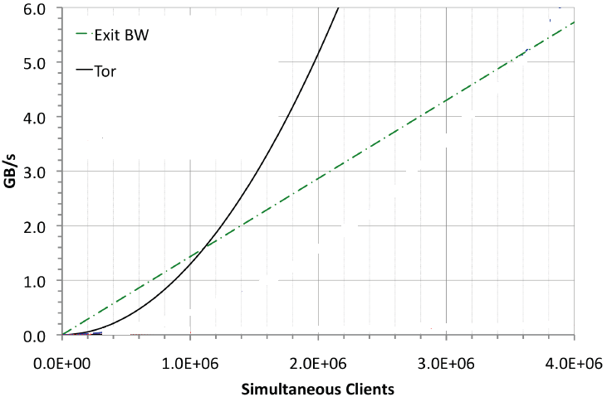
Performance Problem in Tor’s Architecture: Global View
Global view
Not scalable
Directory
Servers
List of servers?
Need solutions without global system view
Torsk – CCS09

Slide 25
Current Solution: Peer-to-peer Paradigm
Morphmix [WPES 04]
Broken [PETS 06]
Salsa [CCS 06]
Broken [CCS 08, WPES 09]
NISAN [CCS 09]
Broken [CCS 10]
Torsk [CCS 09]
Broken [CCS 10]
ShadowWalker [CCS 09]
Broken and fixed(??) [WPES 10]
Very hard to argue security of a distributed,
dynamic and complex P2P system.

Slide 26
Design Goals
A scalable client-server architecture with easy to analyze security properties.
Avoid increasing the attack surface
Equivalent security to Tor
Preserve Tor’s constraints
Guard/middle/exit relays,
Load balancing
Minimal changes
Only relay selection algorithm

Slide 27

Key Observation
Relay # 10, 25
Directory
Server
Need only 18 random middle/exit relays in 3 hours
So don’t download all 2000!
Naïve approach: download a few random relays from directory servers
Problem: malicious servers
Route fingerprinting attacks
Download selected relay descriptors without letting directory
servers know the information we asked for.
Private Information Retrieval (PIR)
Bob
10: IP address, key
25: IP address, key
10
25
Inference: User likely
to be Bob

Slide 28
Private Information Retrieval (PIR)
Information theoretic PIR
Multi-server protocol
Threshold number of servers don’t collude
Computational PIR
Single server protocol
Computational assumption on server
Only ITPIR-Tor in this talk
See paper for CPIR-Tor
R_{A}
A
R_{B}
B
R_{C}
C
Database
A
R_{A}
Database

Slide 29
ITPIR-Tor: Database Locations
Tor places significant trust in guard relays
3 compromised guard relays suffice to undermine user anonymity in Tor.
Choose client’s guard relays to be directory servers
Exit relay compromised:
Exit relay honest
At least one guard relay is honest
All guard relays compromised
Equivalent security to the current Tor network
Middle
Exit
Middle
Exit
Middle
Middle
Exit
Exit
Deny Service
End-to-end Timing Analysis
Guards
ITPIR does not provide privacy
But in this case, Tor anonymity broken
Guards
ITPIR guarantees user privacy
Guards
Guards

Slide 30
ITPIR-Tor Database Organization and Formatting
Middles, exits
Separate databases
Exit policies
Standardized exit policies
Relays grouped by exit policies
Load balancing
Relays sorted by bandwidth
Sort by
Bandwidth
Relay
Descriptors
m1
e1
m2
e2
m3
e3
Exit Policy 1
m4
e4
m5
e5
Exit Policy 2
m6
e6
m7
e7
Non-standard
Exit policies
m8
e8
Middles
Exits

Slide 31
ITPIR-Tor Architecture
Guard relays/
PIR Directory servers
Trusted
Directory
Authority
2. Initial connect
Download PIR database
3. Signed meta-information
18 PIR Queries(1 middle/exit)
5. 18 middle,18 PIR Query(exit)
6. PIR Response
m1
e1
4. Load balanced
index selection
m2
e2
m3
e3
m4
e4
m5
e5
m6
e6
m7
e7
m8
e8
Middles
Exits

Slide 32
Performance Evaluation
Percy [Goldberg, Oakland 2007]
Multi-server ITPIR scheme
2.5 GHz, Ubuntu
Descriptor size 2100 bytes
Max size in the current database
Exit database size
Half of middle database
Methodology: Vary number of relays
Total communication
Server computation

Slide 33
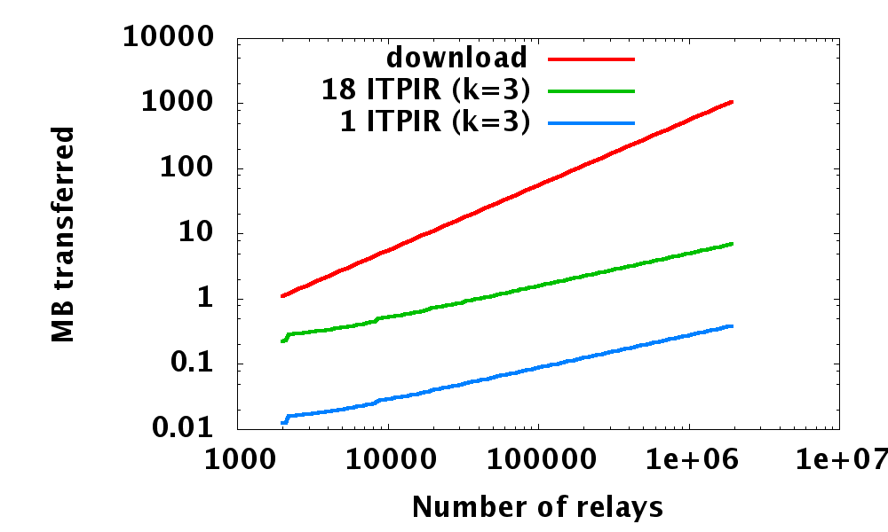
Performance Evaluation: Communication Overhead
Advantage of PIR-Tor becomes larger due to its sublinear scaling: 100x--1000x improvement
1.1 MB
216 KB
Current Tor network: 5x--100x improvement
12 KB

Slide 34
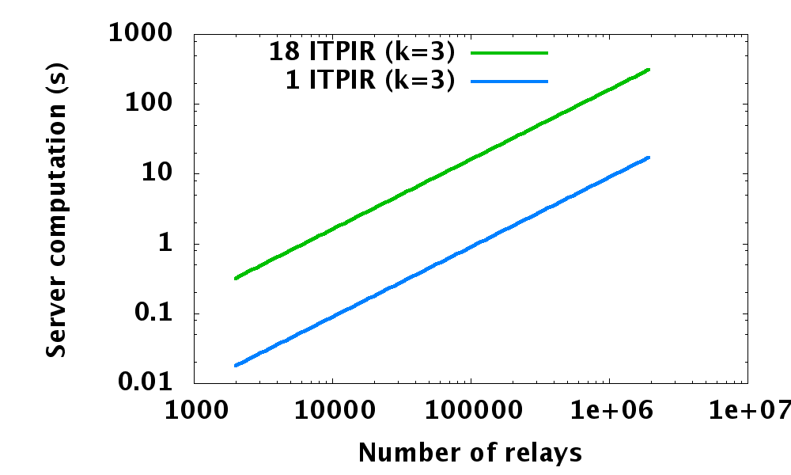
Performance Evaluation: Server Computational Overhead
100,000 relays: about 10 seconds (does not impact user latency)
Current Tor network: less than 0.5 sec

Slide 35
Performance Evaluation: Scaling Scenarios
Scenario |  |  | Tor Communication (per client) | ITPIR Communication (per client) | ITPIR Core Utilization
Explanation | Relay | Clients
Current Tor | 2,000 | 250,000 | 1.1 MB | 0.2 MB | 0.425 %
10x relay/client | 20,000 | 2.5M | 11 MB | 0.5 MB | 4.25 %
Clients turn relays | 250,000 | 250,000 | 137 MB | 1.7 MB | 0.425 %

Slide 36
Conclusion
PIR can be used to replace descriptor download in Tor.
Improves scalability
10x current network size: very feasible
100x current network size : plausible
Easy to understand security properties
Side conclusion: Yes, PIR can have practical uses!
Questions?

Slide 37
Acknowledgement
Some of the slides, content, or pictures are borrowed from the following resources, and some pictures are obtained through Google search without being referenced below:
Stefan Dziembowski, Private Information Retrieval
Amos Beimel, Private Information Retrieval
Prateek Mittal, PIR-Tor

