Slide 1
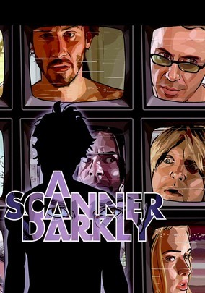
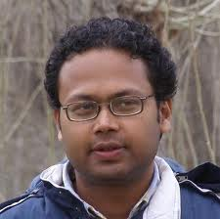
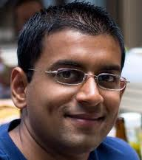

Featuring
Suman Jana
Arvind
Narayanan
Vitaly
Shmatikov
Protecting User Privacy from Perceptual Applications

Slide 2
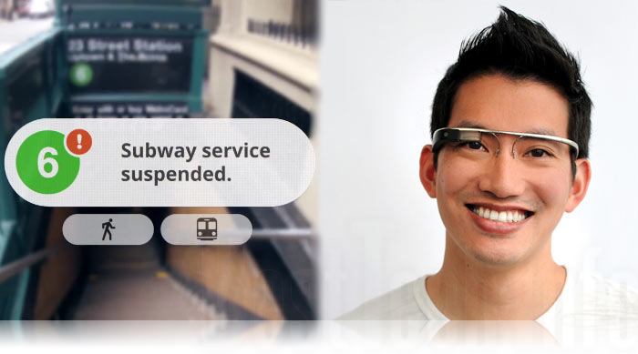
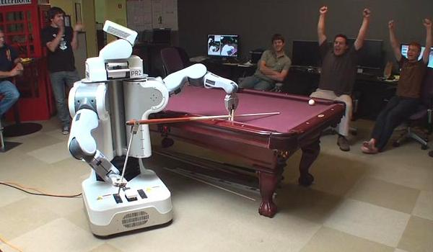
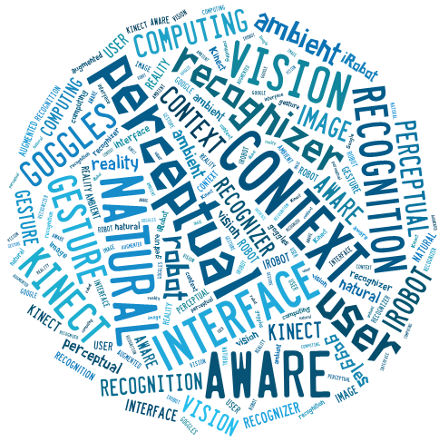
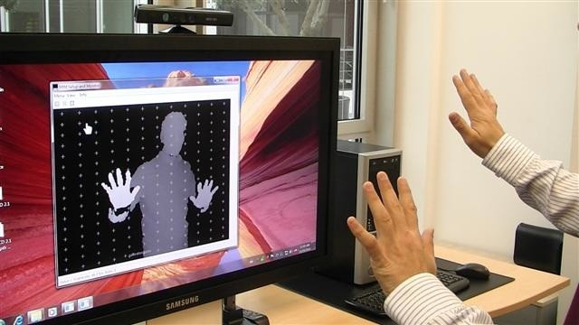
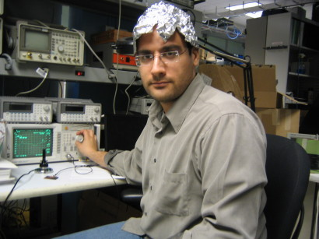
The Future of Computing?
What does this all mean for a
security & privacy researcher?

Slide 3
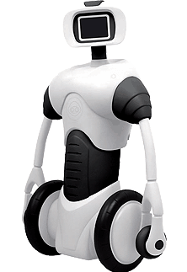
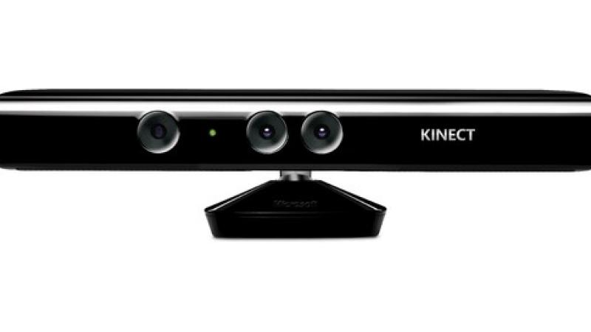
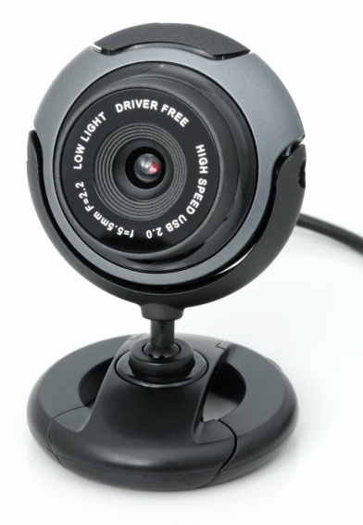
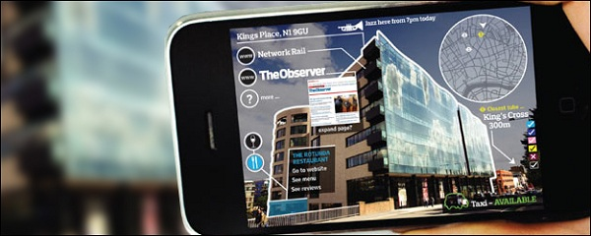
They Are Watching…

Slide 4


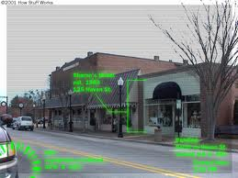
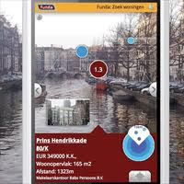
They Are Running Untrusted Code…
“… Your robots are always up-to-date with the coolest apps”
200+ projects on GitHub
Augmented-reality
apps on mobile phones

Slide 5
Privacy Risks Hierarchy of Perceptual Apps
Over-collection of data
Sensitive items
(e.g. credit cards, license plates…)
increasing
sophistication
Aggregation, tracking and surveillance
Semantic inference - patterns of movement and proximity, contexts…

Slide 6
Non-Solutions
Block access to perceptual inputs?
The whole purpose of these apps is to analyze and use information about their environment!
Anonymize collected data?
How to “anonymize” the video feed of a room?
Differential privacy?
Uh-huh

Slide 7
Introducing Darkly
Domain- and data-specific system for protecting user privacy from perceptual apps
Exploits typical structure of perceptual software
Integrated with a popular computer vision library for maximum portability
(Almost) transparent to existing software
“Defense in depth”
Access control + algorithmic privacy transforms + user audit

Slide 8
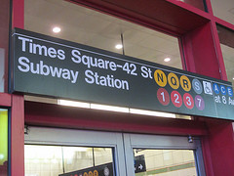


Structure of Perceptual Apps
perceptual app
computer vision library
very hard!

Slide 9
Intuition Behind Darkly
privacy protection layer
perceptual app
computer vision library
right level of abstraction
library API remains unchanged

Slide 10

Architecture of Darkly
trusted input sensors, OS, hardware
standard OS user isolation
Darkly process
Darkly server
computer vision library
app
interposition library
application

Slide 11
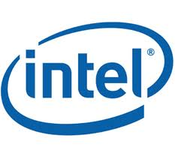



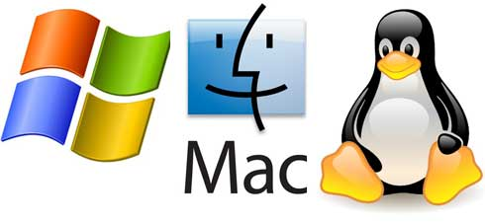
OpenCV: Darkly’s Vision Library
Robot OS

Slide 12
Defense #1: Access Control
Replace pointers to pixel data with
opaque references
OpenCV functions can dereference internally, operate on raw data without loss of fidelity
Applications cannot dereference
Most of our benchmark applications still work correctly without any modifications
They never access pixel data, just pass it back and forth to OpenCV functions!

Slide 13
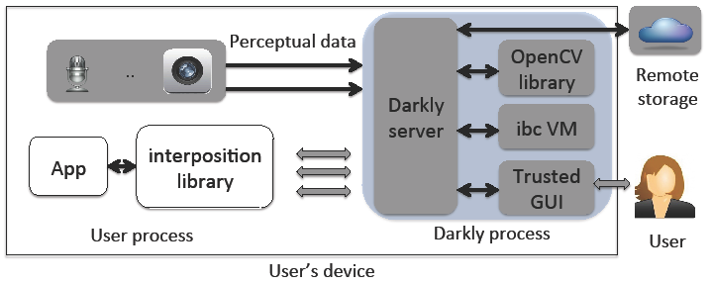
Darkly Facilities: Trusted GUI & Remote Storage
Without accessing raw inputs, apps can …
Display pixel data to user, operate on user input (mouse, keystrokes), store data to remote storage
Examples: Security cam detects movement, shows raw image to the user/stores it in remote storage without accessing pixel data

Slide 14
Access to Image Features
Some applications do need access to the image but are only interested in certain features
A security surveillance app needs object contours to detect movement
A QR code scanner needs black-and-white matrix

Slide 15
Defense #2: Privacy Transforms
App makes OpenCV calls
to obtain image features
Darkly applies
feature-specific
but application-independent
transforms
to OpenCV’s answers
cvMoments
cvFindContours
cvHaarDetectObjects
…

Slide 16
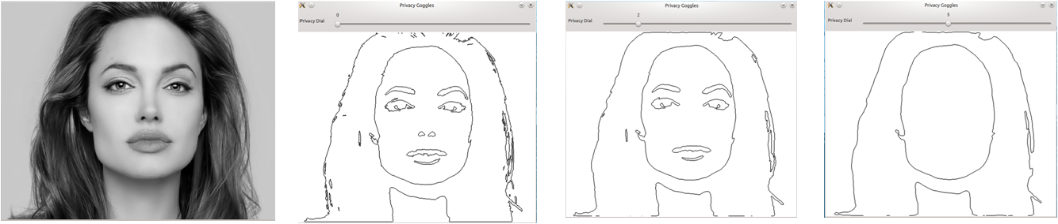
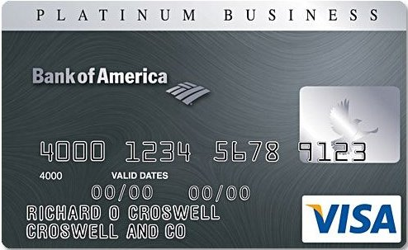
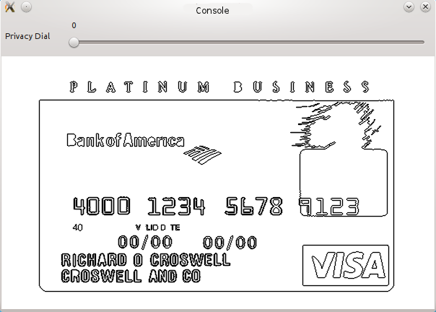
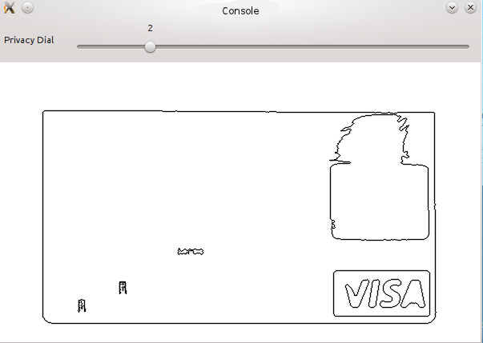
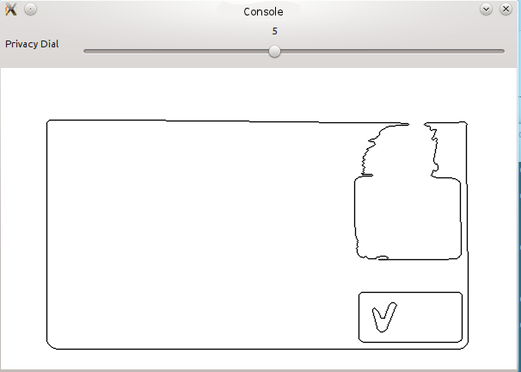
An Example Transform: Sketching
Blurring (box filter), then contour detection
Idea: preserve large-scale features only

Slide 17
Effect on Applications
For many apps, accuracy is not affected!
For some apps, quantifiable tradeoff between the amount of transformation and accuracy
For example, surveillance app may miss smaller motions with larger amount of transformation
User controls how much transformation to apply

Slide 18

But My App Needs Raw Pixels…
Example: eigenface-based face recognizer
Darkly will execute arbitrary
app-provided code, as long
as it’s written in ibc language
Based on GNU bc
Almost pure computation
No access to syscalls, network, sys time
Single 32-bit return value
Easy to sandbox!

Slide 19
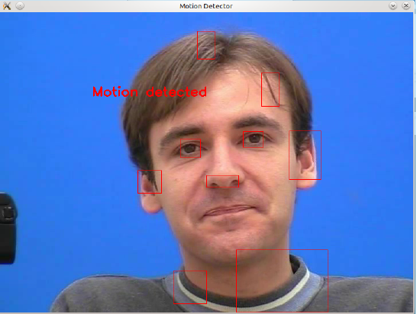
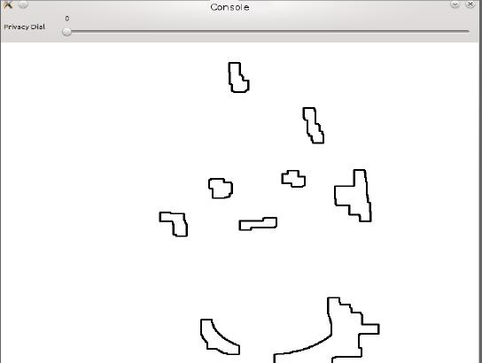
Defense #3: User Audit
Console window shows to the user the outputs of transforms, now and over time
Privacy dial from 0 to 11
lets the user adjust the
degree of transformation
Raw input
Darkly console view

Slide 20
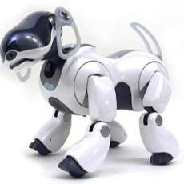

A Complete Example: Ball-Tracking Robot Dog

Slide 21
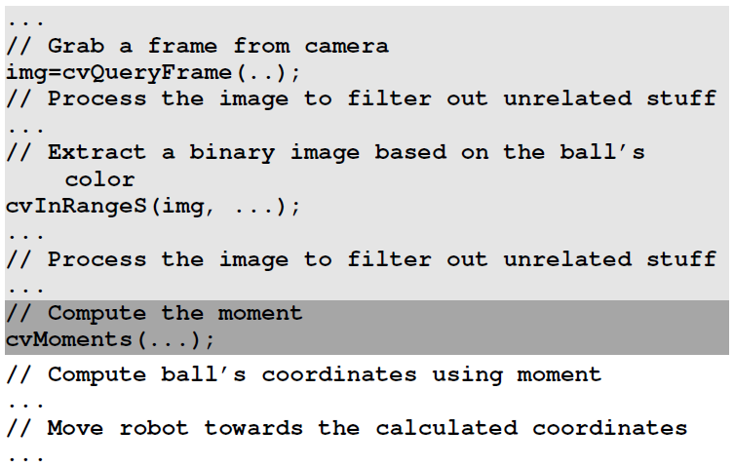
A Complete Example: Ball-Tracking Robot Dog
Opaque references
Apply sketching transform

Slide 22
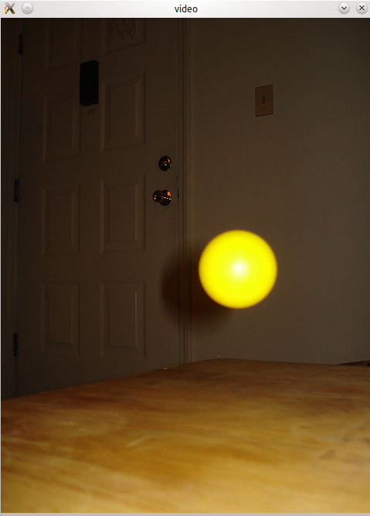

Ball-Tracking Robot Dog: Console View
Raw input
Darkly console view

Slide 23
Evaluation
20 open-source OpenCV applications
Object recognizers and trackers, QR decoder, security cam, facial features recognizer, corner and edge finders, histogram calculators….
18 out of 20 run without any modifications!
Negligible performance overhead (< 3%)
Tradeoffs between accuracy and privacy, but all apps still fully functional

Slide 24
Hierarchy of Perceptual Privacy Risks Revisited
Over-collection of data
Sensitive items
(e.g. credit cards, license plates…)
Aggregation, tracking and surveillance
Semantic inference - patterns of movement and proximity, contexts…

Slide 25

Questions

