Slide 1

Usable Security
Content may be borrowed from other resources.
See the last slide for acknowledgements!
Amir Houmansadr
CS660: Advanced Information Assurance
Spring 2015

Slide 2
Tradeoffs Between Usability and Security
Continuously patch your machine, or get compromised
Beware of phishing websites
Frequently run CPU/memory-intensive antiviruses
Deploy stringent firewall software
Use different passwords for different websites, do not write them down, pick strong passwords (hard to remember)
Do not store sensitive information on mobile devices prone to be lost/stolen

Slide 3
Usable Security
Definition: Security measures developed with attention to usability considerations
(Or, to make security measures usable!)
A sub-area of security
Less technical, but significantly important

Slide 4
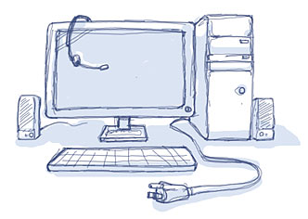
Secure, but usable?

Slide 5
How Does Your Password Measure Up? The Effect of Strength Meters on Password Creation
Click to see slides from the authors
Notes:
https://www.usenix.org/sites/default/files/conference/protected-files/ur_usenixsec12_slides.pdf

Slide 6
Ecological Validity
The methods, materials, and setting of the study must approximate the real-world being examined
Does the “memorability” results have ecological validity?
Participants likely did not care to remember passwords
Should experiment with real users as opposed to paid users

Slide 7
Acknowledgement
Some of the slides, content, or pictures are borrowed from the following resources, and some pictures are obtained through Google search without being referenced below:

