Slide 1

Security and Privacy of Future Internet Architectures: Named-Data Networking
Content may be borrowed from other resources.
See the last slide for acknowledgements!
Amir Houmansadr
CS660: Advanced Information Assurance
Spring 2015

Slide 2
The Internet of today
Design dates back to the 70’s
Inspired by telephony systems
TCP/IP
Main principle: end-to-end communication
Look up the endpoints of interest

Slide 3



Routing in the Internet
Transit AS
Transit AS
User’s AS
CNN’s AS

Slide 4
The Internet of today
Design dates back to the 70’s
TCP/IP
Main principle: end-to-end communication
Look up the endpoints of interest
Build applications on the top of TCP/IP

Slide 5
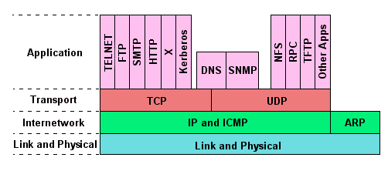

Slide 6
But things have changed a lot since the 70’s!
Back then, communications were mostly end-to-end, so it was efficient
Security is not built into the TCP/IP Internet, but was added as an add-on

Slide 7
Today
New communication paradigms:
Content-intensive communications
Content lookup
Content caching
Mobility
Cloud computing
The current Internet is not efficient anymore
Also, suffers from security challenges

Slide 8




Not efficient!
ISP
ISP

Slide 9

Goal: Look Like This
ISP
ISP

Slide 10
Next-Generation Internet Architectures
Design the Internet of the future!
More efficient
More scalable
Less overhead
Less expensive
…
More secure

Slide 11
Next-Generation Internet Architectures
Various proposals:
Content-centric networking (CCN)
NSF’s FIA program
NDN
MobilityFirst
NEBULA
XIA
ChoiceNet
Many more

Slide 12
Next-Generation Internet Architectures
Main principles:
Built-in security
Content is the first-class citizen
Cache content
Name content
Look for content
Mobility is pervasive
Cloud computing is ubiquitous

Slide 13
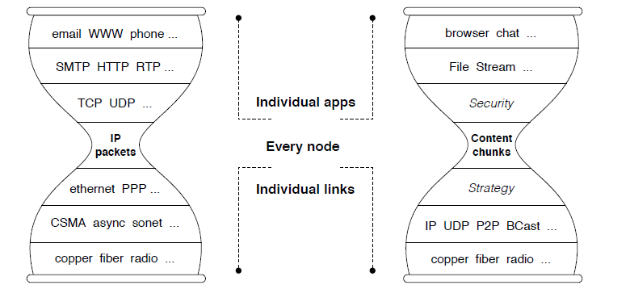
Content-Centric Designs: Narrow Waist is the Content!
TCP/IP
CCN

Slide 14
Named-Data Networking (NDN)
Name the content instead of the end-hosts
A content-centric architecture
NSF FIA and FIA-NP programs
Consumers: send interest packets
Producers: return “pulled” content packets

Slide 15
Routing in the TCP/IP Internet
Transit AS
Transit AS
User’s AS
CNN’s AS

Slide 16
Routing in NDN
Interest
Interest
Interest
Content
Content
Content
Interest
Content

Slide 17
TCP/IP | NDN
Name end-hosts (e.g., IP addresses) | Name content
Communication | Content distribution
Mobility is difficult | Mobility-friendly
Make processes secure | Make content secure

Slide 18
NDN Security
All content objects are signed by the publishers
Authenticity
Integrity
Content objects are encrypted
Confidentiality of content
How about privacy?

Slide 19
NDN: Privacy Benefits
No “source address” in content interests
Not needed for routing
Traffic monitoring less effective for non-global adversaries
Interest
Interest
Interest
Content
Content
Content
Interest
Content
Does not see the interest

Slide 20
NDN: Privacy Challenges
Name privacy
/CNN/Video/03-24-15/protest
Content privacy
Public content
Cache privacy
Detect hit/miss
Signature privacy
Reveal publisher identity

Slide 21
Privacy in NDN
Privacy is not built-in
Need to protect privacy
Design PET tools
Integrate with the architecture

Slide 22
ANDaNA
An anonymous communication network for the NDN architecture
Tor’s counterpart
Based on onion routing
Any router/host can be an anonymizing “relay”
Ephemeral circuits
Non-global adversary assumption

Slide 23
ANDaNA design
A circuit is composed of two routers (relays):
Entry router
Exit router
Comparable to Tor’s three-hop circuits
Why two routers:
NDN itself provides some notion of anonymity because of no source address in interests

Slide 24







Onion Routing in NDN
I: /OR-1
I: /omh/blood-pressure/steve
Nonce: <rand-int>
Loc: /fitbit/key
D: /omh/blood-pressure/steve
Loc: /fitbit/key
{ mmHg: 100 }
I: /OR-2
I: /omh/blood-pressure/steve
Nonce: <rand-int>
Loc: /fitbit/key
D: /OR-2
I: /OR-2
D: /omh/blood-pressure/steve
Loc: /fitbit/key
{ mmHg: 100 }
I: /omh/blood-pressure/steve
Nonce: <rand-int>
Loc: /fitbit/key
I: /omh/blood-pressure/steve
Nonce: <rand-int>
Loc: /fitbit/key
D: /OR-1
/OR-1
D: /OR-2
D: /omh/blood-pressure/steve
Loc: /fitbit/key
{ mmHg: 100 }
/OR-2
Notes:
Encrypt and encapsulate Interests
provide key to each relay that is used to symmetrically encrypt returning Data

Slide 25
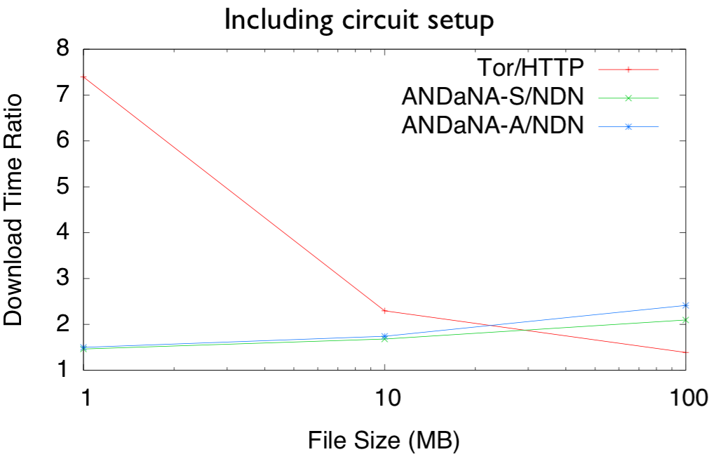
Performance compared to Tor

Slide 26
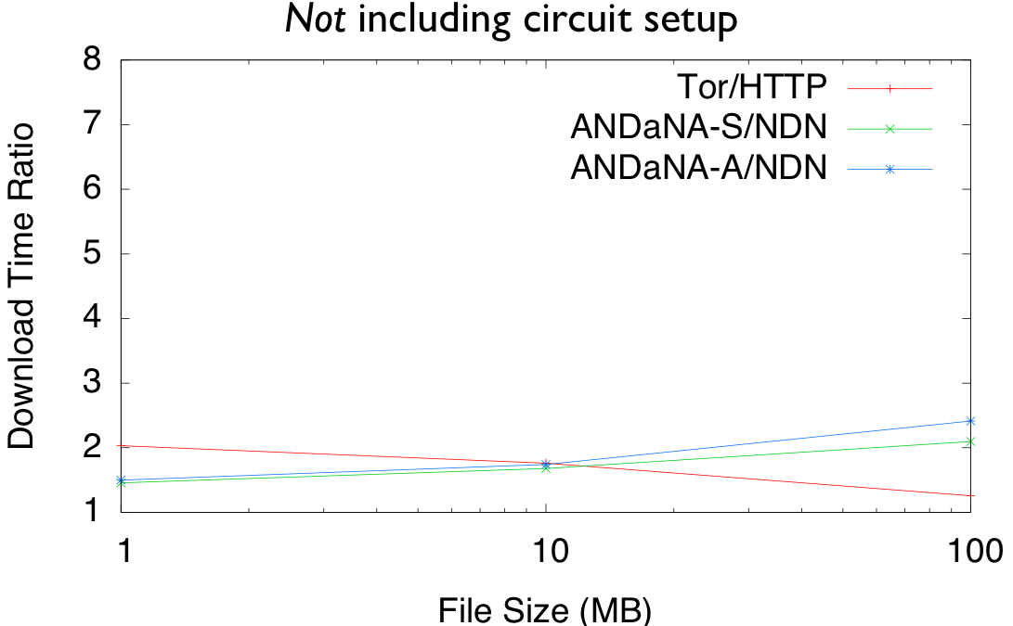
Performance compared to Tor

Slide 27
Discussion
So, is NDN (or other next-generation archs) more/less secure? More/less private?
Is building PET tools easier or harder in NDN?
Tradeoffs between security/privacy and performance?
Do we still benefit from caching?
How is censorship circumvention different? Easier? Harder?
How can we design next-generation Internet architectures with built-in privacy? Is it practical? What are the tradeoffs?

Slide 28
Acknowledgement
Some of the slides, content, or pictures are borrowed from the following resources, and some pictures are obtained through Google search without being referenced below:
NDSS’12 presentation of the ANDaNA paper provided by the authors
Steve DiBenedetto’s slides: ANDaNA: Onion Routing for NDN

