Slide 1

Hardware Security: Trusted Platform Module
Content may be borrowed from other resources.
See the last slide for acknowledgements!
Amir Houmansadr
CS660: Advanced Information Assurance
Spring 2015

Slide 2
Hardware Security
Definition: implement security protection mechanisms in hardware
E.g., design trusted hardware, as opposed to (in addition to) trusted software

Slide 3
Trusted or Trustworthy
A component of a system is trusted means that
the security of the system depends on it
failure of component can break the security policy
determined by its role in the system
A component is trustworthy means that
the component deserves to be trusted
e.g., it is implemented correctly
determined by intrinsic properties of the component
Trusted or trustworthy computation?

Slide 4
Why Hardware Security
Software security: software protect software!
Vulnerable to attacks
Is the antivirus/hardware untouched?
Easy infiltration
Fast spread
Hardware security: hardware protect software
Attacks need physical access
Software infiltration much more difficult

Slide 5
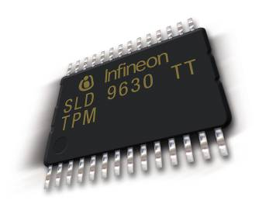
Trusted Platform Module (TPM)
A chip integrated into the platform
The (alleged) purpose is to provide more security
It is a separate trusted co-processor
“The TPM represents a separate trusted coprocessor, whose state cannot be compromised by potentially malicious host system software.”
IBM Research Report
Notes:
The hardware part of TC
Will require O/S support also.
Currently about $5.00 for desktop chips
$7.00 for notebook chips
The real key is that the TPM can’t be compromised by other software processes

Slide 6
The Trusted Computing Group
The Trusted Computing Group (TCG) is a non-profit industry consortium, which develops hardware and software standards. It is funded by many member companies, including IBM, Intel, AMD, Microsoft, Sony, Sun, and HP among others.
Notes:
_

Slide 7
Attestation
The TPM's most controversial feature is attestation, the ability to measure the state of a computer and send a signed message certifying that particular hardware or software is or isn't present.
Controversial
Provide features that can be used to secure hardware against the owner
Notes:
Very powerful (and popular) concepts for corporations and government IT markets.

Slide 8
Components
Root key
PKI private keys could be stored in the chip
PK signatures calculated in the chip itself, never visible outside
Random number generators
SHA-1 encryption
Monotonic counters
Process isolation (encrypted I/O, prevents keystroke loggers, screen scrapers)

Slide 9
Goals
TPMs allow a system to:
Gather and attest system state
Store and generate cryptographic data
Prove platform identity
Prevents unauthorized software
Helps prevent malware

Slide 10
TPM’s Novelty
Not much novel crypto! Most, if not all, of the security ideas already exist
What TPMs bring to the table is a secure sealed storage chip for private keys, on-chip crypto, and random number generators among others
The state of the TPM can not be compromised by malicious host software
Notes:
Software is always vulnerable. Take DRM for example.

Slide 11
Limitations
Advanced features will require O/S support
Potential for abuse by Software vendors
Co-processor or Cop-processor?
“Trusted Computing requires you to surrender control of your machine to the vendors of your hardware and software, thereby making the computer less trustworthy from the user’s perspective” Ross Anderson
Notes:
x
x
x
x

Slide 12
Real-World Applications
Hard drive encryption
BitLocker in Windows 8
Trustworthy OS
Google’s Chromebook use TPM to prevent firmware rollback
Potential applications:
DRM
Fighting pirate software

Slide 13
BitLocker™ Drive Encryption
BitLocker™ Drive Encryption gives you improved data protection on your Windows
Notebooks – Often stolen, easily lost in transit
Desktops – Often stolen, difficult to safely decommission
Servers – High value targets, often kept in insecure locations
All three can contain very sensitive IP and customer data
Designed to provide a transparent user experience that requires little to no interaction on a protected system
Prevents thieves from using another OS or software hacking tool to break OS file and system protections
Prevents offline viewing of user data and OS files
Provides enhanced data protection and boot validation through use of a Trusted Platform Module (TPM)

Slide 14
BitLocker™ Drive Encryption Architecture Static Root of Trust Measurement of boot components

Slide 15


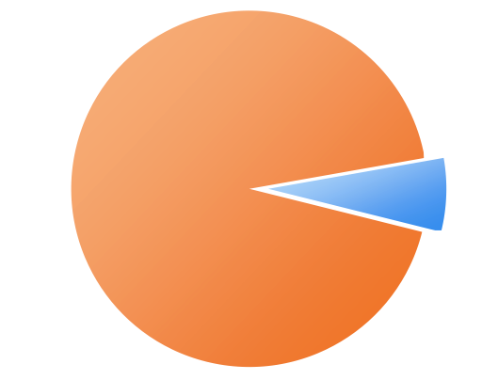
Disk Layout And Key Storage
OS Volume Contains
Encrypted OS
Encrypted Page File
Encrypted Temp Files
Encrypted Data
Encrypted Hibernation File
Where’s the Encryption Key?
SRK (Storage Root Key) contained in TPM
SRK encrypts FVEK (Full Volume Encryption Key) protected by TPM/PIN/USB Storage Device
FVEK stored (encrypted by SRK) on hard drive in the OS Volume
3
OS Volume
2
FVEK
1
SRK
System
System Volume Contains:
MBR, Boot manager, Boot Utilities
(Unencrypted, small)

Slide 16




Spectrum of Protection
Ease of Deployment / Maintenance
BitLocker™ offers a spectrum of protection, allowing an organization to customize according to its own needs
TPM Only
“What it is”
Protects Against:
Most SW attacks
Vulnerable To:
Hardware attacks
User Must:
N/A
No user impact
TPM + PIN
“What it is + what you know”
Protects Against:
Many HW attacks
Vulnerable To:
Hardware attacks
User Must:
Enter PIN to boot
TPM + USB
“What it is + what you have”
Protects Against:
HW attacks
Vulnerable To:
Stolen USB key
User Must:
Protect USB key
USB Only
“What you have”
Protects Against:
HW attacks
Vulnerable To:
Stolen USB key
No boot validation
User Must:
Protect USB key

Slide 17
More Hardware Security
USB tokens
RSA SecureID
Smart Cards
CPU-level techniques
Encryption disks

Slide 18
cTPM: A Cloud TPM for Cross-Device Trusted Applications
Slides from authors at NSDI’14

Slide 19
Acknowledgement
Some of the slides, content, or pictures are borrowed from the following resources, and some pictures are obtained through Google search without being referenced below:
RandyFort, Trusted Platform Modules, class lecture
Shon Eizenhoefer, BitLocker™ Drive Encryption Hardware Enhanced Data Protection

