Slide 1

Mobile Security: Android
Content may be borrowed from other resources.
See the last slide for acknowledgements!
Amir Houmansadr
CS660: Advanced Information Assurance
Spring 2015

Slide 2
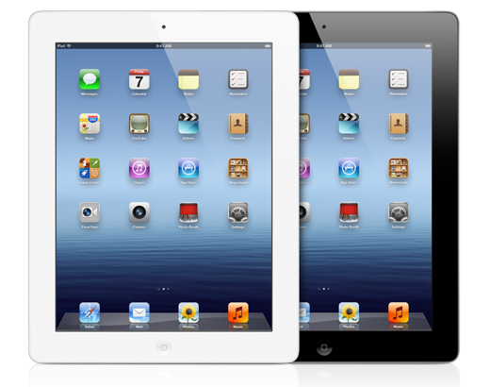

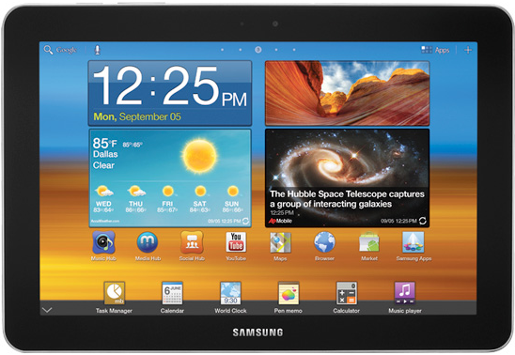
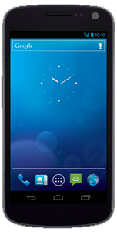
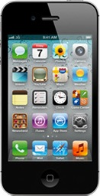
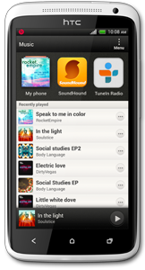








Mobile Devices
Mobile computers:
Mainly smartphones, tablets
Sensors: GPS, camera, accelerometer, etc.
Computation: powerful CPUs (≥ 1 GHz, multi-core)
Communication: cellular/4G, Wi-Fi, near field communication (NFC), etc.
Many connect to the Internet using cellular networks
Billions mobile devices sold annually
Organization

Slide 3
How is it different from PC security?
Limited computing resources
Battery, CPU, memory, storage, bandwidth
Therefore, we can not use PC solutions right out of the box
User education
Broader range of users compared to PCs
More prone to social attacks
Ubiquitous
Less expensive, outnumber PCs
More interfaces for connectivity
Bluetooth, infrared, WiFi, cellular, USB, tethering

Slide 4
How is it different from PC security?
Portable
Subject to loss/stealing
Subject to short range breaches (WiFi, near field communication (NFC))
Subject to search and seizure
Carry sensitive content
Your location!
Your identity (MAC, Bluetooth address, IMEI, IMSI)
Payment apps, financial apps, credit cards
Wider range of software (apps) than PCs
“There’s an app for it”
Untrusted third-party vendors

Slide 5
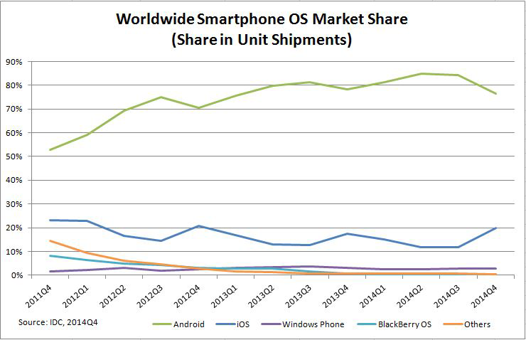
Market Trends
Notes:
http://www.idc.com/prodserv/smartphone-os-market-share.jsp

Slide 6
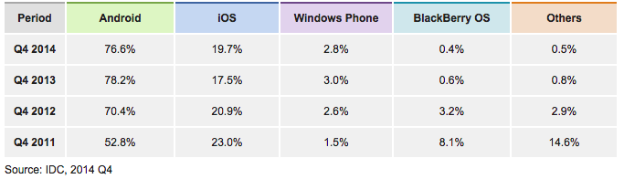
Market Trends
Notes:
http://www.idc.com/prodserv/smartphone-os-market-share.jsp

Slide 7
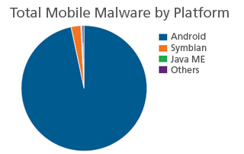
Malware Market
Android gets 97% of malware!
Why?

Slide 8
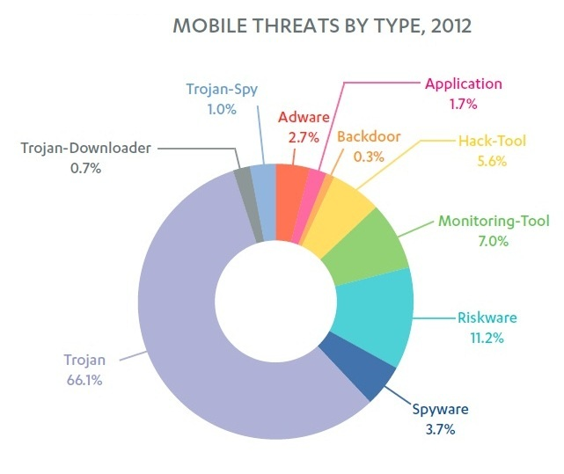
Threats by Type
Notes:
http://www.f-secure.com/static/doc/labs_global/Research/Mobile%20Threat%20Report%20Q4%202012.pdf

Slide 9
Research Trends in Mobile Device Security
User authentication
Passwords, biometrics, etc
OS/software attestation
Access control/permissions
Location privacy
Social engineering
Covert channels
E.g., audio channels

Slide 10
TaintDroid:An Information-FlowTracking System for Realtime Privacy Monitoring on Smartphones
William Enck, Peter Gilbert, Byung-Gon Chun, Landon P. Cox, Jaeyeon Jung, Patrick McDaniel, and Anmol N. Sheth
OSDI’10

Slide 11
Problem
Apps can be installed on a smartphone from GooglePlay, Amazon App store, Mobo-Market etc.
All of the apps which don’t come with the OS are called third-party apps and hence, are suspicious towards information leakage
Monitor when sensitive data is being leaked in real times from the system through third-party applications

Slide 12
Mobile Device Information Leakage
Types of mobile device information sources:
Internal to device (e.g., GPS location, IMEI, etc.)
External sources (e.g., CNN, Chase Bank, etc.)
Third-party mobile apps can leak info
Send out device ID (IMEI/EID), contacts, location, etc.
Apps ask permission to access such info; users can ignore!
Apps can intercept info sent to a source, send to different destination!
Motives:
Monitor activity
Advertisement
Market research (include user location, behavior, etc.)
Identity theft
etc
How do we protect against such information leakage?

Slide 13
Challenges for Monitoring Privacy Info
Resource constraints
E.g. tracking Panorama images would be expensive towards performance
Battery consumption
Third-party apps are entrusted with several types of private information
Sensitive information can be difficult to identify even when it’s sent in clear format
Geo-location data is a pair of floating point numbers
Apps can share information
Facebook, twitter, Google search

Slide 14
Android background
Android is a Linux-based OS
All of the core functionality has been written in Java and C/C++
Applications are written in Java and then are converted into Dalvik Executable (DEX) byte code
DEX code is executed in Dalvik Virtual Machine (DVM)
Applications communicate via binder IPC interface

Slide 15
Android background
Binder IPC (Inter-Process Communication)
Android apps communicate with each other using IPC binder
‘Parcels’ are fundamental components of IPC framework which serialize data objects before sending it out of VM
Binder kernel module passes parcel messages between processes

Slide 16
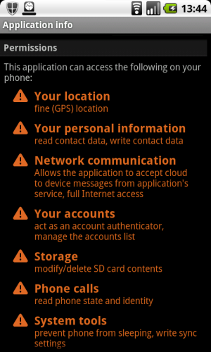
Android background
Permissions
Some apps don’t request for
permissions to perform some
action, they delegate their
job to other apps
[applications.androidxiphone.com]
Notes:
applications.androidxiphone.com

Slide 17
Android background
Each app on an android phone is run inside new Dalvik VM sandbox
Each DVM is assigned a unique user id (uid)
All the permissions requested by an app to access phone resources are assigned to uid
Uid remains same when an app is run/updated but pid can be different

Slide 18
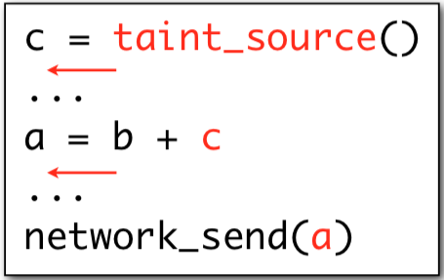
Dynamic Taint Analysis
DTA is a technique that tracks information dependencies from an origin
High-level:
Taint source
Taint propagation
Taint sink

Slide 19
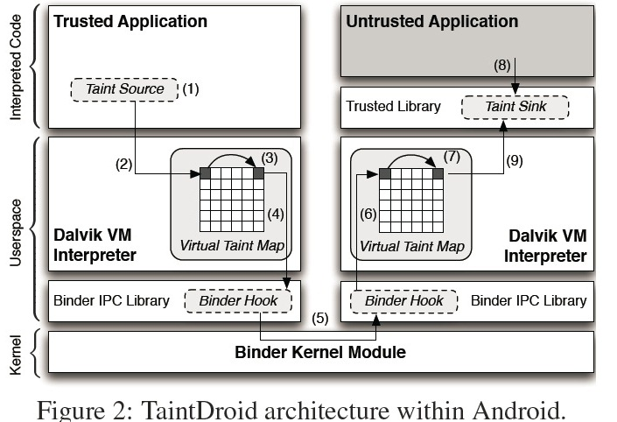
TaintDroid-Framework Design
Notes:
This is also true for one application but here its shown for two apps.
An application is not instrumented but observed here. Whenever an information is tainted (1), it calls a taint library interface in DVM interpreter. Since DVM is instrumented, so it can receive this call. DVM stores this taint information in a virtual taint map. It also propagates taint to other variables as given by data flow rules and store them in virtual taint map. So whenever there is an IPC call to send any of tainted information to other APK, modified binder library ensures that taint tag is attached to this parcel message. On the other end, Binder receives this parcel and adds taint tags to all the variables in the parcel. DVM interpreter stores and propagates the tainted variables. So whenever there is a call to sink API (http get), and this API is using any of these tainted variables, information leakage is reported.

Slide 20
Taint Adaptors
Taint sources and sinks must be carefully integrated into existing architectural framework
Depends on type of information
Low-bandwidth sensors: location, accelerometer
High-bandwidth sensors: microphone, camera
Information databases: address book, SMS data
Device identifiers: IMER, IMSI, ICC-ID
Network taint sink

Slide 21
Experimental Setup
30 apps were selected randomly out of 1100 apps, taken 50 most popular apps from each of 22 categories on Android Market
Apps were played manually which involved installation, registration if required and exercising the functionality offered by the apps
Logs were recorded which included tainted binder messages, tainted file output and tainted network messages
Network traffic using tcpdump was also recorded for verification of results

Slide 22
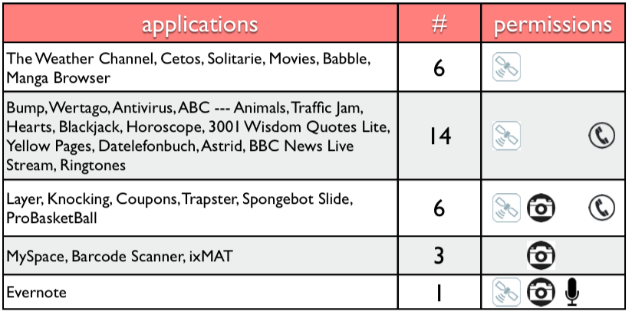
Findings: Permissions requested
Out of 105 flagged connections, only 37 legitimate

Slide 23
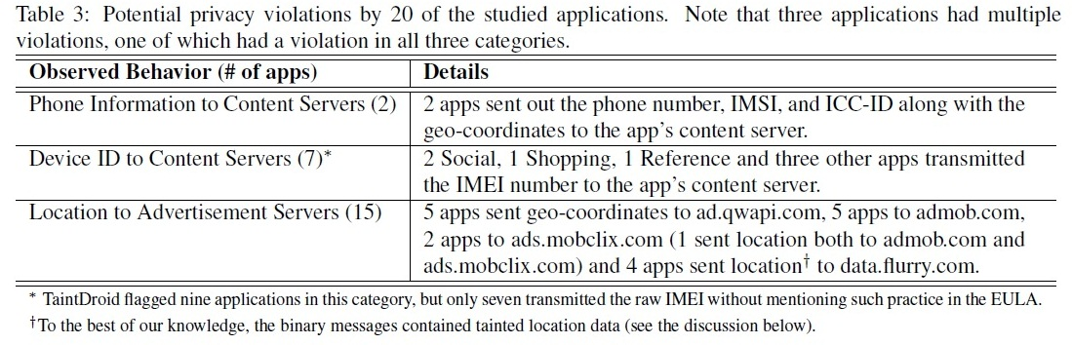
Findings: Information Leakage
[gizmocrazed.com]
Notes:
www.gizmocrazed.com

Slide 24
Performance
All experiments were run on Android 2.1 OS, modified for taintDroid
TaintDroid incurs almost the same performance and memory overhead what an original Android OS does
[sparkwiz.com]
Notes:
sparkwiz.com

Slide 25
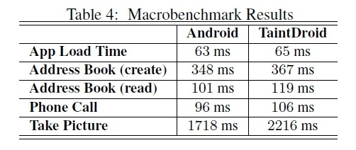
Performance-MacroBenchmarks
Load time: The duration between when an app is clicked to launch and an activity is displayed
Address Book: An account creation time (3 SQL queries) and read time (2 SQL queries)
Phone Call: Duration from pressing ‘dial’ button to ‘in-call’ mode
Take Picture: Duration from pressing ‘Take Picture’ button to re-enabling of ‘Preview’ mode

Slide 26
Performance-Java Microbenchmarks
Android port of CaffeineMark 3.0
Sieve: The classic sieve of eratosthenes finds prime numbers.
Loop: The loop test uses sorting and sequence generation as to measure compiler optimization of loops.
Logic: Tests the speed with which the virtual machine executes decision-making instructions.
Method: The Method test executes recursive function calls to see how well the VM handles method calls.
Float: Simulates a 3D rotation of objects around a point.
[benchmarkhq.ru]
Notes:
http://www.benchmarkhq.ru/cm30/info.html

Slide 27
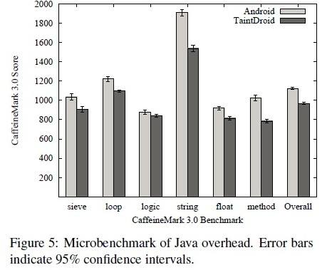
Performance-Java Microbenchmarks
Android port of CaffeineMark 3.0
Scores indicate roughly the number of Java instructions executed per second

Slide 28
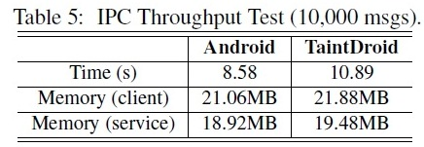
Performance-IPC Benchmarks
Client and service applications were developed which perform binder transactions as fast as possible
Service manipulates account object (username: String, balance: Integer) by provided interfaces: getAccount() and setAccount()
Experiment measures the time for client to invoke interface pair 1000 times
Notes:
The more likely cause of the overhead is the continual copying of taint tags as values are marshalled into and out of the parcel byte buffer.

Slide 29
Limitations
It is a firmware modification, not an app
Only tracks explicit data flows

Slide 30
Acknowledgement
Some of the slides, content, or pictures are borrowed from the following resources, and some pictures are obtained through Google search without being referenced below:
TaintDroid presentation by the authors at OSDI’10
TaintDroid presentation by Mohsen Junaid
Mobile Device Security

