Slide 1

Economics of Malware: Spam
Content may be borrowed from other resources.
See the last slide for acknowledgements!
Amir Houmansadr
CS660: Advanced Information Assurance
Spring 2015

Slide 2
Our Knowledge of Spam
What do we know about spam?
Annoying emails?
Yahoo Mail!
Spam-based advertising is a huge business
While it has engendered both widespread antipathy and a multi-billion dollar anti-spam industry, it continues to exist because it fuels a profitable enterprise

Slide 3
Studying Spam
It is a complex system
Technical: name server, email server, webpages, etc.
Business: payment processing, merchant bank accounts, customer service, and fulfillment
Previous work studied each of the elements in isolation
dynamics of botnets, DNS fast-flux networks, Web site hosting, spam filtering, URL blacklisting, site takedown
This work: quantify the full set of resources employed to monetize spam email— including naming, hosting, payment and fulfillment

Slide 4
Methodology
Extensive measurements of three months of diverse spam data
captive botnets, raw spam feeds, and feeds of spam-advertised URLs
Broad crawling of naming and hosting infrastructures
Over 100 purchases from spam-advertised sites
Identify three popular classes of goods:
pharmaceuticals, replica luxury goods, and counterfeit software

Slide 5
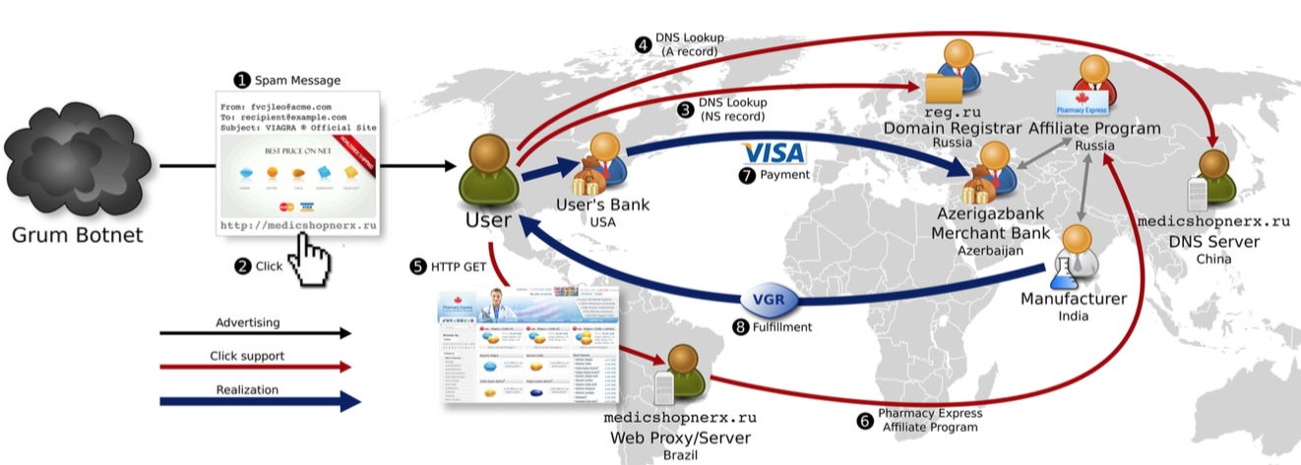
Big Picture

Slide 6
Main Parts
Advertising
Click support
Redirect sites
Third-party DNS, spammers’ DNS
Webservers
Affiliate programs
Realization
Payment services
Fulfillment

Slide 7
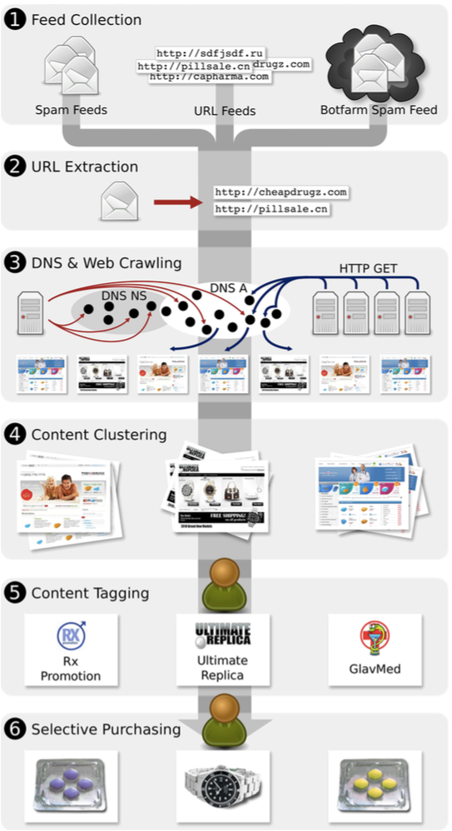
Data Collection and Processing

Slide 8
Collect spam-advertised URLs
data sources of varying types, some of which are provided by third parties, while others we collect ourselves.
we focus on the URLs embedded within such email, since these are the vectors used to drive recipient traffic to particular Web sites.
the “bot” feeds tend to be focused spam sources, while the other feeds are spam sinks comprised of a blend of spam from a variety of sources.

Slide 9
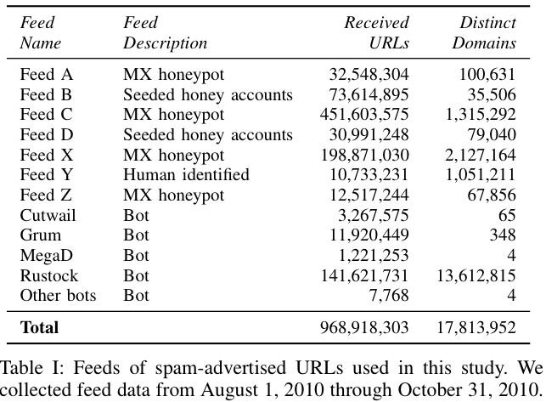

Slide 10
Crawler data
DNS Crawler
From each URL, we extract both the fully qualified domain name and the registered domain suffix.
For example, if we see a domain foo.bar.co.uk we will extract both foo.bar.co.uk as well as bar.co.uk
We ignore URLs with IPv4 addresses (just 0.36% of URLs) or invalidly formatted domain names, as well as duplicate domains already queried within the last day

Slide 11
Web Crawler
The Web crawler replicates the experience
It captures any application-level redirects (HTML, JavaScript, Flash)
For this study we crawled nearly 15 million URLs, of which we successfully visited and downloaded correct Web content for over 6 million
unreachable domains, blacklisting, etc., prevent successful crawling of many pages

Slide 12
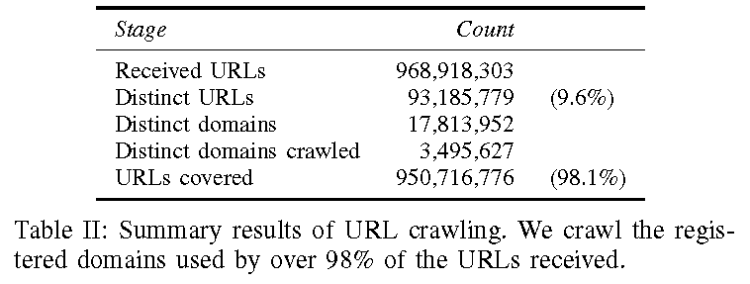
Less than 10% URLs are unique

Slide 13
Content Clustering and Tagging
we exclusively focus on businesses selling three categories of spam-advertised products: pharmaceuticals, replicas, and software
because they are reportedly among the most popular goods advertised in spam

Slide 14
Content clustering
process uses a clustering tool to group together Web pages that have very similar content.
The tool uses the HTML text of the crawled Web pages as the basis for clustering
If the page fingerprint exceeds a similarity threshold with a cluster fingerprint
Otherwise, it instantiates a new cluster with the page as its representative.

Slide 15
Category tagging
The clusters group together URLs and domains that map to the same page content.
We identify interesting clusters using generic keywords found in the page content, and we label those clusters with category tags—“pharma”, “replica”, “software”—that correspond to the goods they are selling.

Slide 16
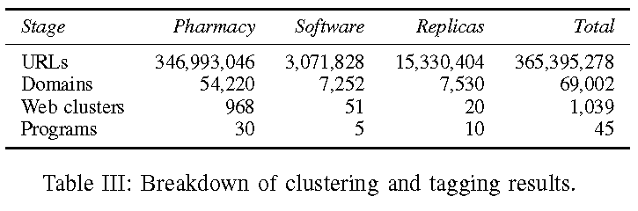

Slide 17
Program tagging
we focus entirely on clusters tagged with one of our three categories, and identify sets of distinct clusters that belong to the same affiliate program.
examining the raw HTML for common implementation artifacts, and making product purchases
we assigned program tags to 30 pharmaceutical, 5 software, and 10 replica programs that dominated the URLs in our feeds.

Slide 18

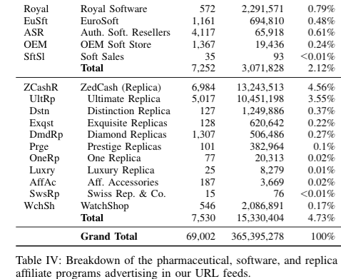

Slide 19
Purchasing
Purchased goods being offered for sale
We attempted 120 purchases, of which 76 authorized and 56 settled.
Of those that settled, all but seven products were delivered.
We confirmed via tracking information that two undelivered packages were sent several weeks after our mailbox lease had ended, two additional transactions received no follow-up email

Slide 20
Operational protocol
We placed our purchases via VPN connections to IP addresses located in the geographic vicinity to the mailing addresses used.
This constraint is necessary to avoid failing common fraud checks that evaluate consistency between IP-based geolocation, mailing address and the Address Verification Service (AVS) information provided through the payment card association.

Slide 21
Analysis
Redirection
32% of crawled URLs in our data redirected at least once and of such URLs, roughly 6% did so through public URL shorteners, 9% through well-known “free hosting” services, 40% were to a URL ending in .html

Slide 22
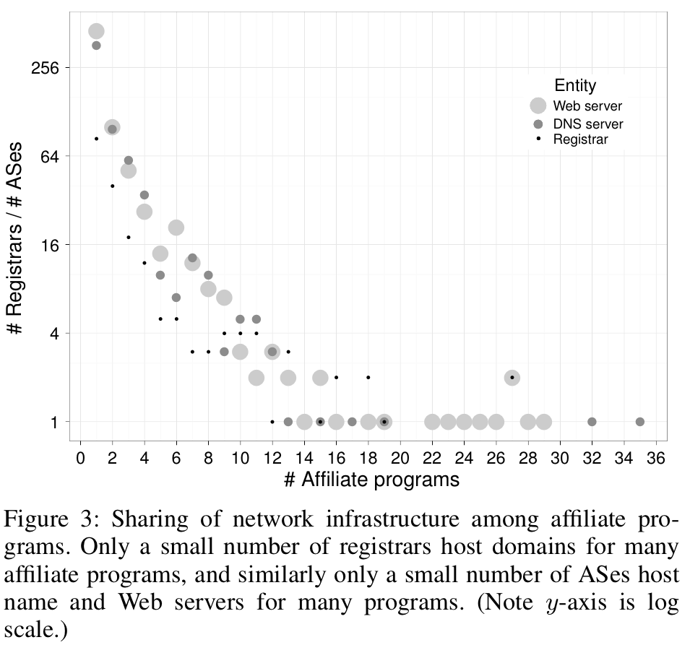

Slide 23
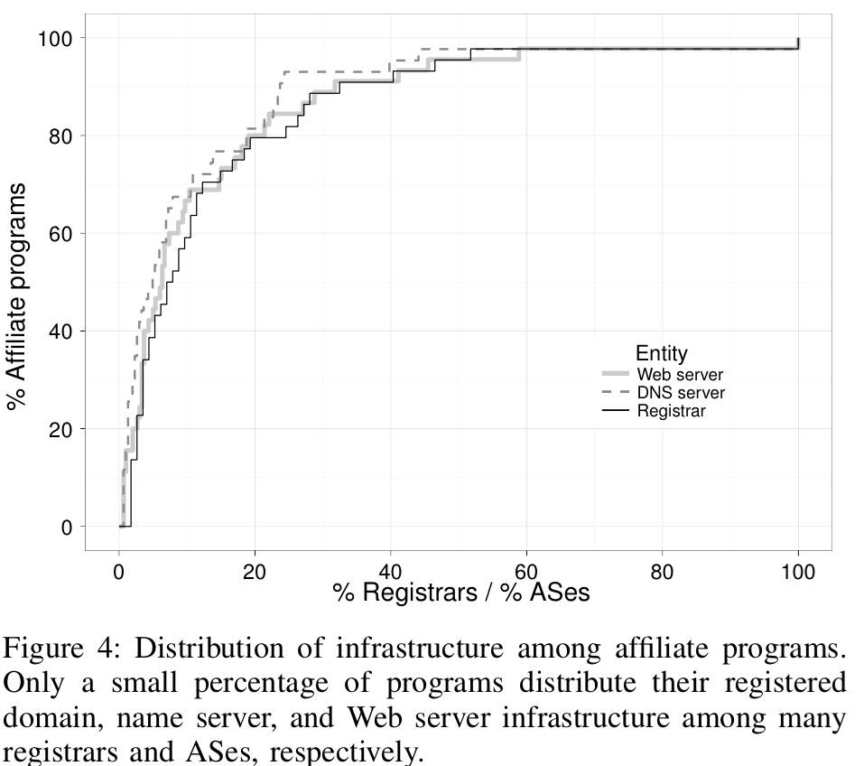

Slide 24
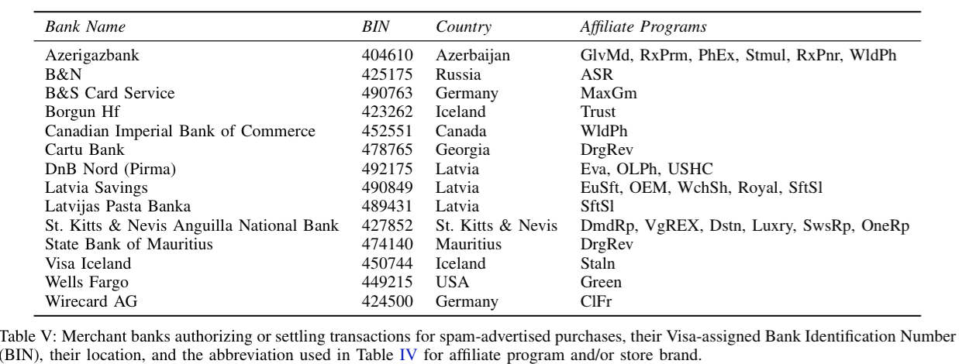

Slide 25
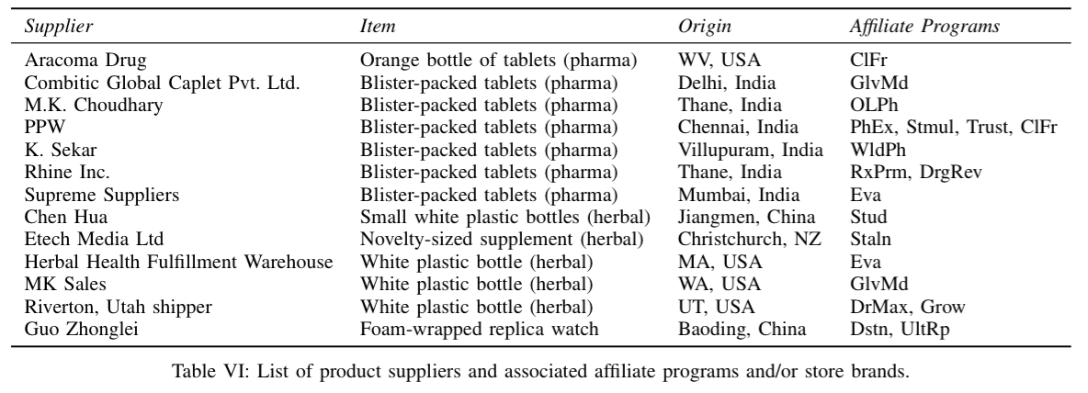

Slide 26
Discussion
With this big picture, what do you think are the most effective mechanisms to defeat spam?

Slide 27
Intervention Analysis
Anti-spam interventions need to be evaluated in terms of two factors:
their overhead to implement
their business impact on the spam value chain.

Slide 28
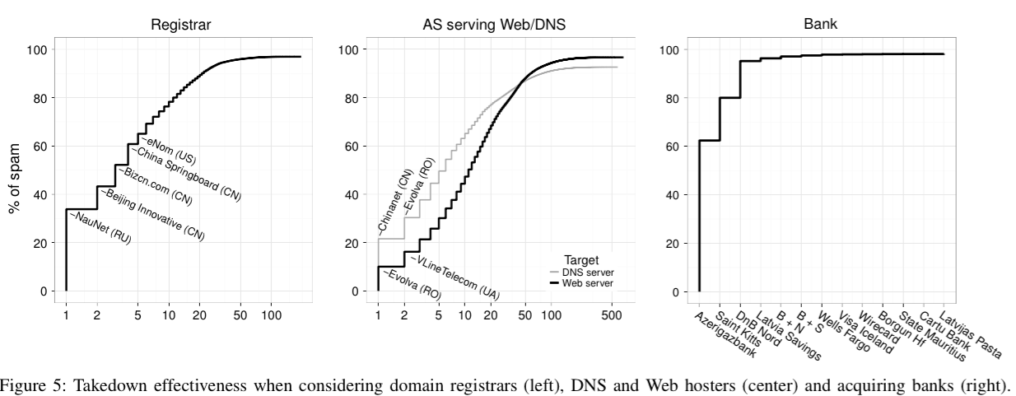

Slide 29
Acknowledgement
Some of the slides, content, or pictures are borrowed from the following resources, and some pictures are obtained through Google search without being referenced below:
MinHao Wu’s slides online

