Slide 1

Online Tracking
Content may be borrowed from other resources.
See the last slide for acknowledgements!
Amir Houmansadr
CS660: Advanced Information Assurance
Spring 2015

Slide 2
Billions of web users surf the web daily
Some websites have billions of user accounts
Tracking users and their online habits
Lucrative for advertising companies
Privacy-intrusive to the users

Slide 3
Forms of Tracking
Client-side
Cookies
Server-side
User accounts
Device fingerprinting

Slide 4
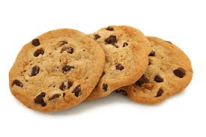
Cookies
HTTP protocol is stateless
Cookies introduced by Napster
Allows a web server to store a small amount of data on the computers of visiting users, which is then sent back to the web server upon subsequent requests
Today, a core technology on which complex, stateful web applications are built

Slide 5
But … Cookie Abuse
Can be used to track users
A Webpage contains various resources
HTML, images, CSS, JavaScript
Located on the hosting server, or a third-party server
Third-party cookies

Slide 6





Third-party Cookies
tracking.com
NYTimes.com contains an image from tracking.com
When downloaded, creates a cookie
When user goes to okcupid.com, also containing a tracking.com image, tracking.com detects the user
Allows tracking.com to profile the user, e.g., for online behavioral advertising
User

Slide 7
Can use of anonymity systems help?
Degrades anonymity to pseudonymity
This is the case for all forms of tracking

Slide 8





Behavioral Targeting
Ad network
Advertisers
Publishers

Slide 9
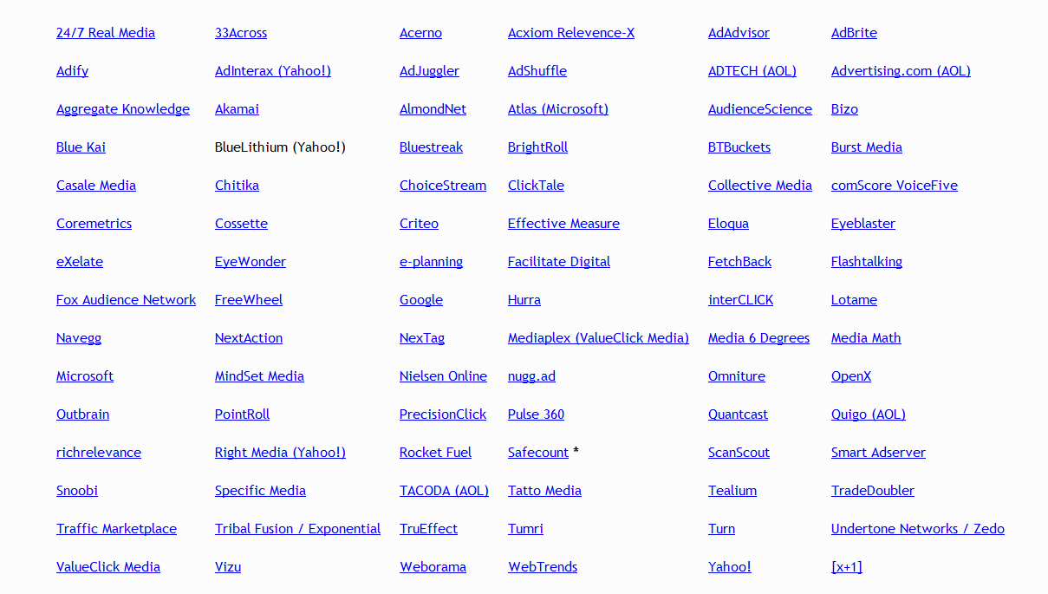
Partial List of Ad Networks

Slide 10
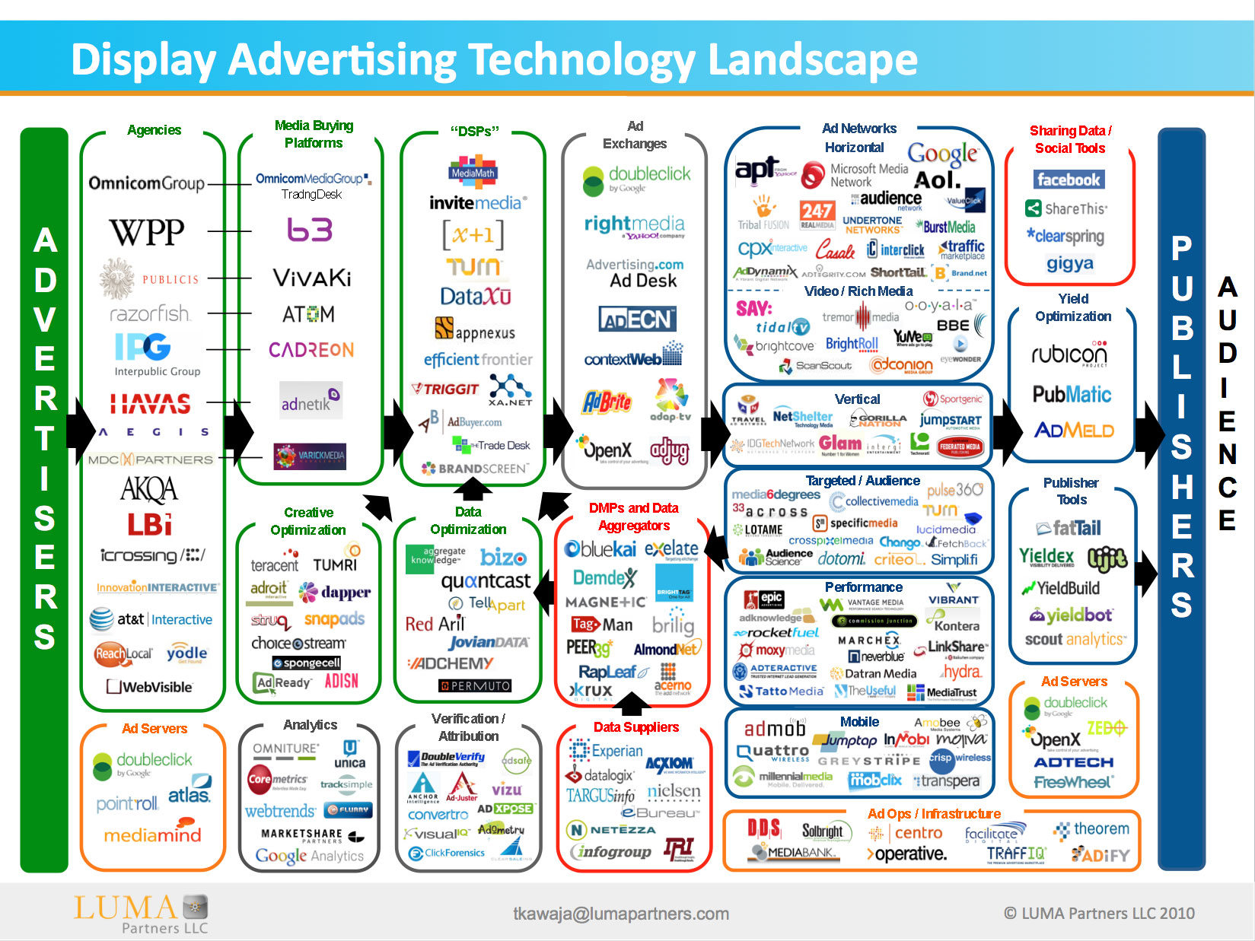

Slide 11
Countermeasures?
Deleting cookies frequently
One out of three users do it every month
Browser extensions that reveal third-party tracking
Modern browsers have native support to reject all third-party cookies
Private browsing mode

Slide 12
Counter-countermeasure (!) By Trackers
Cookies no more reliable/accessible
Counter-countermeasure: cookieless tracking
Browser (device) fingerprinting

Slide 13
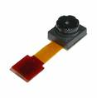
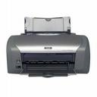


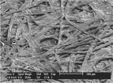


Everything Has a Fingerprint

Slide 14
Browser fingerprinting
Features of a browser and its plugins
Introduced in 2009
Small number of commercial companies use such methods to provide “device identification” through web-based fingerprinting
Constructive use:
Combat fraud
Destructive use:
Track users between sites, without their knowledge and without a simple way of opting-out
Deliver tailored malware

Slide 15
Fingerprinting Web Browsers
User agent
HTTP ACCEPT headers
Browser plug-ins
MIME support
Clock skew
Installed fonts
Cookies enabled?
Browser add-ons
Screen resolution

Slide 16
First demonstrated in P. Eckersley, “How Unique Is Your Browser?
Try your own browser here

Slide 17
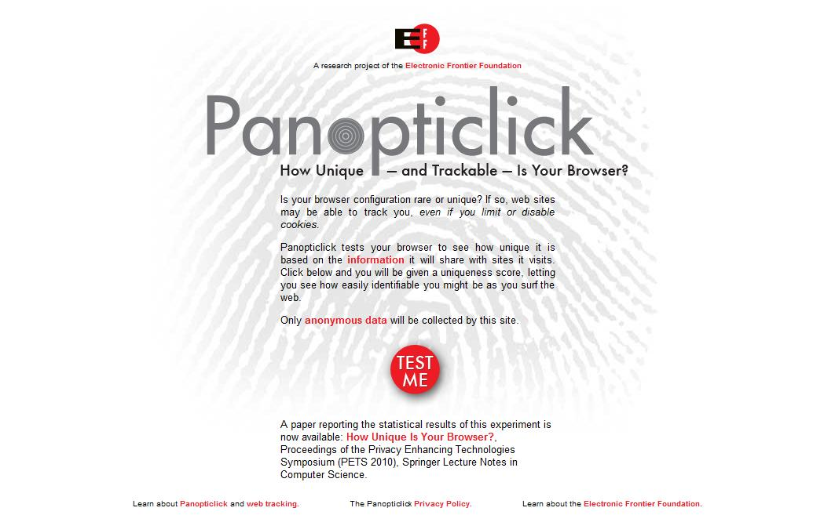
Your browser fingerprint appears to be unique among the 3,435,834 tested so far

Slide 18
Panopticlick Example
Plugin 0: Adobe Acrobat; Adobe Acrobat Plug-In Version 7.00 for Netscape; nppdf32.dll; (Acrobat Portable Document Format; application/pdf; pdf) (Acrobat Forms Data Format; application/vnd.fdf; fdf) (XML Version of Acrobat Forms Data Format; application/vnd.adobe.xfdf; xfdf) ( Acrobat XML Data Package; application/vnd.adobe.xdp+xml; xdp) (Adobe FormFlow99 Data File; application/vnd.adobe.xfd+xml; xfd). Plugin 1: Adobe Acrobat; Adobe PDF Plug-In For Firefox and Netscape; nppdf32.dll; (Acrobat Portable Document Format; application/pdf; pdf) (Adobe PDF in XML Format; application/vnd.adobe.pdfxml; pdfxml) (Adobe PDF in XML Format; application/vnd.adobe.x-mars; mars) (Acrobat Forms Data Format; application/vnd.fdf; fdf) (XML Version of Acrobat Forms Data Format; application/vnd.adobe.xfdf; xfdf) ( Acrobat XML Data Package; application/vnd.adobe.xdp+xml; xdp) (Adobe FormFlow99 Data File; application/vnd.adobe.xfd+xml; xfd). Plugin 2: Google Update; Google Update; npGoogleOneClick8.dll; (; application/x-vnd.google.oneclickctrl.8; ). Plugin 3: MicrosoftÂ® Windows Media Player Firefox Plugin; np-mswmp; np-mswmp.dll; (np-mswmp; application/x-ms-wmp; *) (; application/asx; *) (; video/x-ms-asf-plugin; *) (; application/x-mplayer2; *) (; video/x-ms-asf; asf,asx,*) (; video/x-ms-wm; wm,*) (; audio/x-ms-wma; wma,*) (; audio/x-ms-wax; wax,*) (; video/x-ms-wmv; wmv,*) (; video/x-ms-wvx; wvx,*). Plugin 4: Move Media Player; npmnqmp 07103010; npmnqmp07103010.dll; (npmnqmp; application/x-vnd.moveplayer.qm; qmx,qpl) (npmnqmp; application/x-vnd.moveplay2.qm; ) (npmnqmp; application/x-vnd.movenetworks.qm; ). Plugin 5: Mozilla Default Plug-in; Default Plug-in; npnul32.dll; (Mozilla Default Plug-in; *; *). Plugin 6: Shockwave Flash; Shockwave Flash 10.0 r32; NPSWF32.dll; (Adobe Flash movie; application/x-shockwave-flash; swf) (FutureSplash movie; application/futuresplash; spl). Plugin 7: Windows Genuine Advantage; 1.7.0059.0; npLegitCheckPlugin.dll; (npLegitCheckPlugin; application/WGA-plugin; *).
84% of browser fingerprints are unique
With Flash or Java, 94% are unique

Slide 19
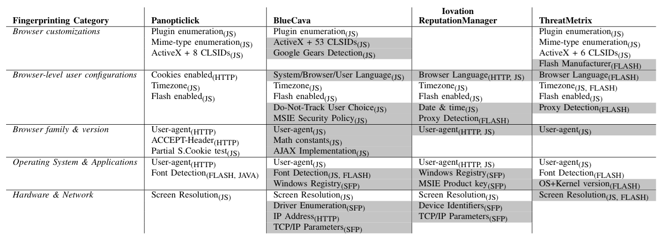
Commercial Trackers
Cookieless Monster: Exploring the Ecosystem of Web-based Device Fingerprinting

Slide 20
WebFonts
Problem: Clients ship with ugly fonts
Solution: Browsers should download fonts from the Internet on demand!
@font-face { font-family: 'Sirin Stencil'; font-style: normal; font-weight: 400; src: url(http://themes.googleusercontent.com/static/fonts/sirinstencil/v1/[...].woff) format('woff');}

Slide 21
45 Ways To Sirin Stencil
context.font = "12pt 'Sirin Stencil'";
Windows
OS X
Linux

Slide 22
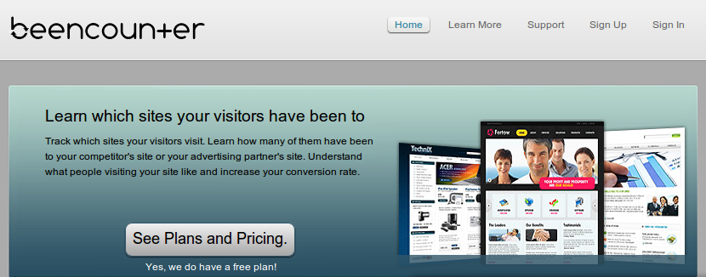
History Sniffing
How can a webpage figure out which sites you
visited previously?
Color of links
CSS :visited property
getComputedStyle()
Cached Web content timing
DNS timing

Slide 23
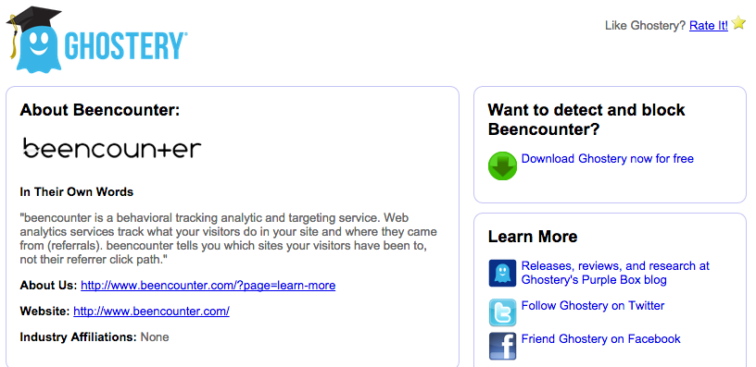

Slide 24
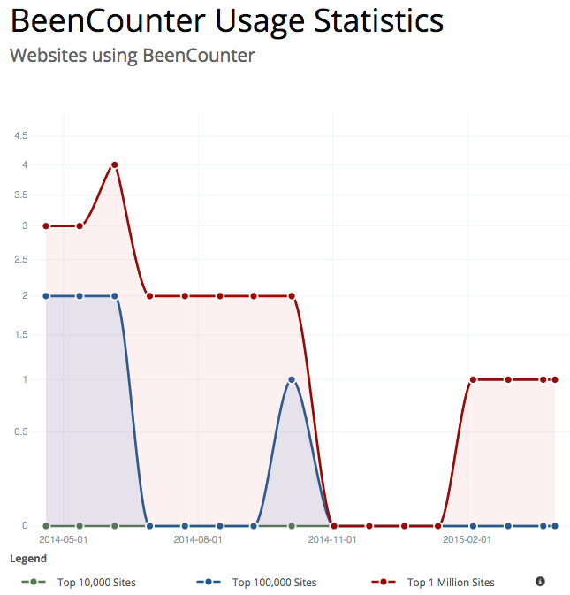
BeenCounter website is down!

Slide 25
Identity Sniffing
[Wondracek et al. Oakland 2010]
All social networking sites allow users to join groups
Users typically join multiple groups
Some of these groups are public
Group-specific URLs are predictable
Intersection of group affiliations acts as a fingerprint
Can sometimes infer identity by computing the intersection of group membership lists
Notes:
http://oakland31.cs.virginia.edu/slides/sonda-oakland.pdf

Slide 26

Do Not Track
Basics
HTTP header
DNT: 1
Standardization
Browser support in FF4, IE9
Beginning to see adoption
(AP, NAI)… or not
Privacy protections
No tracking across sites
Who is the “third” party?
No intrusive tracking
Limits on regular log data
Exceptions for fraud
prevention, etc.

Slide 27
“Do Not Track” (DNT) header
The user is still fingerprinted for fraud detection, but the companies “promise” not to use the information for advertising purposes
The fingerprinting scripts will execute regardless of the DNT value
Hard to verify misuse

Slide 28
DNT Adoption Issues
“But the NAI [Network Advertising Initiative] code also recognizes that companies sometimes need to continue to collect data for operational reasons that are separate from ad targeting based on a user’s online behavior. For example, online advertising companies may need to gather data to prove to advertisers that an ad has been delivered and should be paid for; to limit the number of times a user sees the same ad; or to prevent fraud.”
Translation: we’re going to keep tracking you, but we’ll simply call it “operational reasons.”

Slide 29
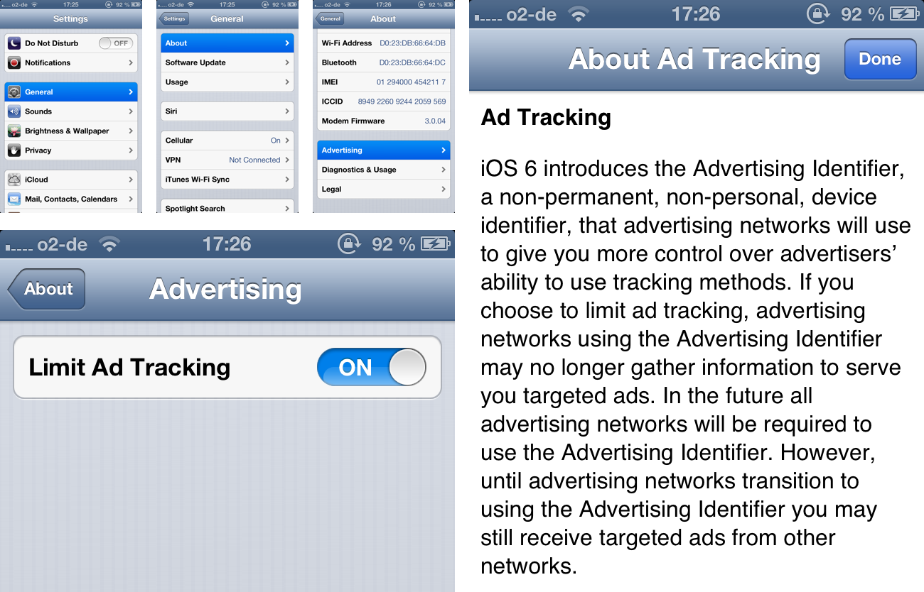

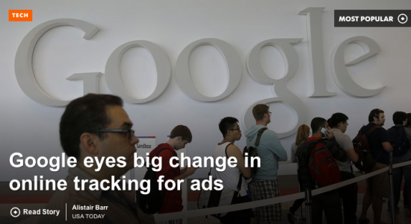

Brave New World?
How are these identifiers different from third-party cookies?
Today, we are announcing the launch of Atlas. We’ve rebuilt Atlas from the ground up to tackle today’s marketing challenges, like reaching people across devices and bridging the gap between online impressions and offline purchases
Google AdID

Slide 30
Acknowledgement
Some of the slides, content, or pictures are borrowed from the following resources, and some pictures are obtained through Google search without being referenced below:
Vitaly Shmatikov’s course lecture slides

