Slide 1

Botnet Detection
Content may be borrowed from other resources.
See the last slide for acknowledgements!
Amir Houmansadr
CS660: Advanced Information Assurance
Spring 2015

Slide 2

What is a Bot?
A malware instance that runs autonomously and automatically on a compromised computer (zombie) without owner’s consent
Profit-driven, professionally written, widely propagated
You might have seen them before in chat rooms, online games, etc.

Slide 3
What is a Botnet
Botnet (Bot Army): network of bots controlled by criminals
Definition: “A coordinated group of malware instances that are controlled by a botmaster via some C&C channel”
Coordinated: do coordinated actions
Group: yes, it’s a group of bots!
Botmaster: meet the cybercriminal
C&C channel: command and control channel

Slide 4
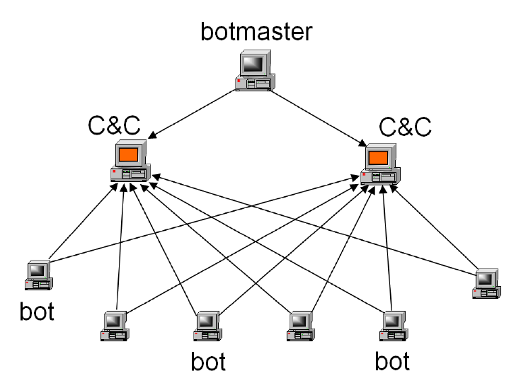

Slide 5
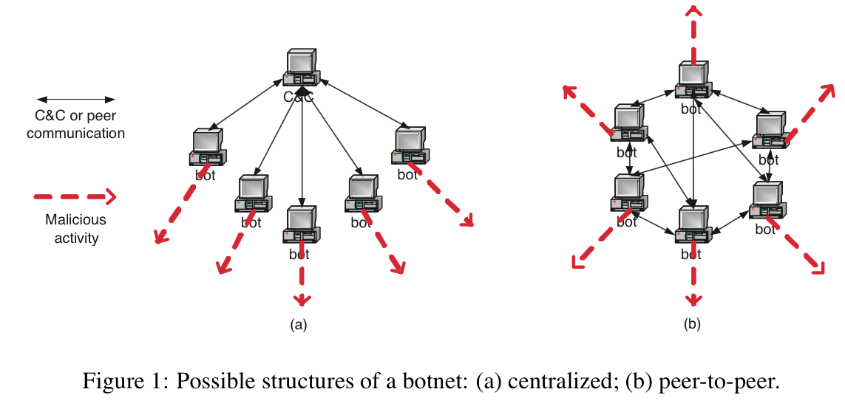
Structures
Centralized
IRC channels
HTTP
Distributed
P2P

Slide 6
Breadth
Numerous variations of botnets
According to a study in 2013 by Incapsula, more than 61 percent of all Web traffic is now generated by bots
25% of Internet PCs are part of a botnet!” ( - Vint Cerf)
It’s a real threat!

Slide 7
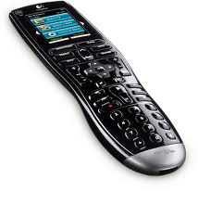
What is the Command and Control (C&C) Channel?
The Command and Control (C&C) channel is needed so bots can receive their commands and coordinate fraudulent activities
The C&C channel is the means by which individual bots form a botnet

Slide 8
Amercia’s 10 Most Wanted Botnets
Zeus (3.6 million)
Koobface (2.9 million)
TidServ (1.5 million)
Trojan.Fakeavalert (1.4 million)
TR/DIdr.Agent.JKH (1.2 million)
Monkif (520,000)
Hamweq (480,000)
Swizzor (370,000)
Gammima (230,000)
Conficker (210,000)
Source

Slide 9
What are they used for?
Distributed Denial-of-Service Attacks
Spam
Phishing
Information Theft
Distributing other malware

Slide 10
Botnet Detection is Hard!
One out of four PC infected
Bots are stealthy on infected machines
Botnets are dynamically evolving and becoming more flexible
Static and signature-based approached less effective
Come in many variations
Centralized/distributed, different channels, etc.
There’s no one-size-fits-all solution

Slide 11
Existing Techniques not Effective
AntiVirus tools are evaded
need to update frequently
Bots use rootkit
…
Intrusion detection systems
Do not have a big picture
Past research aims are too specific
Some apply to specific type of botnet (e.g., IRC-based only, or centralized only)
Some apply to specific instances of botnet

Slide 12
BotMiner
Observation:
Bots part of a botnet have similar communications
Bots part of a botnet take similar actions
Bots stay there for long term
Approach: Let’s find machines that have correlated (similar) communication and actions over time

Slide 13
BotMiner
Analysis is done over two planes:
C-plane (Communication plane): “who is talking to whom, and how”
A-plane (Activity plane): “who is doing what”

Slide 14
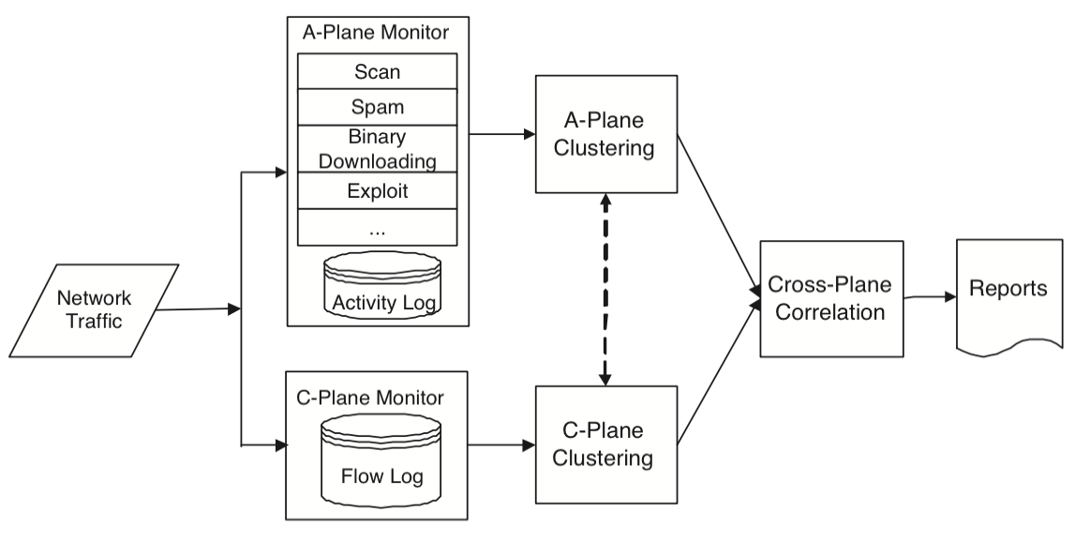
BotMiner’s Main Architecture

Slide 15
MAIN COMPONENTS OF BOTMINER DETECTION SYSTEM
C-PLANE MONITOR
A-PLANE MONITOR
C-PLANE CLUSTERING
A-PLANE CLUSTERING
CROSS-PLANE CORRELATOR

Slide 16
Traffic Monitors
C-PLANE MONITOR
A-PLANE MONITOR
Captures network flows and records information on “who is talking to whom”
The fcapture tool was used (very efficient on high-speed networks)
Each flow record contained: time, duration, source IP, destination IP, destination port, and # packets/bytes transferred in both directions
Logs information on “who is doing what”
Based on Snort (open-source intrusion detection tool)
Capable of detecting scanning activities, spamming, and binary downloading

Slide 17
C-plane Clustering
Responsible for reading logs generated by the C-plane monitor and finding clusters of machines that share similar communication patterns
Start→ Irrelevant traffic flows are filtered out
(2 steps: basic filtering and white-listing)
After basic filtering and white-listing, traffic is reduced further by aggregating related flows into communication flows (C-flows)

Slide 18
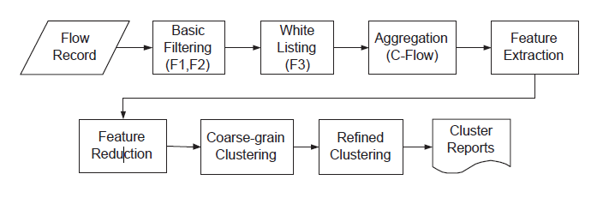
Architecture of C-plane Clustering

Slide 19
C-plane Clustering
Given an epoch E (1 day)
A communication flow (C-flow) is determined by:
protocol (TCP or UDP)
source IP
destination IP
Port
All matching TCP/UDP flows are aggregated into the same C-flow

Slide 20
Vector Representation of C-flows
To apply clustering algorithms to C-flows they must be translated into suitable vector representation
A number of statistical features are extracted from each C-flow and then they are translated into a d-dimensional pattern of vectors.
Given a C-flow, the discrete sample distribution is computed for 4 variables:
The number of flows per hour (fph)
The average # of bytes per second (bps)
The number of packets per flow (ppf)
The average # of bytes per packet (bpp)

Slide 21
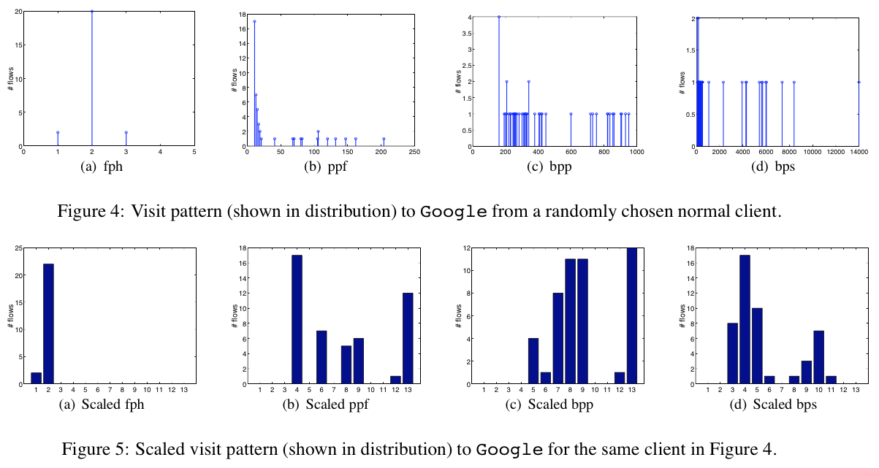

Slide 22
2-Step Clustering
Clustering C-flows is very expensive
Because the % of machines in a network that are infected by bots is generally small, the authors separate the botnet-related C-flows from a large number of benign C-flows
To cope with the complexity of clustering the task is broken down into steps

Slide 23
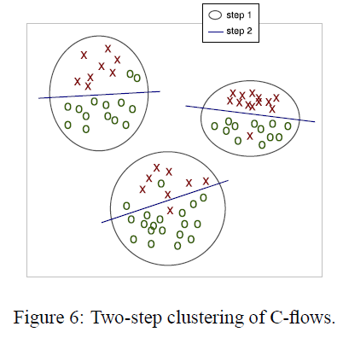
2-Step Clustering of C-flows
Notes:
At the first step, they perform coarse-grained clustering on a reduced feature space using a simple clustering algorithm. The results of the first-step clustering is a set of C-flows (relatively large clusters). Later a second step of clustering is done on each different dataset. They implemented the 1st and 2nd step using the X means clustering algorithm (which is a efficient algorithm based on K-means). X-means is fast and scales well with respect to the size of the dataset.

Slide 24
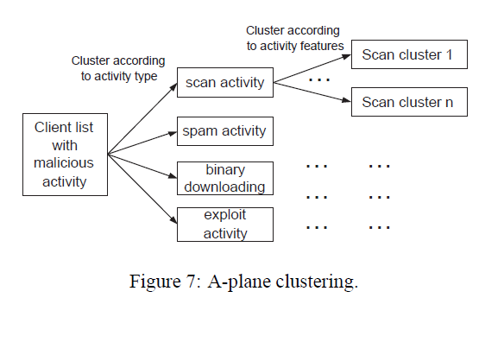
A-plane Clustering
In this stage, 2 layer clustering is performed on activity logs
A scan activity could include scanning ports (e.g, two machines scanning the same ports)
Another feature could be target subnet/distribution (e.g. when machines are scanning the same subnet)
For spam activity, two machines could be clustered together if their SMTP connection destinations are highly overlapped
In the paper, the authors cluster scanning activities according to the destination scanning ports

Slide 25
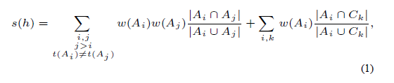
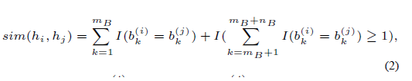
Cross-Plane Clustering
The idea is to cross-check both clusters (A-PLANE & C-PLANE) to find out whether there is evidence of the host being a part of a botnet
The first step is to compute the bot score s(h) for each host h on which at least one kind of suspicious activity has been performed
Host that have a score below a certain threshold are filtered out
The remaining most suspicious host are grouped together according to a similarity metric that takes into account A-PLANE and C-PLANE clusters
Two hosts in the same A-luster and at least one common C-cluster are clustered together
Hierarchical clustering

Slide 26
Evaluations
Tested performance on several real-world network traces (campus network)
C-PLANE and A-PLANE monitors were ran continuously for 10 days
Collected 6 different botnets (IRC and HTTP)
Two P2P botnets, namely Nugache (82 bots) and Storm(13 bots); the network trace lasted a whole day

Slide 27
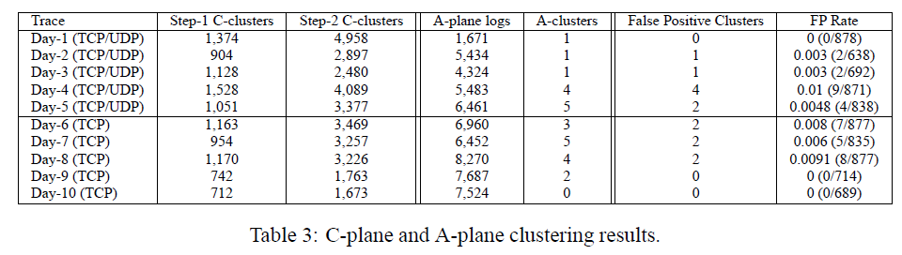
10 Days

Slide 28
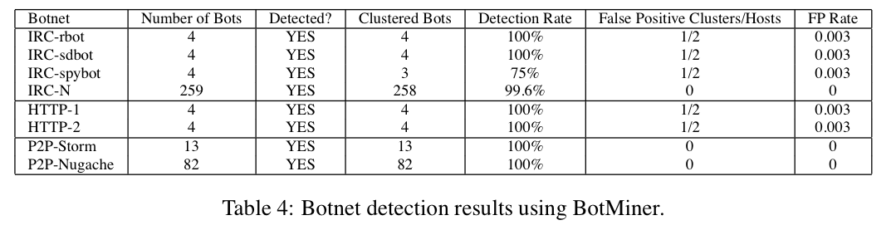
Detection Results

Slide 29
Limitations of BotMiner
Can adversaries who know how BotMiner work evade it? Or decrease its accuracy?

Slide 30
Evading C-PLANE Monitoring and Clustering
Evasion Method
Examples
Manipulate communication patterns
Switch between multiple C&C servers
Randomizing individual communication patterns (e.g. injecting random packets in a flow or by padding random bytes in a packet)
Bots could use covert channels to hide their actual C&C communications

Slide 31
Evading A-plane Monitoring and Clustering
Evasion Method
Example
Performing very stealthy malicious activities
Vary the way bots are commanded in the same monitored network
Scan very slow (e.g. send one scan per hour)
The “botmaster” sends out different commands to each bot

Slide 32
Evading Cross-Plane Analysis
The “botmaster” can send commands that are extremely delayed tasks
Malicious activities are performed on different days
Trade-off: The “botmaster” also suffers because as the C&C communications slow down, efficiency of controlling the bot army declines

Slide 33
Acknowledgement
Some of the slides, content, or pictures are borrowed from the following resources, and some pictures are obtained through Google search without being referenced below:
Latasha A. Gibbs’s slides for BotMiner
Guofi Gu’s slides

